Slide 1
GP120 815 mammalian display sequencing overview
Match Criteria: Barcode1-18NT-Barcode2
"GAAAATATC” - 18 NTs - "ATAATCGTC"
# GAAAATATA would be WT, so TATC is the first barcode
# ATCATCGTC would be WT, so ATAA is the second barcode
WT sequence is "TNNGKN"
S_118CDRH1del/L1-118CDRH1del-1_S3.assembled.fasta.
Number of sequences: 920154
Number Non-matches : 7440105
S_118mat/L1-118mat-1_S2_L001.assembled.fasta.
Number of sequences: 236001
Number Non-matches : 6199829
S_118minV2/L1-118minV2-2_S4.assembled.fasta.
Number of sequences: 158916
Number Non-matches : 1913146
S_unsorted/L1-unsorted-1_S1_L001.assembled.fasta.
Number of sequences: 12151
Number Non-matches : 4372310

Slide 2
Position Specific Amino Acid sequences
Across ALL sequences for which there are 3 or more counts
==> count.log.S_118CDR <==
A R N D C Q E G H I L K M F P S T W Y V
1 4 5 4 4 4 1 2 4 2 8 14 1 3 13 2 5 1 1 5 6 T
2 3 3 2 2 3 1 1 3 3 6 12 1 2 20 1 8 2 5 11 3 N
3 8 3 27 17 0 0 5 15 0 0 - 1 0 - 0 8 10 0 0 0 N
4 17 1 10 16 0 0 8 12 0 0 - 1 0 - 0 12 18 - 0 0 G
5 - 0 0 - - - 0 - - 0 - 99 0 - - - 0 - - - K
6 4 1 6 7 6 0 0 6 2 7 3 0 0 23 1 13 3 0 3 7 N
==> count.log.S_118mat <==
A R N D C Q E G H I L K M F P S T W Y V
1 3 4 4 3 5 1 1 3 3 7 12 2 3 13 3 10 4 2 5 6 T
2 3 4 4 3 4 1 1 3 3 5 11 1 3 12 3 9 3 2 7 7 N
3 11 5 14 14 0 - 4 15 0 - 0 6 0 - 0 10 16 - - 0 N
4 14 5 14 13 - 0 4 13 - - - 5 - - 0 10 17 - - 0 G
5 - 0 0 - - 0 0 0 - - - 99 - - - - - - - - K
6 3 2 4 5 7 0 0 4 3 8 5 0 0 16 2 11 5 0 7 8 N
==> count.log.S_118min <==
A R N D C Q E G H I L K M F P S T W Y V
1 3 4 5 3 4 1 1 3 4 7 12 1 4 12 2 6 4 3 6 5 T
2 2 4 2 4 4 1 1 3 4 6 11 1 4 15 1 8 3 3 9 5 N
3 11 2 17 18 0 - 4 12 - 0 - 3 0 - 0 10 18 - - 0 N
4 13 2 15 14 - - 4 12 - - - 3 - - 0 13 19 - - - G
5 - 0 0 - - - 0 - - - - 99 0 - - - - - - - K
6 5 2 4 5 7 0 0 5 4 8 4 0 0 19 1 12 3 0 6 8 N
==> count.log.S_unsort <==
A R N D C Q E G H I L K M F P S T W Y V
1 2 4 4 3 5 1 1 3 2 7 12 1 2 14 2 10 3 2 7 5 T
2 3 4 3 3 4 1 1 3 3 7 13 1 3 11 2 9 3 2 6 7 N
3 12 5 16 11 0 - 4 14 0 0 - 7 - - - 10 15 0 0 0 N
4 13 5 16 13 - - 4 14 - 0 - 5 0 - - 13 13 0 0 - G
5 - 0 0 - - 0 0 - - - - 99 0 - - - - - - - K
6 3 2 5 4 7 - 0 4 3 9 5 - - 17 2 10 3 - 7 9 N
Note:
Unsort has bias for certain AAs at each position that are seen in the sorted sets. You may be able to see small changes from that bias.
If we look at most freq sequences rather than ‘all’, we may see differences between unsorted and sorted datasets.

Slide 3
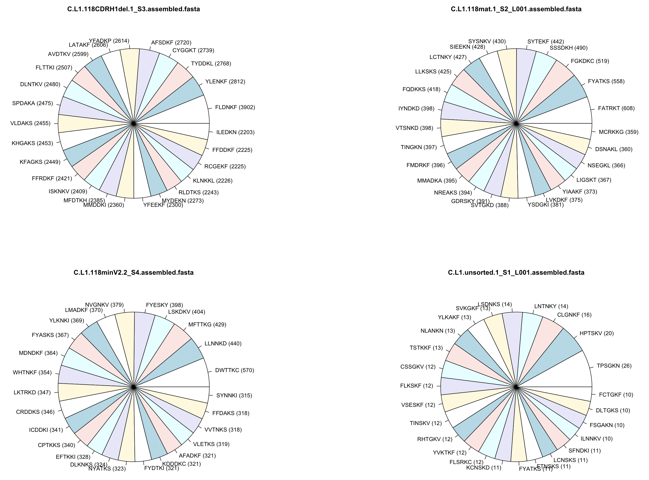
Top 25 most frequently found sequences

Slide 4
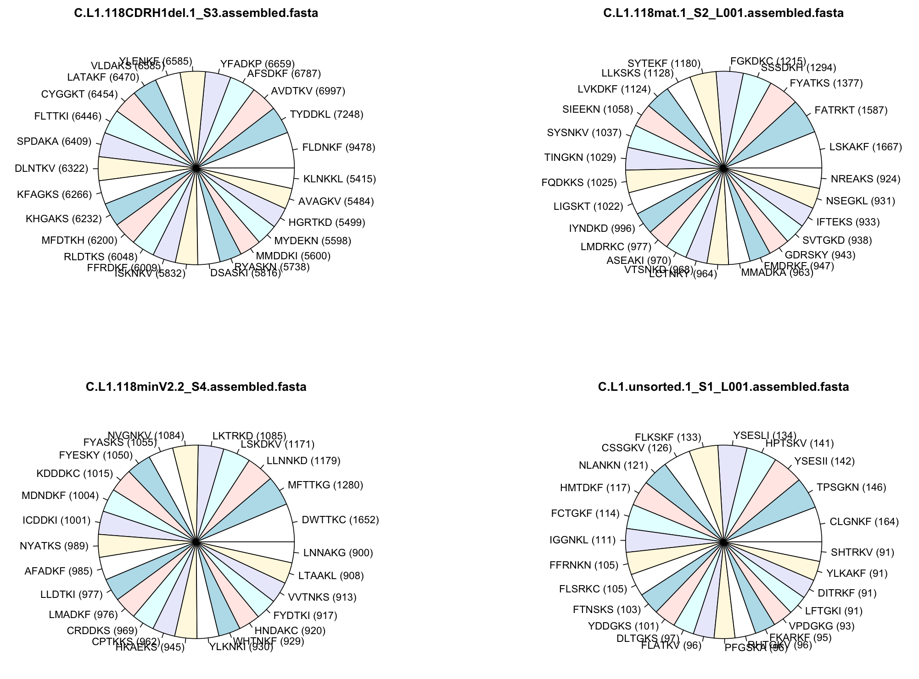
Top 25 most frequently found sequences
Shorter barcodes of 4 NT on either side

Slide 5
Frequent sequences across sorted datasets
In sequences with >10% counts for 1-18 CDRH1del and 1-18 mature (normalized freq):
"FLNNKY" "SGASKL" "FYATKF" "ALDTKF" "SLDAKS" "SLNTKS" "FIADKF" "FLDAKF” "YRNAKI" "CVNDKF" "ISNTKV" "FYTTKF" "NFAEKF”
In sequences with >0.5% counts for 1-18 CDRH1del, 1-18 mature and 1-18 min (normalized freq):
"CFNTKS" "FFNTKF" "FFNTKI”
Short barcodes: "FFNSKF" "ISNTKV" "FFDDKF" "FLDAKF" "VFSGKS"
At least 2 sequences found in all 1-18 sorts:
"CFNTKS" "FFNTKI"
At least 3 sequences found in all 1-18 sorts:
Short barcodes: "LIADKF" "CSNNKF" "CFNTKS" "IFTEKS" "FFNTKI"
Possible enrichments: ‘F’ at second position, ‘D’ at third position, S/F at last position. ??

