Slide 1
Monkey Pox in the US
Forecasting the effectiveness of educational intervention
Hedieh Kalachahi
Saira Faiz
Colby Jamieson

Slide 2
Outline
Background
Policy Research Questions
Mathematical Modelling
Educational Intervention Model
Data Fitting
Results
Sensitivity Analysis
Limitations
Key Messages
Future Work

Slide 3

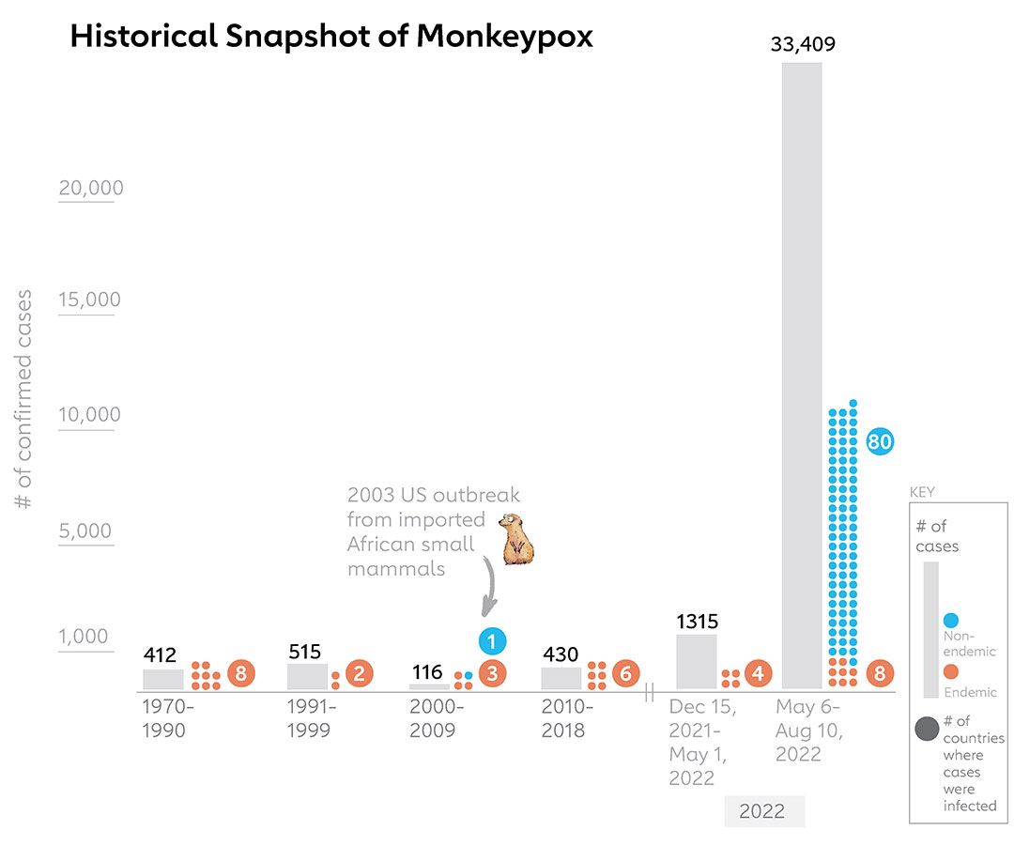
Background
Monkeypox was first discovered in 1958 in Monkeys kept for research in African country of Denmark. First human case was reported in 1970 in Democratic Republic of Congo. In 2003, US saw an outbreak of monkeypox, in prairie dogs who were imported from Africa as a part of exotic pet trade. They were infected by Gambian giant rat.

Slide 4
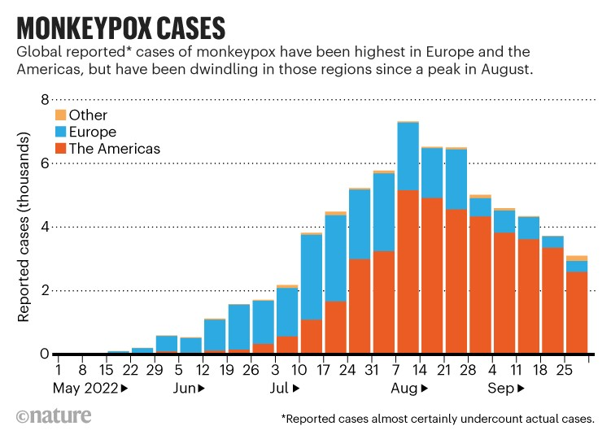
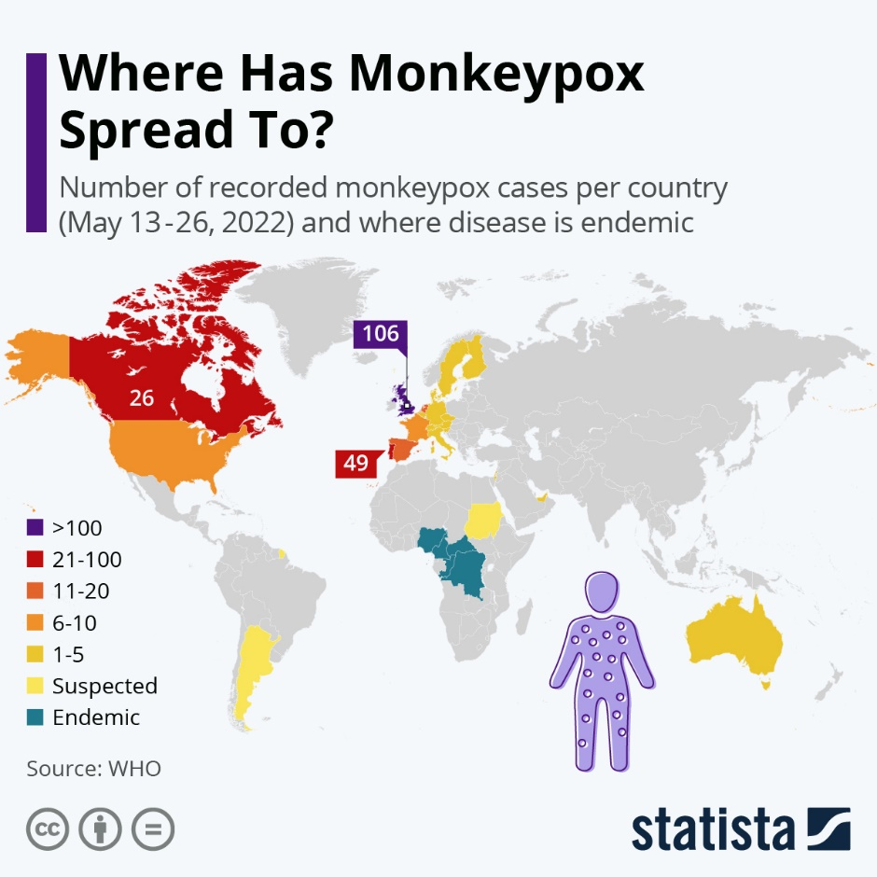
Background

Slide 5
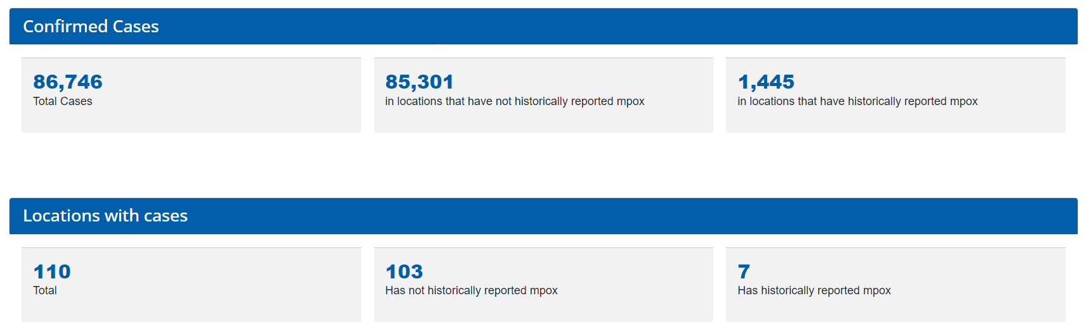
Background
Number of Monkeypox cases as of March 2023
1.67%

Slide 6
Background
35%
Country | Cases | Deaths | Category | As of
United States | 30,286 | 38 | Has not historically reported mpox | Data as of 29 Mar 2023
Brazil | 10,890 | 15 | Has not historically reported mpox | Data as of 29 Mar 2023
Spain | 7,546 | 3 | Has not historically reported mpox | Data as of 29 Mar 2023
France | 4,128 | 0 | Has not historically reported mpox | Data as of 29 Mar 2023
Colombia | 4,089 | 0 | Has not historically reported mpox | Data as of 29 Mar 2023
Mexico | 3,937 | 4 | Has not historically reported mpox | Data as of 29 Mar 2023
Peru | 3,785 | 20 | Has not historically reported mpox | Data as of 29 Mar 2023
United Kingdom | 3,738 | 0 | Has not historically reported mpox | Data as of 29 Mar 2023
Germany | 3,692 | 0 | Has not historically reported mpox | Data as of 29 Mar 2023
Canada | 1,478 | 0 | Has not historically reported mpox | Data as of 29 Mar 2023
Other | 13,177 | 32 | Has not historically reported mpox | Data as of 29 Mar 2023
 | 86,746 | 112

Slide 7
Background
Data Acquisition: Data is collected from “Centers for disease control and prevention(cdc.gov)” Choice of Analysis: Parameter fitting Sensitivity Analysis

Slide 8
Policy Research Questions
How effective would an education campaign be in reducing ultimate number of people infected?
How many people would we need to educate to see a significant drop in peak infections?
Notes:
Speaking notes:
Policy questions
Why is this important to policy makers?
How do we translate questions into mathematical expressions

Slide 9

Mathematical Modelling
Susceptible population is exposed to virus from contact with infected
Susceptible
Those exposed move to infected once symptomatic
Exposed
Infected
Those infected recover
Recovered
We assume no immunity after infection
Notes:
To do:
Add easy-to-understand compartment model
Discuss importance of assumptions (maybe state assumptions when they come up with icon), why are assumptions important in modelling?
Discuss parameter fitting

Slide 10
Data
300 days of infection data from 2022 U.S. outbreak
We assume data only includes people who have not received Mpox education
www.cdc.gov, 2023

Slide 11
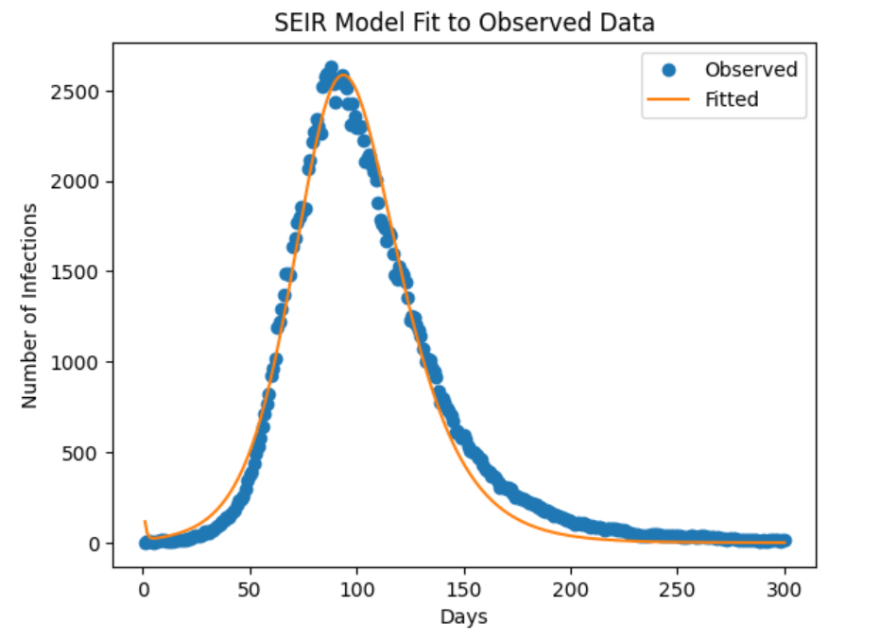
Data Fitting & Optimized Parameters
Parameter | Optimized Rate
Exposed | 0.00000841
Latency | 0.095
Recovery | 0.891

Slide 12
Educational Interventions
Intervention | Risk Reduction
Comprehensive | 4%
Abstinence | 0%
All | 1%
We assume effectiveness of educational interventions studied will be comparable to Mpox intervention
Effective Evidence-Based Programs for Preventing Sexually Transmitted Infections: A Meta Analysis; Petrova, D & Garcia-Retamero, R; 2015
Notes:
Speaking notes:
Why do we consider educational interventions?
Spread is dependent on behaviour of individuals
Reducing stigma
Types of educational interventions and their effectiveness:
Comprehensive includes information and strategies for infection reduction; more effective.
Abstinence includes discouraging sexual activity; not effective.
We assume these risk reduction rates will be comparable to proposed mpox interventions
Mpox isn’t necessarily only sexually transmitted
Studied interventions were traditional STI education

Slide 13
Educational Intervention Model
Susceptible
Exposed
People in each compartment receive education at a constant rate
Infected
Susceptible
Recovered
Exposed
Educated Stream
Those infected that received education do not spread the disease
Infected
Notes:
To do:
Add how the intervention effectiveness rates are integrated into new model
Explain new model and reassert assumptions

Slide 14
Results: Daily Infections
How many people would we need to educate to see a significant drop in peak infections?

Slide 15
Results: Total Infected
How effective would an education campaign be in reducing ultimate number of people infected?

Slide 16
Sensitivity Analysis

Slide 17
Limitations
Comparability with STI educational effectiveness
Limited knowledge of high-risk groups
Initial model parameters from African outbreak data analysis
Unsure what level of educational coverage is feasible

Slide 18
Key Messages
By reaching 0.1 to 0.4 per cent of those susceptible to monkey pox with an effective education program, we can:
Decrease total infections 60 to 98 per cent.
Significantly reduce peak infections (flatten the curve).

Slide 19
Future Work
Stratification
Vaccine analysis
Quarantine analysis

Slide 20

Questions?

Slide 21

References
Centers for Disease Control and Prevention. (2023, March 29). U.S. Mpox Case Trends Reported to CDC. Retrieved from Centers for Disease Control and Prevention: https://www.cdc.gov/poxvirus/mpox/response/2022/mpx-trends.html
Mohr, J. (n.d.). Smallpox. Retrieved from American Museum of Natural History: https://www.amnh.org/explore/science-topics/disease-eradication/countdown-to-zero/smallpox#:~:text=One%20of%20history's%20deadliest%20diseases,the%20first%20disease%20ever%20eradicated.
Parker, S., & Buller, R. M. (2013). A review of experimental and natural infections of animals with monkeypox virus between 1958 and 2012. Future Virol, 129-157.
Peter, O. J., Abidemi, A., Ojo, M. M., & Ayoola, T. A. (2023). Mathematical model and analysis of monkeypox with control strategies. The European Physical Journal Plus.
Peter, O. J., Kumar, S., Kumari, N., Oguntolu, F. A., Oshinubi, K., & Musa, R. (2021). Transmission dynamics of Monkeypox virus: a mathematical modelling approach. Nature Public Health Emergency Collection, 3423–3434.
Peter, O. J., Oguntolu, F. A., Ojo, M. M., Oyeniyi, A. O., Jan, R., & Khan, I. (2022). Historically, outbreaks of monkeypox have been linked to animal-to-human transmission, where wild animals like African rats and monkeys transmit the virus to people which could occur as a result of bites or scratches the processing of bush meat, direct co. Physica Scripta.

Slide 22
Appendix A: Mathematical Model
S
E
I
R
βSI
σE
γI
αS
αE
αI
γI_{e}
S_{e}
E_{e}
I_{e}
β_{e}E_{e}I
σE_{e}

Slide 23
Appendix B: Model Equations

Slide 24
Appendix C: Variables and Parameters
Population variables:
S – susceptible
S_{e} – susceptible population that received educational intervention
E – exposed
E_{e} – exposed population that received educational intervention
I – Infected
I_{e} – infected population that received educational intervention
Parameters:
β – infectious rate for susceptible population
β_{e} – infectious rate for susceptible population that received educational intervention
σ – exposed to infected rate
γ – recovery rate
α – education rate

Slide 25
Appendix D: Assumptions
Horizontal transmission through direct contact with infected
Homogeneous individual mixing
Rate of transfer proportional to population size of compartment
Infected individuals have latency period
No acquired immunity
No input or output of individuals through birth, migration, or death
Educated infected individuals quarantine and do not infect others
Education rate is constant for each compartment
Recovery rate is constant for each infected compartment
Individuals represented in data are considered not educated
Effectiveness of educational interventions studied are comparable to proposed mpox intervention
There is no vaccine

