Slide 1
Monkey Pox in the US
Forecasting the effectiveness of educational intervention
Hedieh Kalachahi
Saira Faiz
Colby Jamieson

Slide 2
Outline
Background
Policy Research Questions
Mathematical Modelling
Educational Intervention Model
Data
Results
Sensitivity Analysis
Limitations
Key Messages
Future Work

Slide 3
Background
To do:
Outbreak in the US
Disease profile

Slide 4
Policy Research Questions
How effective would an education campaign be in reducing ultimate number of people infected?
How many people would we need to educate to see a significant drop in ultimate number of people infected?
Notes:
Speaking notes:
Policy questions
Why is this important to policy makers?
How do we translate questions into mathematical expressions

Slide 5

Mathematical Modelling
Susceptible population is exposed to virus from contact with infected
Susceptible
Those exposed move to infected once symptomatic
Exposed
Infected
Those infected recover
Recovered
We assume no immunity after infection
Notes:
To do:
Add easy-to-understand compartment model
Discuss importance of assumptions (maybe state assumptions when they come up with icon), why are assumptions important in modelling?
Discuss parameter fitting

Slide 6
Educational Interventions
Intervention | Risk Reduction
Comprehensive | 4%
Abstinence | 0%
All | 1%
We assume effectiveness of educational interventions studied will be comparable to Mpox intervention
Effective Evidence-Based Programs for Preventing Sexually Transmitted Infections: A Meta Analysis; Petrova, D & Garcia-Retamero, R; 2015
Notes:
Speaking notes:
Why do we consider educational interventions?
Spread is dependent on behaviour of individuals
Reducing stigma
Types of educational interventions and their effectiveness:
Comprehensive includes information and strategies for infection reduction; more effective.
Abstinence includes discouraging sexual activity; not effective.
We assume these risk reduction rates will be comparable to proposed mpox interventions
Mpox isn’t necessarily only sexually transmitted
Studied interventions were traditional STI education

Slide 7
Educational Intervention Model
Susceptible
Exposed
People in each compartment receive education at a constant rate
Infected
Susceptible
Recovered
Exposed
Educated Stream
Those infected that received education do not spread the disease
Infected
Notes:
To do:
Add how the intervention effectiveness rates are integrated into new model
Explain new model and reassert assumptions

Slide 8
Data
To do:
Explain data used
Add assumption that data contains people who have not received education
We assume data only includes people who have not received Mpox education

Slide 9
Results
To do:
Add forecasts for each intervention effectiveness level at varying levels of education rates (alpha)
Add cumulative infected (final size) per scenario.

Slide 10
Sensitivity Analysis
To do:
Add how sensitive education rate (alpha - # of people educated per day) and education effectiveness (beta_e) on total cumulative infected.

Slide 11
Limitations
Comparability with STI educational effectiveness
More?

Slide 12
Key Messages
To do:
What are the key messages policy professionals take away from the analysis and use in their own discussions.

Slide 13
Future Work
Age stratification
Vaccine analysis
Quarantine analysis
Any others?

Slide 14

Questions?

Slide 15

References

Slide 16
Appendix A: Mathematical Model
S
E
I
R
βSI
σE
γI
αS
αE
αI
γI_{e}
S_{e}
E_{e}
I_{e}
β_{e}E_{e}I
σE_{e}

Slide 17
Appendix B: Variables and Parameters
Population variables:
S – susceptible
S_{e} – susceptible population that received educational intervention
E – exposed
E_{e} – exposed population that received educational intervention
I – Infected
I_{e} – infected population that received educational intervention
Parameters:
β – infectious rate for susceptible population
β_{e} – infectious rate for susceptible population that received educational intervention
σ – exposed to infected rate
γ – recovery rate
α – education rate

Slide 18
Appendix C: Assumptions
Horizontal transmission through direct contact with infected
Homogeneous individual mixing
Rate of transfer proportional to population size of compartment
Infected individuals have latency period
No acquired immunity
No input or output of individuals through birth, migration, or death
Educated infected individuals quarantine and do not infect others
Education rate is constant for each compartment
Recovery rate is constant for each infected compartment
Individuals represented in data are considered not educated
Effectiveness of educational interventions studied are comparable to proposed mpox intervention
There is no vaccine

Slide 19
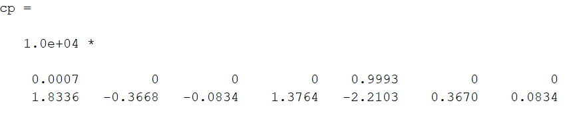
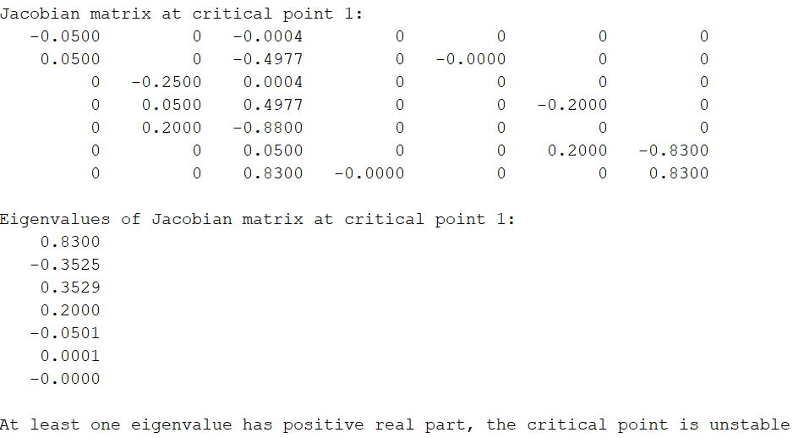
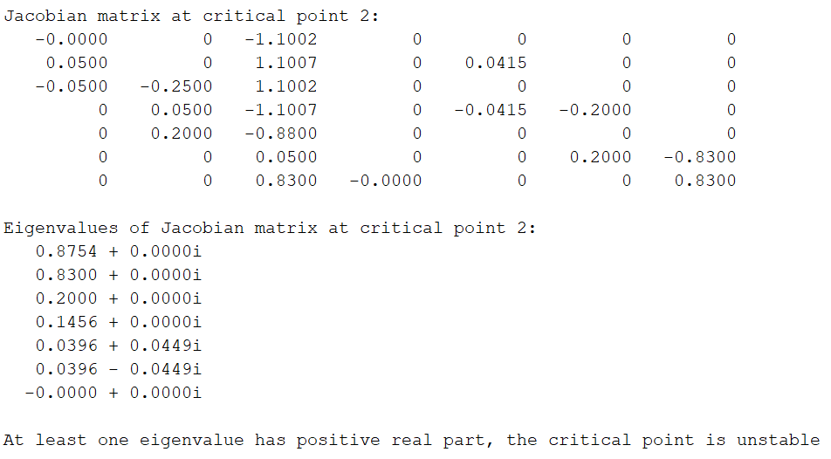
Appendix D: Stability Analysis

