Slide 1
Tool-chain Setup in CLion

Slide 2
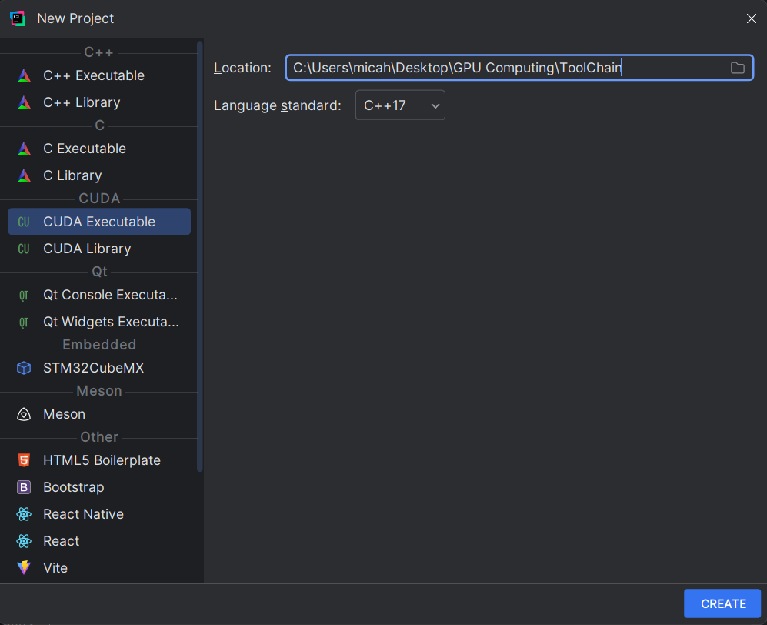
First you must have a project that is a CUDA executable file

Slide 3
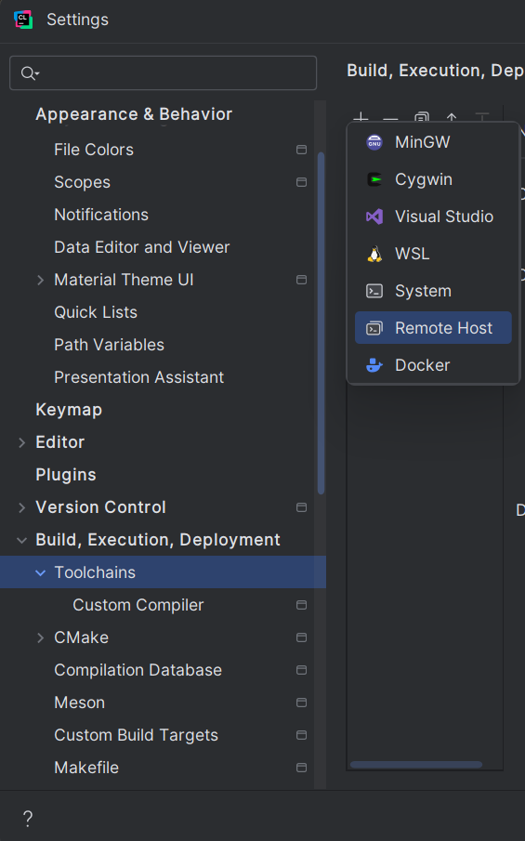
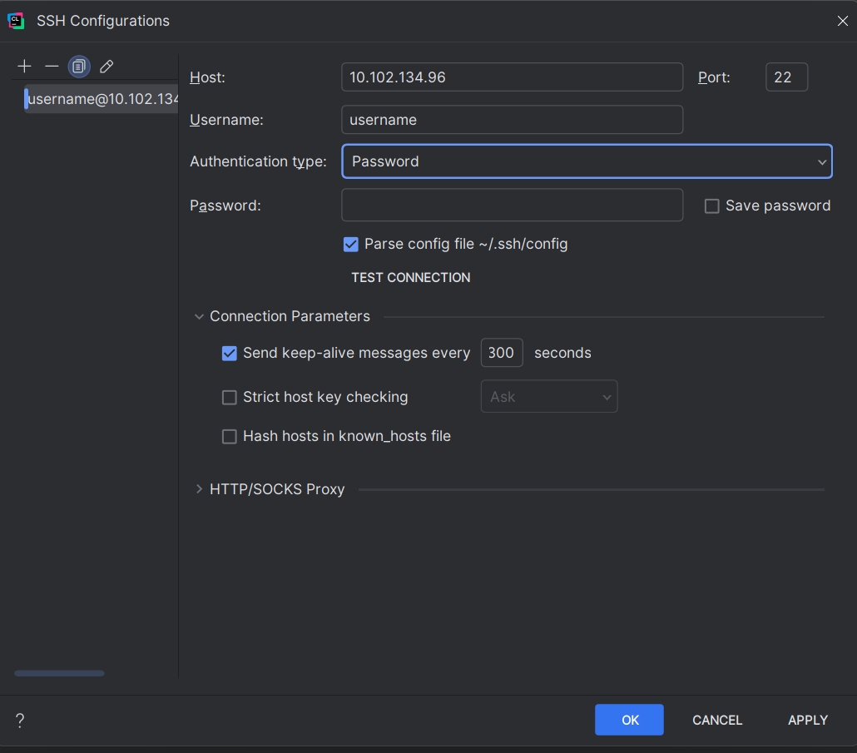
After the File is created, go to Go to File>settings>Build, Execution, Deployment>Toolchain
Enter your username for the server, Authentication type password, then enter your password.

Slide 4
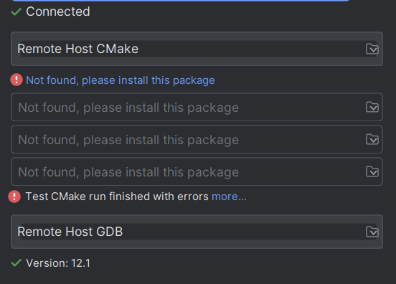
Once you hit ok after entering your username and password, it should be connected.

Slide 5
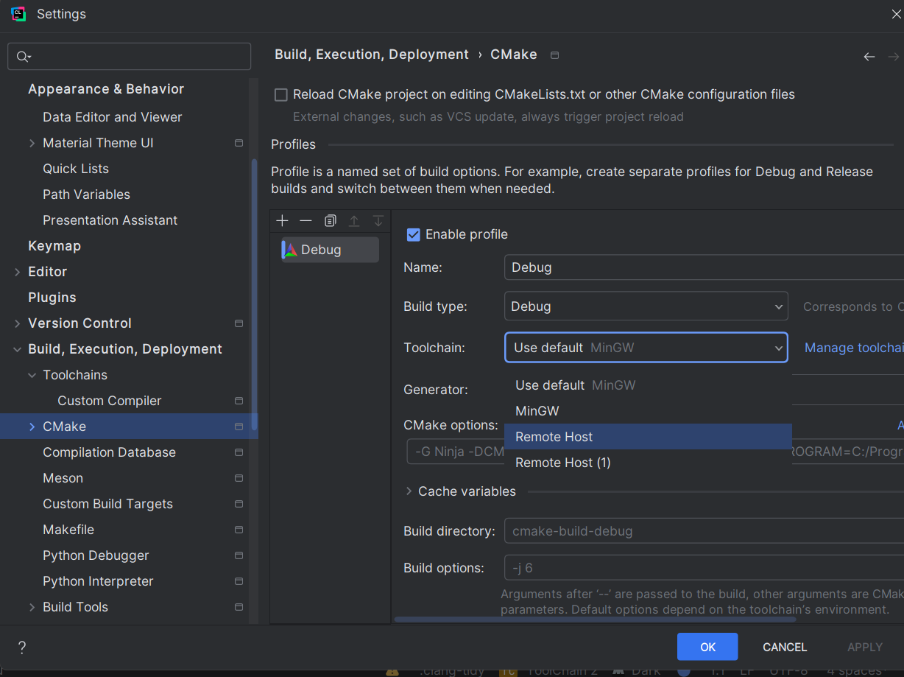
Then go to Go to file>settings>Build, Execution, Deployment>CMake
You can just click remote host, I had Remote Host(1) which is just a copy I made on accident. Then you can hit ok or apply.

Slide 6
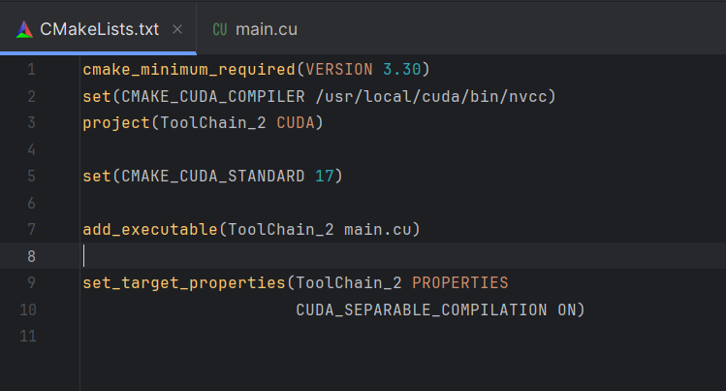
Go to your CMakeLists.txt and paste this set(CMAKE_CUDA_COMPILER /usr/local/cuda/bin/nvcc) The path is the absolute path to the compiler(I used Gemini to help me with this again I don’t understand what this line even does for the most part lol) Might not be necessary I got another example working without this line but maybe!

Slide 7
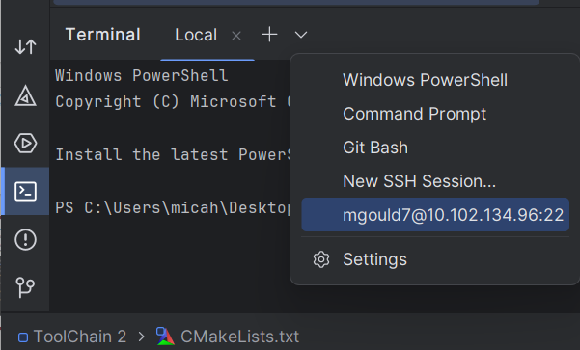
Go to terminal then the drop down arrow should give the option to connect to the server

Slide 8
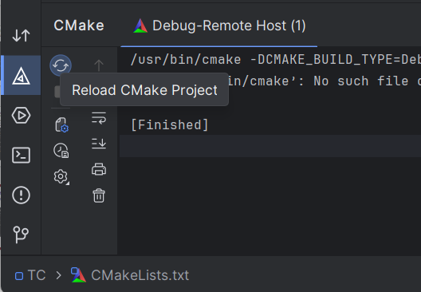
Go to Cmake and hit reaload Cmake Project

Slide 9

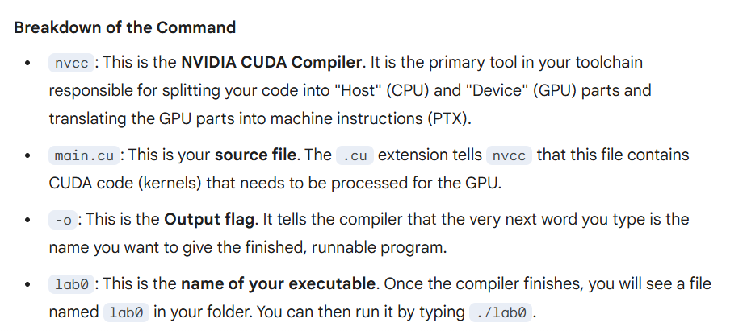
If the reload Cmake project says finished, you should be able to go to the terminal and do this
Thanks Gemini

Slide 10
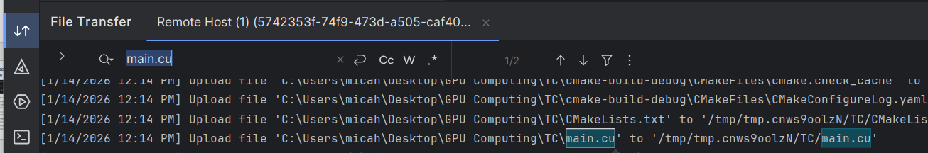
If you cannot find the directory you need to be in, then go to File Transfer and control f to find main.cu to see what directory its in.
This is the directory that you need to run your program in on the terminal that is connected to the Linux Server, yours will not be the same as this one though but just find where main.cu is and cd into the directory then you should be able to run your program.

Slide 11
What it should do put simply
The toolchain is the bridge. It handles the synchronization of the files to the server, invokes the remote Linux compiler (NVCC) to build the project, and pipes the output back to your local interface. It allows you to use the server's hardware as if it were plugged directly into your laptop.

