Slide 1
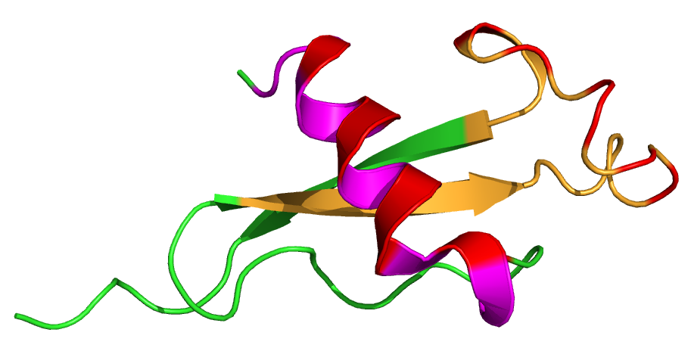
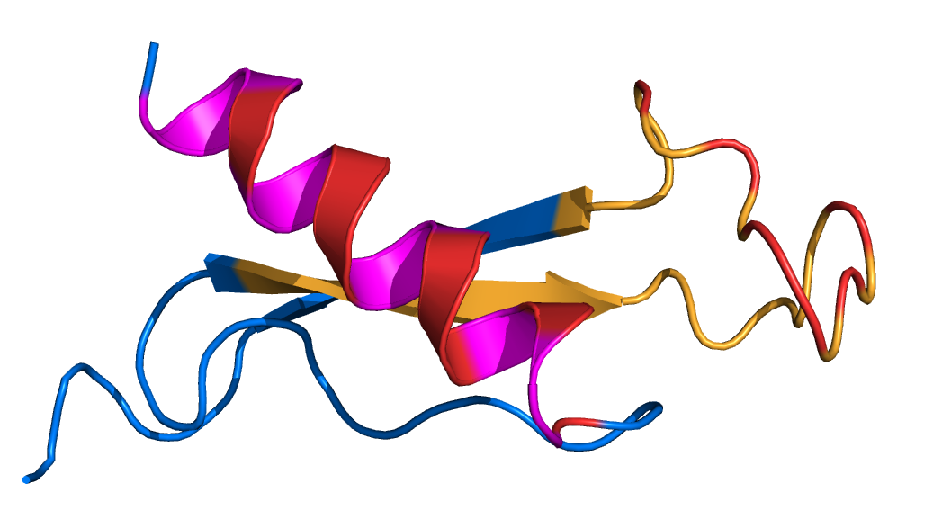
A) CSP Reference: | EPSDKHIEQYLKKIQNSLSTEWSPCSVTCGNGIQVRIKPGSANKPKDELDYENDIEKKICKMEKCSS
B) CSP Haplotypes: | EPSDQHIKKYLNTIKNSISTEWSPCSVTCGNGIQVRIKPGSAGKSKNQLNYANDIEKKICKMEKCSS

Slide 2
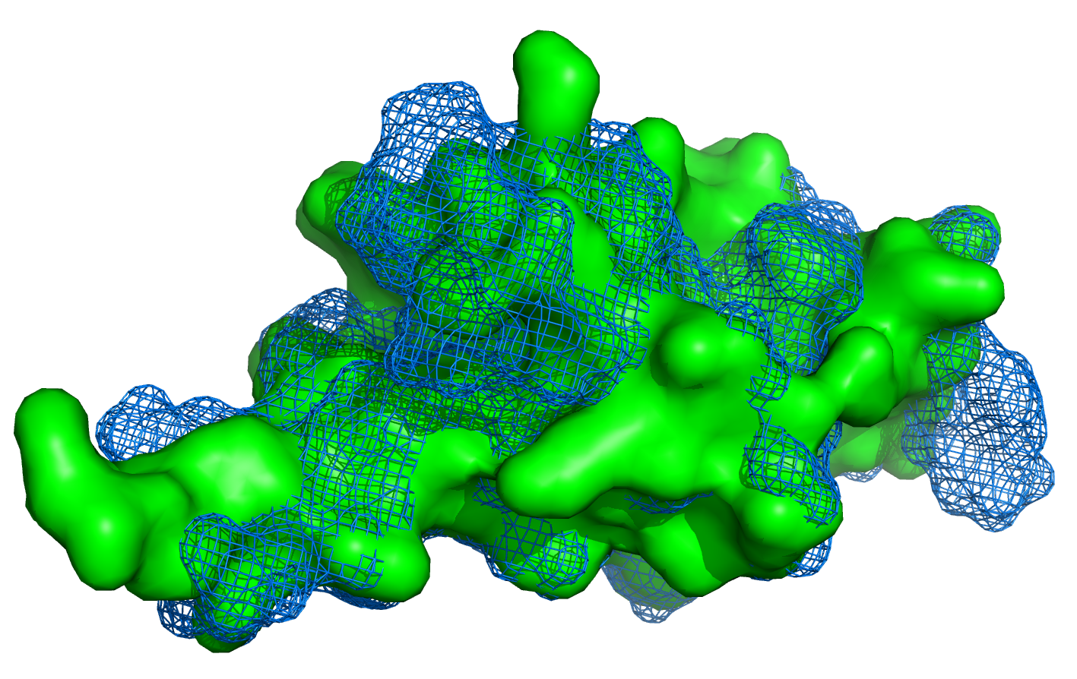
A) CSP Reference: | EPSDKHIEQYLKKIQNSLSTEWSPCSVTCGNGIQVRIKPGSANKPKDELDYENDIEKKICKMEKCSS
B) CSP Haplotypes: | EPSDQHIKKYLNTIKNSISTEWSPCSVTCGNGIQVRIKPGSAGKSKNQLNYANDIEKKICKMEKCSS

