Slide 1

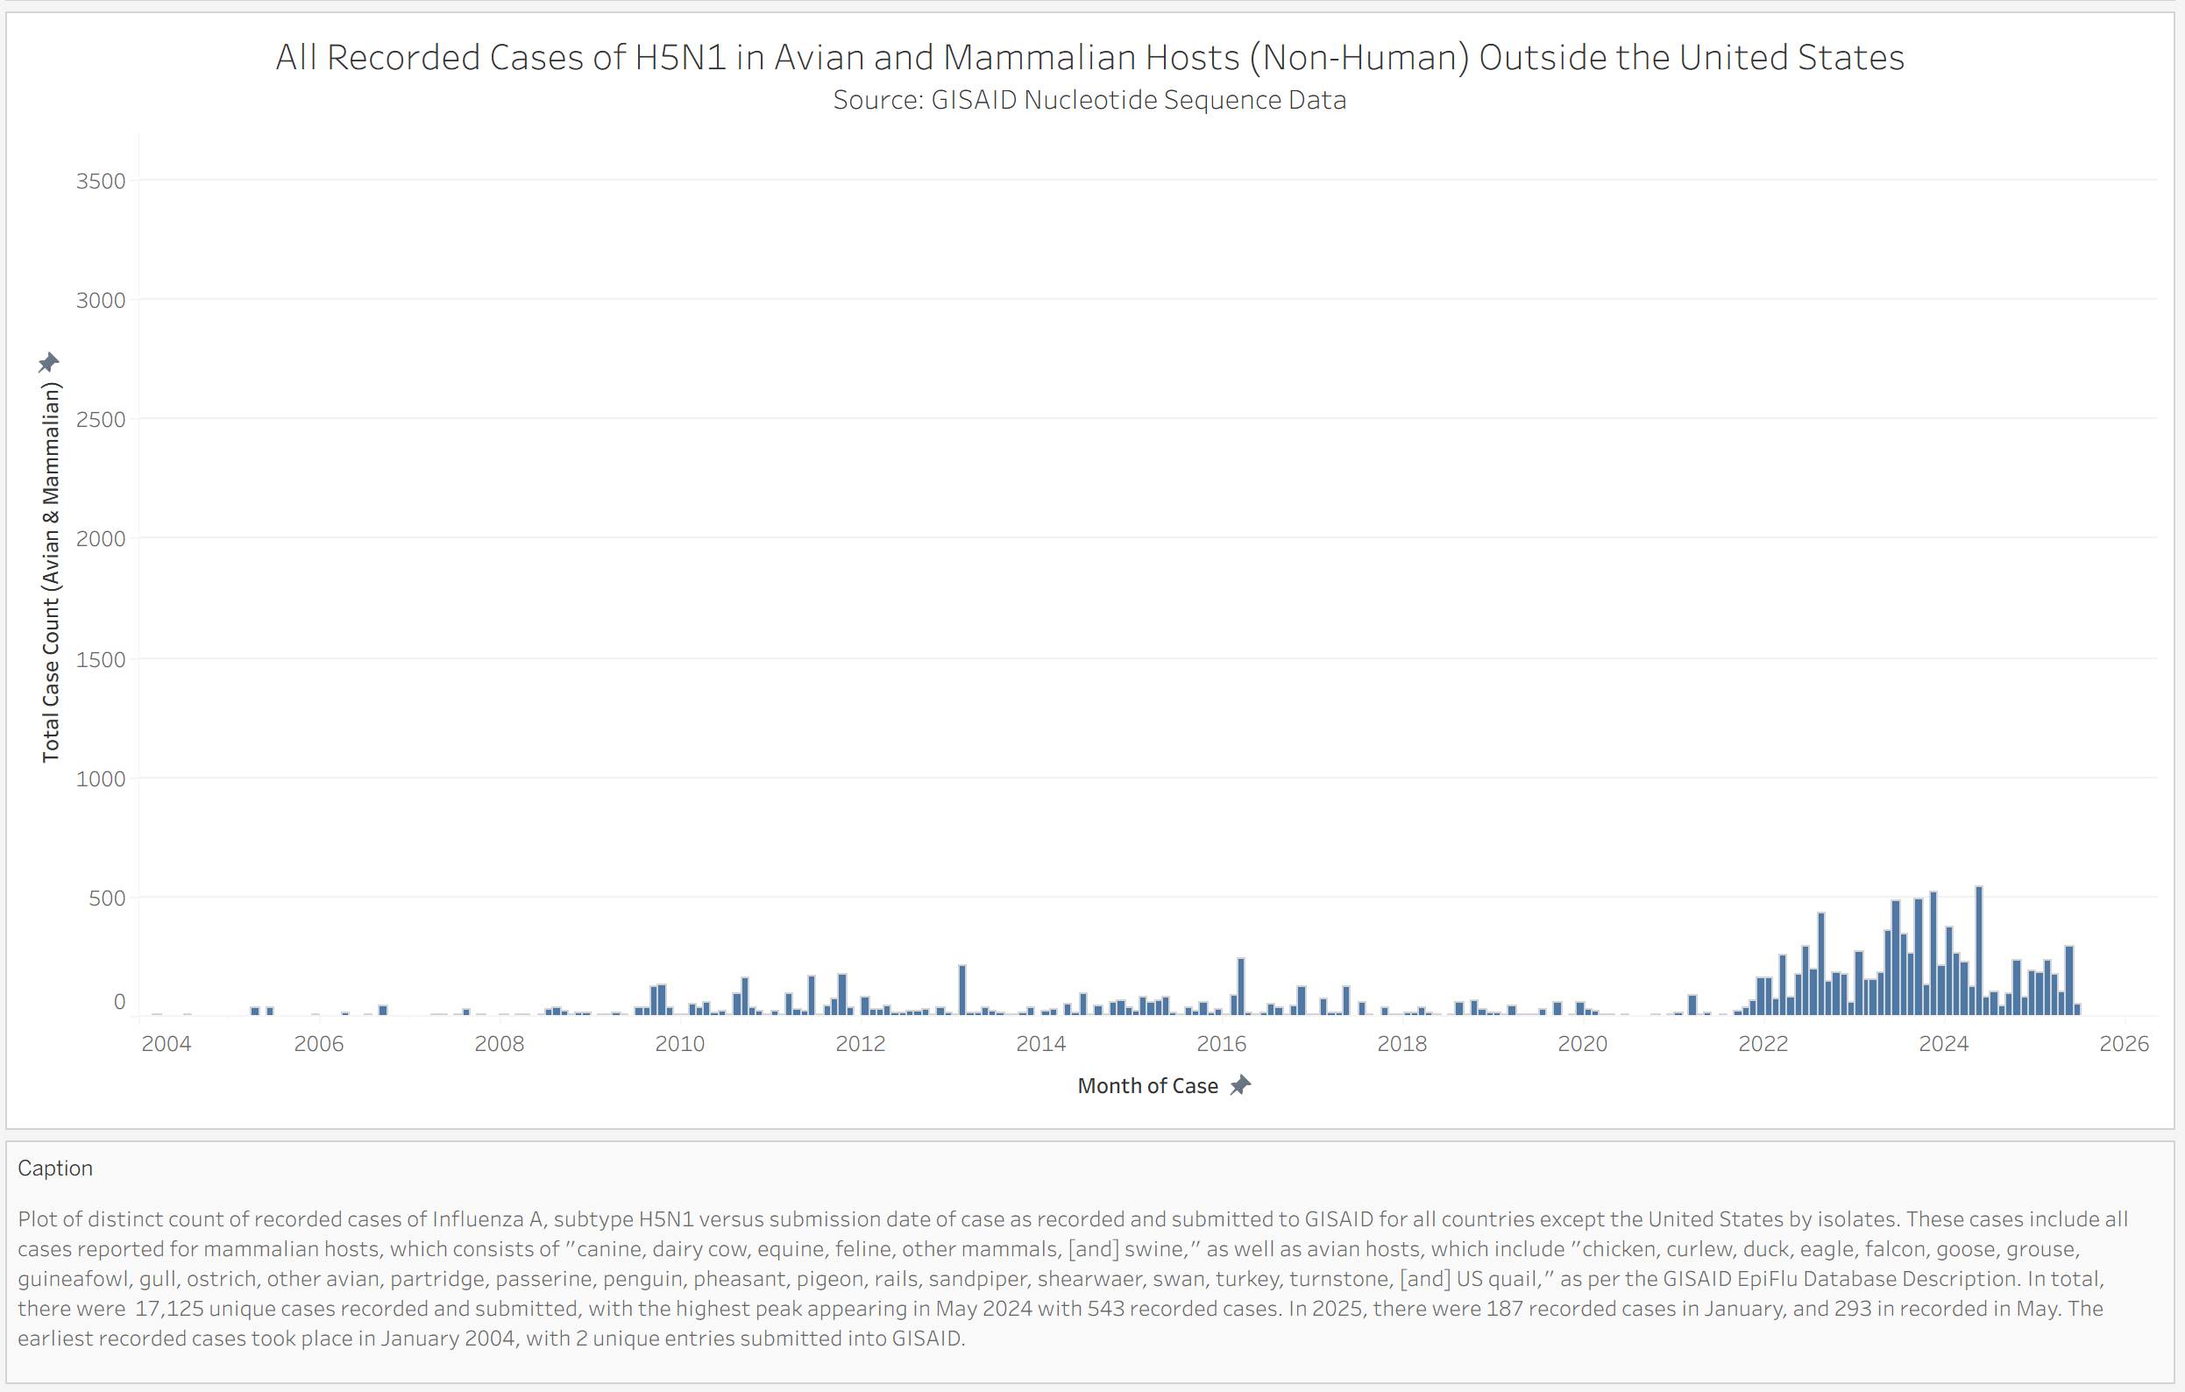
All Recorded Animal Cases of H5N1 Outside the US

Slide 2
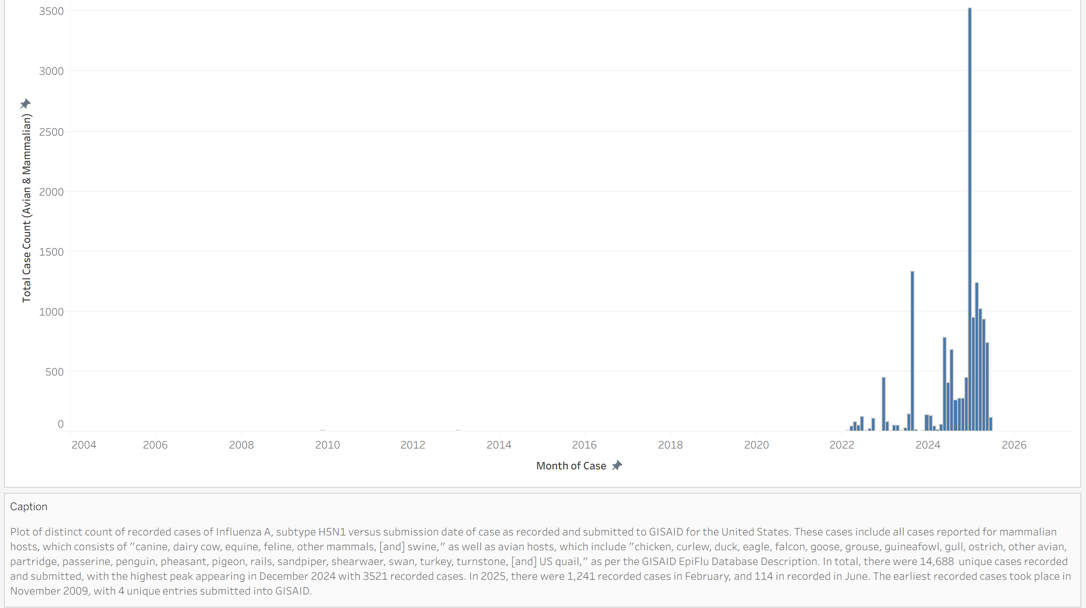
All Recorded Animal Cases of H5N1 Inside the US

Slide 4
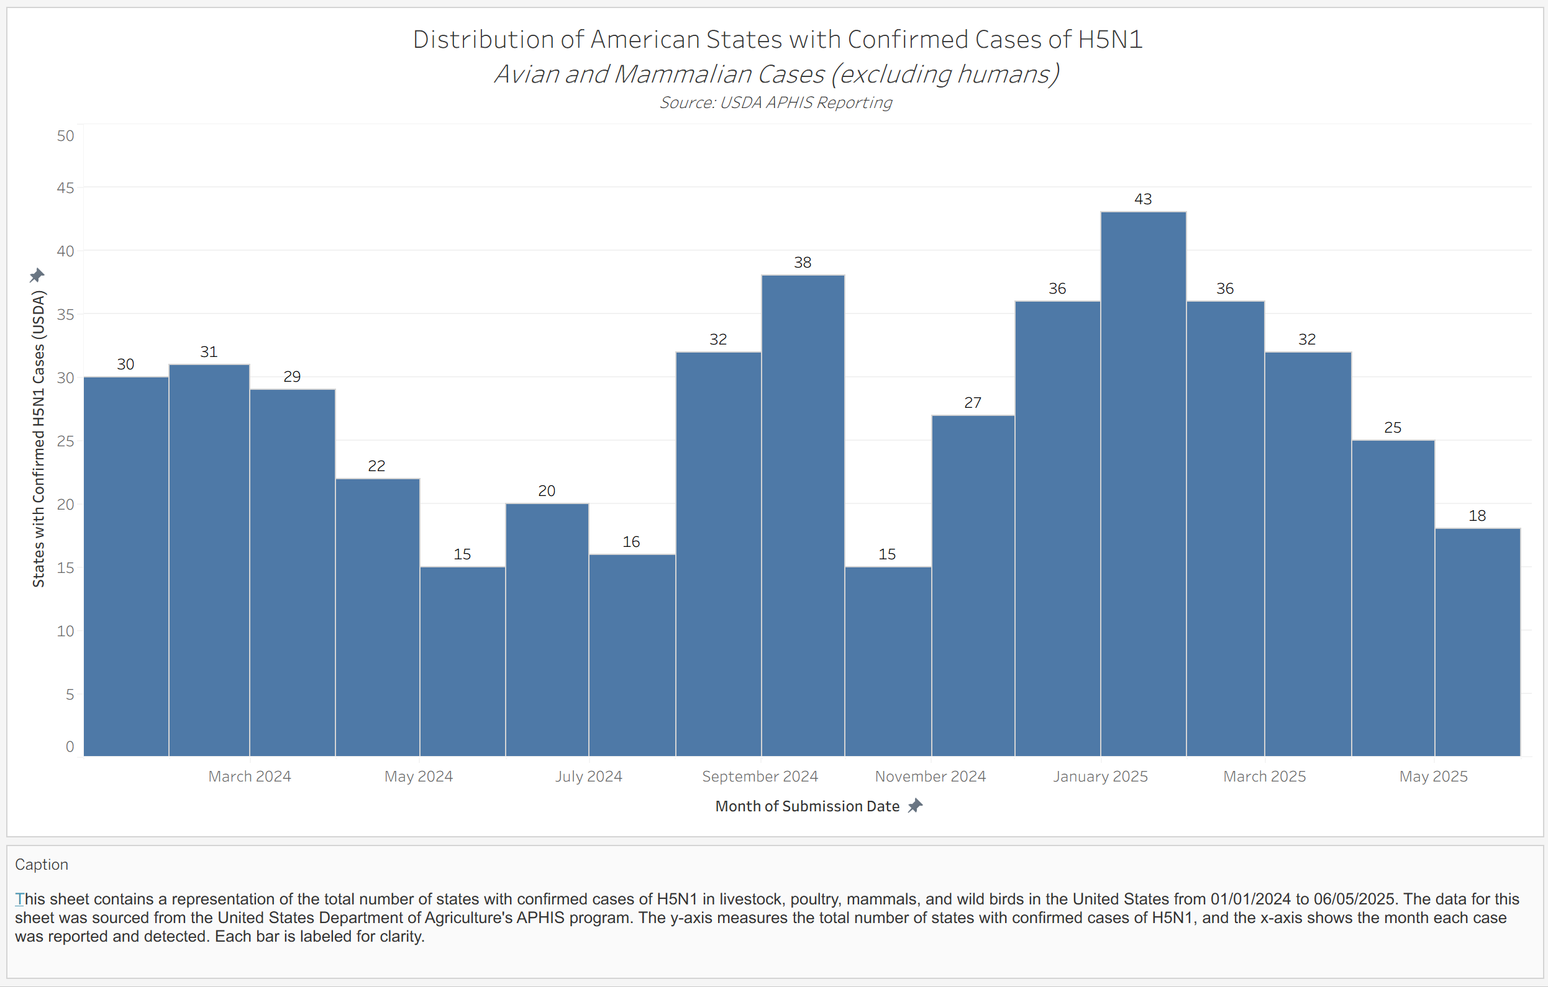
Count of US States with Confirmed H5N1 Animal Cases

Slide 6
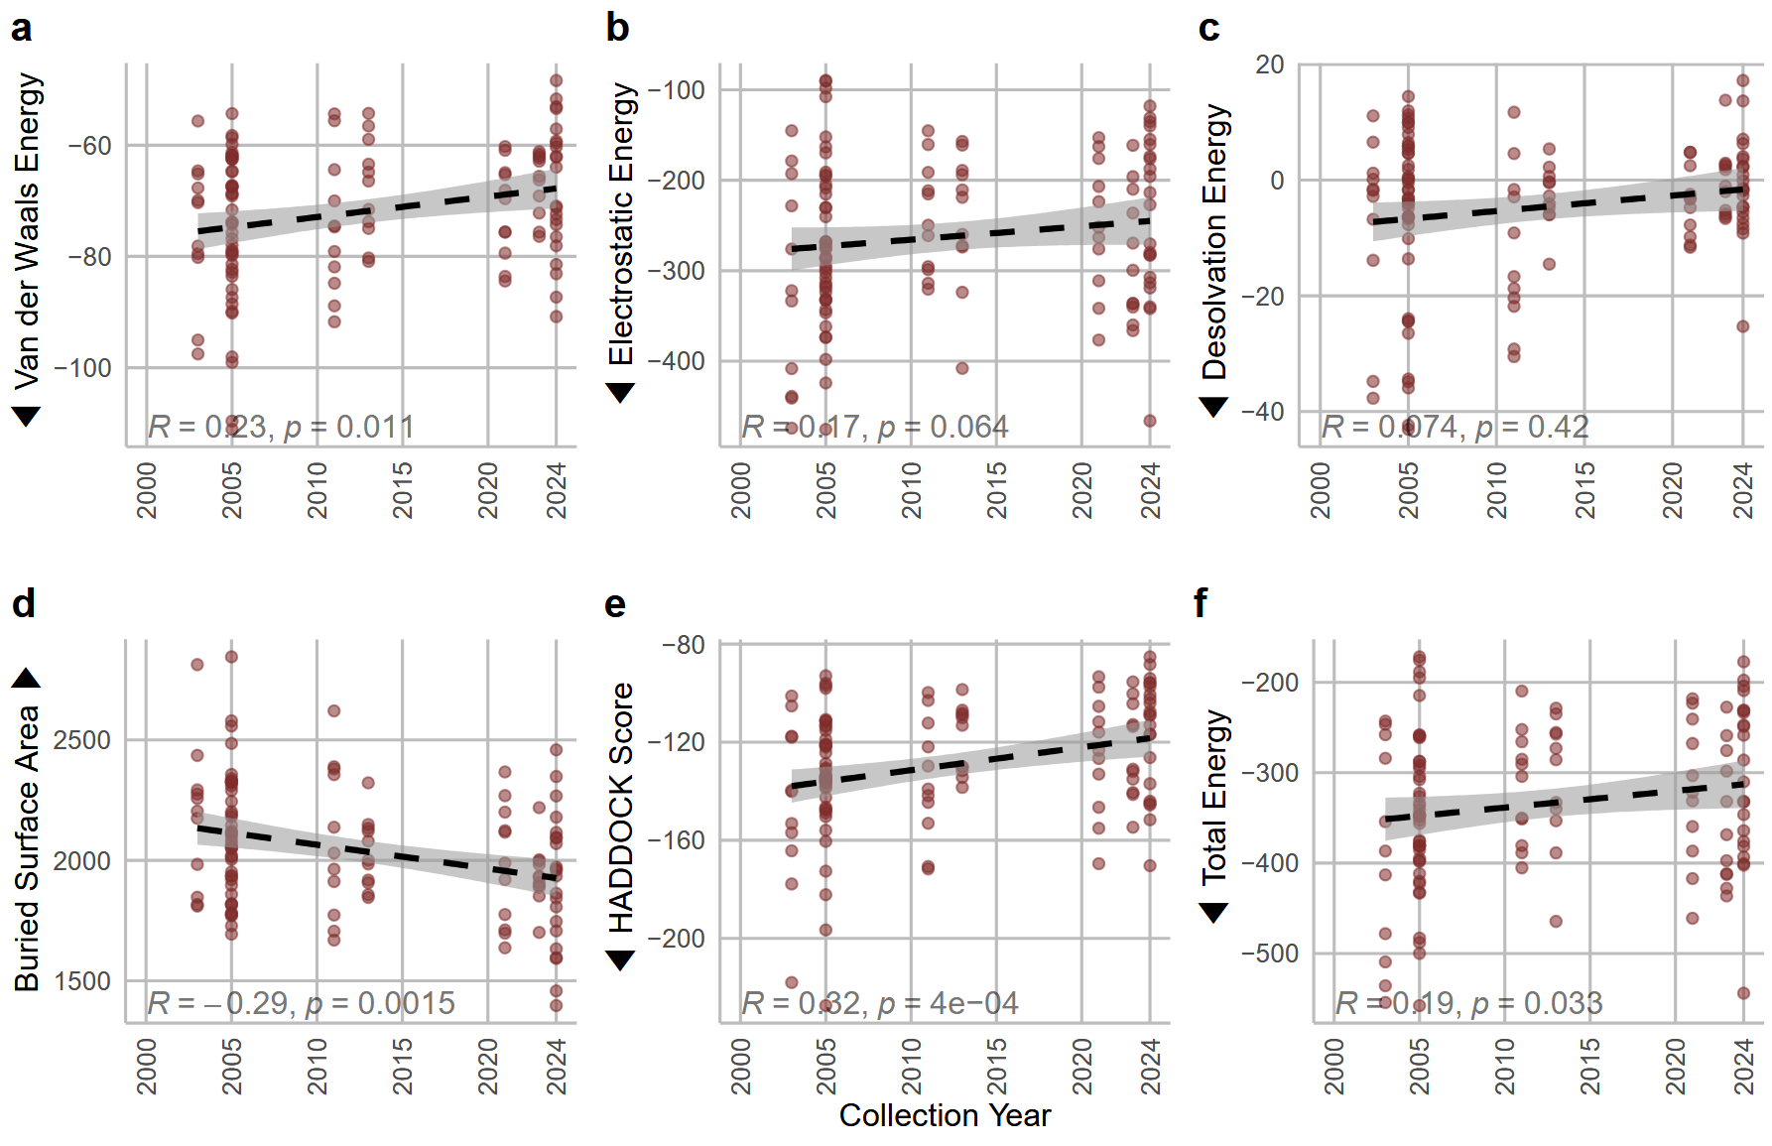
Reduction in Antibody Binding Over Time

Slide 7
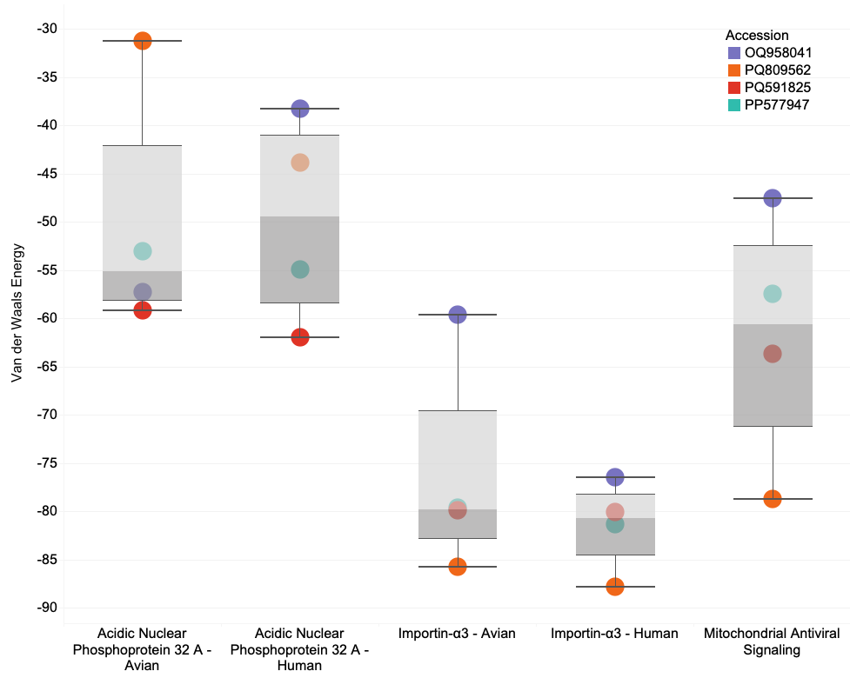
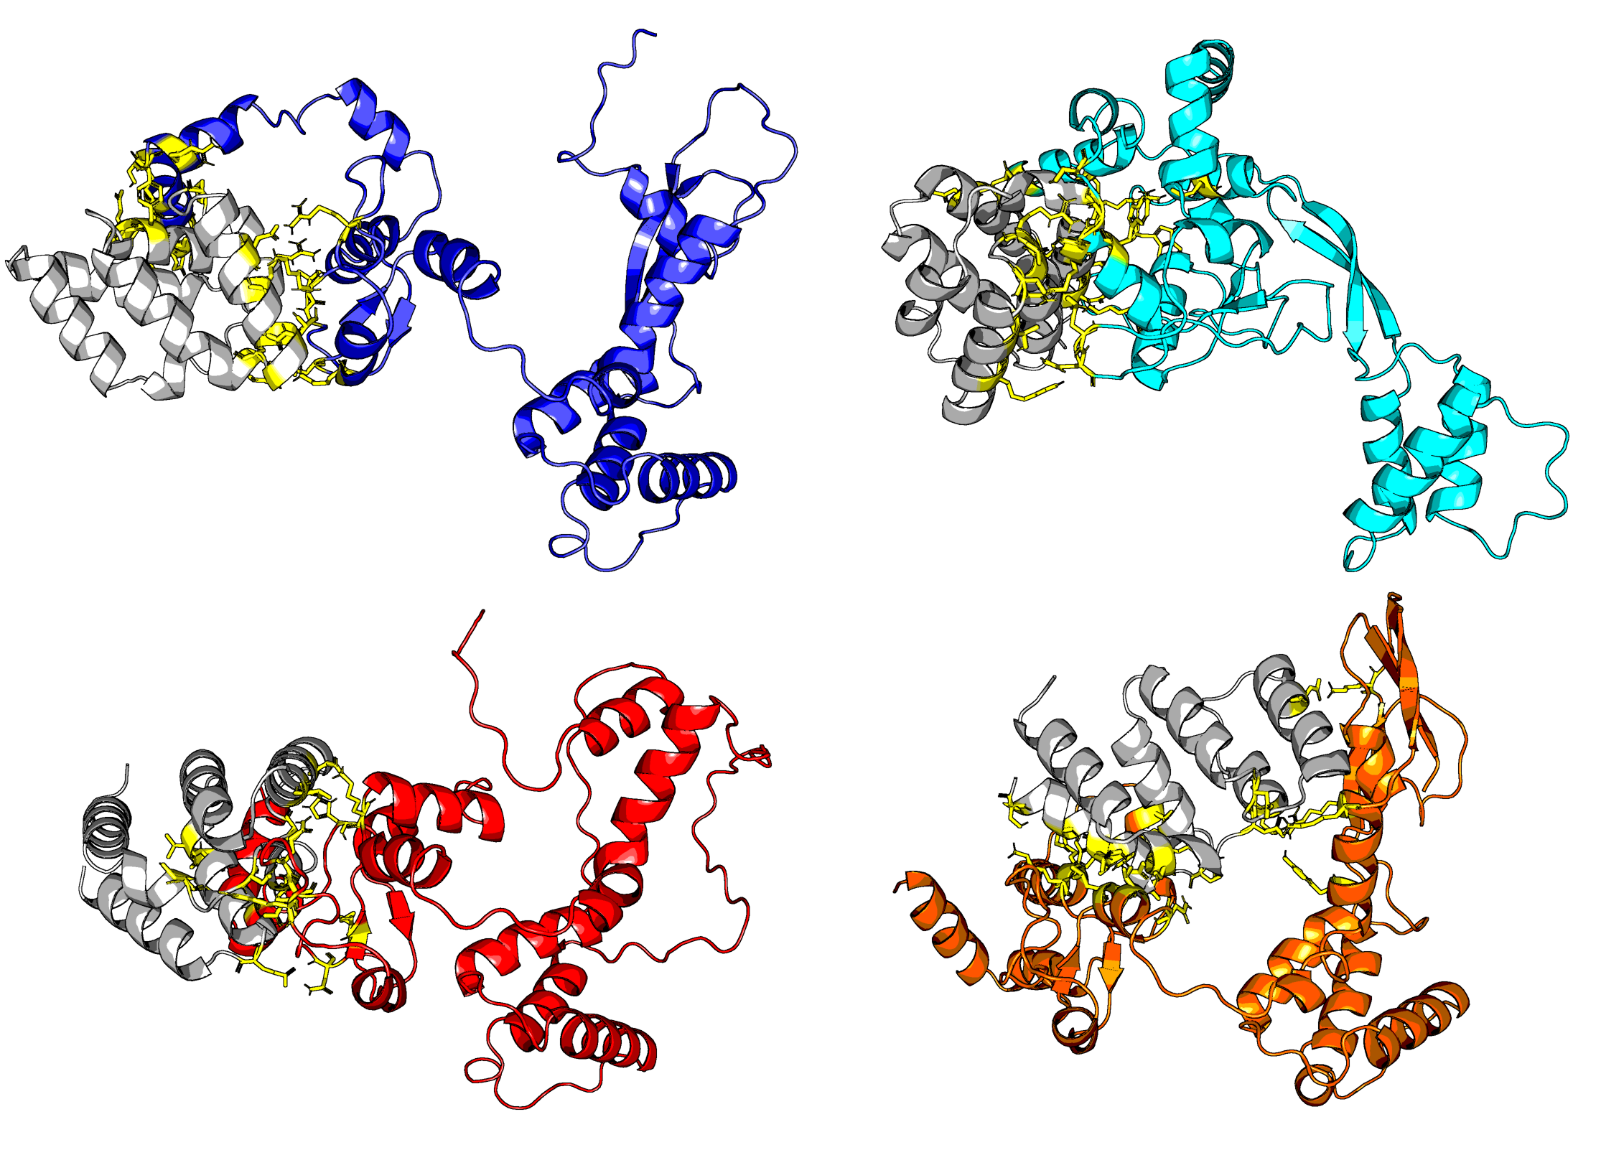
H5N1 PB2 Protein - Highjacking the Host Cell’s Innate Immune Defense
MAVS (in grey)
docked against PB2
Astrakhan 2020
Vaccine Candidate
Texas 2024
Cow-to-Human Case
California 2024
Human Case
Louisiana 2024
Bird-to-Human Fataility
Notes:
\

Slide 8
