Slide 1

H5N1 Influenza A is now promiscuous in host range and has improved replication in mammals
Author: Sayal Guirales-Medrano
Co-Authors: Daniel Janies, Kary Ocaña, Khaled Obeid, Rachel Alexander, and Colby T. Ford
Affiliations: CIPHER Center at UNC Charlotte, NC, USA
National Laboratory of Scientific Computing, Rio de Janeiro, Brazil
Notes:
Good morning everyone. My name is Sayal Guirales-Medrano, and I'm delighted to present our work titled 'H5N1 Influenza A is now promiscuous in host range and has improved replication in mammals'. This research explores how H5N1 Influenza A is circulating and adapting to new host species in North America, and, as you'll see today, we leveraged phylogenetic methodologies in our workflow to understand the relationship of select proteins and we used computational structural biology to compare the HA and PB2 viral proteins in clade 2.3.4.4b H5N1 Influenza A.

Slide 2

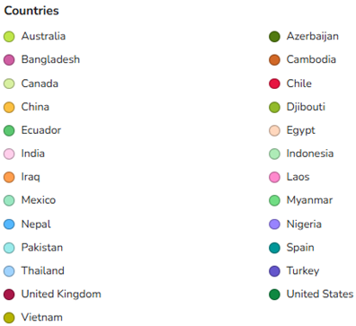
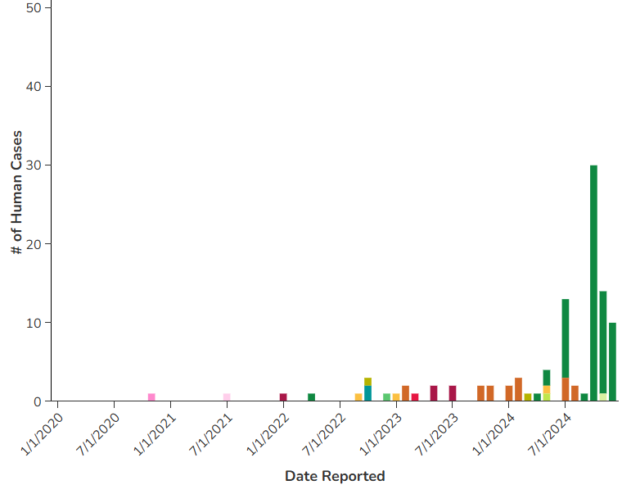
Introduction & Research Question
How have phylogenetic relationships and natural selection shaped the host range promiscuity and enhanced mammalian replication of clade 2.3.4.4b H5N1 Influenza A viral lineage in North America?
What specific mutations in the HA and PB2 proteins of H5N1 clade 2.3.4.4b viral lineage correlate with observed host shifts and increased viral replication in mammals?
Do structural analyses of HA's receptor binding and PB2's interaction with host immune proteins provide molecular insights into H5N1's adaptation to new hosts and evasion of innate immunity?
Source: https://www.cdc.gov/bird-flu/php/surveillance/chart-epi-curve-ah5n1.html
Notes:
H5N1 influenza, specifically clade 2.3.4.4b, has recently infected hundreds of species of wild and domestic birds and mammals in North America, posing a significant threat to animal and human health. While H5N1 has circulated since 1996 in avians, human infection has been sporadic. However, around the world and more drastically in North America, we have seen an increase in the number of cases in both livestock and humans. Major surge occurred last year in 2024 and had several fatalities. In North America, we're seeing an expanded host range and more efficient replication. Our primary research question was: How have evolutionary forces shaped the H5N1 virus ability to infect new hosts and evade immune responses, and can phylogenetic and structural approaches illuminate these adaptive processes in the Hemagglutinin (HA) and Polymerase Basic 2 (PB2) proteins?

Slide 3
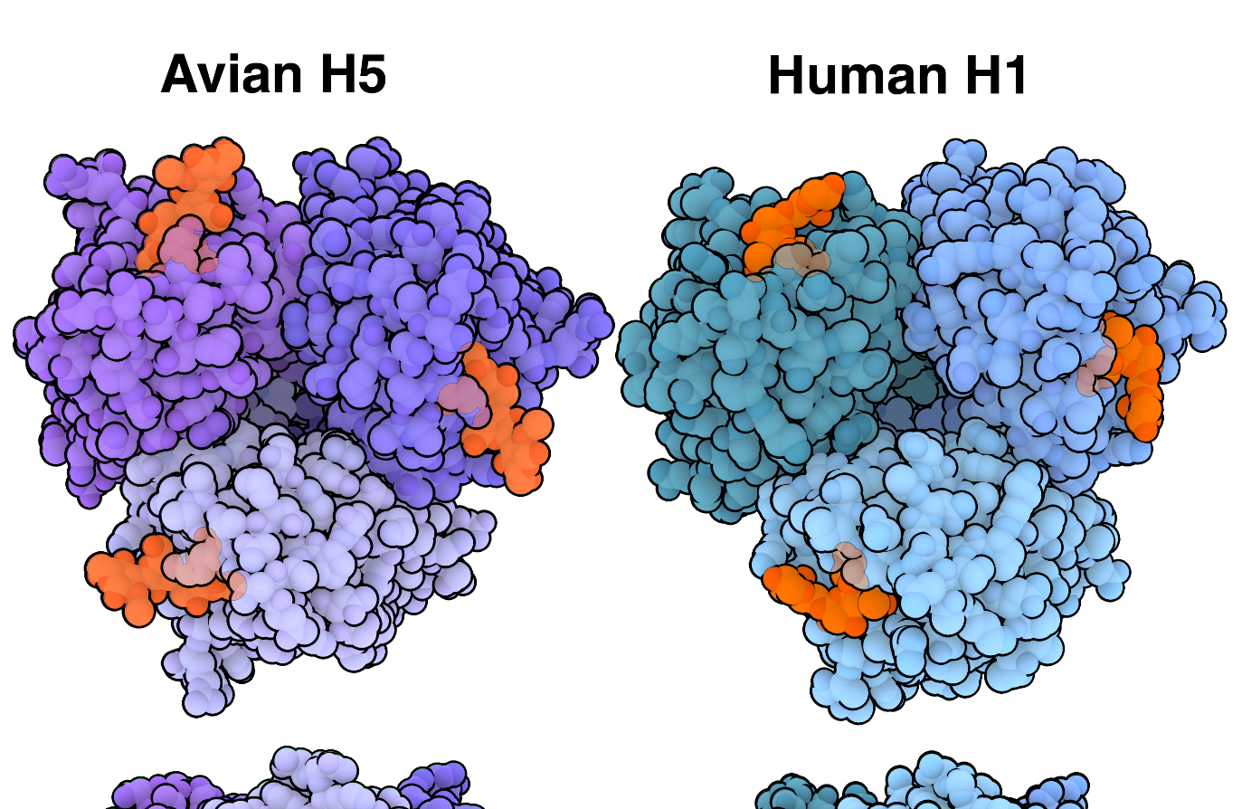
Avian vs. Human Influenza
History
Avian influenza first emerged in 1878
Kills millions of birds across the globe and has also caused sickness in wild and domestic mammals. Historically has killed 60% of human cases.
Subtypes
Hemagglutinin: H1 to H18 subtypes
Humans: H1, H2, H3…
Birds: Almost any (except H17 and H18), but H5 and H7 cause severs disease
Neuraminidase: N1 to N11 subtypes
Zoonosis
H5N1 is known to infect humans and other mammals
Human-to-human transmission of H5N1 has historically been very rare and inefficient
Sialic Acid bound
to HA1 Region of H
Source: https://pdb101.rcsb.org/motm/302
Notes:
Some background information on Influenza. Avian Influenza first emerged in 1878 in Italy, while H5N1 first emerged in China in geese. This virus has killed millions of birds across the globe and has caused sickness in many mammals. Historically Avian Influenza has killed in 60% of human cases. Influenza A is categorized in subtypes based on the identification of two proteins on the surface of the virus, hemagglutinin (H) and neuraminidase (N). The numbering of these proteins come from a serological assay where specific antibodies were used to bind to these proteins. If antibody 1 bound to the HA then it was categorized as H1. Influenza is able to target different host based on a specific receptor found on host cells. This receptor is the sialic acid receptor.
The history of avian influenza - ScienceDirect
Highly Pathogenic Avian Influenza A(H5N1) Virus Infection in a Dairy Farm Worker | New England Journal of Medicine

Slide 4
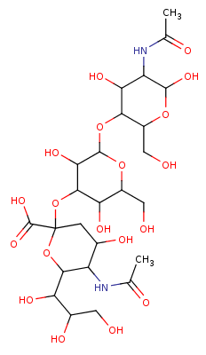
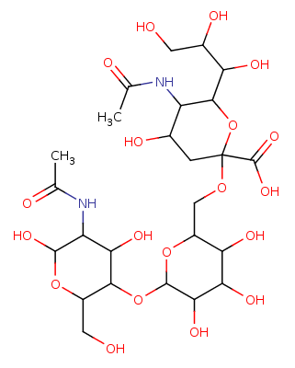
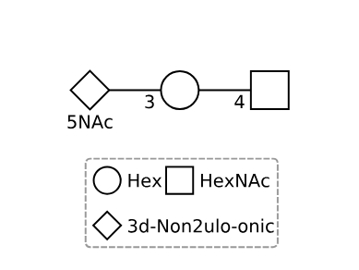

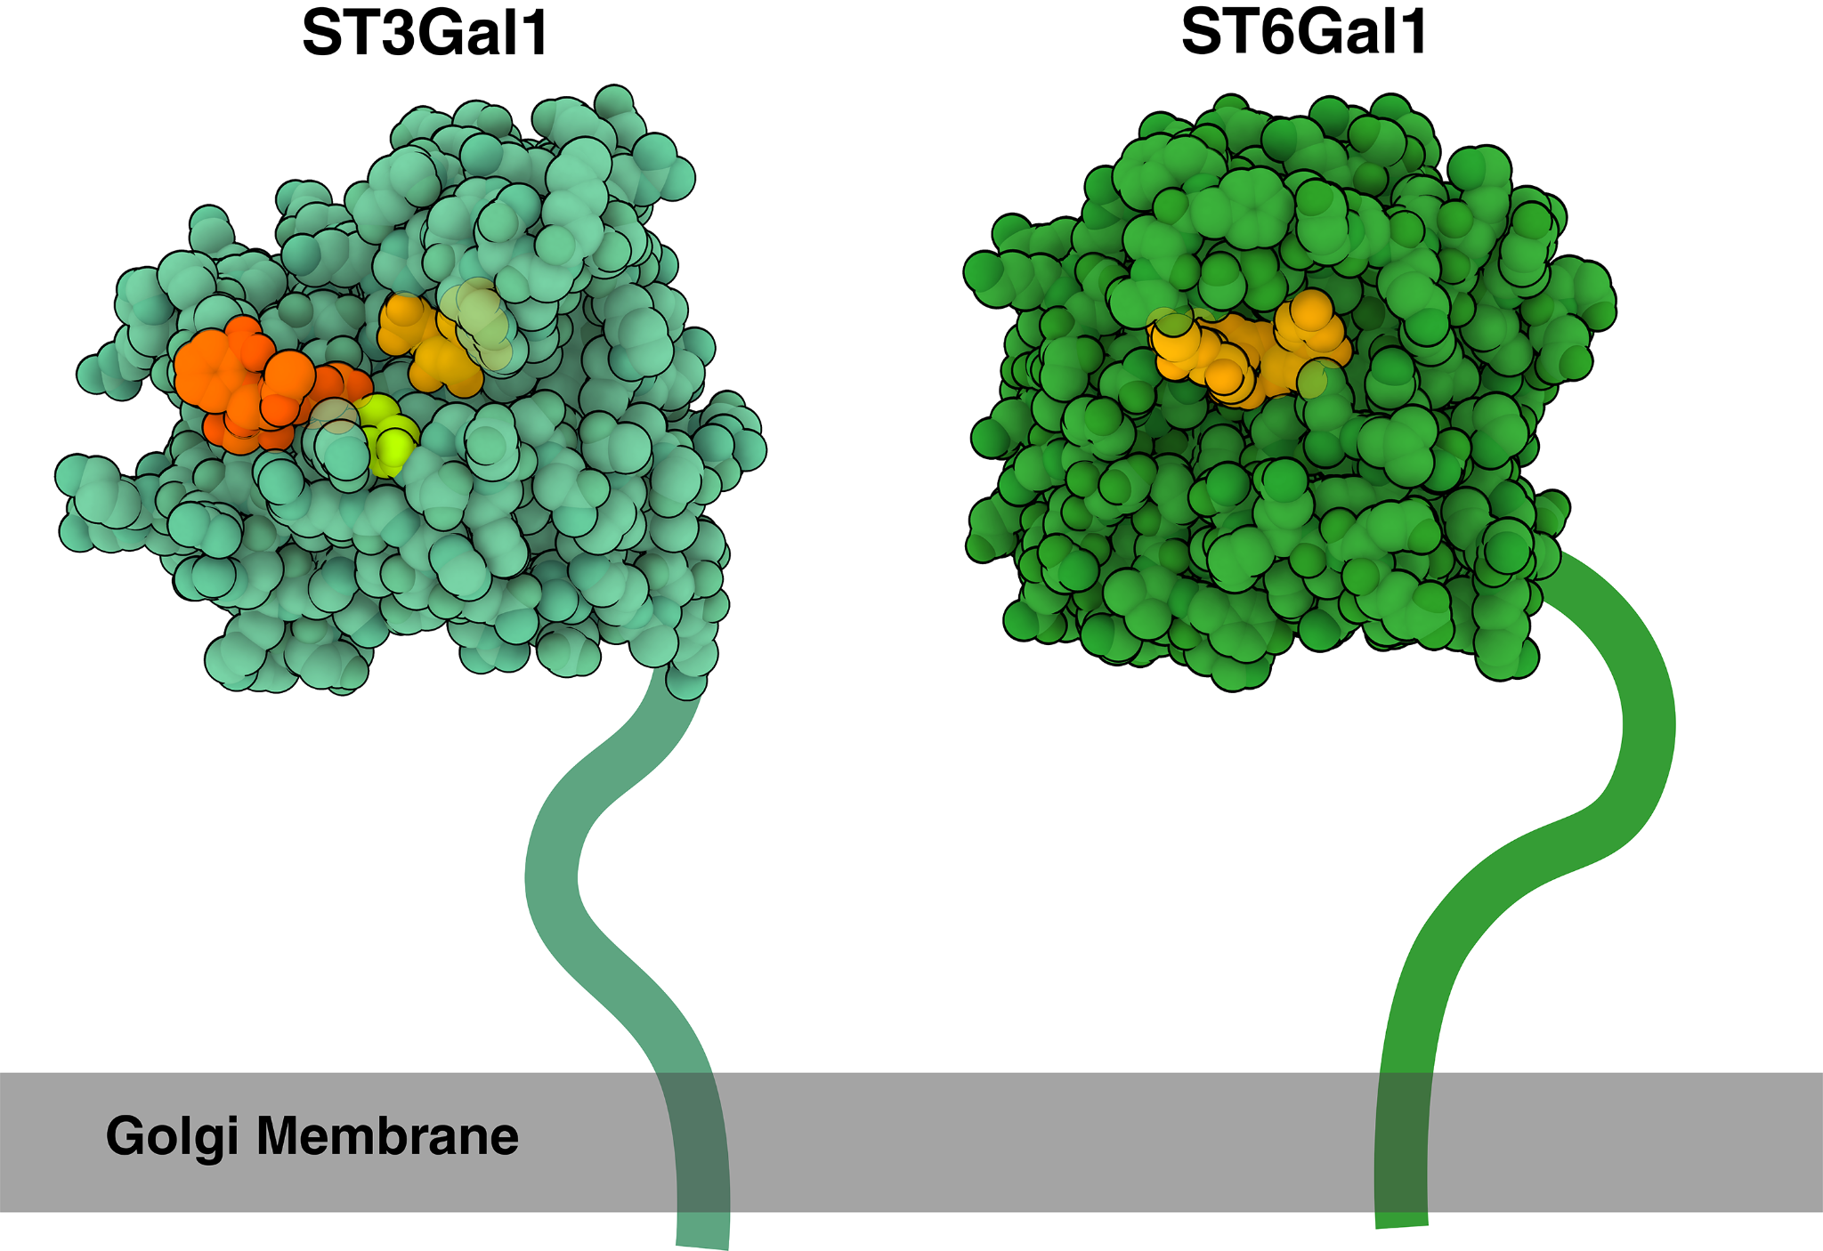
Sweetly Specific
Glycan Entry:
Hemagglutinin recognizes and attaches to sialic acid molecules on the cell surface.
Sialic acids are a family of nine-carbon sugar molecules that are commonly found at the tips of glycans, or sugar chains, that are attached to proteins and lipids on the cell surface.
Sialic Acid Linkage to Glycans:
Avian influenza viruses, such as H5N1 or H7N9, are adapted to bind to α-2,3-linked sialic acid receptors.
Predominantly found in the respiratory and gastrointestinal tracts of birds.
Human influenza viruses, such as H1N1, are adapted to bind to α-2,6-linked sialic acid receptors.
Human cells in the upper respiratory tract (nose, throat, and trachea) have α-2,6-linked sialic acid receptors.
Mammary glands of cows are rich in α-2,3-linked sialic acid receptors, allowing H5N1 to replicate and be released in milk, and potentially to be transmitted to other cows through contaminated milking equipment.
2,3
2,6
Sialyltransferases with Sialic acid
Source: https://pdb101.rcsb.org/motm/302
Notes:
The main function of hemagglutinin is to mediate cell entry. It does this by binding to a sugar molecule, which is the sialic acid, this is found on both avian and mammalian cells. The key difference between avian and mammalian sialic acids are the configuration of the sialic acid molecule. Avians had an a-2,3 linkage while mammals and humans primarily have an a-2,6 linkage. Mutations in the HA protein allow avian influenza to sometimes bind to mammalian sialic acid. In cows, where we have seen a large number of infection cases, they have both a-2,3 and a-2,6 sialic acid receptors. This makes them a potentially great environment to develop those types of mutations.

Slide 5
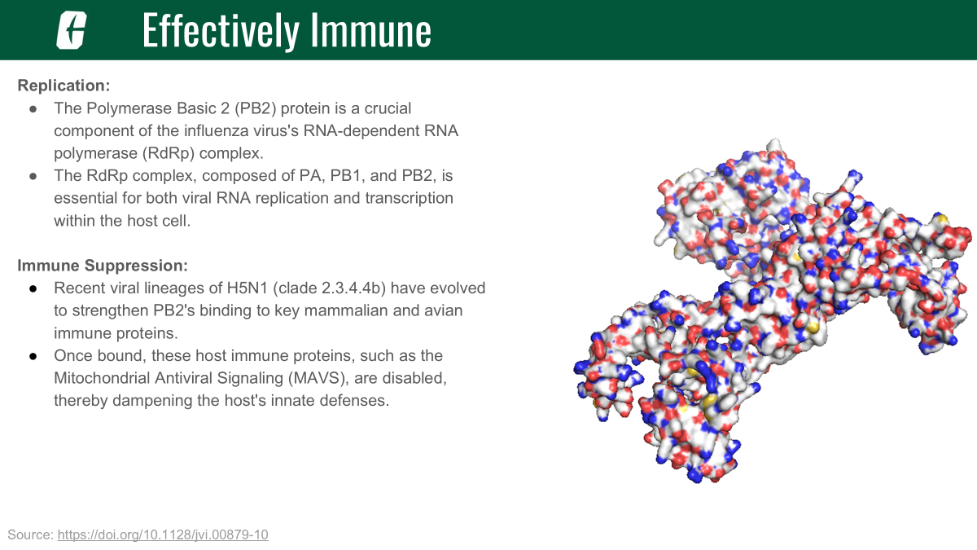
Notes:
Another influenza protein that we were interested in studying was the Polymerase Basic 2 protein or PB2. This protein is one of three that come together to form the RNA-dependent RNA polymerase, which is responsible for viral RNA replication. The PB2’s main function is to steal 5’ mRNA caps from the host to jump start its own replication. The other function of PB2 that we were interested in was its role in host immune response suppression. In humans, PB2 has been found to enter both the nucleus and the mitochondria and bind to an immune protein known as Mitochondrial Antiviral Signaling, or MAVS. MAVS is responsible for initiating the interferon response and cause cell death. PB2 binds to MAVS and prevents this signaling from occurring and thus allowing viral replication to continue.

Slide 6
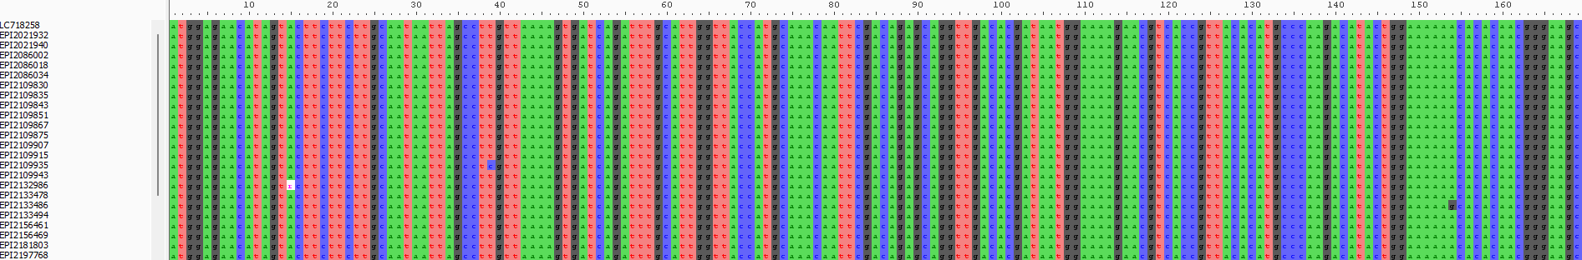
Data Collection - Homolog Identification & Alignment
Data collected from United States National Institutes of Health’s Genbank (NIH; ncbi.nih.nlm.gov) and The Global Initiative to Share all Avian Influenza Data (GISAID; gisaid.org).
HA - 9,359 nucleotide sequences
PB2 - 3,415 nucleotide sequences
Notes:
Our workflow began with comprehensive data collection. We created a large dataset of 9,359 Hemagglutinin (HA) nucleotide sequences and 3,415 PB2 nucleotide sequences. These sequences were collected from NCBI Genbank and GISAID, specifically focusing on clade 2.3.4.4b and relevant background data. We then performed multiple sequence alignment using MAFFT. Crucially, during this step, we trimmed ragged edges, padded gaps, and eliminated sequences that broke the reading frame, ensuring high-quality alignments for both HA and PB2.

Slide 7
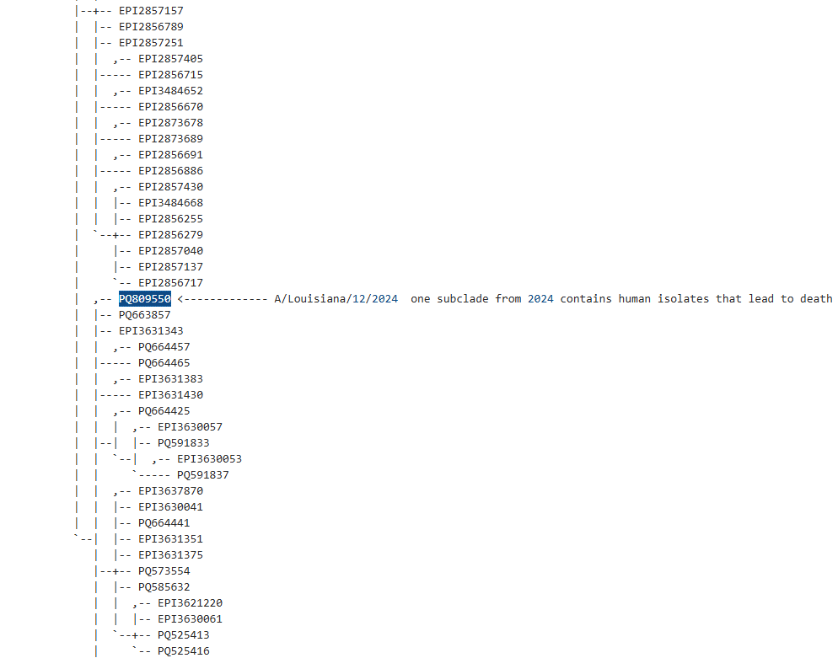
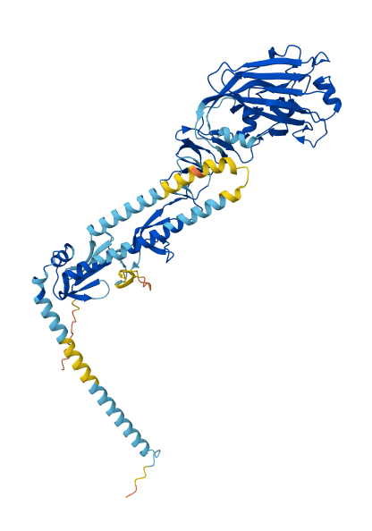
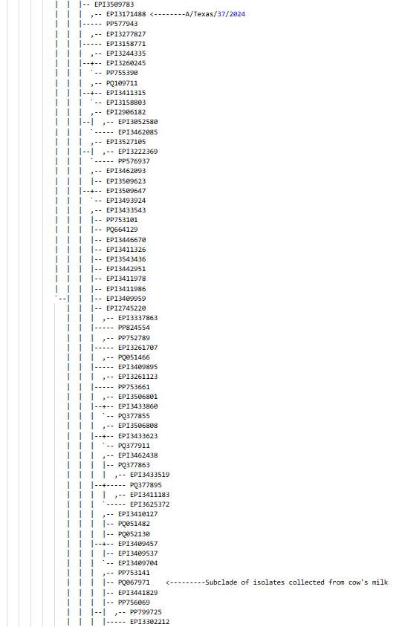
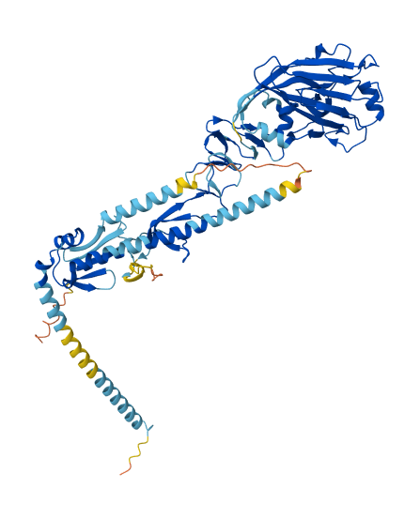
Notes:
For structural biologists, phylogeny allows us to distinguish between shared ancestry and convergent evolution, identify key conserved residues, predict functional shifts, and reconstruct ancestral states. Critically for our study, we used phylogeny to identify two distinct subclades of H5N1 interest and to effectively sort our large datasets into manageable subsets of recent relevance, enabling focused structural and functional analyses. With our aligned sequences, the next critical step was phylogenetic inference. For tree searches on our,HA and PB2 datasets, we used TNT (Version 1.6). For both HA and PB2 we used older H5N1 strains from chicken infections as the outgroups. From this heuristic parsimony approach we selected the shortest trees as our basis of inference. To understand character evolution, we also mapped host and date of isolation characters onto the tree using Mesquite. We found two clades that were distantly related and had different zoonotic patterns (at the time of our study). Selection of these subclades allow us to identify any likely functional patterns of mutation between clades. These mutational differences usually drive phenotypic changes through change in protein structure.

Slide 8
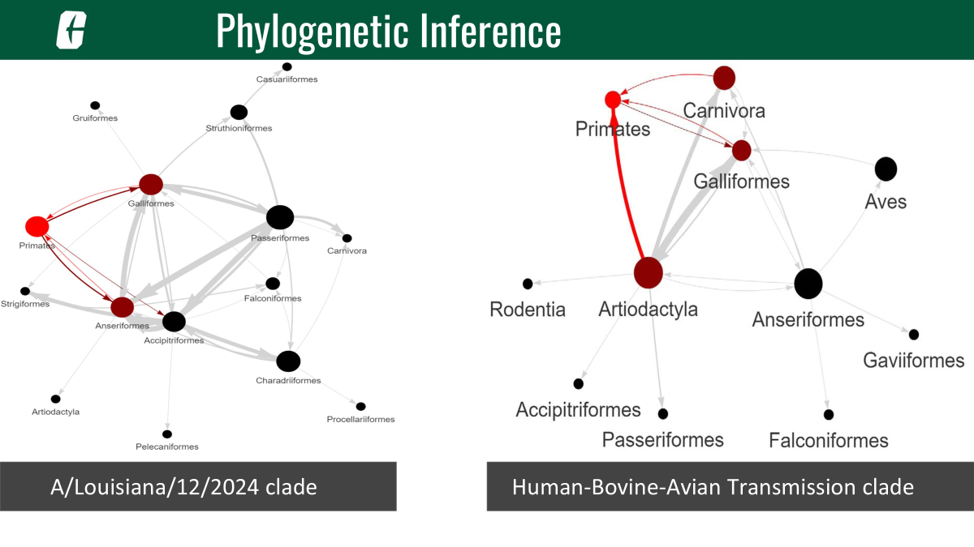
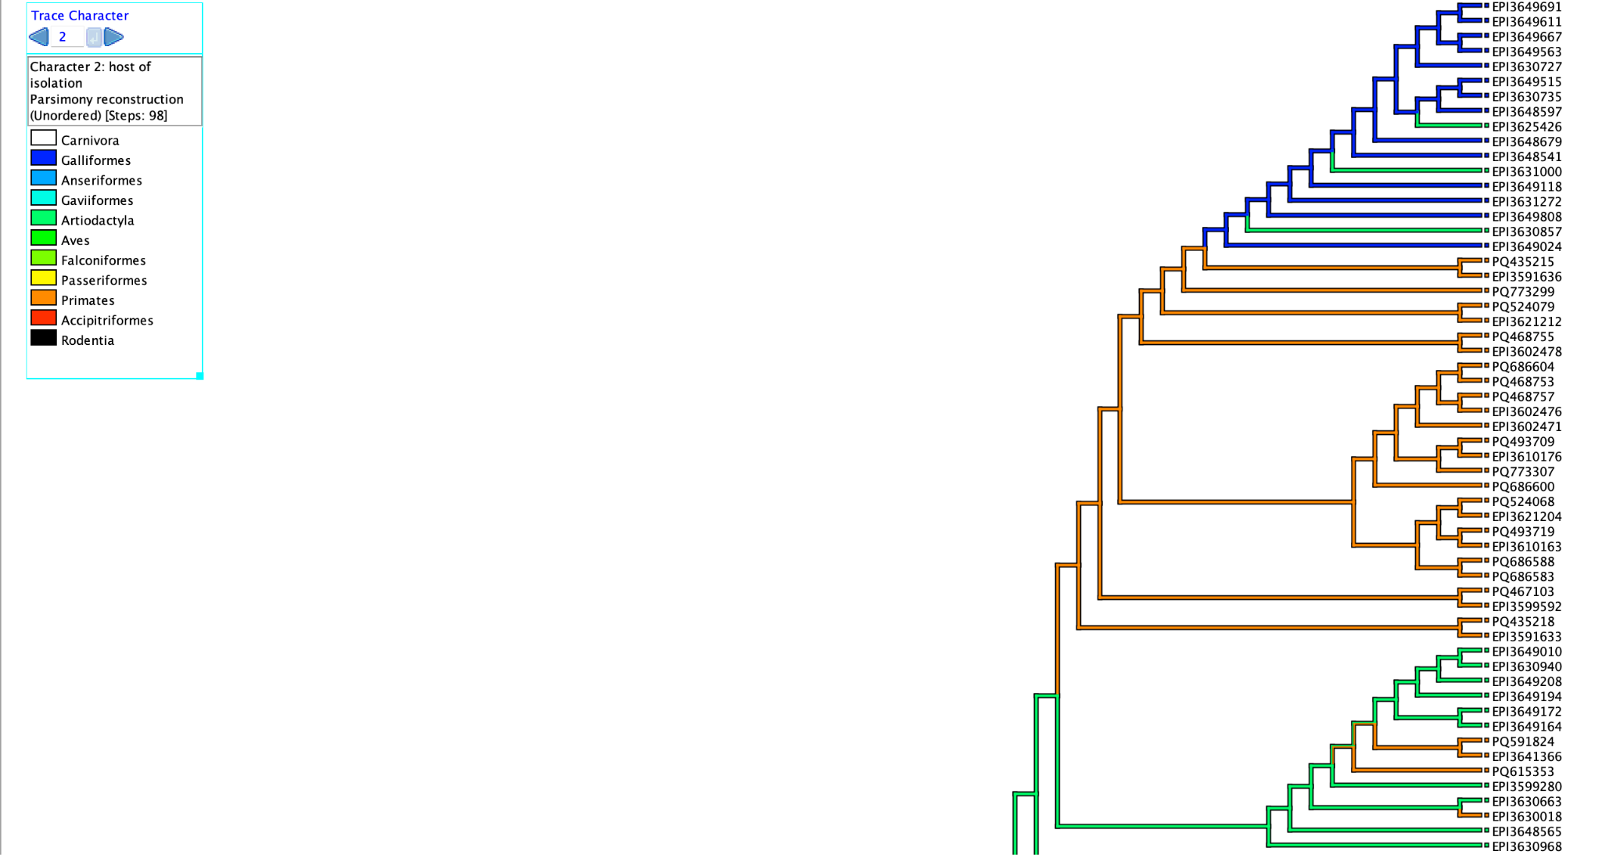
Phylogenetic Inference
Notes:
For subclade analyses, such as the HA isolates related to the human death in Louisiana or human-bovine-avian transmission events, trees were calculated using RAXML (version 8.2.12). We also analyzed change in host character state using one of our own tools, Strainhub, to map these transmission networks for our two subclades. In our Louisiana clade we see mainly transmission between our primates and avians. In our Human-Bovine-Avian clade, we see an inclusion of other carnivora mammals and bovine (cows).

Slide 9
Natural Selection Analyses Using HyPhy (M8 model)
Protein | Clade | Amino Acid Site | Probability (DN/DS > 1) | Mutation(s)
HA | surrounding deceased patient infected with H5N1 in Louisiana | 230 | 0.9685961144425779 | A230V
HA | human-bovine-avian | 147 | 0.9988807760818452 | V147M*
PB2 | current H5N1 lineages | 292 | 0.9922498777048648 | I292L/V/T/M
PB2 | current H5N1 lineages | 344 | 0.9999928310390789 | V344M/A/I
PB2 | current H5N1 lineages | 627 | 0.9999895456621494 | E627K/V*
Notes:
Beyond simply inferring relationships, we assessed adaptation using computational analyses of natural selection of the nucleotide diversity of HA and PB2 genes. All subclade datasets were cleaned using MACSE (V2). To assess natural selection, we employed HyPhy (version 2.5.67) and the Nielsen and Yang (NY) approach for detecting positive selection, which estimates the dN/dS ratio at each codon. We rigorously tested several models, including M0, M1, M2, M3, M7, M8 (Beta & ω), and M12, to evaluate both purifying and episodic positive selection. Here I am showing the results for the M8 model. This allowed us to identify specific amino acid sites under significant selective pressure. I wanted to point out two specific mutations of interest. V147M is located near a mutation that has shown to allow host change from avian to mammal. E627K in PB2, similarly has been cited to allow the host jump from avian to mammal.

Slide 10
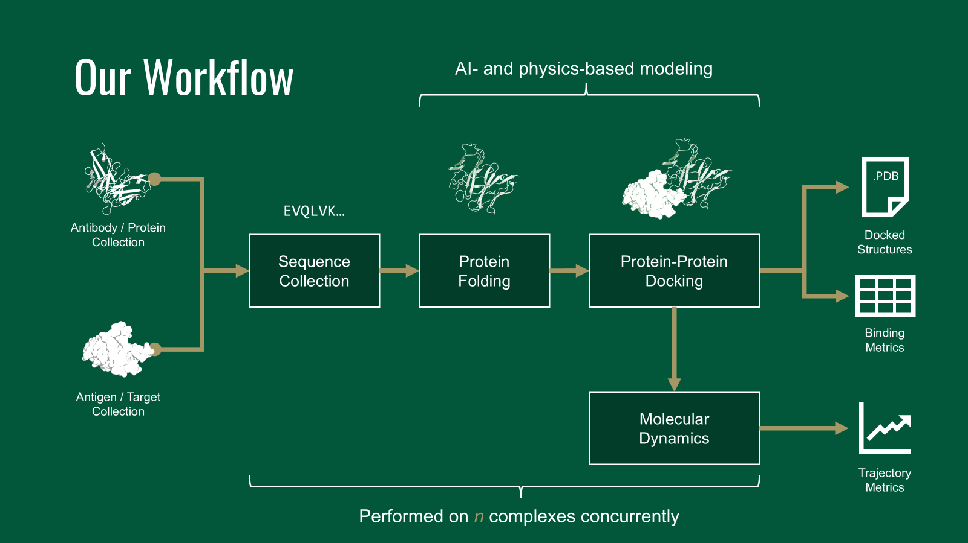
Linking Phylogeny to Structural Diversity
Notes:
Now, let's bridge the gap between evolutionary history and structural biology. Our phylogenetic analyses revealed that H5N1 (clade 2.3.4.4b) is spreading in North America as two distinct subclades of interest. One subclade contains the human isolate that led to death in Louisiana, with its ancestry traced to Galliformes and a sister relationship to an Accipitriformes isolate. Another subclade is distinct and contains multiple human-bovine-avian transmission events, showing high-frequency unidirectional transmission from Artiodactyla to Primates. By mapping these phylogenetic patterns to structural information, we aimed to evaluate the binding affinity of HA from different strains to host receptor proteins, specifically human and avian sialic acid (SA) glycans and binding PB2 to human immune proteins. Explain structural workflow.

Slide 11
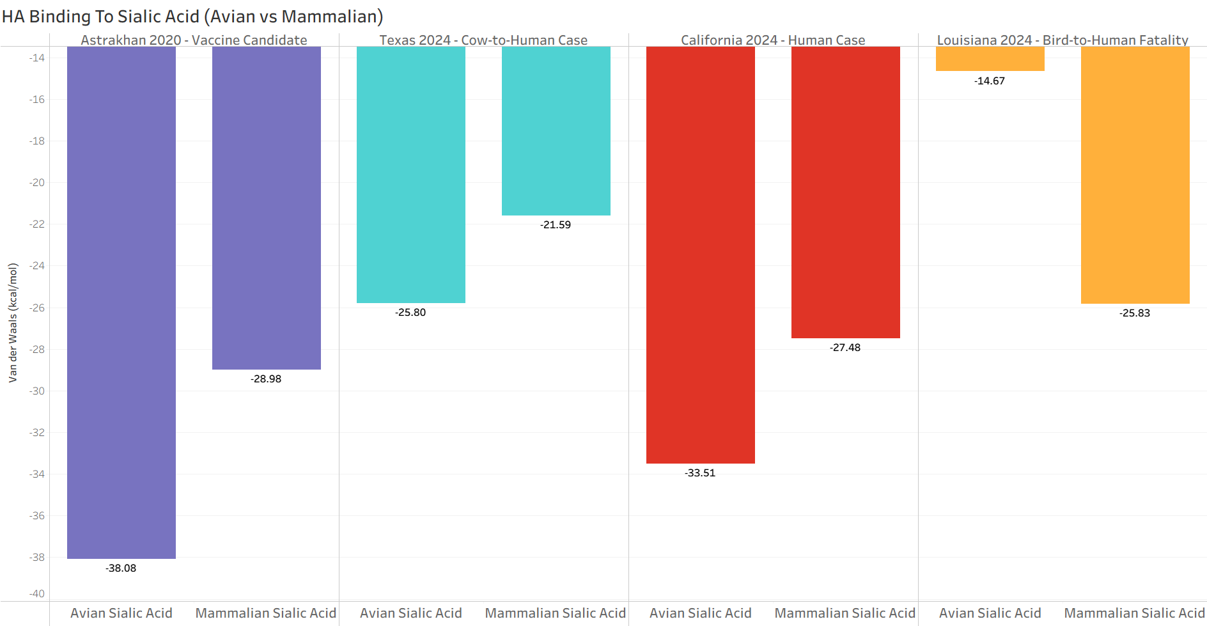
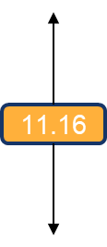

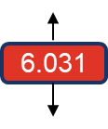
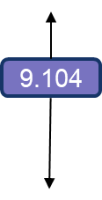
Structural Biology - HA Docking and Insights
Notes:
To understand the structural basis of HA's expanding host range, we manually extracted amino acid sequences of four HA sequences of interest based on our phylogenetic analyses, including a vaccine candidate. These sequences were folded into three-dimensional structures using ColabFold. We then performed protein-glycan docking simulations using HADDOCK3 (v2024.12.0b7), evaluating binding interactions against both human and avian SA glycans obtained from PDB structures 4K63 and 4KDO respectively. These simulations provided insights into potential differences in HA-SA binding affinities among strains, correlating structural changes with observed host shifts and promiscuity driven by HA mutations.

Slide 12
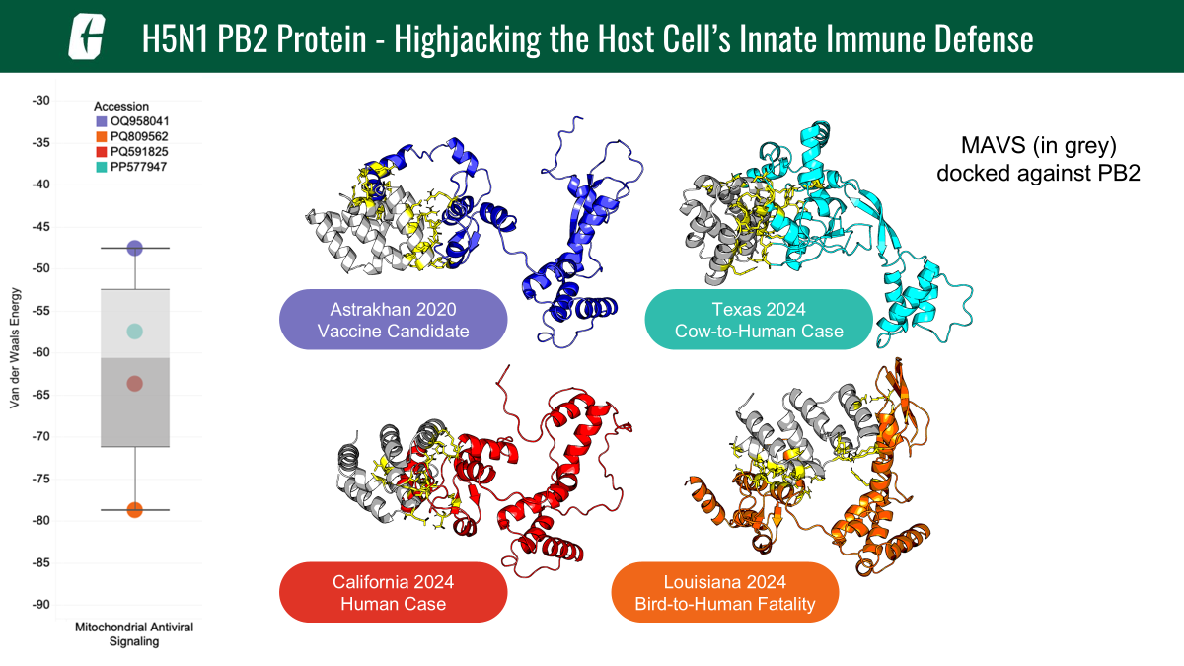
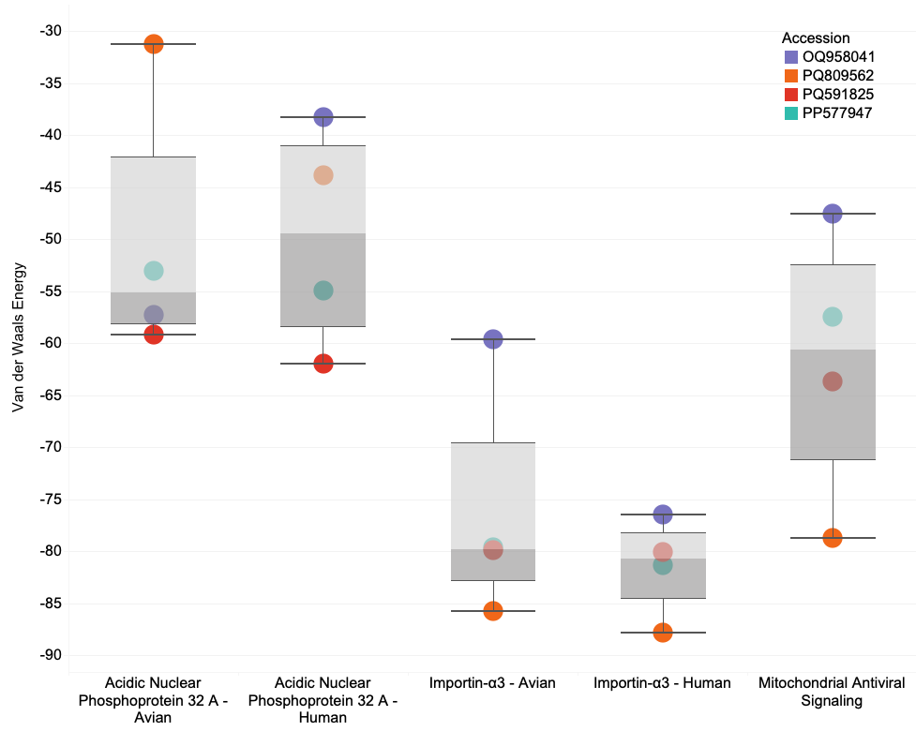
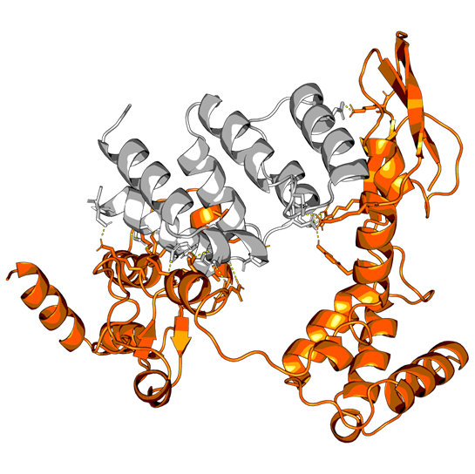

Structural Biology - PB2 and Immune Evasion
Notes:
Our primary objective for PB2 was to evaluate its binding affinity to host immune factors, gaining insights into potential changes in immune evasion and replication mechanisms. We selected known host immune response proteins that interact with viral PB2, such as Human mitochondrial antiviral-signaling protein (MAVS; PDB: 2MS8), human and avian Importin-α3 orthologs (PDB: 4UAE), and Human acidic leucine-rich nuclear phosphoprotein 32 family member A (ANP32A; PDB: 6XZQ), as targets for our docking studies. PB2 sequences were folded with ColabFold, and protein-protein docking simulations were conducted using HADDOCK3. Our analyses of natural selection in PB2 show that mutations have adapted the H5N1 viral lineage to increase their ability to bind these crucial host proteins, thus dampening the hosts' innate defenses and setting the stage for increased viral replication.

Slide 13
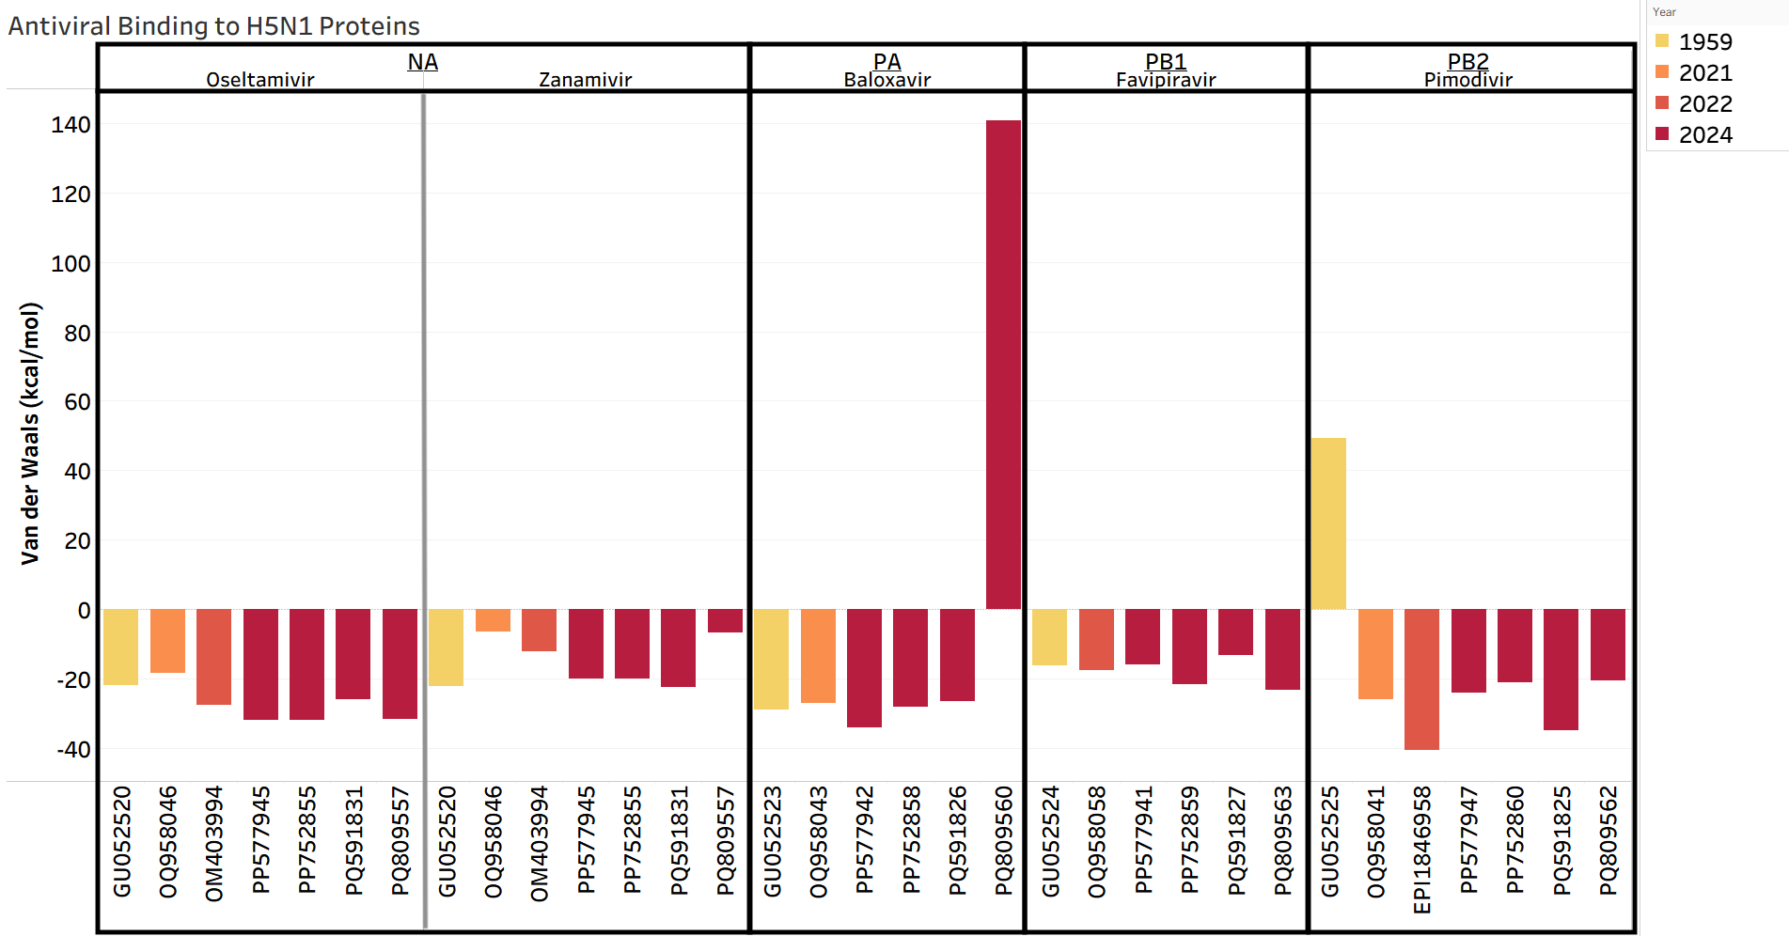
Efficacy of Antivirals Against H5N1

Slide 14
Key Findings and Broader Impact
HA mutations contribute to the virus’ shift from avian adaptation to promiscuity across various mammalian and avian hosts.
PB2 mutations enhance the virus' ability to bind hosts’ innate immune proteins and thus increase replication.
H5N1's rapid spread and adaptation across hundreds of species.
Notes:
Our workflow, integrating phylogenetics, natural selection analyses, and computational structural biology, has revealed critical insights into H5N1 clade 2.3.4.4b. We showed that HA mutations contribute to the virus's shift from avian adaptation to promiscuity across various mammalian and avian hosts. Furthermore, PB2 mutations enhance the virus's ability to bind host immune proteins, dampening innate defenses and promoting viral replication. This comprehensive approach not only illuminates the mechanisms behind H5N1's rapid spread and adaptation but also provides a powerful paradigm for understanding protein evolution and function. Our findings have significant implications for disease surveillance, vaccine development, and informing public health strategies.

Slide 15
Conclusion
A robust phylogenetic framework for H5N1 clade 2.3.4.4b, identifying distinct subclades with significant host shift events.
Specific mutations in HA and PB2 under positive selection that correlate with enhanced host range and adaptation.
Computational structural analyses elucidate the molecular mechanisms by which HA increases host receptor binding promiscuity and PB2 strengthens binding to host innate immune proteins, thus lowering the innate immune response.
Notes:
In conclusion, our study demonstrates:
A robust phylogenetic framework for H5N1 clade 2.3.4.4b, identifying distinct subclades with significant host shift events.
Specific mutations in HA and PB2 under positive selection that correlate with enhanced host range and immune evasion.
Computational structural analyses elucidate the molecular mechanisms by which HA increases host receptor binding promiscuity and PB2 strengthens binding to host immune proteins, promoting viral replication.

Slide 16
Acknowledgements
We gratefully acknowledge all GISAID data contributors (i.e., the authors and their originating laboratories) responsible for obtaining the specimens, and their submitting laboratories for generating the genetic sequence and metadata and sharing via the GISAID Initiative, on which this research is based.
We acknowledge the following entities at the University of North Carolina at Charlotte: Academic Affairs, The Office of Research (Ignite Award), The Center for Computational Intelligence to Predict Health and Environmental Risks (CIPHER), The Department of Bioinformatics and Genomics, The College of Computing and Informatics, and the University Research Computing group. We gratefully acknowledge the support of the Belk Family and the Levine Scholars program.
Notes:
I'd like to express my sincere gratitude to my co-authors Daniel Janies, Kary Ocaña, Sayal Guirales-Medrano, Khaled Obeid, and Rachel Alexander. I also acknowledge the Center for Computational Intelligence to Predict Health and Environmental Risks (CIPHER) at UNC Charlotte, the National Laboratory of Scientific Computing, and Tuple LLC, and all collaborators and funding agencies for their invaluable contributions and support. Thank you, and I'm happy to take any questions.

Slide 17
References
Janies, D., Ocaña, K., Guirales-Medrano, S., Obeid, K., Alexander, R., & Ford, C. T. (2025). Analyses of phylogenetics, natural selection, and protein structure of clade 2.3.4.4b H5N1 Influenza A reveal that recent viral lineages have evolved promiscuity in host range and improved replication in mammals in North America (p. 2025.03.15.641219). bioRxiv. https://doi.org/10.1101/2025.03.15.641219
Lupiani, B., & Reddy, S. M. (2009). The history of avian influenza. Comparative Immunology, Microbiology and Infectious Diseases, 32(4), 311–323. https://doi.org/10.1016/j.cimid.2008.01.004
Uyeki, T. M., Milton, S., Hamid, C. A., Webb, C. R., Presley, S. M., Shetty, V., Rollo, S. N., Martinez, D. L., Rai, S., Gonzales, E. R., Kniss, K. L., Jang, Y., Frederick, J. C., Cruz, J. A. D. L., Liddell, J., Di, H., Kirby, M. K., Barnes, J. R., & Davis, C. T. (2024). Highly Pathogenic Avian Influenza A(H5N1) Virus Infection in a Dairy Farm Worker. New England Journal of Medicine, 390(21), 2028–2029. https://doi.org/10.1056/NEJMc2405371

Slide 18
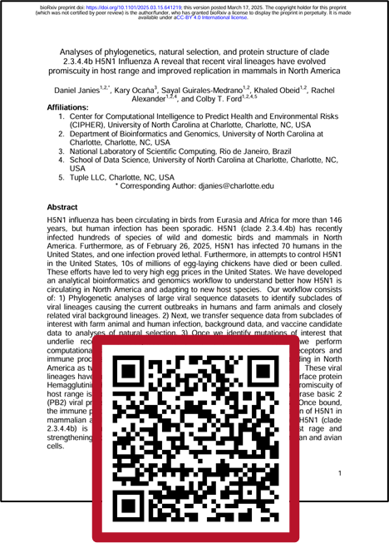
Questions?
Email: sguirale@charlotte.edu

