Slide 1

H5N1 Influenza A is now promiscuous in host range and has improved replication in mammals
Author: Sayal Guirales-Medrano
Co-Authors: Daniel Janies, Kary Ocaña, Khaled Obeid, Rachel Alexander, and Colby T. Ford
Affiliations: CIPHER Center at UNC Charlotte, NC, USA
National Laboratory of Scientific Computing, Rio de Janeiro, Brazil
Notes:
Good morning everyone. My name is Sayal Guirales-Medrano, and I'm delighted to present our work titled 'H5N1 Influenza A is now promiscuous in host range and has improved replication in mammals'. This research explores how H5N1 Influenza A is circulating and adapting to new host species in North America, and, as you'll see today, we leveraged phylogenetic methodologies in our workflow to understand the relationship of select proteins and we used computational structural biology to compare the HA and PB2 viral proteins in clade 2.3.4.4b H5N1 Influenza A.

Slide 2

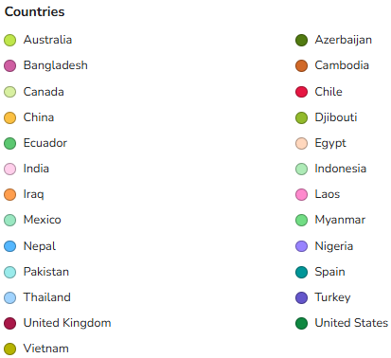
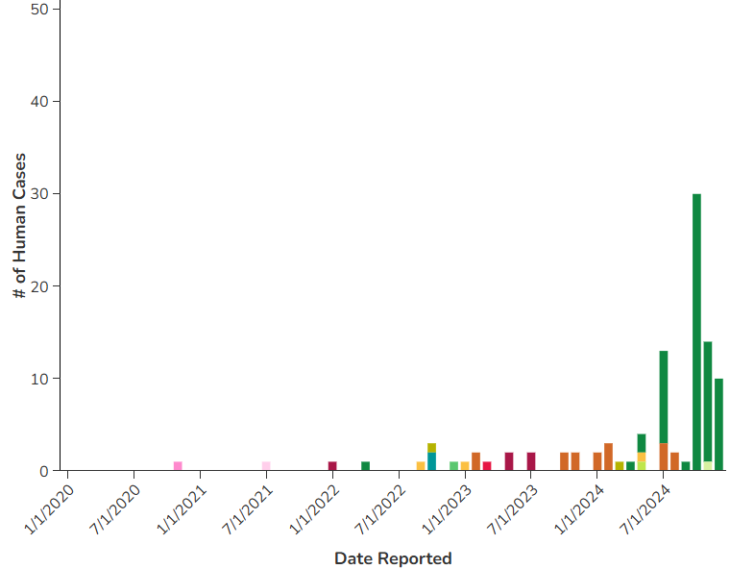
Introduction & Research Question
How have phylogenetic relationships and natural selection shaped the host range promiscuity and enhanced mammalian replication of clade 2.3.4.4b H5N1 Influenza A viral lineage in North America?
What specific mutations in the HA and PB2 proteins of H5N1 clade 2.3.4.4b viral lineage correlate with observed host shifts and increased viral replication in mammals?
Do structural analyses of HA's receptor binding and PB2's interaction with host immune proteins provide molecular insights into H5N1's adaptation to new hosts and evasion of innate immunity?
Source: https://www.cdc.gov/bird-flu/php/surveillance/chart-epi-curve-ah5n1.html
Notes:
H5N1 influenza, specifically clade 2.3.4.4b, has recently infected hundreds of species of wild and domestic birds and mammals in North America, posing a significant threat to animal and human health. While H5N1 has circulated in Eurasia for over 146 years, human infection has been sporadic. However, in North America, we're seeing an expanded host range and more efficient replication. Our primary research question was: How have evolutionary forces shaped the H5N1 virus ability to infect new hosts and evade immune responses, and can phylogenetic and structural approaches illuminate these adaptive processes in the Hemagglutinin (HA) and Polymerase Basic 2 (PB2) proteins?

Slide 3
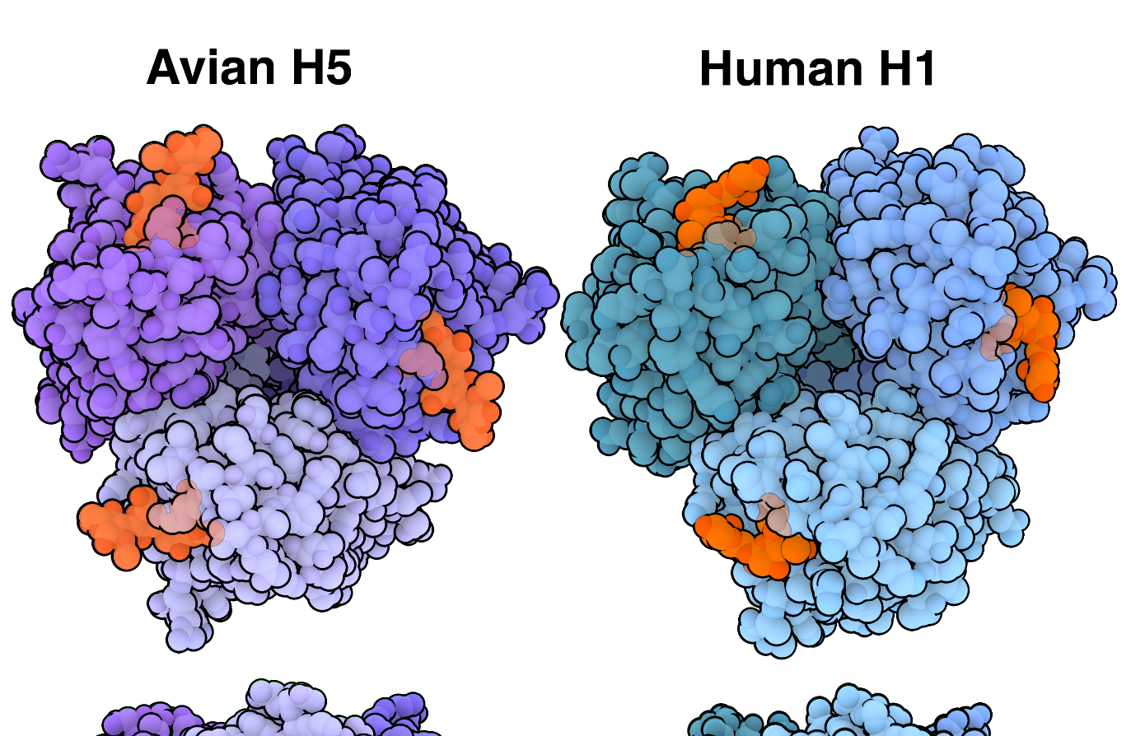
Avian vs. Human Influenza
History
Avian influenza first emerged in 1878
Kills millions of birds across the globe and has also caused sickness in wild and domestic mammals. Historically has killed 60% of human cases.
Subtypes
Hemagglutinin: H1 to H18 subtypes
Humans: H1, H2, H3…
Birds: Almost any (except H17 and H18), but H5 and H7 cause severs disease
Neuraminidase: N1 to N11 subtypes
Zoonosis
H5N1 is known to infect humans and other mammals
Human-to-human transmission of H5N1 has historically been very rare and inefficient
Mammary glands of cows are rich in α-2,3-linked sialic acid receptors, allowing H5N1 to replicate and be released in milk, and potentially to be transmitted to other cows through contaminated milking equipment.
Sialic Acid bound
to HA1 Region of H
Source: https://pdb101.rcsb.org/motm/302
Notes:
The history of avian influenza - ScienceDirect
Highly Pathogenic Avian Influenza A(H5N1) Virus Infection in a Dairy Farm Worker | New England Journal of Medicine

Slide 4
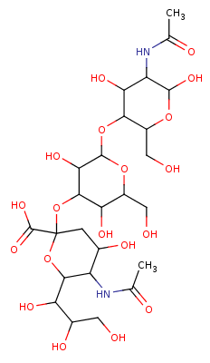
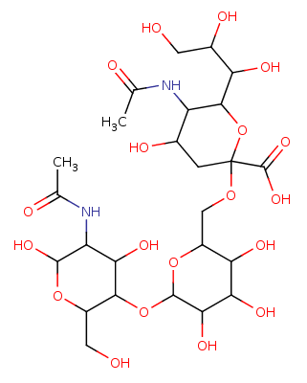
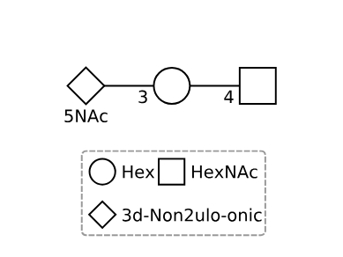

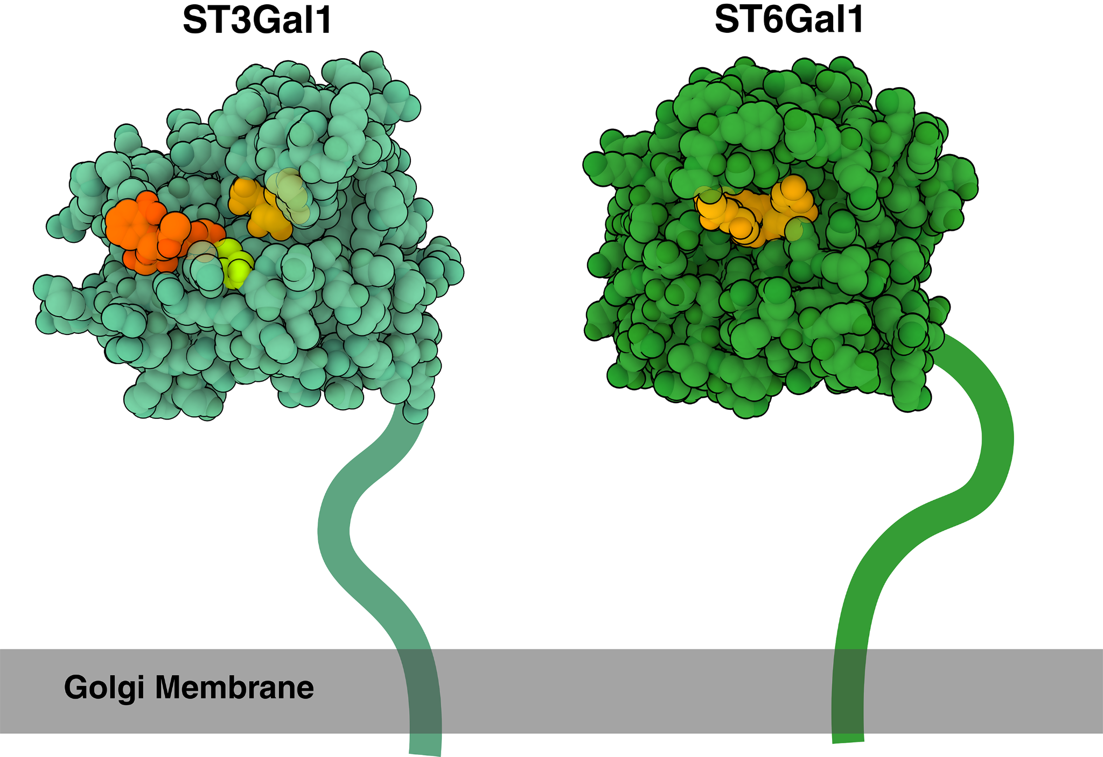
Sweetly Specific
Glycan Entry:
Hemagglutinin recognizes and attaches to sialic acid molecules on the cell surface.
Sialic acids are a family of nine-carbon sugar molecules that are commonly found at the tips of glycans, or sugar chains, that are attached to proteins and lipids on the cell surface.
Sialic Acid Linkage to Glycans:
The two common linkage types: α-2,3 and α-2,6.
Avian influenza viruses, such as H5N1 or H7N9, are adapted to bind to α-2,3-linked sialic acid receptors.
Predominantly found in the respiratory and gastrointestinal tracts of birds.
Human influenza viruses, such as H1N1, are adapted to bind to α-2,6-linked sialic acid receptors.
Human cells in the upper respiratory tract (nose, throat, and trachea) have α-2,6-linked sialic acid receptors.
2,3
2,6
Sialyltransferases with Sialic acid
Source: https://pdb101.rcsb.org/motm/302

Slide 5
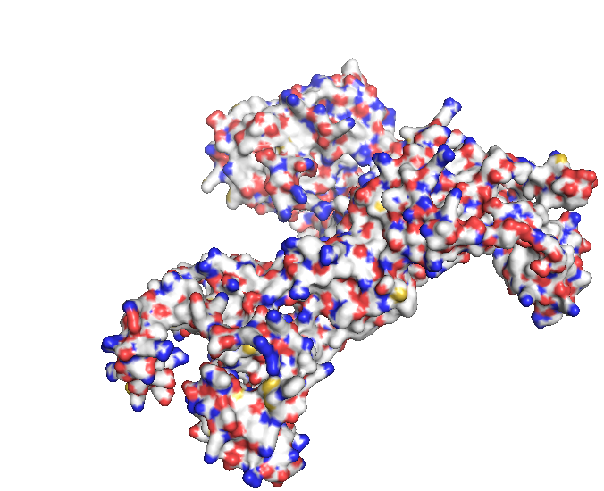
Effectively Immune
Replication:
The Polymerase Basic 2 (PB2) protein is a crucial component of the influenza virus's RNA-dependent RNA polymerase (RdRp) complex.
The RdRp complex, composed of PA, PB1, and PB2, is essential for both viral RNA replication and transcription within the host cell.
Immune Suppression:
Recent viral lineages of H5N1 (clade 2.3.4.4b) have evolved to strengthen PB2's binding to key mammalian and avian immune proteins.
Once bound, these host immune proteins, such as the Mitochondrial Antiviral Signaling (MAVS), are disabled, thereby dampening the host's innate defenses.
Source: https://doi.org/10.1128/jvi.00879-10
Notes:
PB2 plays a key role in cap-snatching, a mechanism where the virus cleaves the 5' cap from host mRNAs to prime its own transcription, effectively hijacking the host's translational machinery. This process is vital for efficient viral gene expression.
Beyond its role in replication, PB2 also contributes significantly to the influenza virus's ability to evade the host's innate immune system.
This suppression of the immune response allows for more efficient replication of H5N1 in both mammalian and avian cells, contributing to the virus's increased virulence and expanded host range. Mutations in PB2 have adapted the viral lineage to enhance this immune evasion capability.

Slide 6
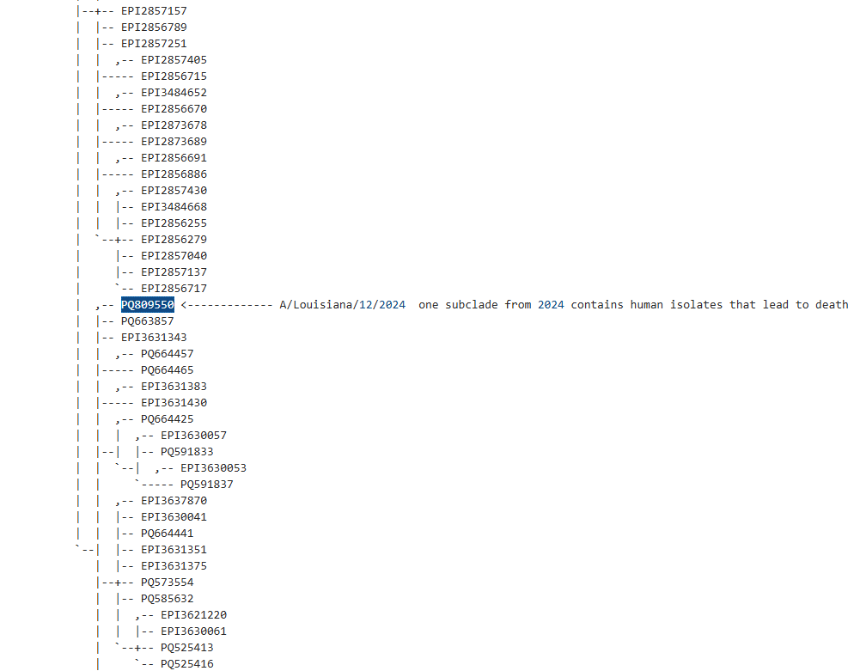
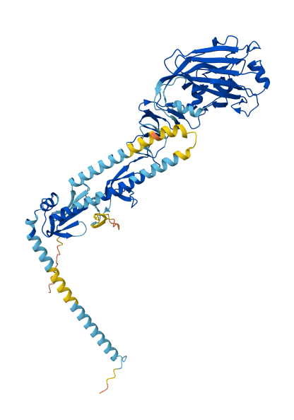
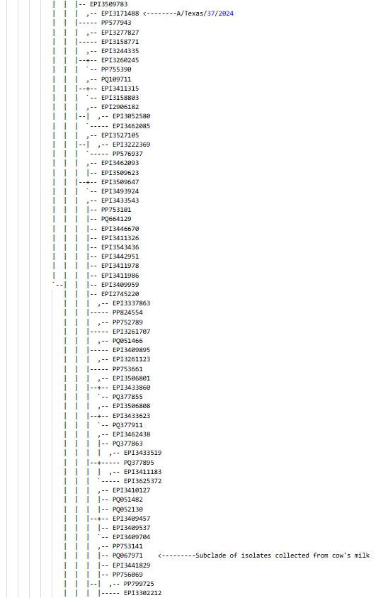
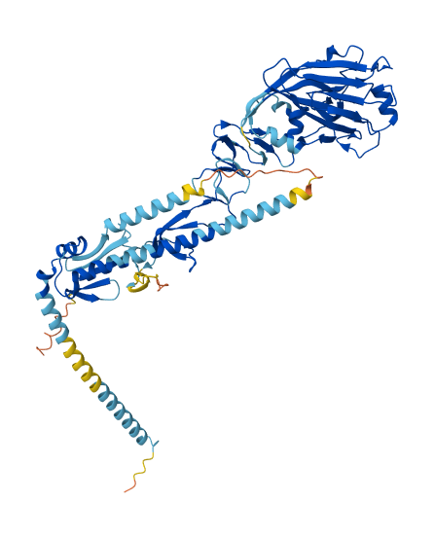
Notes:
At the Willi Hennig Society, we all appreciate the power of phylogenetic systematics. For structural biologists, understanding evolutionary relationships isn't just a matter of classification; it's fundamental to interpreting protein structure and function. Phylogeny allows us to distinguish between shared ancestry and convergent evolution, identify key conserved residues, predict functional shifts, and reconstruct ancestral states. The image here show how we can link the structural differences in the same protein to the phylogenetic connection between these various viruses. Critically for our study, we used phylogeny to identify two distinct subclades of H5N1 interest and to effectively sort our large datasets into manageable subsets of recent relevance, enabling focused structural and functional analyses. This targeted approach, guided by robust phylogenetic inference, is crucial for understanding how proteins adapt and diversify over evolutionary time, ultimately impacting their three-dimensional architecture and biochemical roles, especially in the context of viral host shifts and immune evasion.

Slide 7
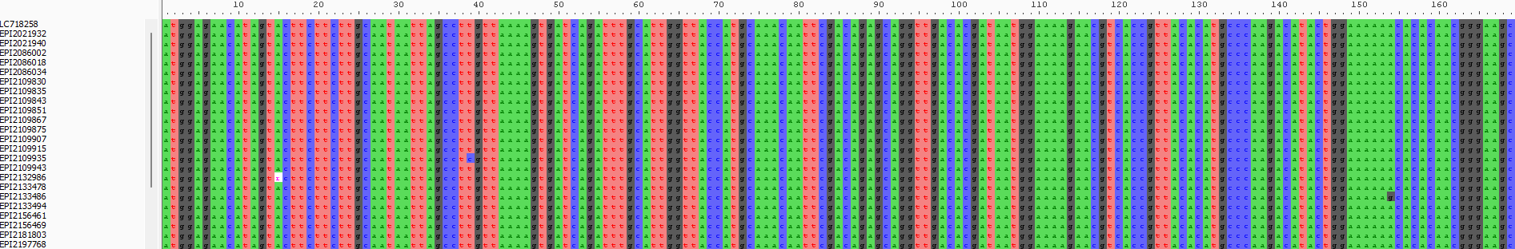
Data Collection - Homolog Identification & Alignment
Data collected from United States National Institutes of Health’s Genbank (NIH; ncbi.nih.nlm.gov) and The Global Initiative to Share all Avian Influenza Data (GISAID; gisaid.org).
HA - 9,359 nucleotide sequences
PB2 - 3,415 nucleotide sequences
Notes:
Our analytical bioinformatics and genomics workflow began with comprehensive data collection. We updated a large dataset of 18,289 Hemagglutinin (HA) sequences and aligned a dataset of Polymerase Basic 2 (PB2) nucleotide sequences of H5N1 influenza. These sequences were collected from Genbank and GISAID, specifically focusing on clade 2.3.4.4b and relevant background data. We then performed multiple sequence alignment using MAFFT. Crucially, during this step, we trimmed ragged edges, padded gaps, and eliminated sequences that broke the reading frame, ensuring high-quality alignments for both HA and PB2. This careful alignment laid the groundwork for robust phylogenetic inference.

Slide 8
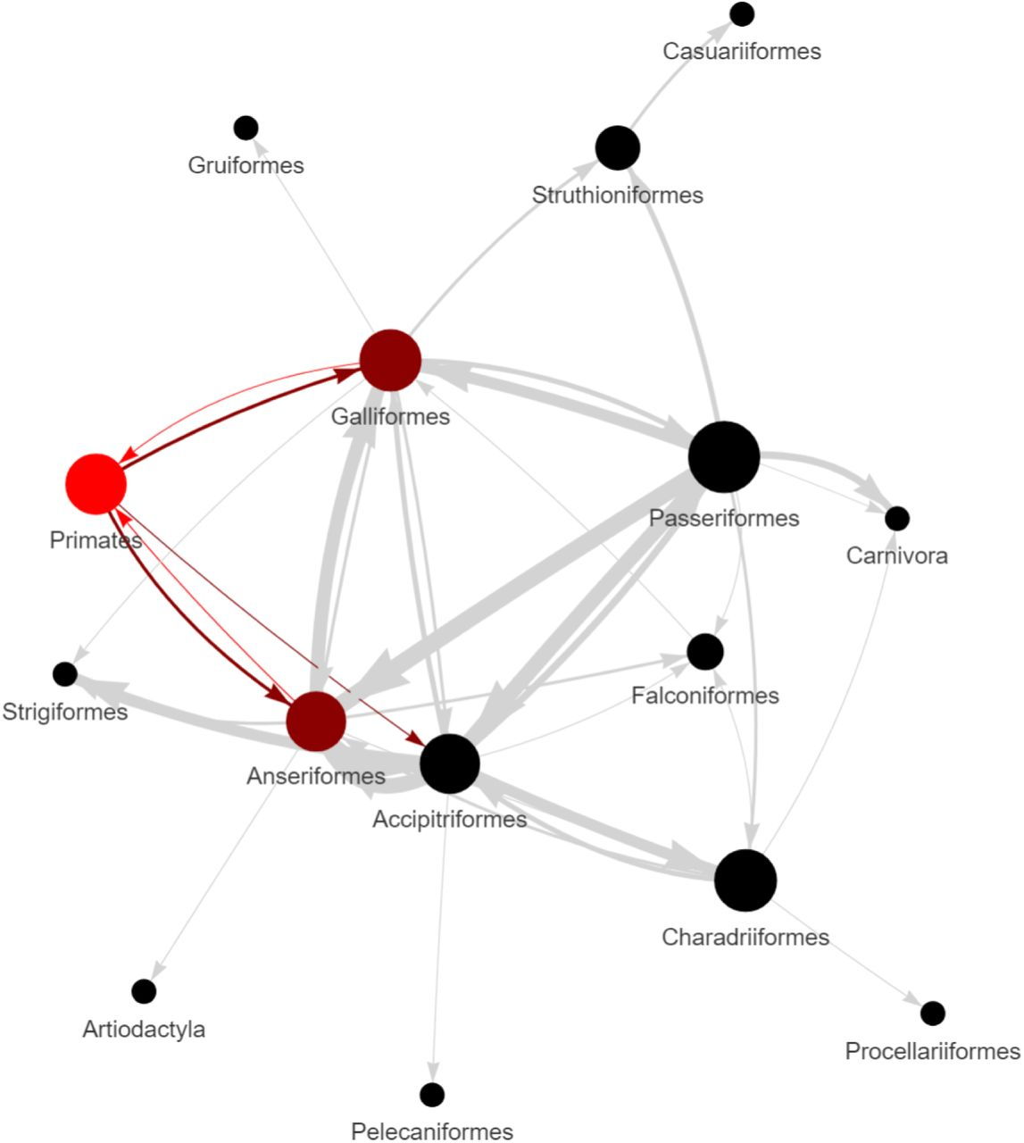
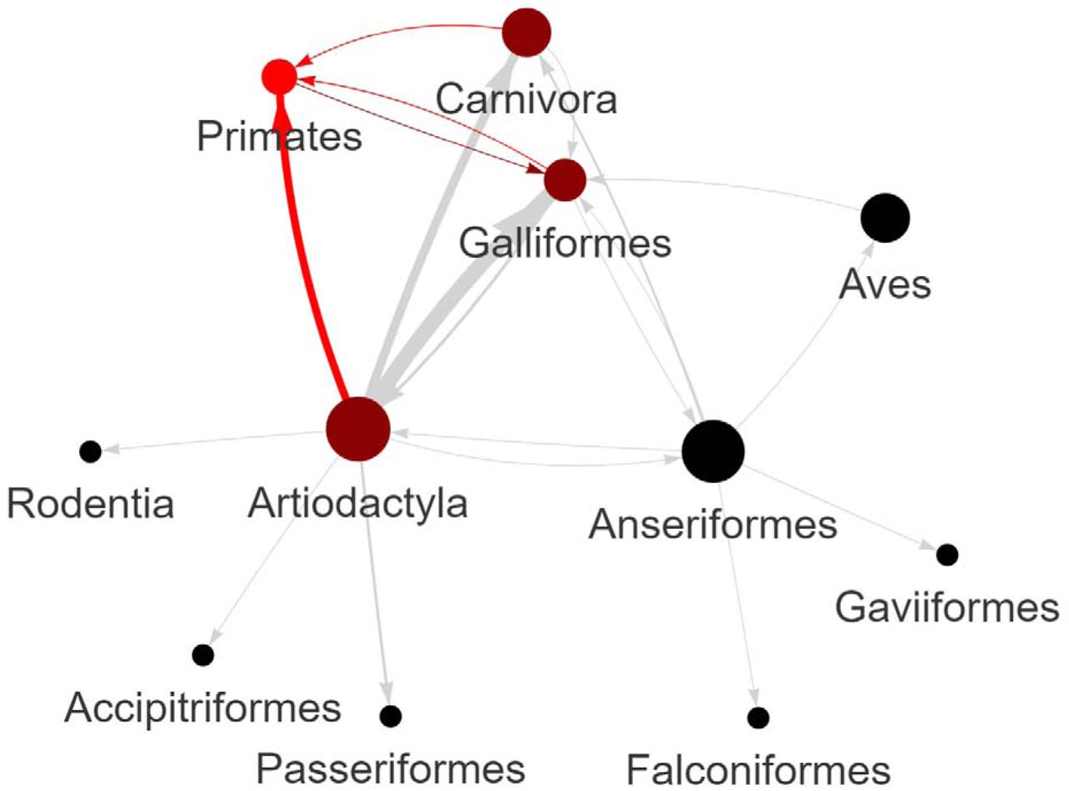
Phylogenetic Inference
A/Louisiana/12/2024 clade
Human-Bovine-Avian Transmission clade
Notes:
With our aligned sequences, the next critical step was phylogenetic inference. For tree searches on our large HA and PB2 datasets, we used TNT (Version 1.6) with equal weighting for edit costs. We used GISAID sequence EPI100512 as an outgroup for HA, and GISAID sequence GU052525 as an outgroup for PB2. To understand character evolution, we mapped host and date of isolation characters onto the tree using Mesquite. For subclade analyses, such as the HA isolates related to the human death in Louisiana or human-bovine-avian transmission events, trees were calculated using RAXML (version 8.2.12). This rigorous approach allowed us to infer highly supported phylogenetic trees, revealing the evolutionary relationships of our homologs and isolating clades of interest for human and farm animal infection.

Slide 9
Natural Selection Analyses Using HyPhy (M8 model)
Protein | Clade | Amino Acid Site | Probability (DN/DS > 1) | Mutation(s)
HA | surrounding deceased patient infected with H5N1 in Louisiana | 230 | 0.9685961144425779 | A230V
HA | human-bovine-avian | 147 | 0.9988807760818452 | V147M*
PB2 | current H5N1 lineages | 292 | 0.9922498777048648 | I292L/V/T/M
PB2 | current H5N1 lineages | 344 | 0.9999928310390789 | V344M/A/I
PB2 | current H5N1 lineages | 627 | 0.9999895456621494 | E627K/V*
Notes:
Beyond simply inferring relationships, we assessed adaptation using computational analyses of natural selection of the nucleotide diversity of HA and PB2 genes. All subclade datasets were cleaned using MACSE (V2). To assess natural selection, we employed HyPhy (version 2.5.67) and the Nielsen and Yang (NY) approach for detecting positive selection, which estimates the dN/dS ratio at each codon. We rigorously tested several models, including M0, M1, M2, M3, M7, M8 (Beta & ω), and M12, to evaluate both purifying and episodic positive selection. This allowed us to identify specific amino acid sites under significant selective pressure, such as N140D/H, A230V, V298I/L, D490N, and E509G in HA, and V11I, V147M, A172T, K250E/N/R, and I526V in another HA subclade.

Slide 10
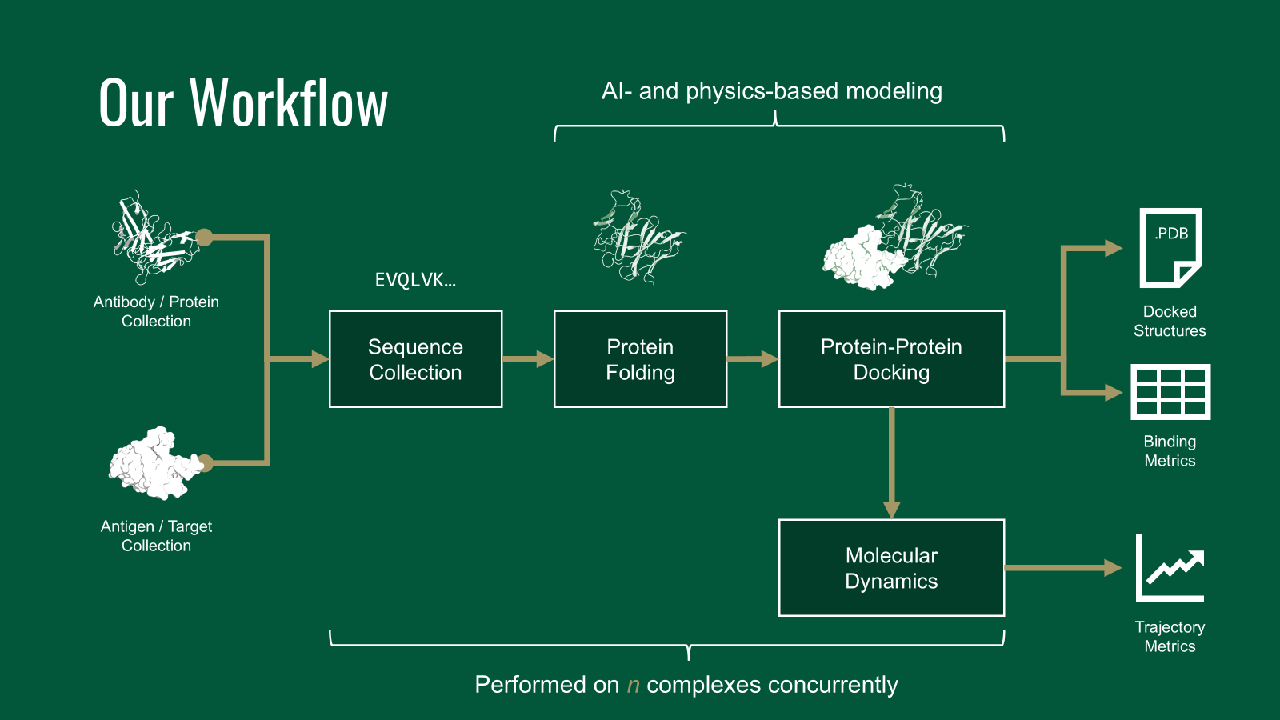
Linking Phylogeny to Structural Diversity
Notes:
Now, let's bridge the gap between evolutionary history and structural biology. Our phylogenetic analyses revealed that H5N1 (clade 2.3.4.4b) is spreading in North America as two distinct subclades of interest. One subclade, Genotype D1.1, contains the human isolate that led to death in Louisiana, with its ancestry traced to Galliformes and a sister relationship to an Accipitriformes isolate. Another subclade, Genotype B3.13, is distinct and contains multiple human-bovine-avian transmission events, showing high-frequency unidirectional transmission from Artiodactyla to Primates. By mapping these phylogenetic patterns to structural information, we aimed to evaluate the binding affinity of HA from different strains to host receptor proteins, specifically human and avian sialic acid (SA) glycans. HA mutations have shifted the virus from adaptation to avian cells to promiscuity in many species of wild and domestic mammals and birds.

Slide 11
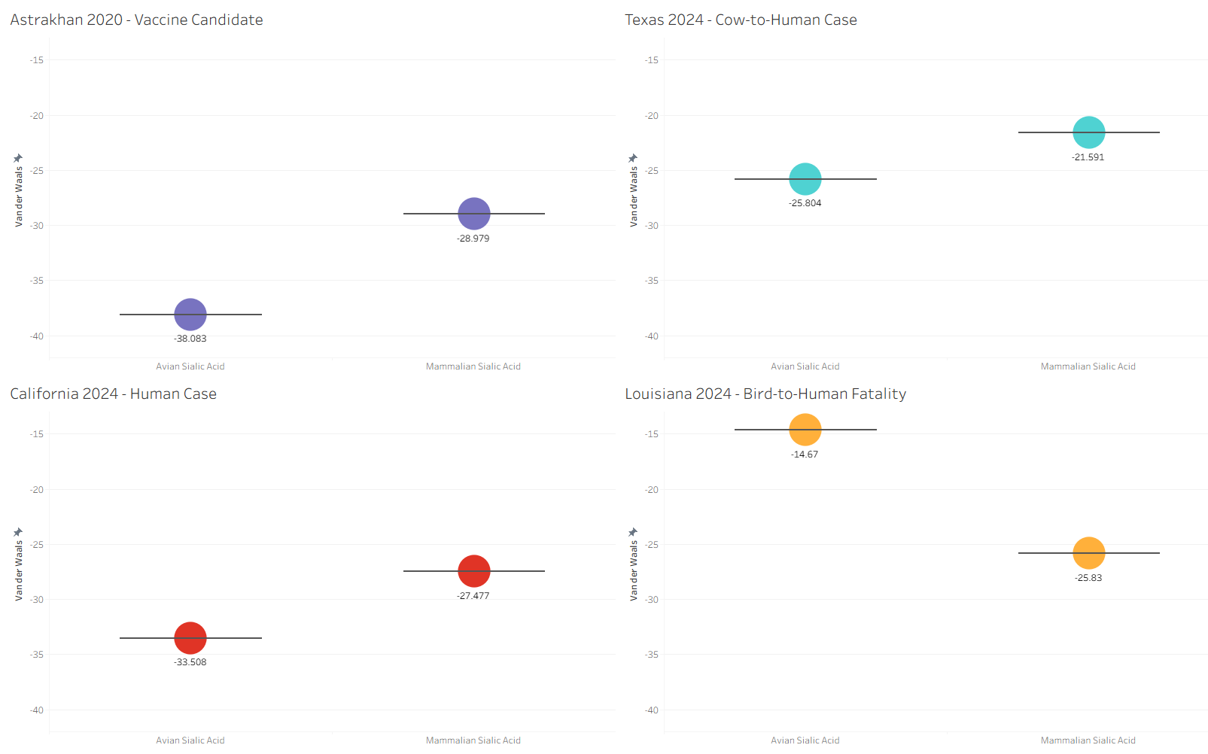
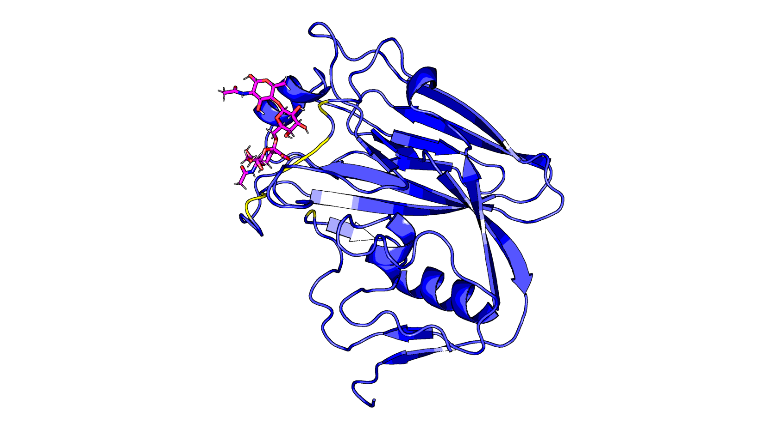
Structural Biology - HA Docking and Insights
4.213
9.104
11.16
Human Sialic Acid (in pink) docked against HA (EPI1846961, in blue)
6.031
Notes:
To understand the structural basis of HA's expanding host range, we manually extracted amino acid sequences of four HA sequences of interest based on our phylogenetic analyses, including a vaccine candidate. These sequences were folded into three-dimensional structures using ColabFold. We then performed protein-glycan docking simulations using HADDOCK3 (v2024.12.0b7), evaluating binding interactions against both human and avian SA glycans obtained from PDB structures 4K63 and 4KDO respectively. These simulations provided insights into potential differences in HA-SA binding affinities among strains, correlating structural changes with observed host shifts and promiscuity driven by HA mutations. Accession EPI184961 is strain A/Astrakhan/3212/2020, which is used as a Vaccine Candidate.

Slide 12
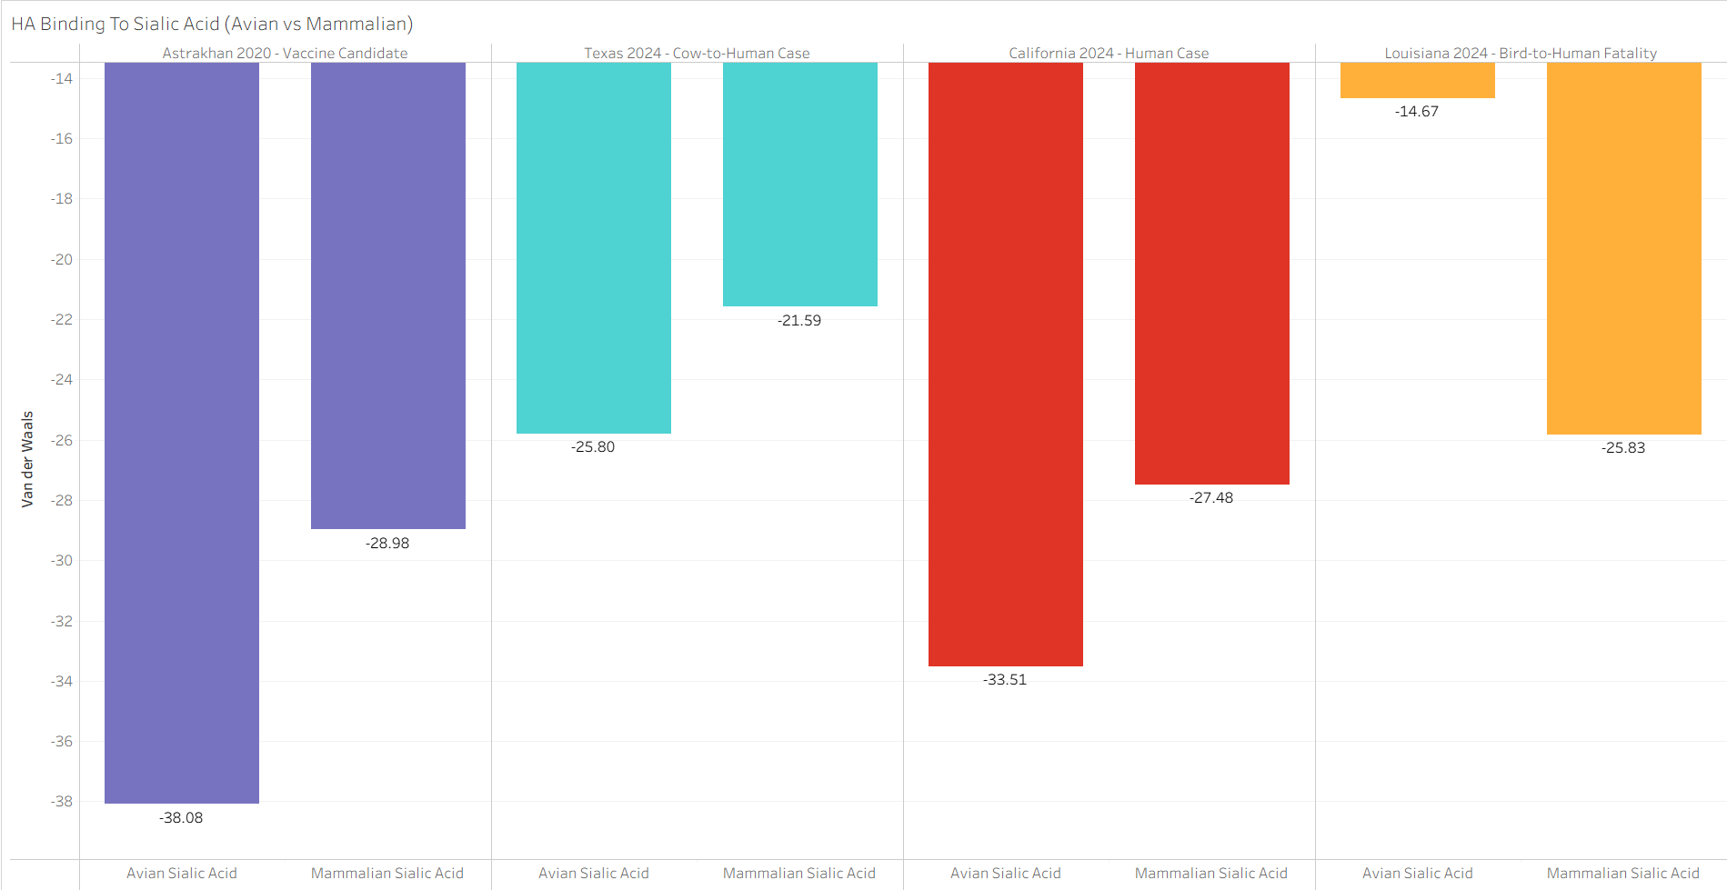
Structural Biology - HA Docking and Insights
11.16
4.213
6.031
9.104
Human Sialic Acid (in pink) docked against HA (EPI1846961, in blue)
Notes:
To understand the structural basis of HA's expanding host range, we manually extracted amino acid sequences of four HA sequences of interest based on our phylogenetic analyses, including a vaccine candidate. These sequences were folded into three-dimensional structures using ColabFold. We then performed protein-glycan docking simulations using HADDOCK3 (v2024.12.0b7), evaluating binding interactions against both human and avian SA glycans obtained from PDB structures 4K63 and 4KDO respectively. These simulations provided insights into potential differences in HA-SA binding affinities among strains, correlating structural changes with observed host shifts and promiscuity driven by HA mutations. Accession EPI184961 is strain A/Astrakhan/3212/2020, which is used as a Vaccine Candidate.

Slide 13
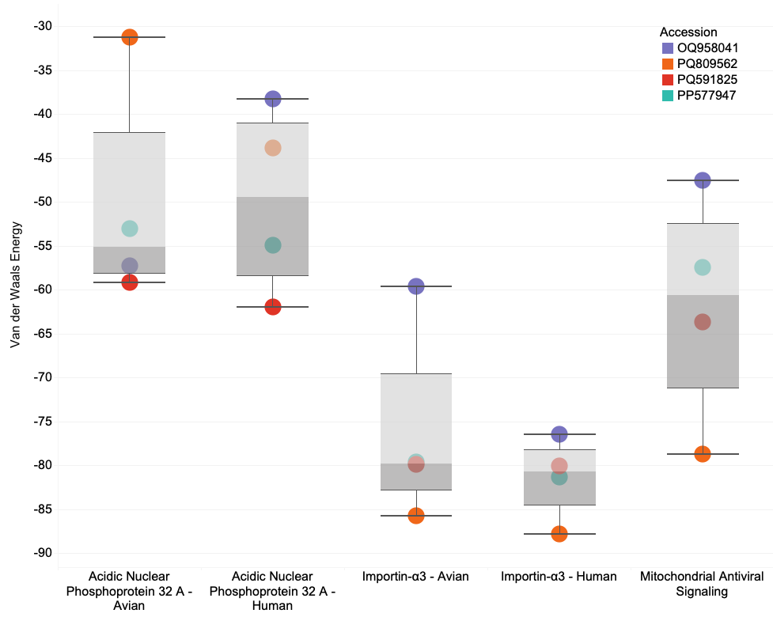
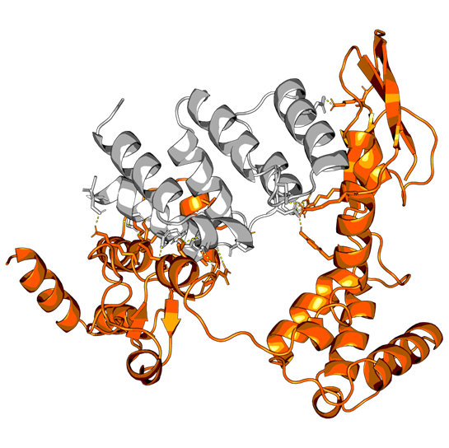

Structural Biology - PB2 and Immune Evasion
Notes:
Our primary objective for PB2 was to evaluate its binding affinity to host immune factors, gaining insights into potential changes in immune evasion and replication mechanisms. Similar structural and docking analyses were performed for PB2 using sequences from viral strains of interest, including a vaccine candidate and proteins carrying mutations at PB2 protein position 588 (A588T, A588S, A588V). We selected known host immune response proteins that interact with viral PB2, such as Human mitochondrial antiviral-signaling protein (MAVS; PDB: 2MS8), human and avian Importin-α3 orthologs (PDB: 4UAE), and Human acidic leucine-rich nuclear phosphoprotein 32 family member A (ANP32A; PDB: 6XZQ), as targets for our docking studies. PB2 sequences were folded with ColabFold, and protein-protein docking simulations were conducted using HADDOCK3. Our analyses of natural selection in PB2 show that mutations have adapted the H5N1 viral lineage to increase their ability to bind these crucial host proteins, thus dampening the hosts' innate defenses and setting the stage for increased viral replication. Accession ID PQ809562 is strain A/Louisiana/12/2024, the louisiana case of the farm worker death.

Slide 14
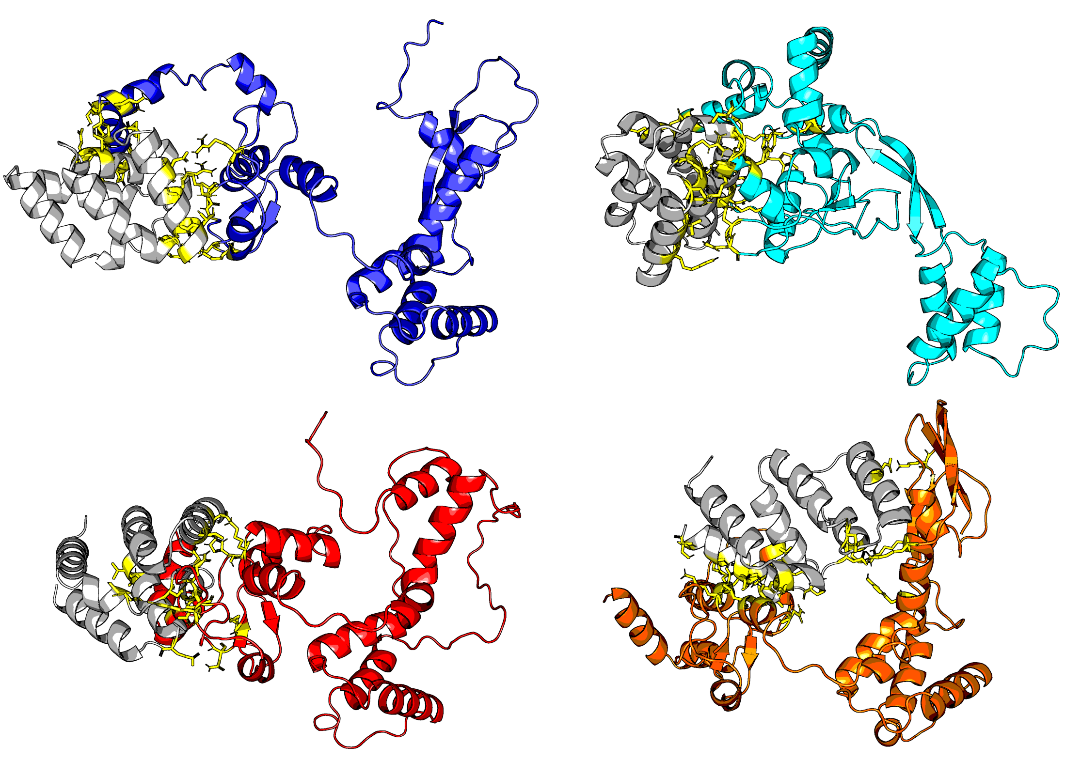
H5N1 PB2 Protein - Highjacking the Host Cell’s Innate Immune Defense
MAVS (in grey)
docked against PB2
Astrakhan 2020
Vaccine Candidate
Texas 2024
Cow-to-Human Case
California 2024
Human Case
Louisiana 2024
Bird-to-Human Fatality
Notes:
Our primary objective for PB2 was to evaluate its binding affinity to host immune factors, gaining insights into potential changes in immune evasion and replication mechanisms. Similar structural and docking analyses were performed for PB2 using sequences from viral strains of interest, including a vaccine candidate and proteins carrying mutations at PB2 protein position 588 (A588T, A588S, A588V). We selected known host immune response proteins that interact with viral PB2, such as Human mitochondrial antiviral-signaling protein (MAVS; PDB: 2MS8), human and avian Importin-α3 orthologs (PDB: 4UAE), and Human acidic leucine-rich nuclear phosphoprotein 32 family member A (ANP32A; PDB: 6XZQ), as targets for our docking studies. PB2 sequences were folded with ColabFold, and protein-protein docking simulations were conducted using HADDOCK3. Our analyses of natural selection in PB2 show that mutations have adapted the H5N1 viral lineage to increase their ability to bind these crucial host proteins, thus dampening the hosts' innate defenses and setting the stage for increased viral replication. Accession ID PQ809562 is strain A/Louisiana/12/2024, the louisiana case of the farm worker death.

Slide 15
Key Findings and Broader Impact
HA mutations contribute to the virus’ shift from avian adaptation to promiscuity across various mammalian and avian hosts.
PB2 mutations enhance the virus' ability to bind hosts’ innate immune proteins and thus increase replication.
H5N1's rapid spread and adaptation across hundreds of species.
Notes:
Our workflow, integrating phylogenetics, natural selection analyses, and computational structural biology, has revealed critical insights into H5N1 clade 2.3.4.4b. We showed that HA mutations contribute to the virus's shift from avian adaptation to promiscuity across various mammalian and avian hosts. Furthermore, PB2 mutations enhance the virus's ability to bind host immune proteins, dampening innate defenses and promoting viral replication. This comprehensive approach not only illuminates the mechanisms behind H5N1's rapid spread and adaptation but also provides a powerful paradigm for understanding protein evolution and function. Our findings have significant implications for disease surveillance, vaccine development, and informing public health strategies.

Slide 16
Conclusion
A phylogenetic framework for H5N1 clade 2.3.4.4b, identifying distinct subclades with significant host shift events.
Specific mutations in HA and PB2 under positive selection that correlate with enhanced host range and adaptation.
Computational structural analyses elucidate the molecular mechanisms by which HA increases host receptor binding promiscuity and PB2 strengthens binding to host innate immune proteins, thus lowering the innate immune response.
Notes:
In conclusion, our study demonstrates:
A robust phylogenetic framework for H5N1 clade 2.3.4.4b, identifying distinct subclades with significant host shift events.
Specific mutations in HA and PB2 under positive selection that correlate with enhanced host range and immune evasion.
Computational structural analyses elucidate the molecular mechanisms by which HA increases host receptor binding promiscuity and PB2 strengthens binding to host immune proteins, promoting viral replication.
I'd like to express my sincere gratitude to my co-authors Daniel Janies, Kary Ocaña, Sayal Guirales-Medrano, Khaled Obeid, and Rachel Alexander. I also acknowledge the Center for Computational Intelligence to Predict Health and Environmental Risks (CIPHER) at UNC Charlotte, the National Laboratory of Scientific Computing, and Tuple LLC, and all collaborators and funding agencies for their invaluable contributions and support. Thank you, and I'm happy to take any questions.

Slide 17
Acknowledgements
Thank you to the organizers of the 42nd Willi Hennig Society Annual Symposium.
We gratefully acknowledge all GISAID data contributors (i.e., the authors and their originating laboratories) responsible for obtaining the specimens, and their submitting laboratories for generating the genetic sequence and metadata and sharing via the GISAID Initiative, on which this research is based.
We acknowledge the following entities at the University of North Carolina at Charlotte: Academic Affairs, The Office of Research (Ignite Award), The Center for Computational Intelligence to Predict Health and Environmental Risks (CIPHER), The Department of Bioinformatics and Genomics, The College of Computing and Informatics, and the University Research Computing group. We gratefully acknowledge the support of the Belk Family and the Levine Scholars program.

Slide 18
References
Janies, D., Ocaña, K., Guirales-Medrano, S., Obeid, K., Alexander, R., & Ford, C. T. (2025). Analyses of phylogenetics, natural selection, and protein structure of clade 2.3.4.4b H5N1 Influenza A reveal that recent viral lineages have evolved promiscuity in host range and improved replication in mammals in North America (p. 2025.03.15.641219). bioRxiv. https://doi.org/10.1101/2025.03.15.641219
Graef, K. M., Vreede, F. T., Lau, Y.-F., McCall, A. W., Carr, S. M., Subbarao, K., & Fodor, E. (2010). The PB2 Subunit of the Influenza Virus RNA Polymerase Affects Virulence by Interacting with the Mitochondrial Antiviral Signaling Protein and Inhibiting Expression of Beta Interferon. Journal of Virology, 84(17), 8433–8445. https://doi.org/10.1128/jvi.00879-10
Lupiani, B., & Reddy, S. M. (2009). The history of avian influenza. Comparative Immunology, Microbiology and Infectious Diseases, 32(4), 311–323. https://doi.org/10.1016/j.cimid.2008.01.004
Uyeki, T. M., Milton, S., Hamid, C. A., Webb, C. R., Presley, S. M., Shetty, V., Rollo, S. N., Martinez, D. L., Rai, S., Gonzales, E. R., Kniss, K. L., Jang, Y., Frederick, J. C., Cruz, J. A. D. L., Liddell, J., Di, H., Kirby, M. K., Barnes, J. R., & Davis, C. T. (2024). Highly Pathogenic Avian Influenza A(H5N1) Virus Infection in a Dairy Farm Worker. New England Journal of Medicine, 390(21), 2028–2029. https://doi.org/10.1056/NEJMc2405371

Slide 19
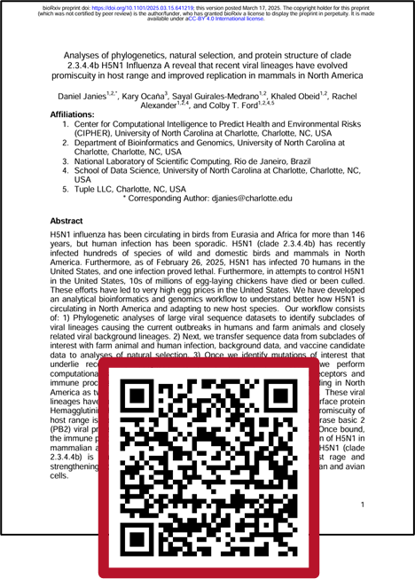
Questions?
Email: sguirale@charlotte.edu

