Slide 1
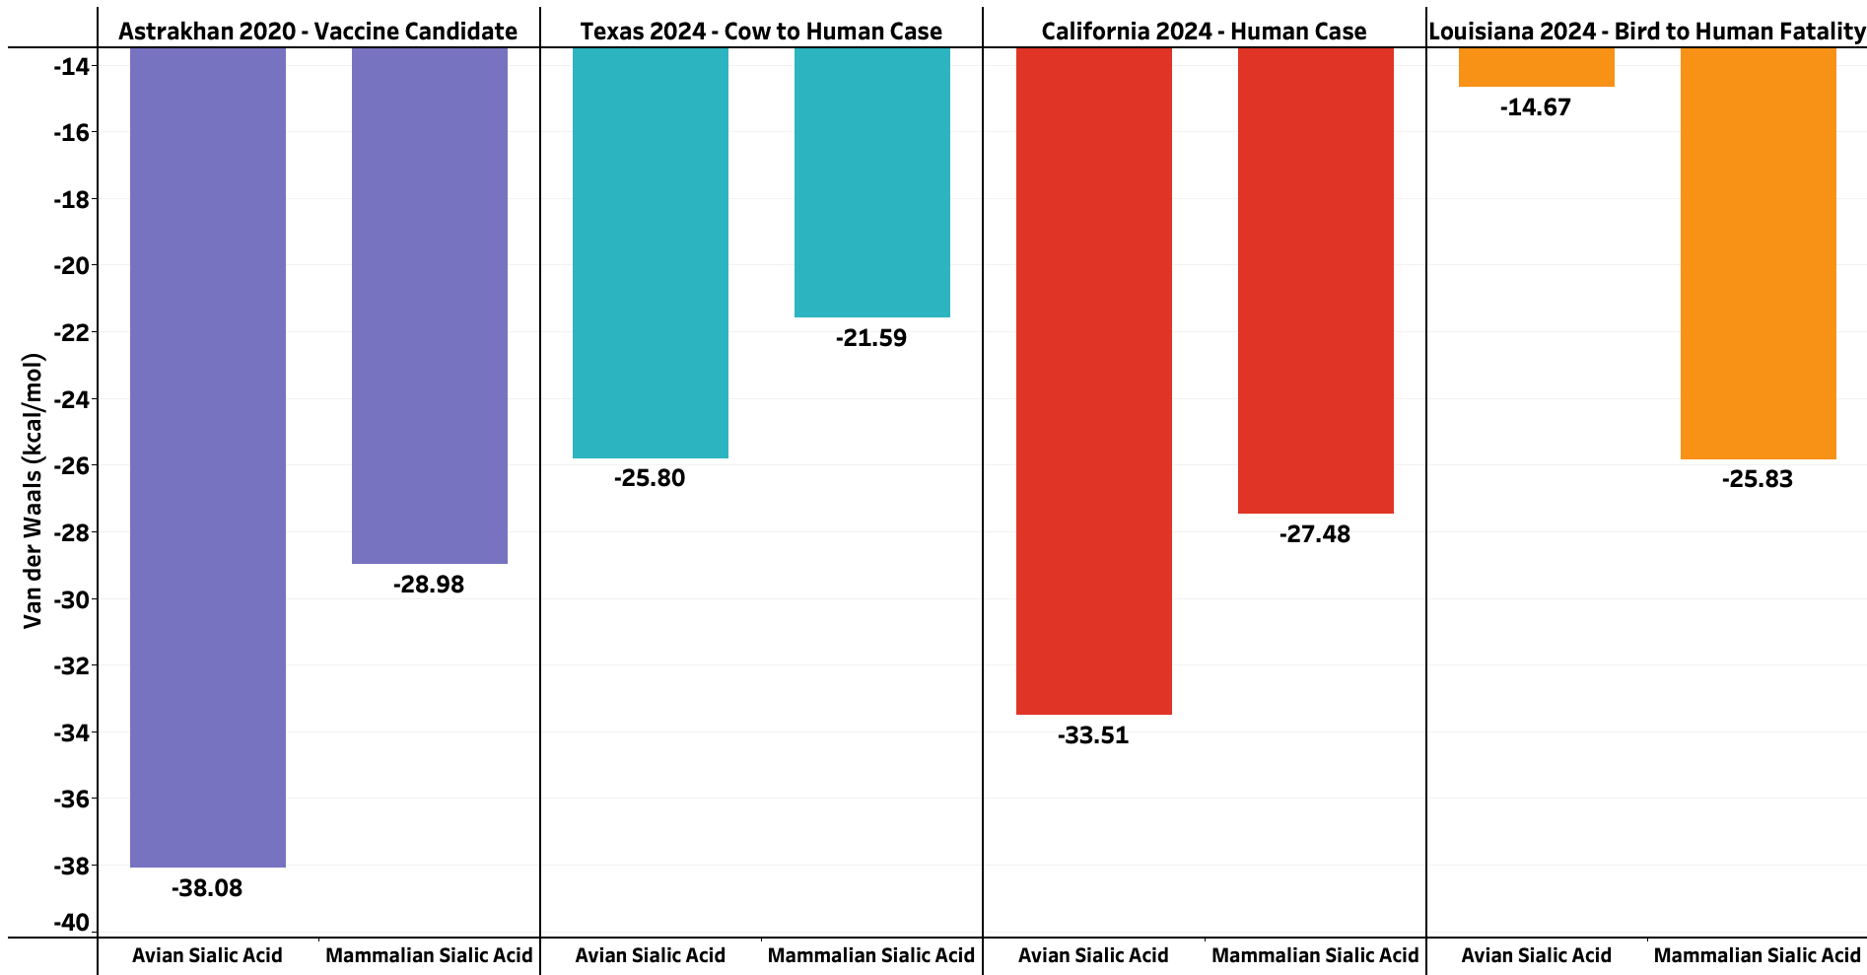
11.16
4.213
6.031
9.104

