Slide 1
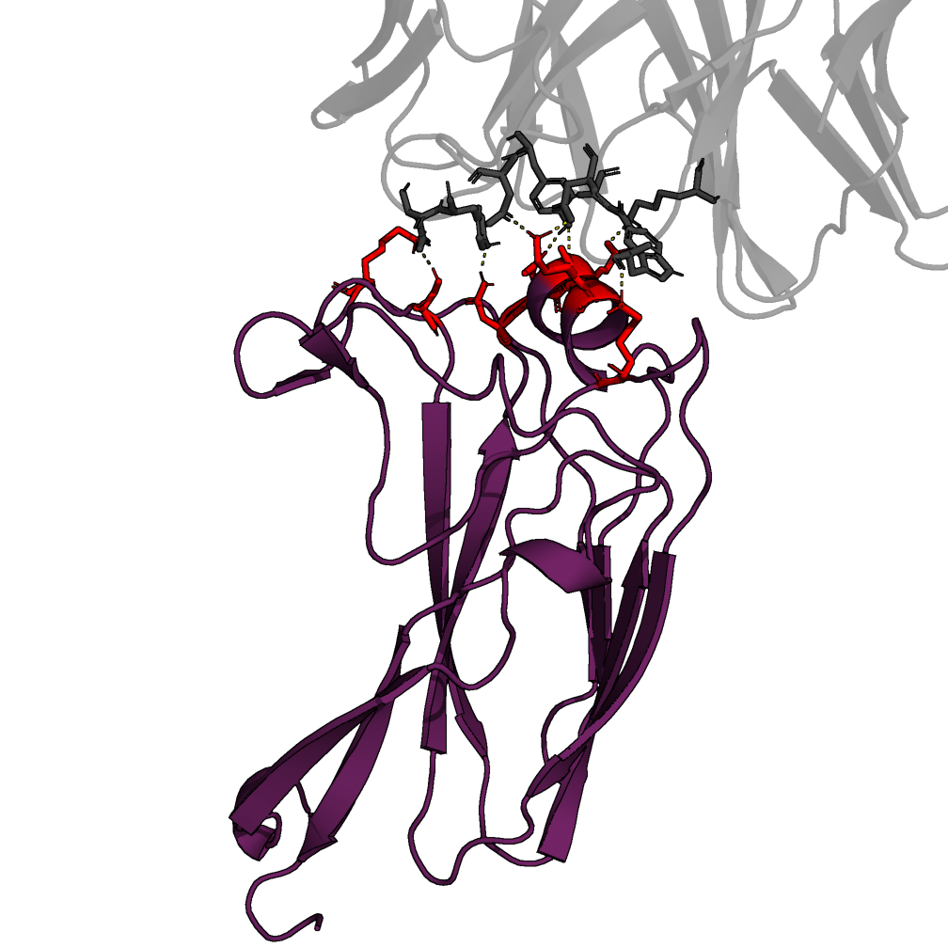
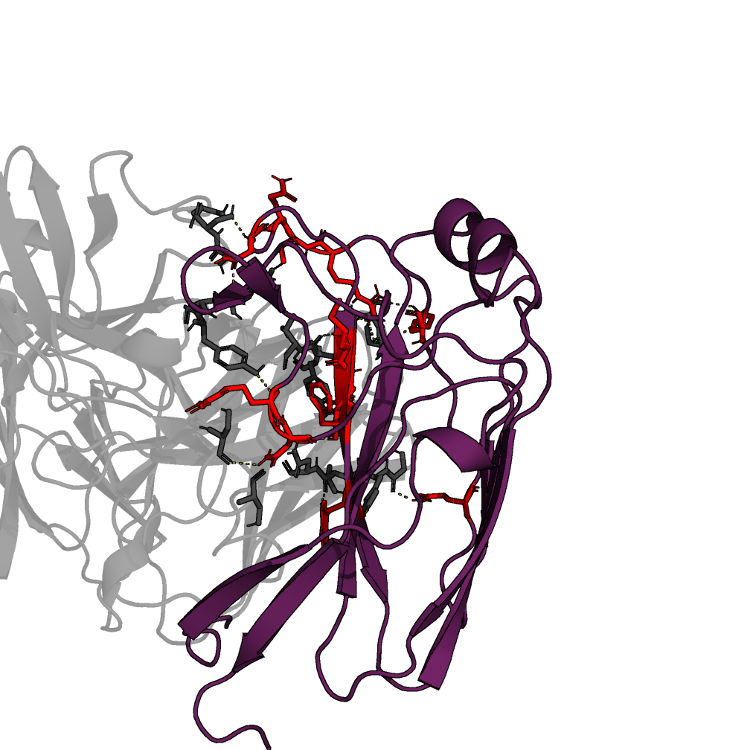
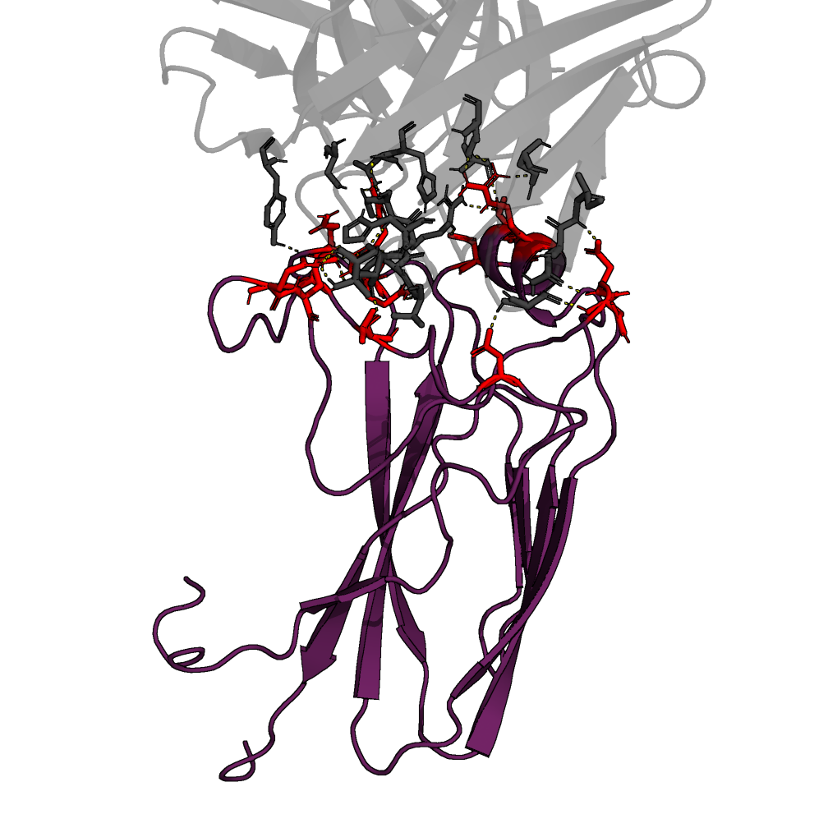
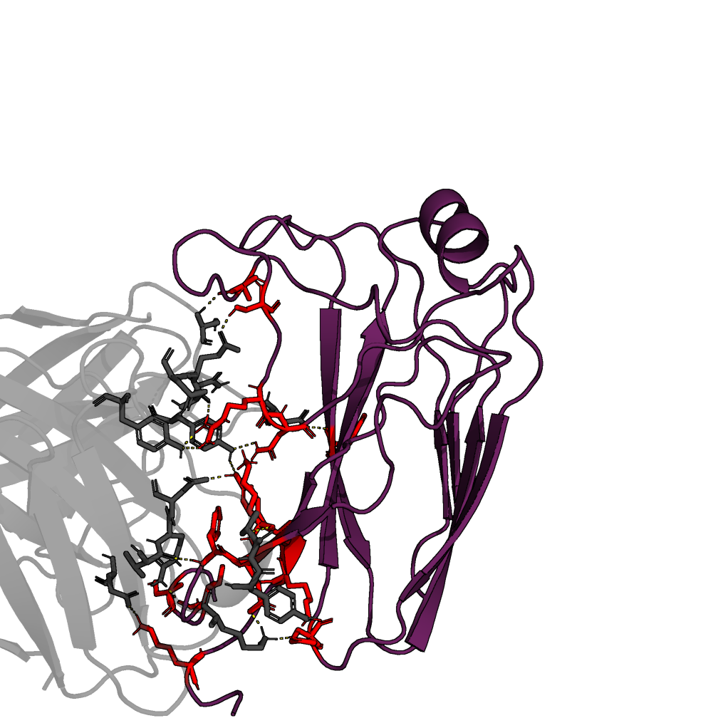
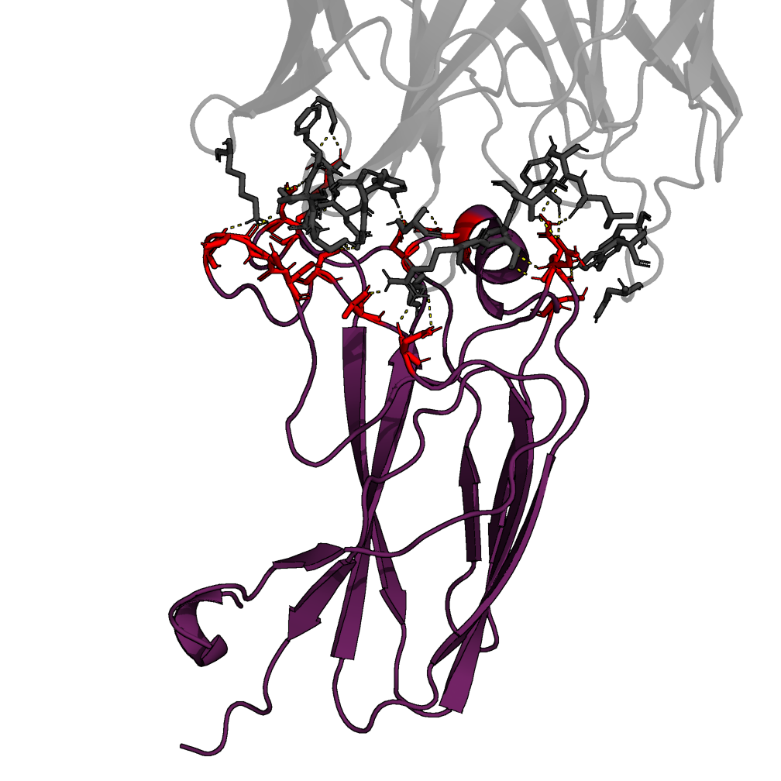
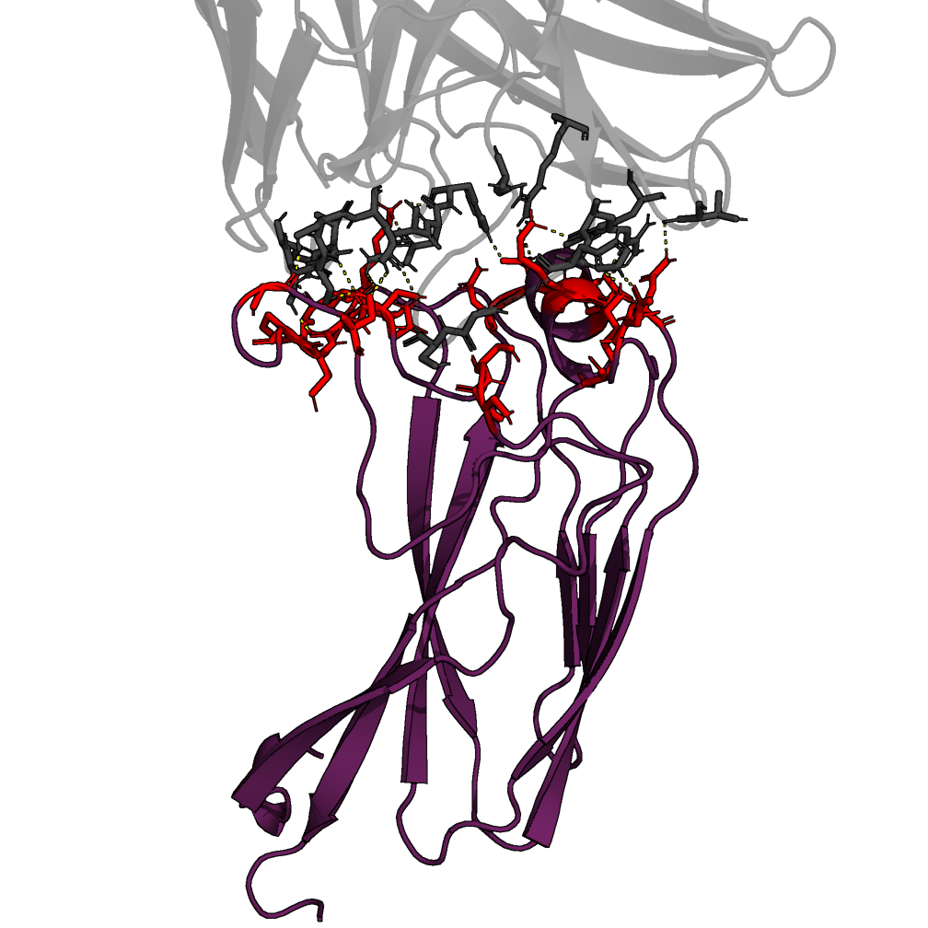
A
B
C
AVFluIgG01 ◄► EPI168674
100F4 ◄► EPI2429052
13D4 ◄► EPI3358339
K159, N189, D190, E191, A192, K196, K225, S230
R152, N153, Q214, K219, R223, S224,
Q225, N227, M233, D234, F235, W237
D133, V138, S140, E147, S148, N161, D162, D190, T192, R196, Q225, G228, Q229, R230
D
E
F
12H5 ◄► EPI658567
FLD194 ◄► EPI3178330
65C3 ◄► EPI242227
S113, I115, F118, E119, K120, A141, S149,
R152, N153, E177, F236, Y261, K262, K266
N133, T135, S137, G142, S143, S144, S145, N158, N159, D186, N190, S198, R222, D225
S135, S136, S140, A141, C142, P143, G146, S148, K159, D160, N161, N189, D190, A191, T195, K196, K225, N227, G228, Q229

