Slide 1
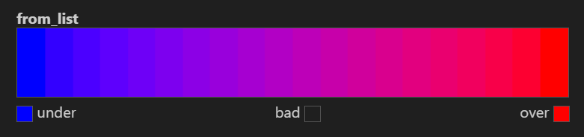
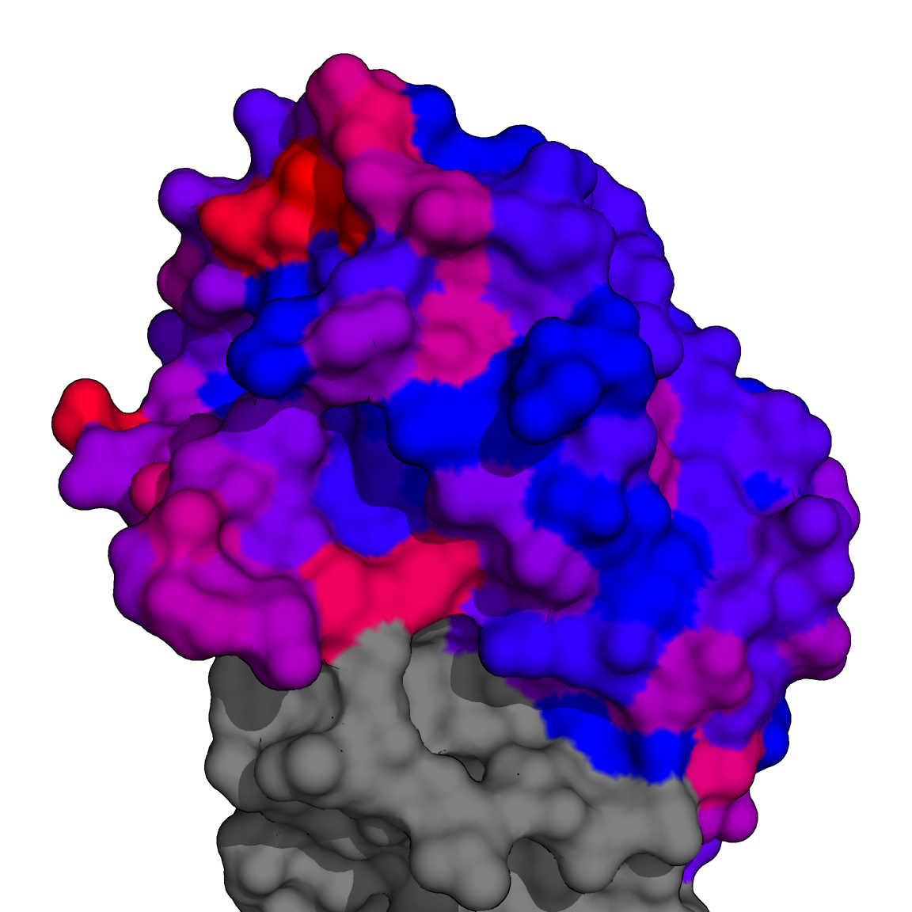
1RD8
S159
G158
K156
S193
H130
T132
K222
A137
A144
R149
S117
0% | Polar Contact Prevalence | 26%

Slide 2
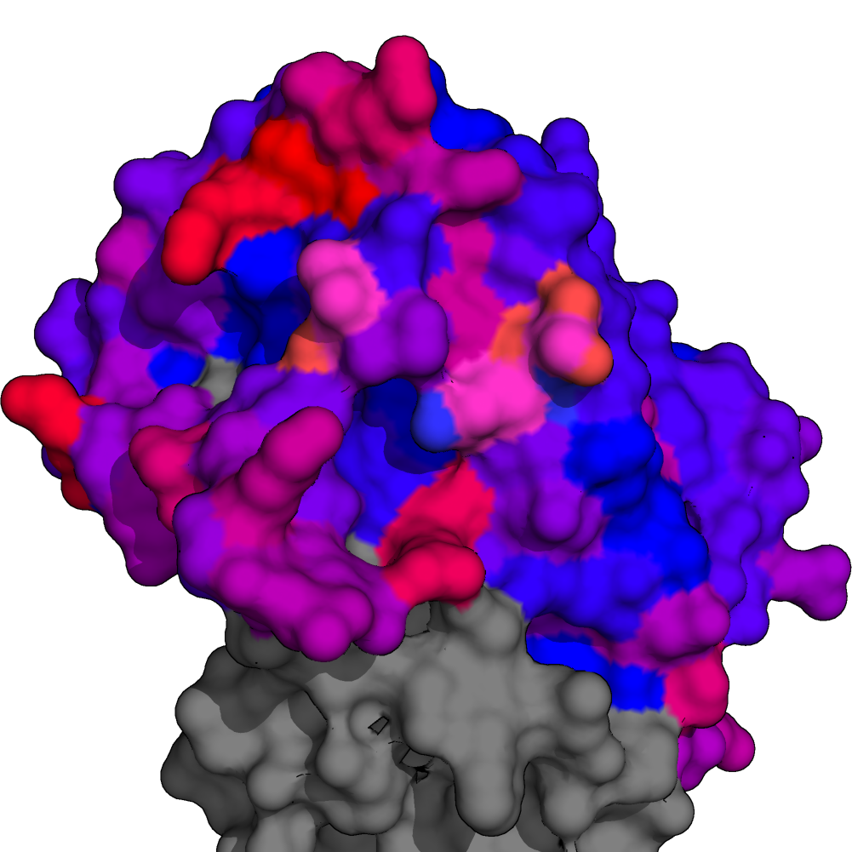
2FK0
S159
N158
K156
H130
K193
A132
K222
K144
S137
R149
H117
0% | Polar Contact Prevalence | 26%

Slide 3
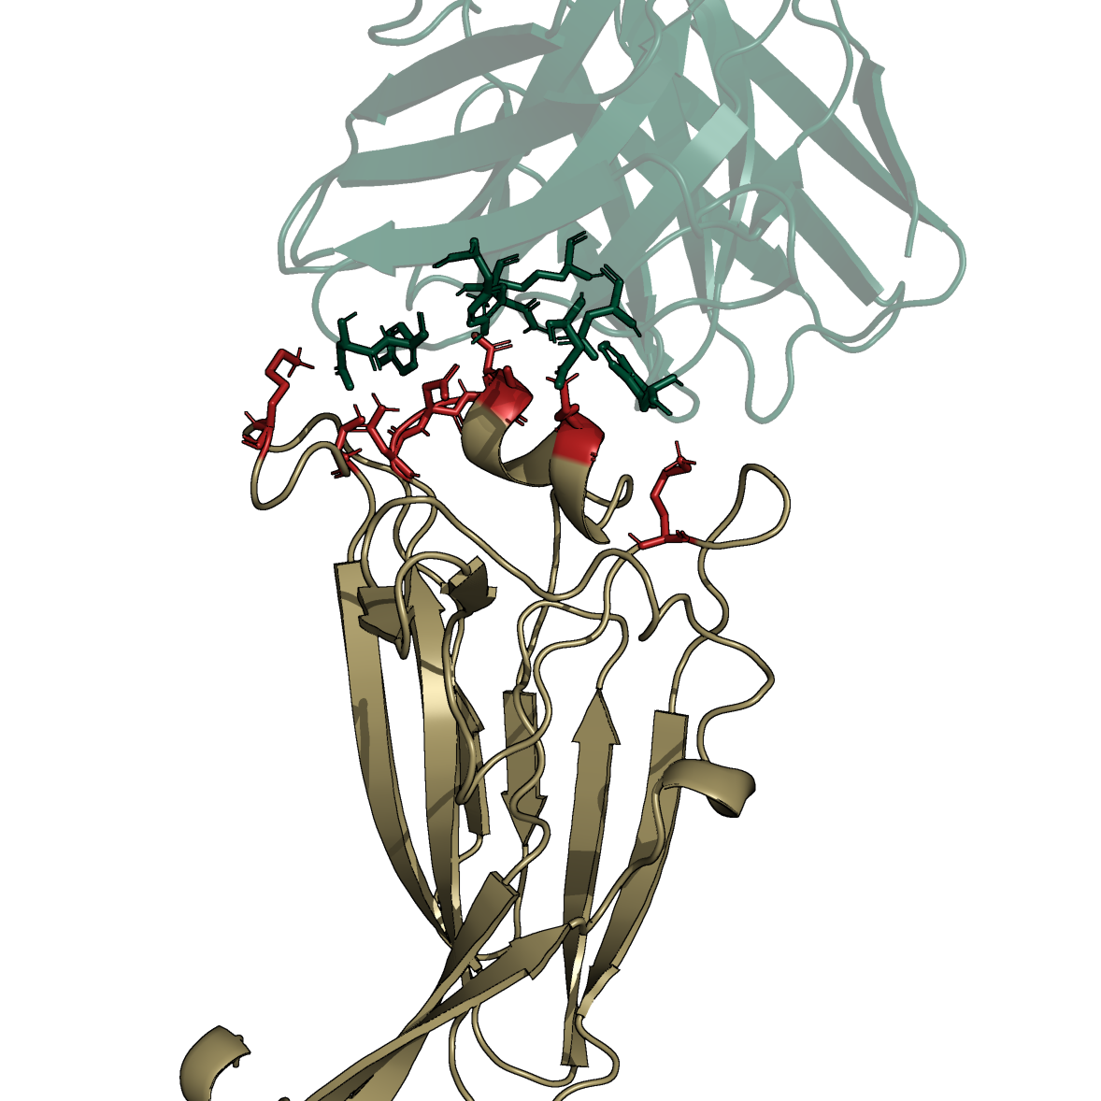
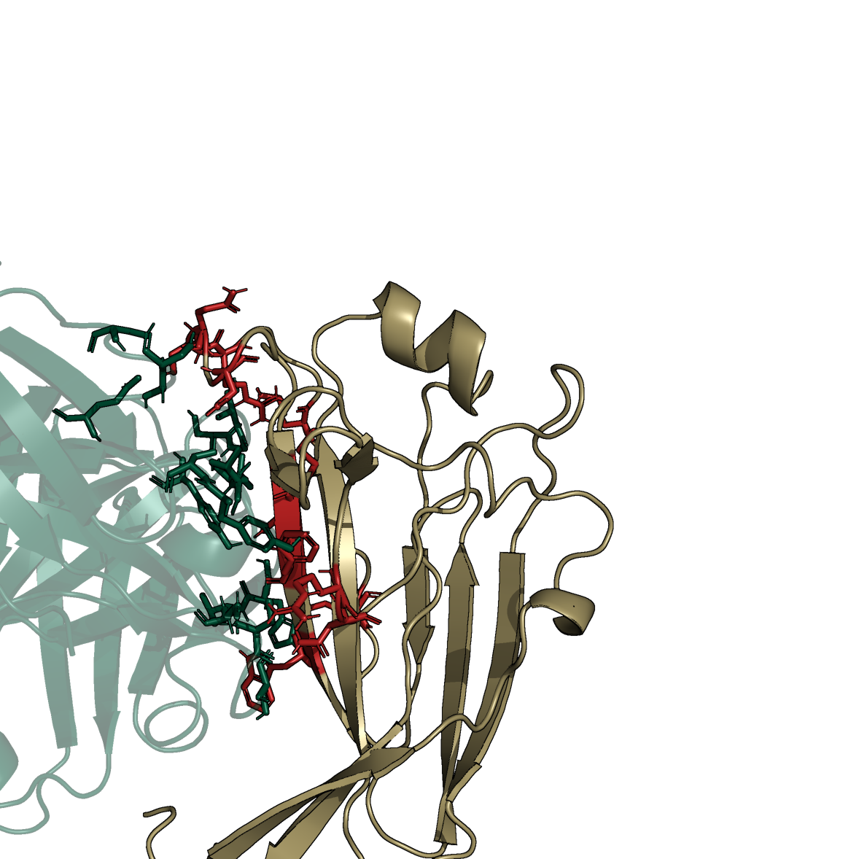
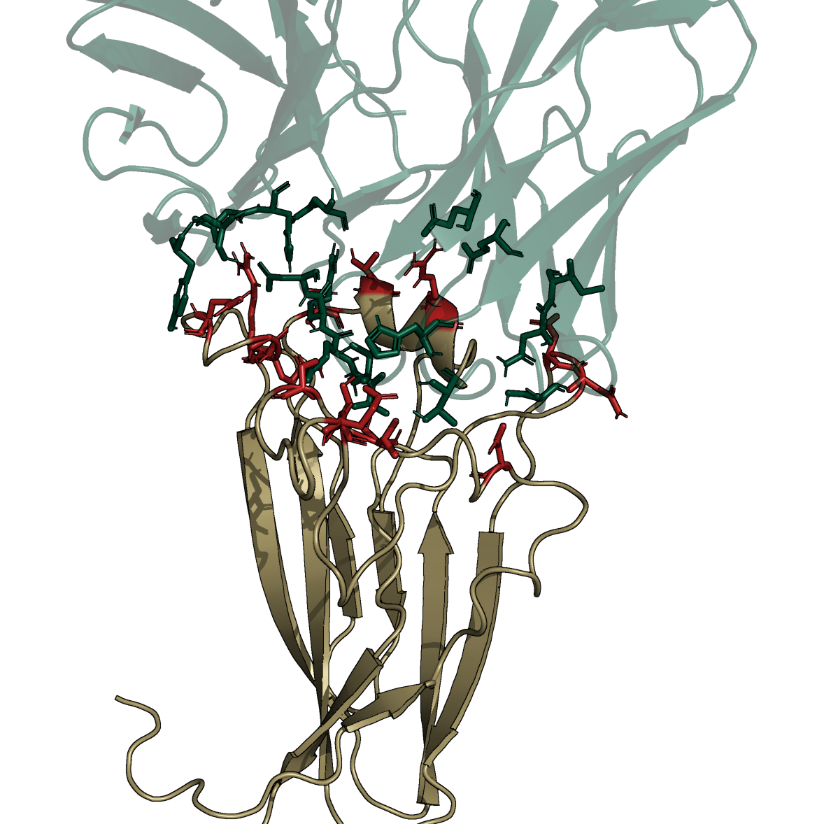
AVFluIgG01 ◄► EPI168674
100F4 ◄► EPI2429052
13D4 ◄► EPI3358339
K159, H189, D190, E191,
A192, K196, K225, S231
R152, N153, Q214, K219,
R223, S224, Q225, N227,
M233, D234, F235, W237
D133, V136, S140, E147, S148,
N161, D162, D190, T192, R196,
Q225, G228, Q229, R230

