Slide 1
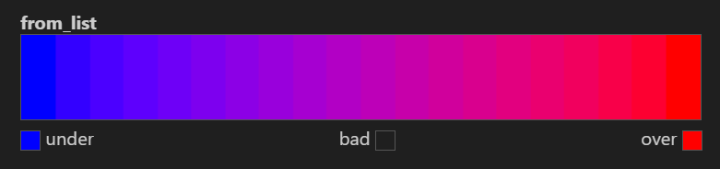
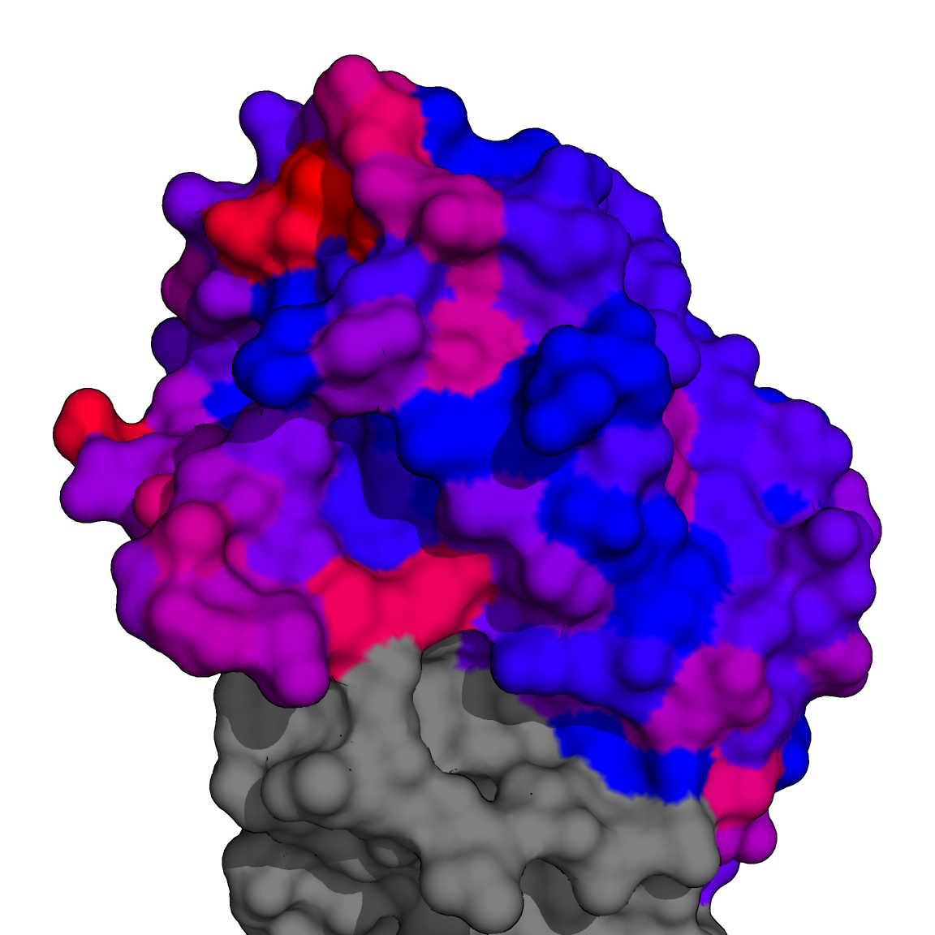
1RD8
S159
G158
K156
S193
H130
T132
K222
A137
A144
R149
S117
0% | Polar Contact Prevalence | 26%

Slide 2
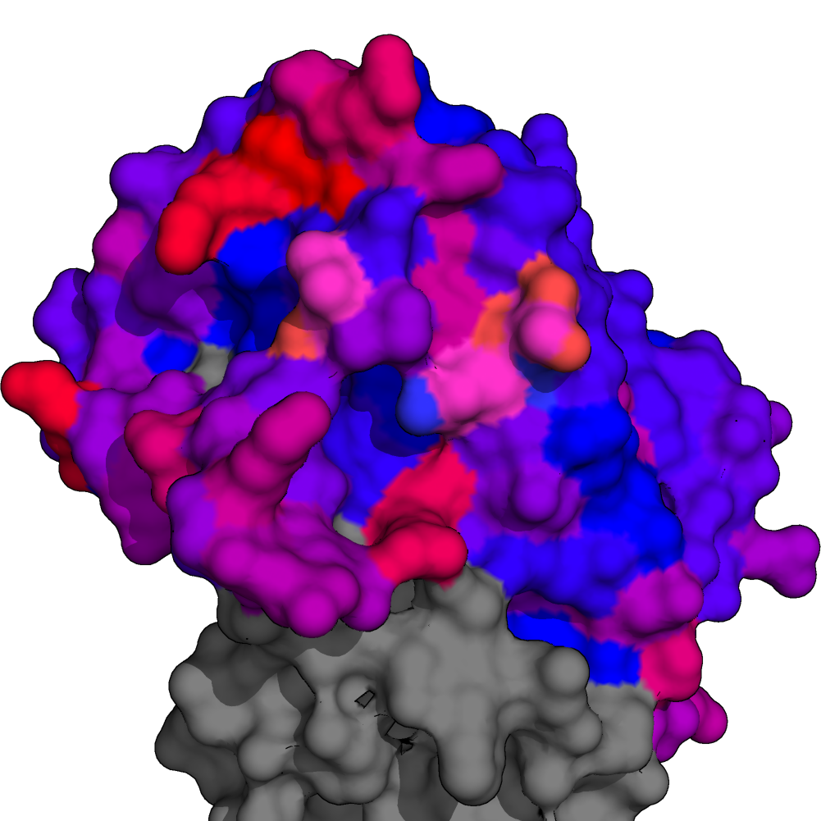
2FK0
S159
N158
K156
H130
K193
A132
K222
K144
S137
R149
H117
0% | Polar Contact Prevalence | 26%

