Slide 1
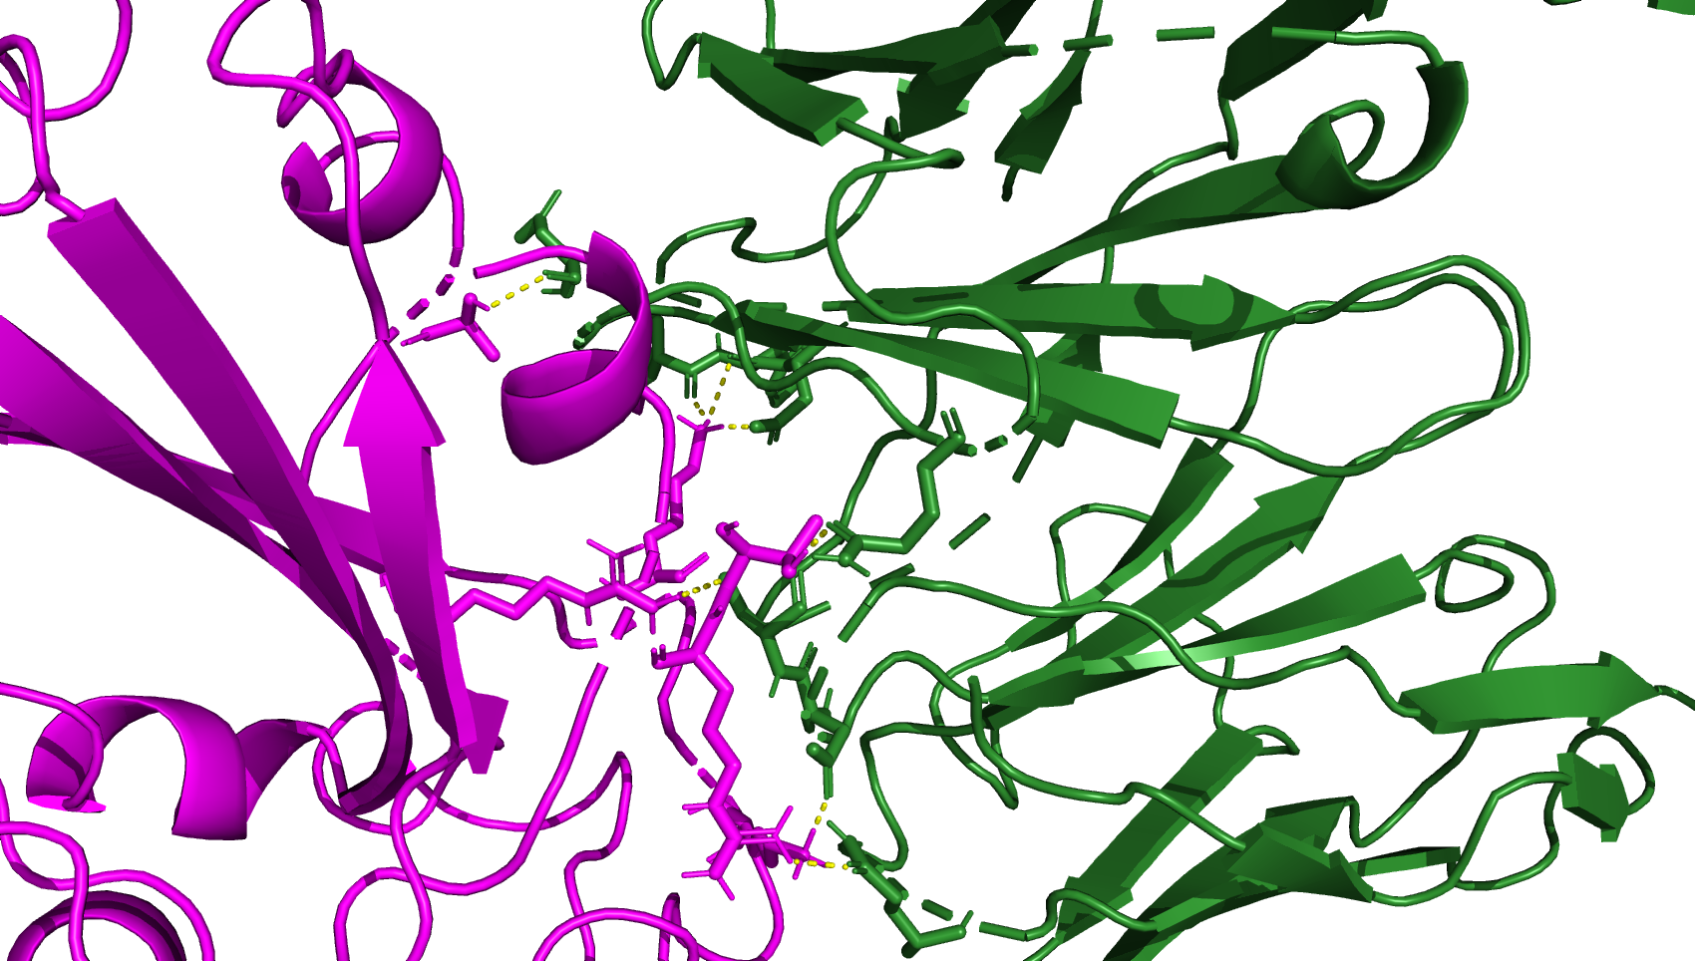
8dw9_BA286, the page after is JN.1 from 8dw9
A372
K440
T345
R508
K444
R346

Slide 2
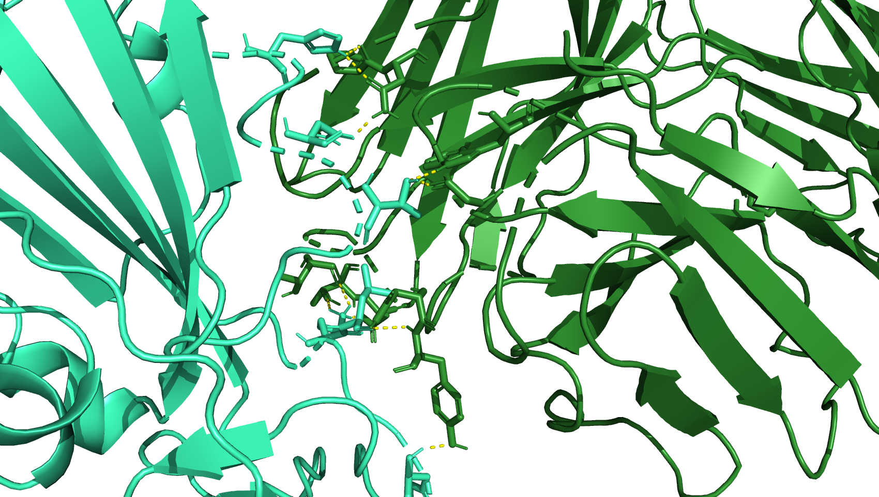
H339
N343
T345
K440
L441
H445

