Slide 1
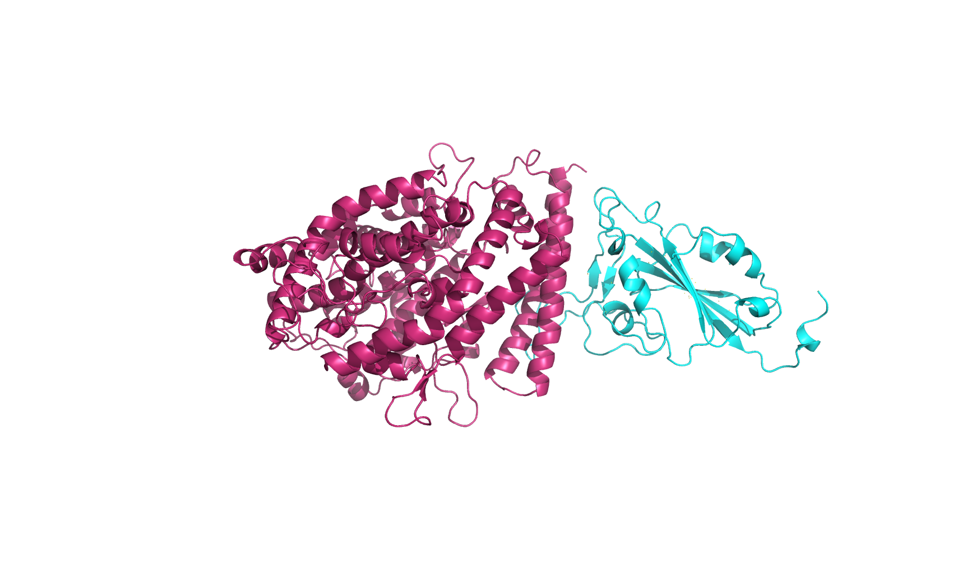
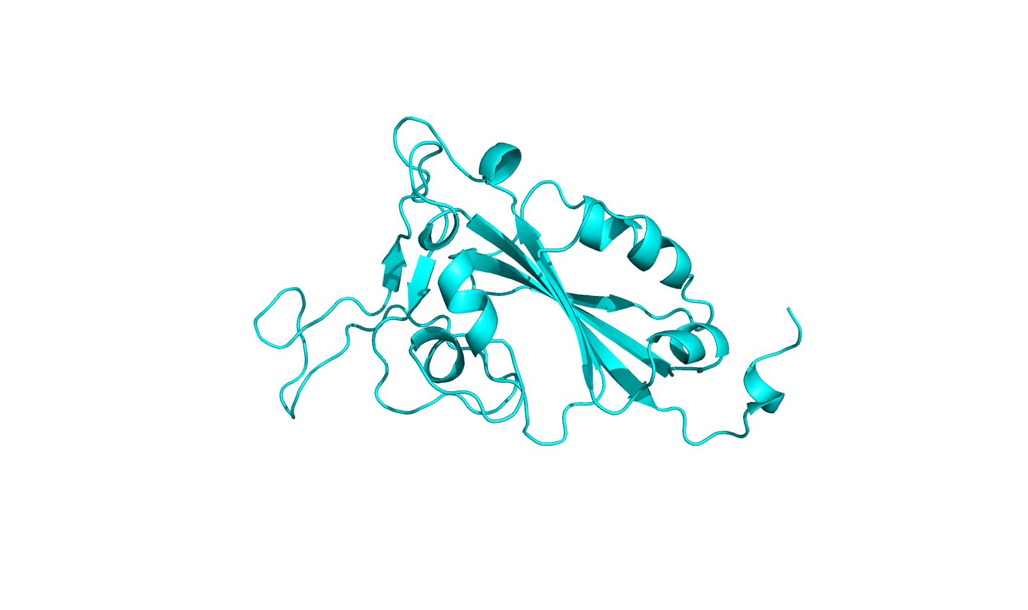
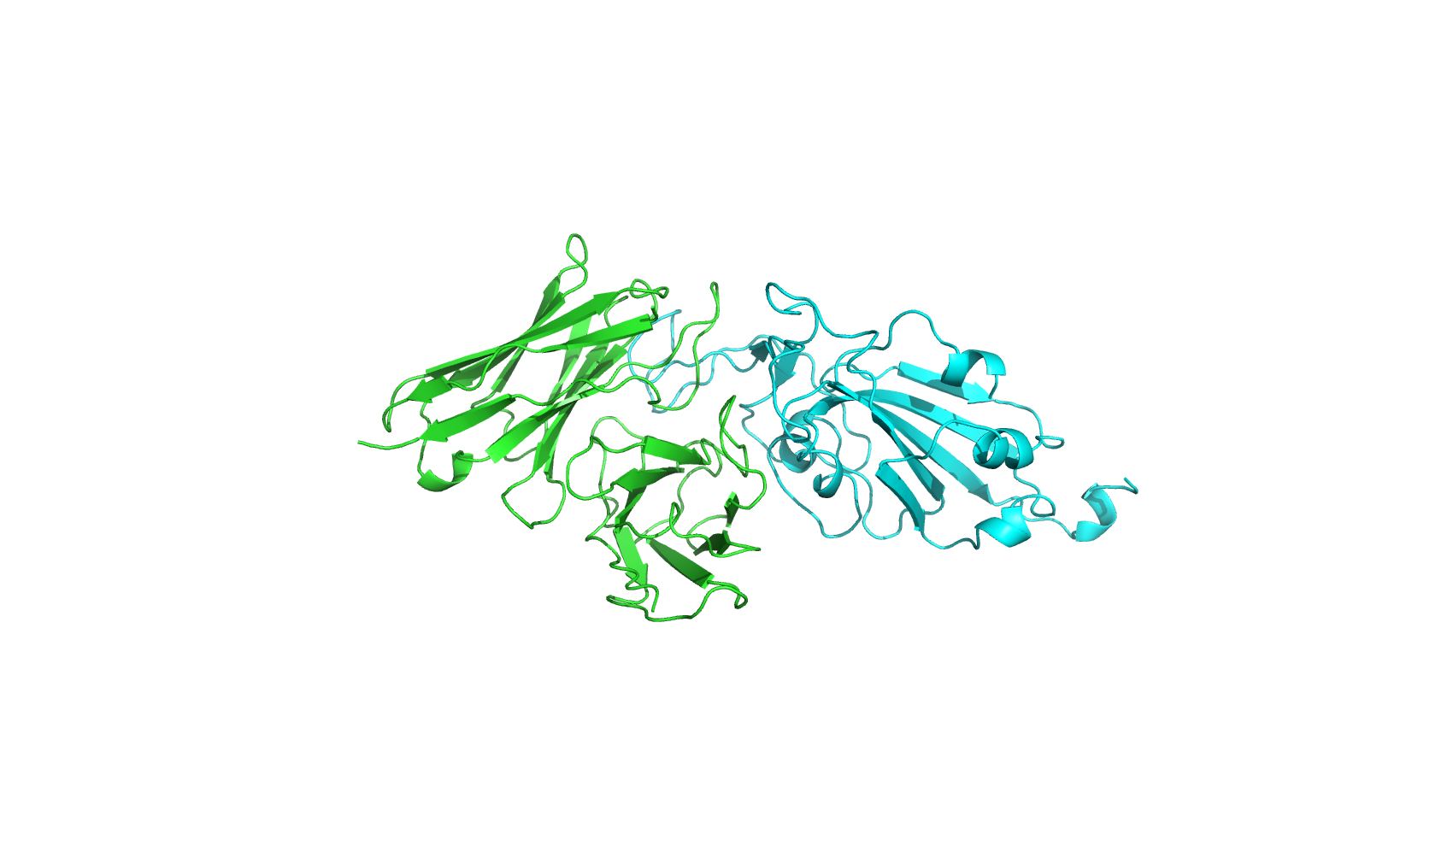
RBD Amino Acid Sequence
RBD PDB Structure
Docked Structures
FHEVFNATRFASVYAWNRTRISNCVADYSVLYNFAPFFAFKCYGVSPTKLNDLCFTNVYADSFVIKGNEVSQIAPGQTGNIADYNYKLPDDFTGCVIAWNSNKLDSKHSGNYDYWYRSFRKSKLKPFERDISTEIYQAGNKPCKGKGPNCYFPLQSYGFRPTYGVGHQPYRVVVLSFELLHAPATVCGPK
ACE2
ColabFold
HADDOCK
Docked the RBD with external PDB structures of ACE2 and neutralizing Antibodies
Antibody
Obtained the RBD structures of WT, BA.1, and BA.2 variant from PDB, forgoing Step 1 for them
Completed docking process for following variants: WT, BA.1, BA.2, XBB.1.5, BA.2.86, JN.1
Post-Docking Analysis
No statistically significant difference in binding between JN.1/ BA.2.86 and previous variants
Conclusions

