Slide 1
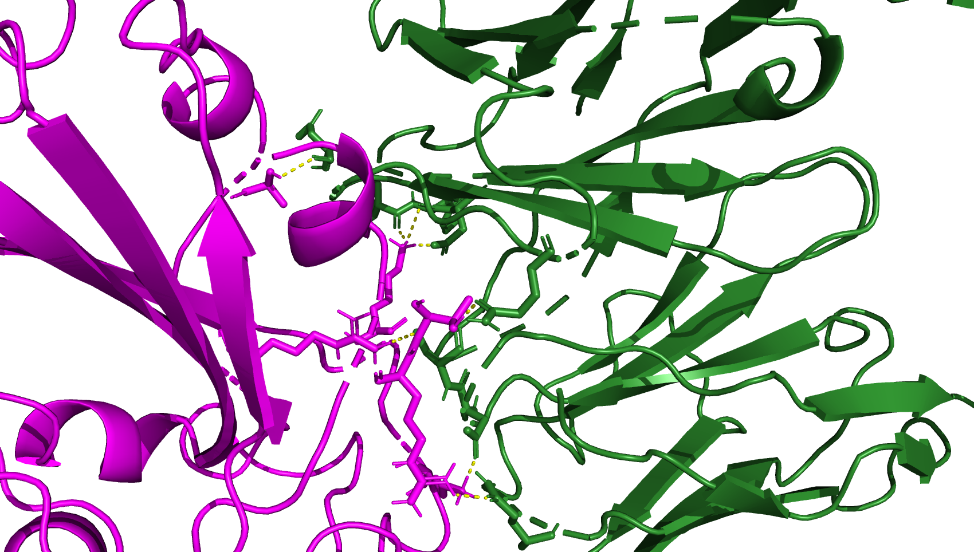
8dw9_BA286, the page after is JN.1 from 8dw9
A372
K440
T345
R508
K444
R346

Slide 2
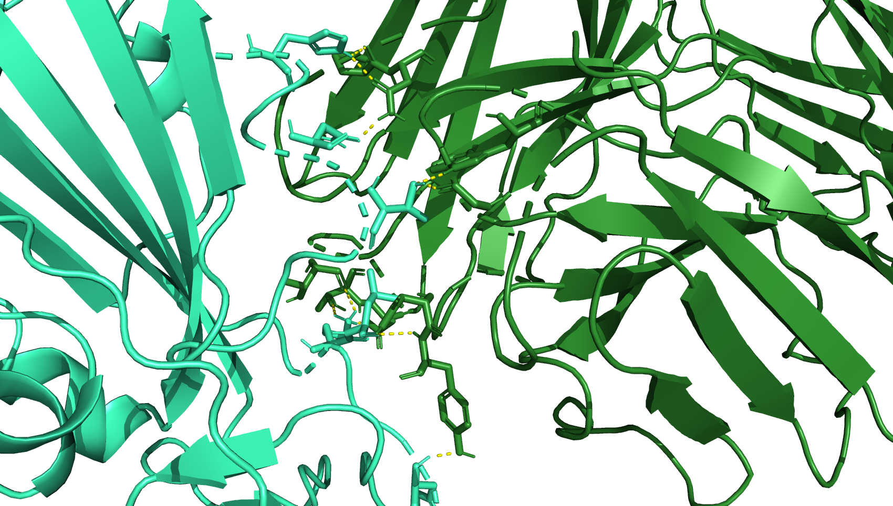
H339
N343
T345
K440
L441
H445

Slide 3
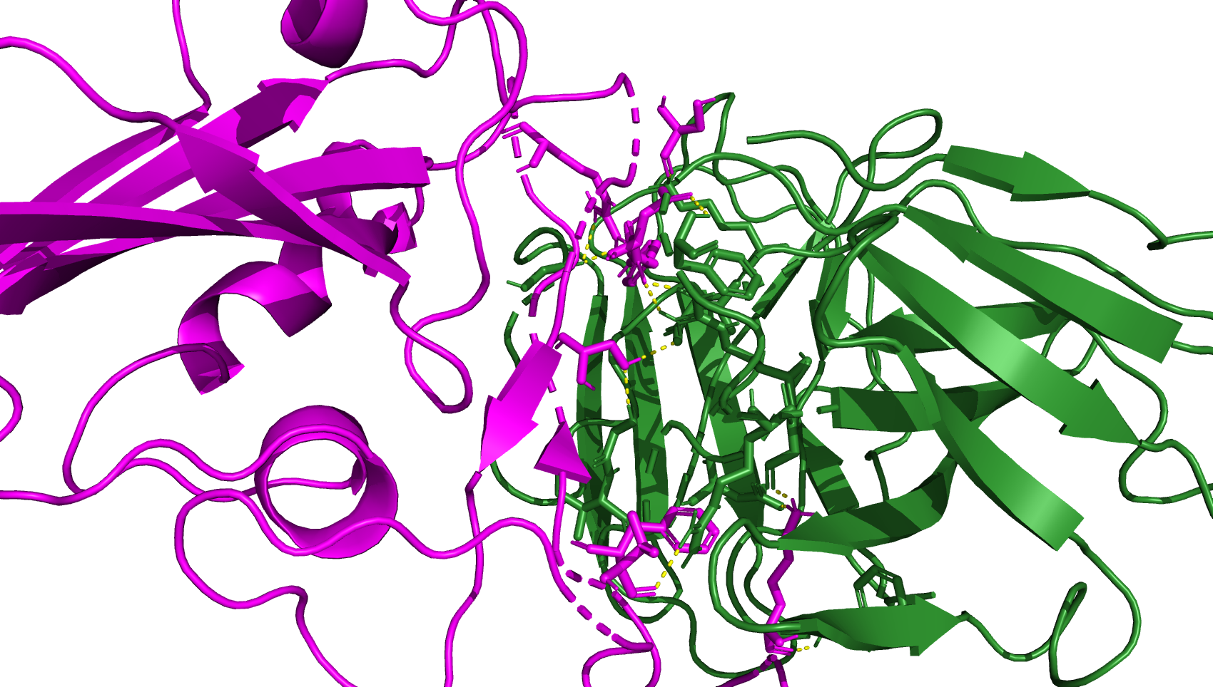
7xd2 BA286 and Jn.1 is after this for 7xd2
R497
S446
D450
Y449

Slide 4
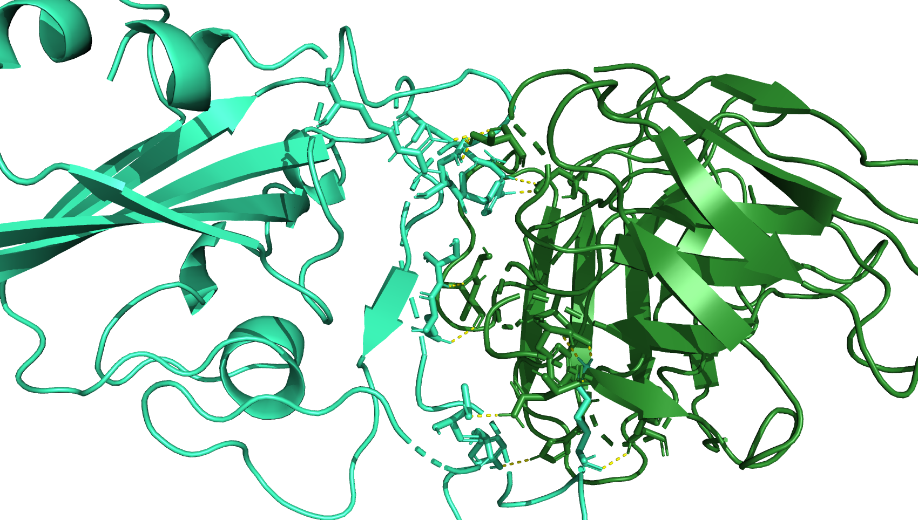
D450
R346
R497
Y449
S493
Q492
K483
T470
Y488

