Slide 1
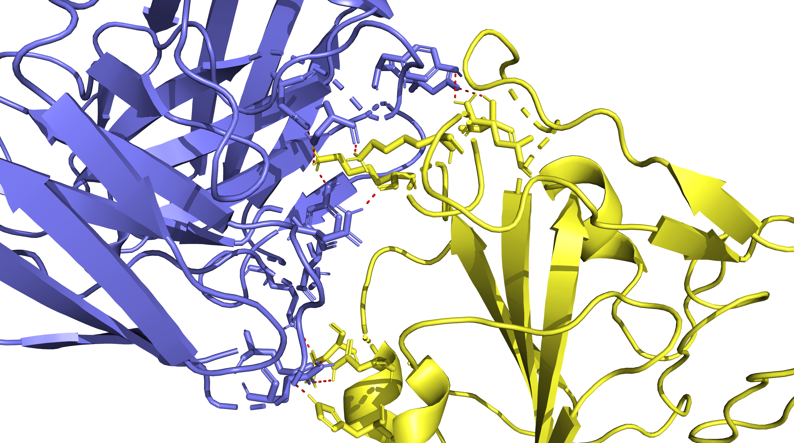
XBB.1.5 in Complex with 7x2h
V503
K444
Q506
K440
N370
N343
H339

Slide 2
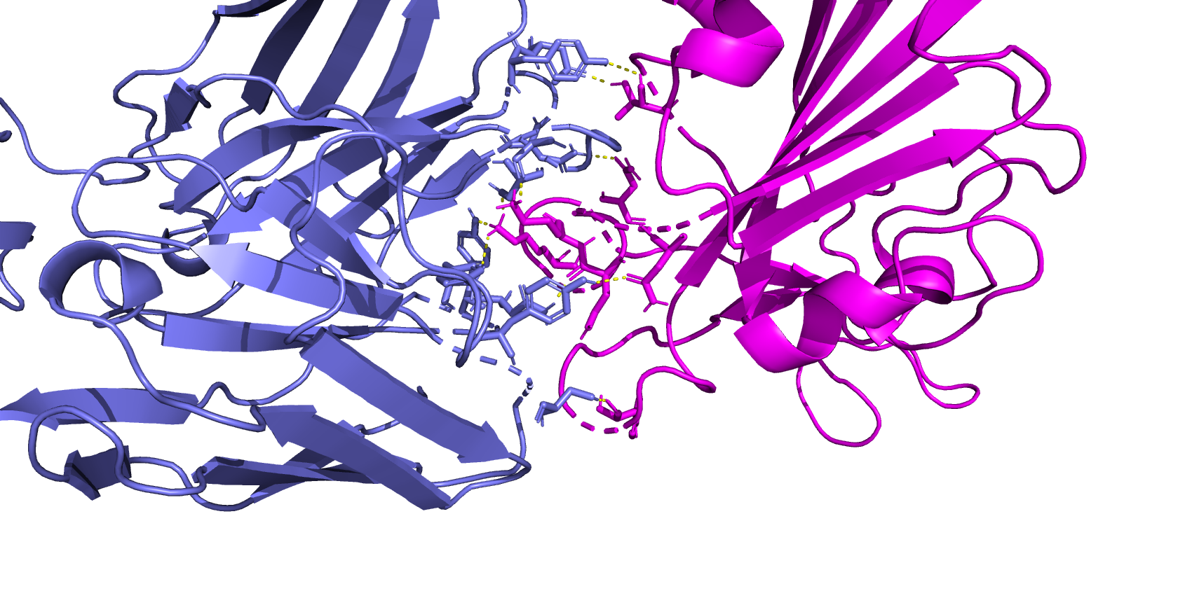
AB 7x2h complexed with BA.2.86
T345
N447
K439
K443
N436
N438

Slide 3
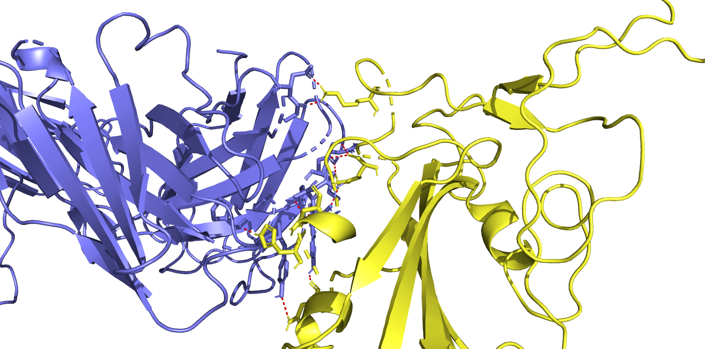
AB 8DW9 complexed with XBB.1.5
K444
K440
N343
H339
N370

Slide 4
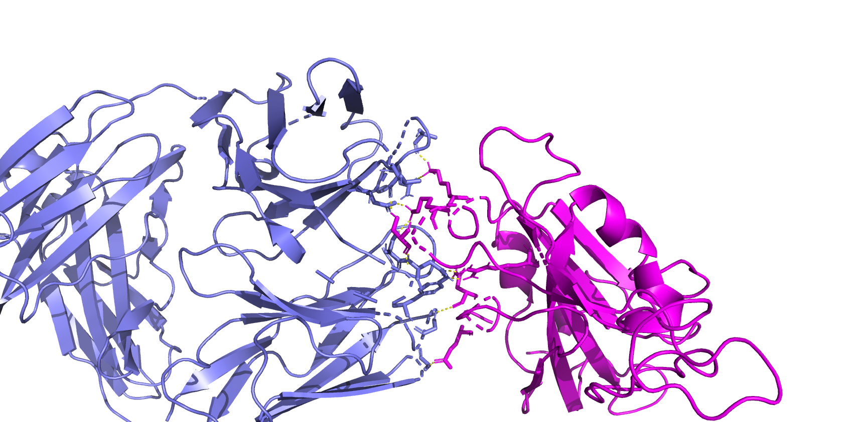
BA286 complex w 8DW9 AB
K439
K443
S445
R506
N343

