Slide 1


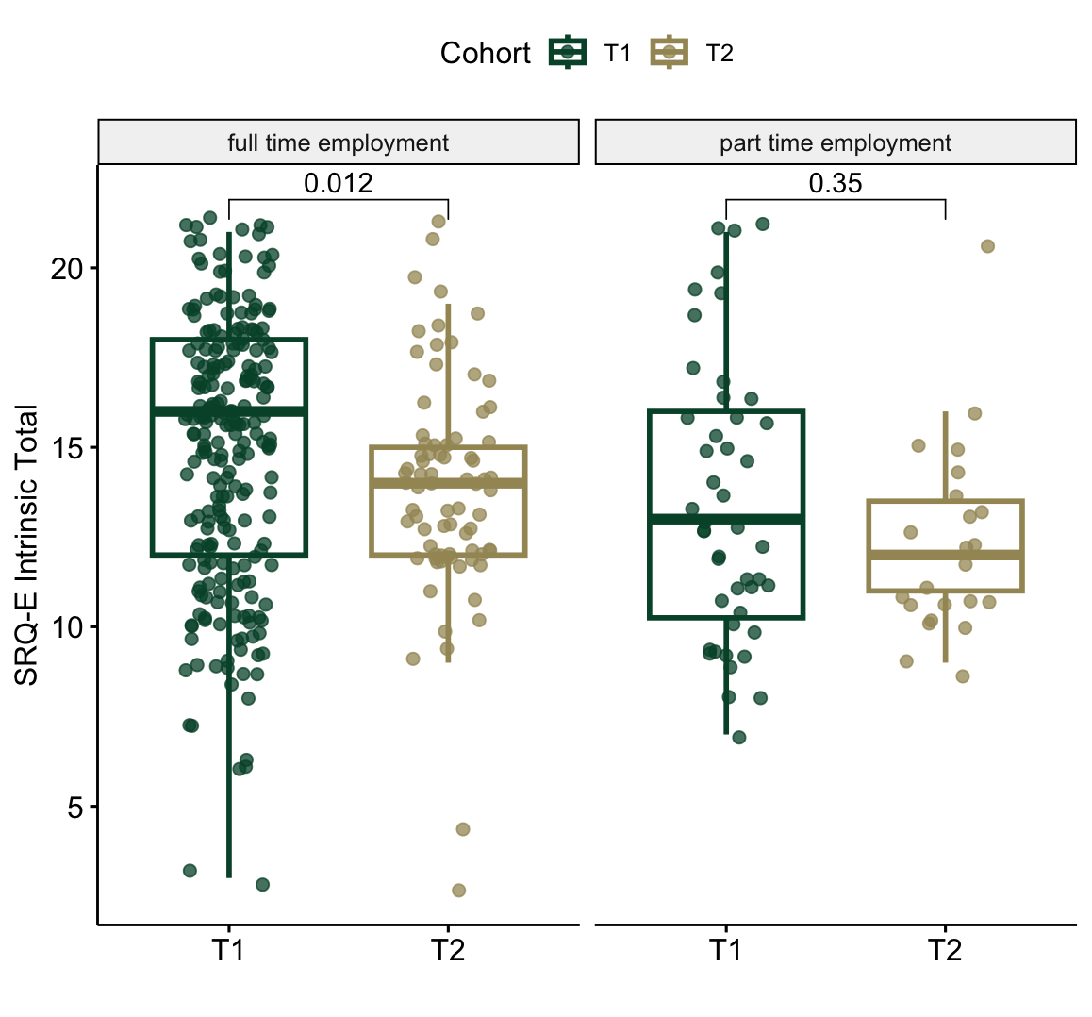
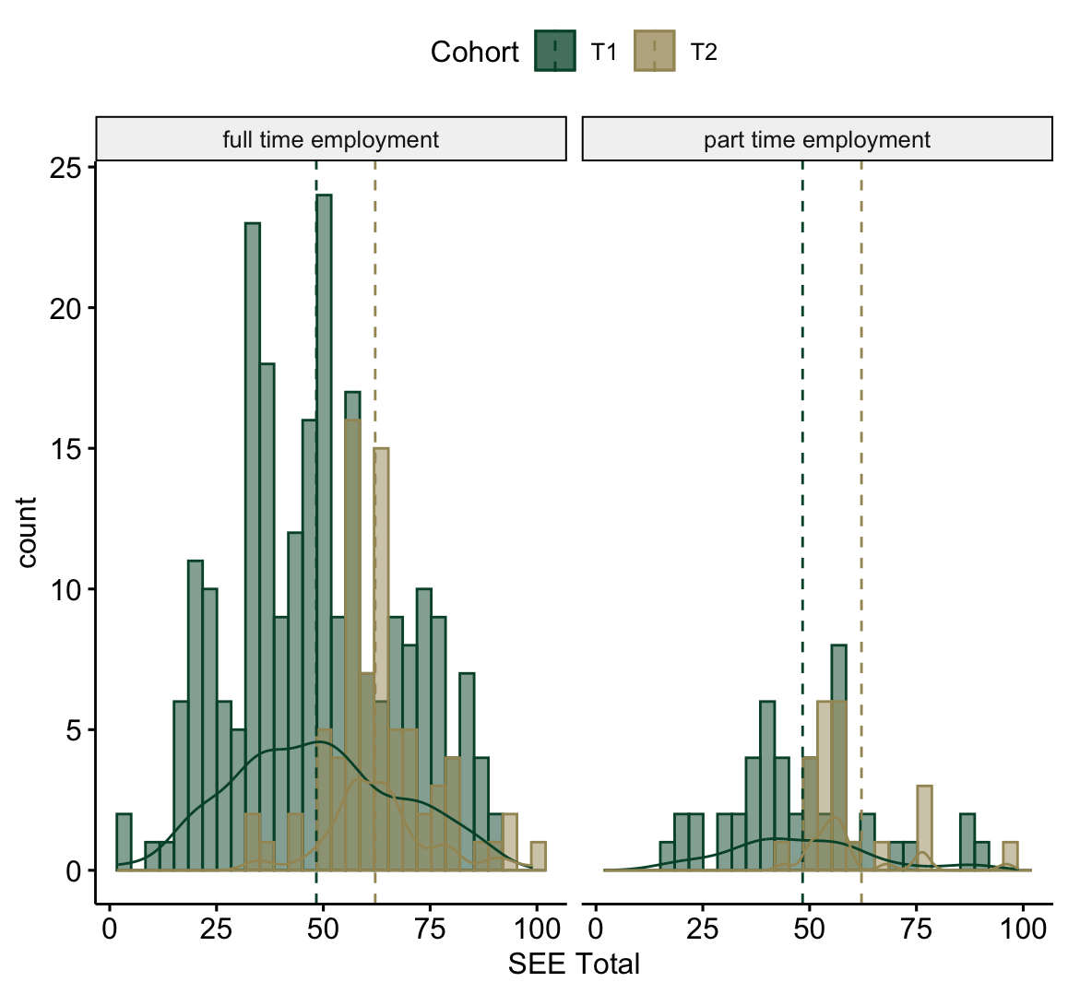
The Effects of Exercise During a Pandemic
Kira Chiles, UNC Charlotte
Candace S. Brown, PhD, Public Health Sciences
Colby T. Ford, PhD, Department of Bioinformatics and Genomics
Introduction
Method
Results
Employment was greatly impacted by the COVID-19 pandemic causing alterations to the “work-from-home” culture.
Regular places of exercise, like gyms or fitness clubs and parks, were closed and impacted an individual’s ability to maintain or begin exercise habits.
The pandemic altered the home and working environments forcing individuals to reconsider routines, including exercise.
Purpose
This study explored the relationship of employment, intrinsic motivation, and self-efficacy to exercise in 2020 and 2022, during and after the COVID-19 pandemic.
Design A cross-sectional design investigated motivation to exercise and employment status from a US national sample.
Procedures IRB Study #19-0739 information and a link to the Qualtrics consent and surveys were distributed via Internet. Participants completed a demographic questionnaire, Exercise Self-Regulation Questionnaire and Self-Efficacy for Exercise Scale.
Analysis
The Kolmogorov-Smirnov and the Shapiro-Wilk tests determined normality. Tableau explored the dataset through descriptive statistics and visualizations. MANOVA and Wilcoxon p-values analyzed between-subject differences. Significance = p <.01.
Conclusions
This study gave us a greater insight into how motivation, employment, and exercise are understood as constructs that are related to one another.
Results indicate that employment status is related to intrinsic motivation to exercise.
This study contributes to the insight on factors that influence individuals to continue exercising.
Physical activity engagement is a public health concern, this study may help inform interventionists and researchers on how motivation may influence exercise engagement during times of altered work schedules.
Figure 1. Box plots comparing SRQ-E Intrinsic totals for T1 and T2 timepoints in both full-time and part-time employment. Wilcoxon p-values were used. Significance observed between the T1 and T2 timepoints for full-time employment (p<0.01).SRQ-E Intrinsic totals include working out due to enjoyment, because it is fun and interested, and for the pleasure of discovering and mastering new training techniques.
Background
Study Measures
The Self-Determination Theory (SDT) acts as a framework through which exercise behavior can be understood.
Exercise is defined as any continuous movement. It improves well-being.
Only 53.3% of adults (18+) meet exercise aerobic guidelines.
Intrinsic motivation is when an individual has personal pleasure and/or satisfaction from exercising.
Individuals who develop more self-efficacy to engage in exercise move further along the regulation continuum towards intrinsic motivation.
Demographic Information Included employment status, COVID-19 effect on employment status, and time spent exercising.
Exercise for Self-Regulation Questionnaire (SRQ-E) Motivation for working out was assessed via the SRQ-E. The 12-item scale presents different personal motivations to exercise and a 7-point scale to assess motivation.
Self-Efficacy for Exercise (SEE) Scale An individuals’ confidence in exercising, despite barriers, was assessed using the SEE Scale. The scale range has total scores from 0-90. A higher score indicated higher self-efficacy for exercise.
References
Brown, C.S.; Cotter, J.J.; Dodd-McCue, D.; Huebschmann, A.G. A Mixed Methods Study of Intrinsic Motives among Aging Black Women Triathletes. International Journal of Multiple Research Approaches 2019, 11, 61-76.
Brynjolfsson, E.; Horton, J.J.; Ozimek, A.; Rock, D.; Sharma, G.; TuYe, H.-Y. COVID-19 and remote work: An early look at US data; 0898-2937; National Bureau of Economic Research: 2020.
Caspersen, C.J.; Powell, K.E.; Christenson, G.M. Physical activity, exercise, and physical fitness: definitions and distinctions for health-related research. Public Health Rep 1985, 100, 126-131.
Corp., I. IBM SPSS, 26.0; Armonk, NY, 2019.
Egli, T.; Bland, H.W.; Melton, B.F.; Czech, D.R. Influence of age, sex, and race on college students’ exercise motivation of physical activity. Journal of American college health 2011, 59, 399-406.
Ghasemi, A.; Zahediasl, S. Normality tests for statistical analysis: a guide for non-statisticians. International journal of endocrinology and metabolism 2012, 10, 486.
Joshi, A.; Kale, S.; Chandel, S.; Pal, D.K. Likert scale: Explored and explained. Current Journal of Applied Science and Technology 2015, 396-403.
Prevention, C.f.D.C.a. Exercise or Physical Activity. 2021.
Resnick, B.; Jenkins, L. S. Testing the reliability and validity of the Self-Efficacy for Exercise Scale. Nursing Research 2000, 49.
Ryan, R.M.; Connell, J.P. Perceived locus of causality and internalization: Examining reasons for acting in two domains. Journal of Personality and Social Psychology 1989, 57, 749-761.
Timo, J.; Sami, Y.-P.; Anthony, W.; Jarmo, L. Perceived physical competence towards physical activity, and motivation and enjoyment in physical education as longitudinal predictors of adolescents’ self-reported physical activity. Journal of Science and Medicine in Sport 2016, 19, 750-754.
Figure 2. Histograms comparing SEE Totals for T1 and T2 timepoints in both full-time (p=7.6e-10) and part-time employment (p=0.0026). Wilcoxon p-values were used, Significance was observed between the T1 and T2 timepoints for both full-time and part-time employment (p<0.01).

