Slide 1

Gitting Started
October 18, 2022 | Colby T. Ford, Ph.D.

Slide 2
Class Goals
Make a GitHub Account
Make a Repo
Commit to your Friend’s Repo
Commit to your Repo
Make an Action
Learn a Little Markdown
Do a Pull Request
Log an Issue
Get GitHub Desktop

Slide 3




About Me
Email: colby.ford@uncc.edu
Research Interests
Biology
Human Genomics
Oncology, Immunology, Neurology, Rare Diseases
Infectious Diseases
SARS-CoV-2, Malaria
Protein Analysis
Immunoproteins (mAbs, HLA, TCR)
Computer Science
Scalable Computing
Machine Learning
Sr. Bioinformatics Cloud Engineer
Manager, Machine Learning
Co-Founder, V.P. Of Technology
Founder, Principal Consultant
Associate Faculty, SDS
University Business Partner
B.A. AppliedMath
M.S. Data Science
Ph.D. Comp. Biology

Slide 4




Oh, You Like Books? 📕

Slide 5

What is Git?
Version Control
Which changes were made?
Who made the changes?
When were the changes made?
Why were changes needed?
Terminology
Code is stored in a repository
If you want to use someone else’s code and make changes, you can fork it. Then, submit a pull request to try and merge the changes back in
Your team can work on separate branches of the same repository
Repositories are usually initialized with a README.md, a .gitignore, and a license.
https://www.youtube.com/watch?v=w3jLJU7DT5E

Slide 6
Commands
https://guides.github.com/introduction/git-handbook/
https://lab.github.com/githubtraining/introduction-to-github
git init
git clone
git commit
git status
git branch
git merge
git pull
git push
Initializes a brand new Git repository and begins tracking an existing directory
Creates a local copy of a project that already exists remotely
Saves the snapshot to the project history and completes the change-tracking process
Shows the status of changes as untracked, modified, or staged
Shows the branches being worked on locally.
Merges lines of development together
Updates the local line of development with updates from its remote counterpart
Updates the remote repository with any commits made locally to a branch.

Slide 7


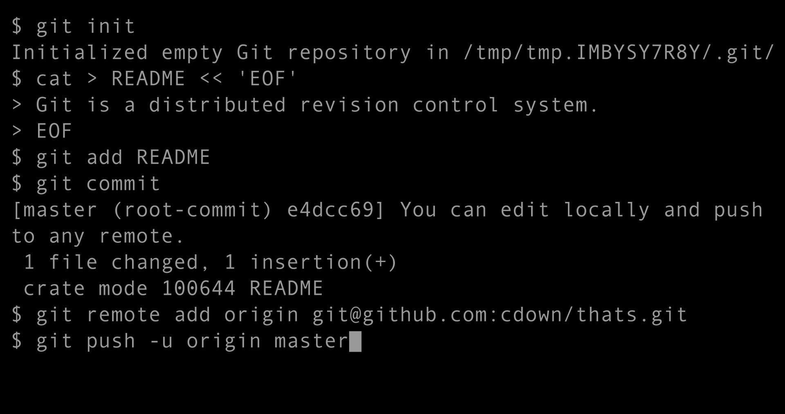





Various Tools to Git it Done
Git Clients
Repository Services

Slide 8


Learning Resources
https://guides.github.com/introduction/git-handbook/
https://lab.github.com/

