Slide 1
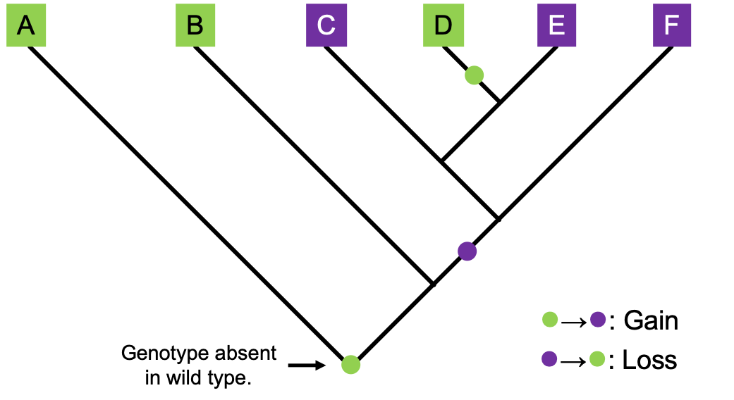
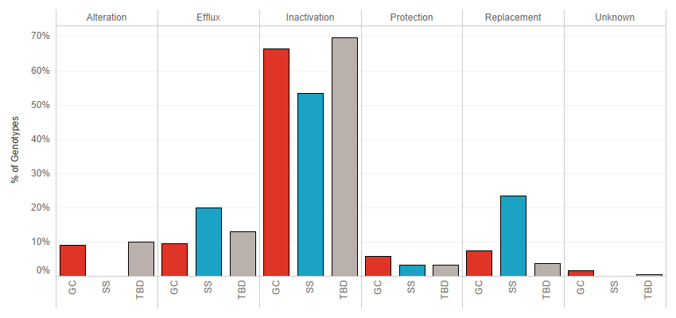
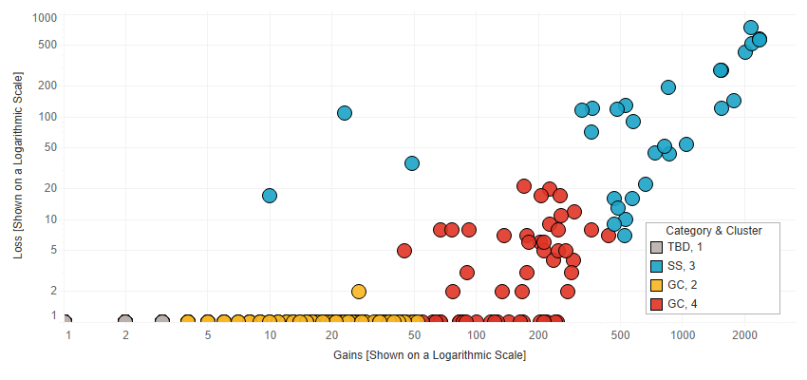
Genetic Capitalism in E. coli
Stabilizing Selection: A genotype is gained and lost frequently across a lineage.
Genetic Capitalism: A genotype is gained across a lineage and not often lost.
Data: 29k E. coli isolates from the NCBI Pathogen Detection Database
Resistance Mechanism
Ford et al. (2020)

Slide 2
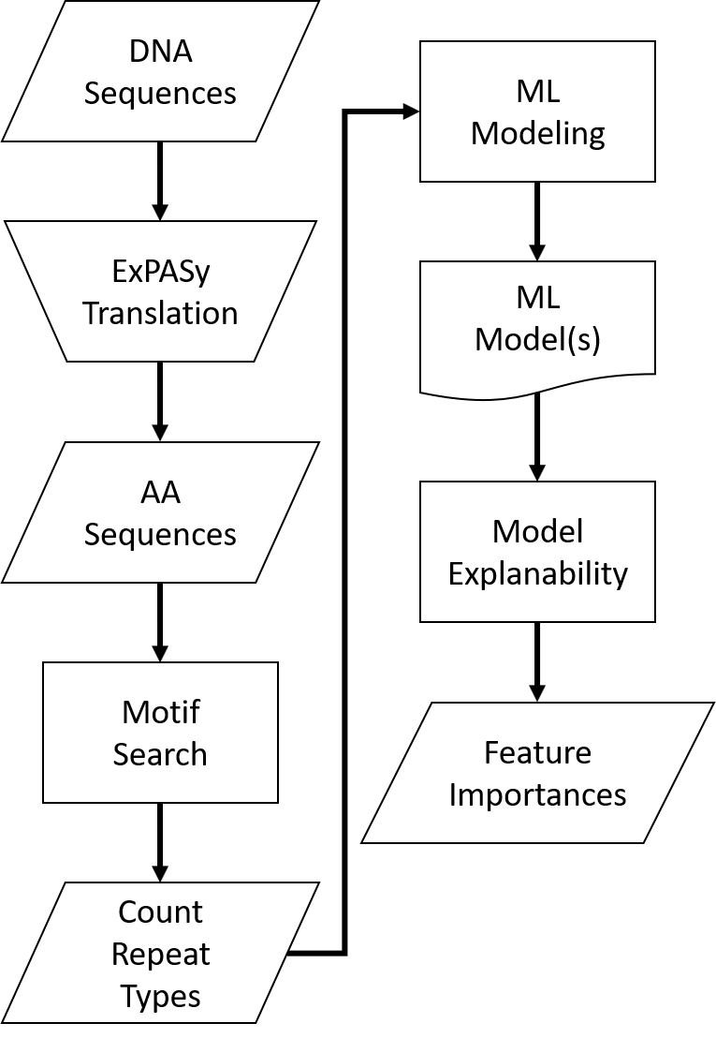
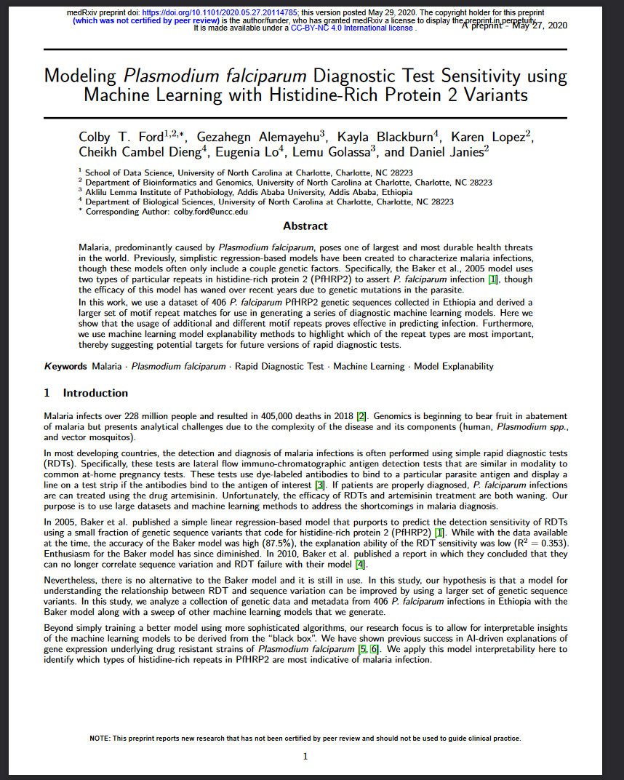
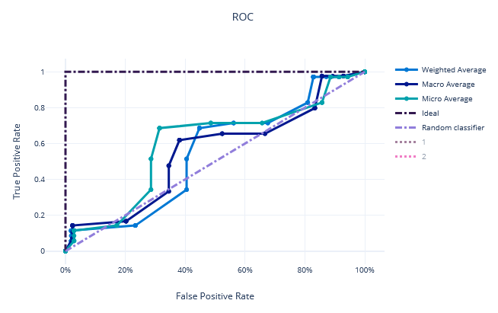
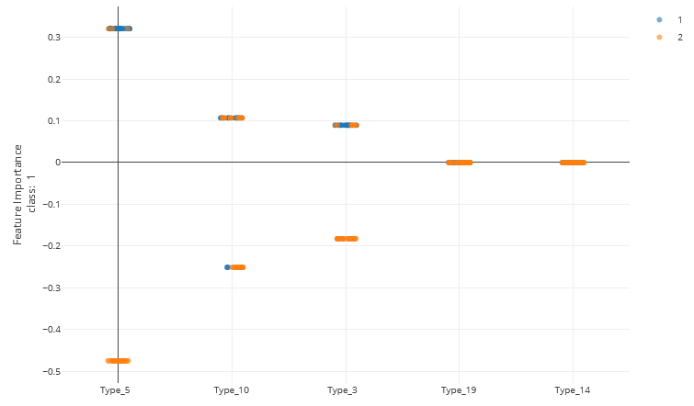
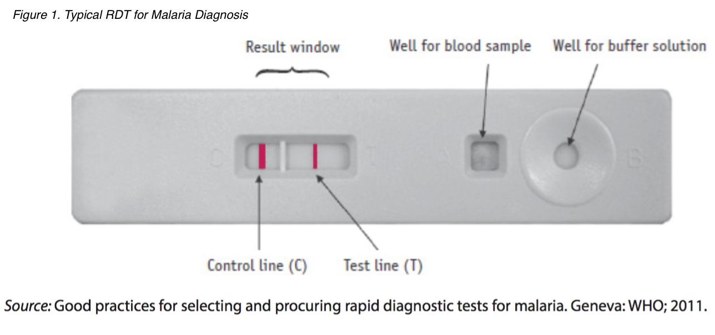
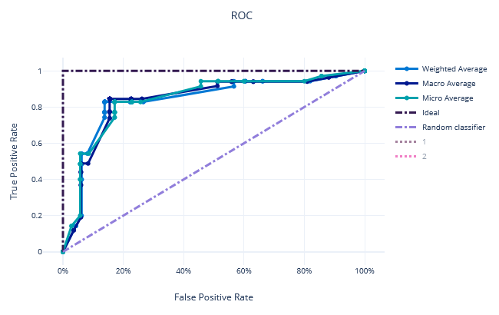
Explainable ML for Malaria Testing 🦟
Explain important factors from general model.
Refine model using only genetic important factors.
Ford et al. (2021)

Slide 3
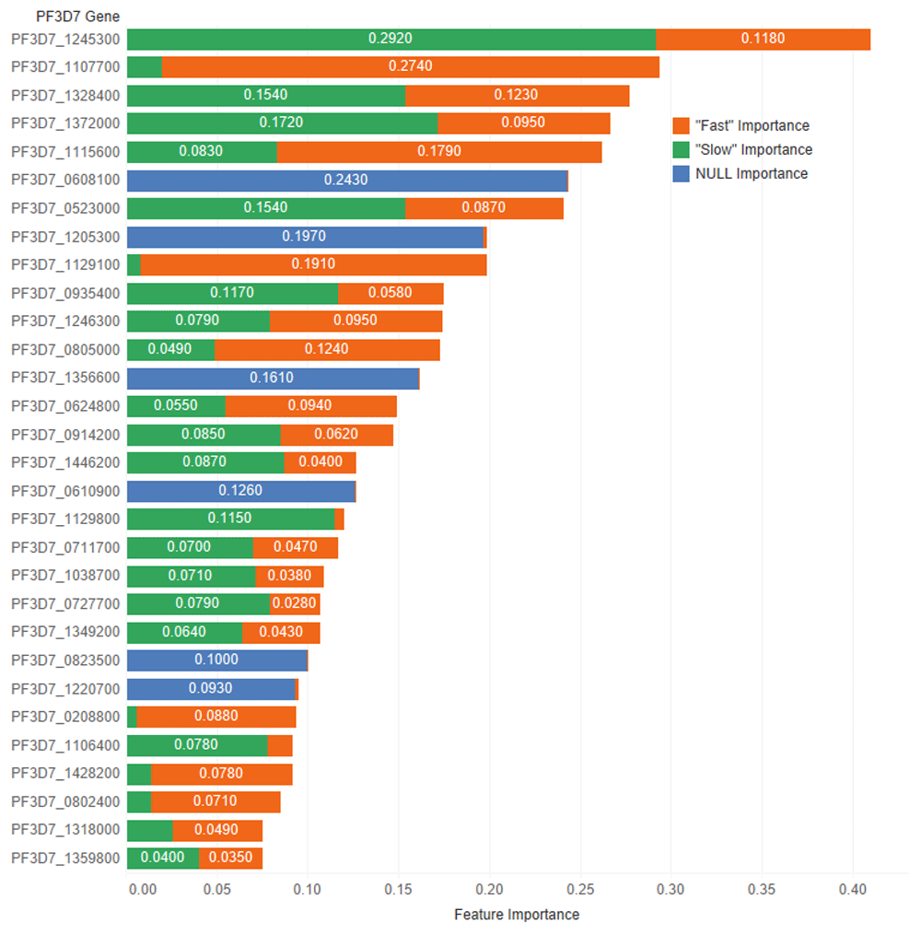
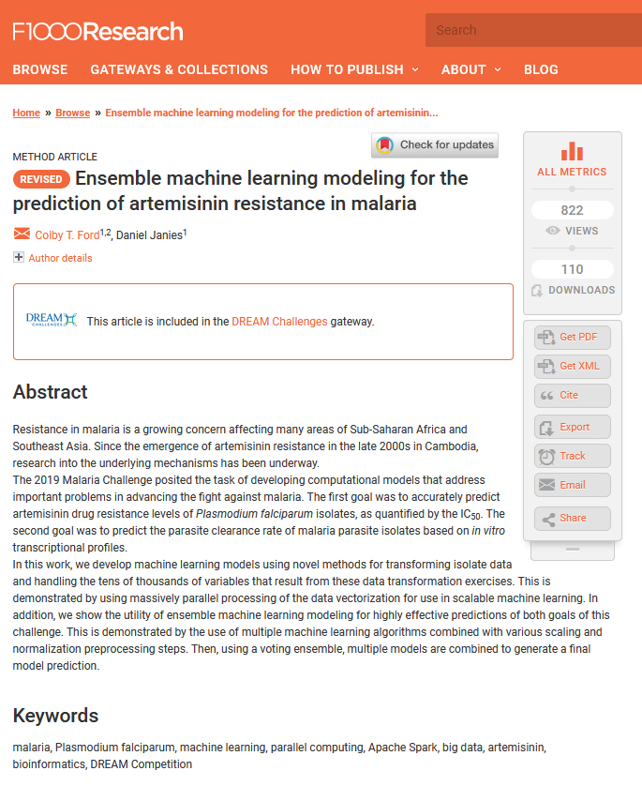
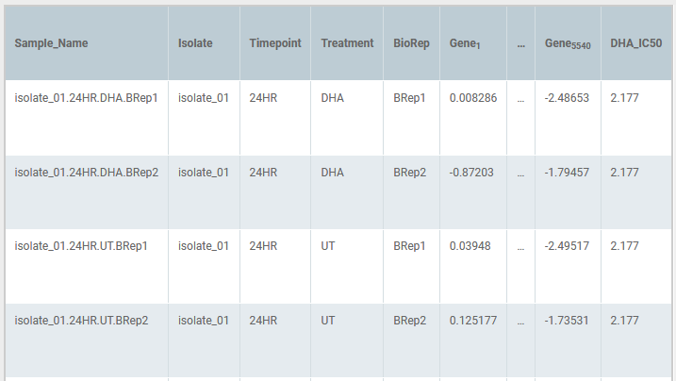
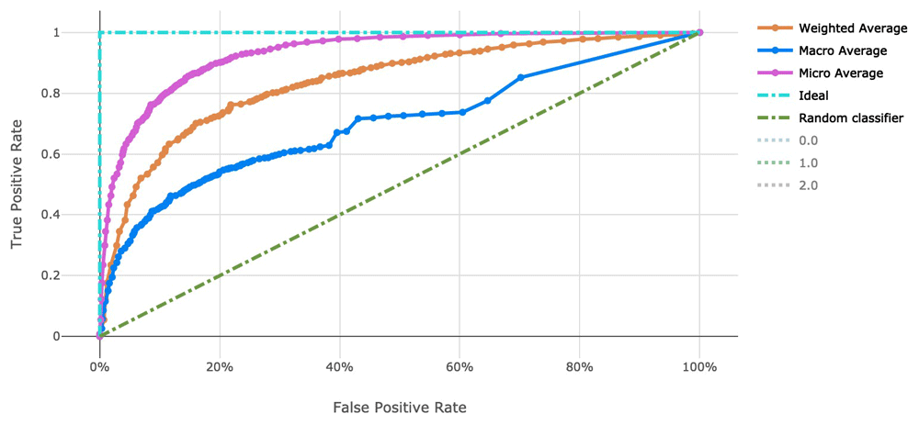
Explainable ML of Artemisinin Resistance in Malaria 🦟
Task: Create a ML model to predict artemisinin resistance and parasite clearance rate in P. falciparum.
Data: Transcriptomes of 30 P. falciparum isolates (5,540 genes).
Regression Model: Artemisinin Resistance (using IC₅₀)
Classification Model: Parasite Clearance Rate (“Fast” or “Slow”)
Ford and Janies (2020)

Slide 4
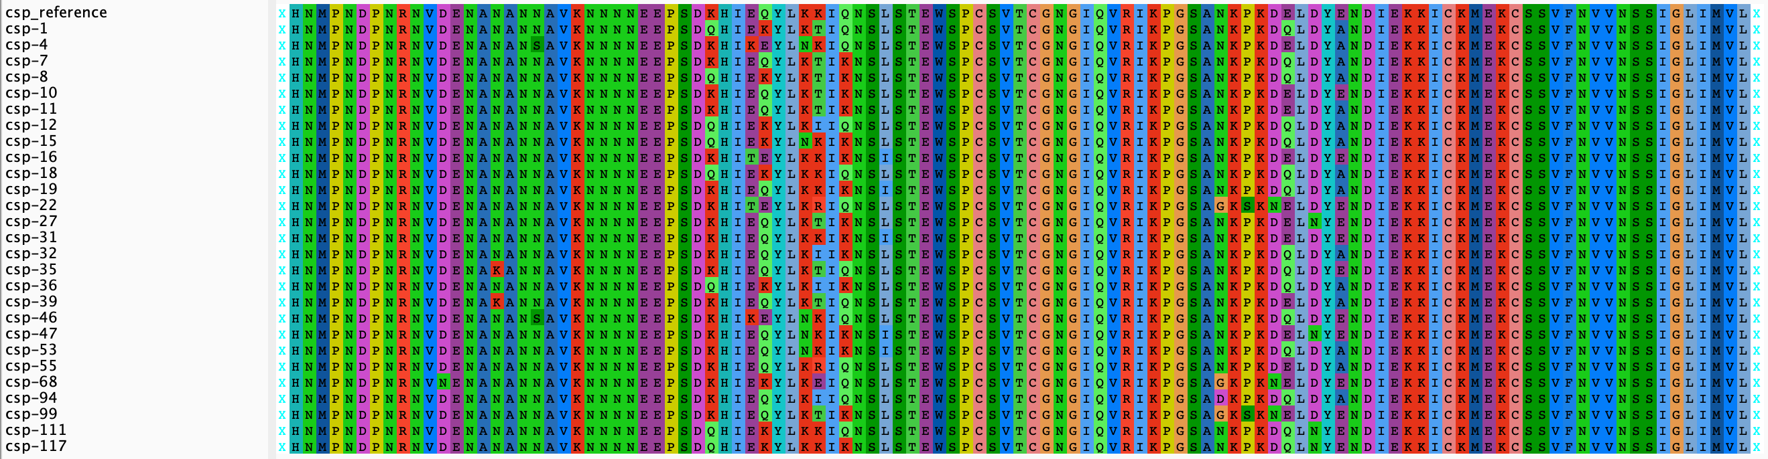
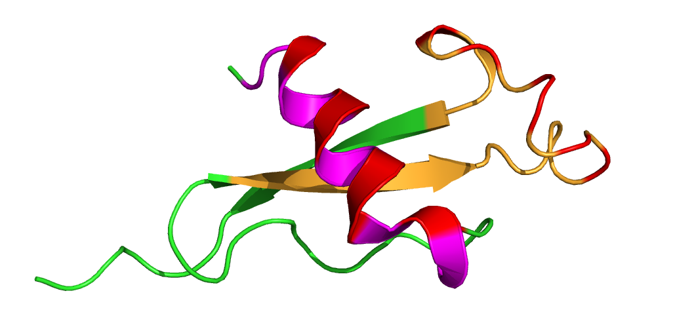
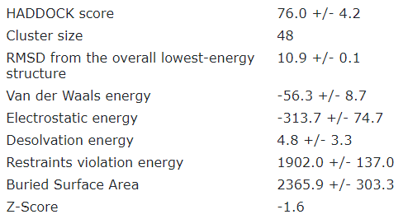
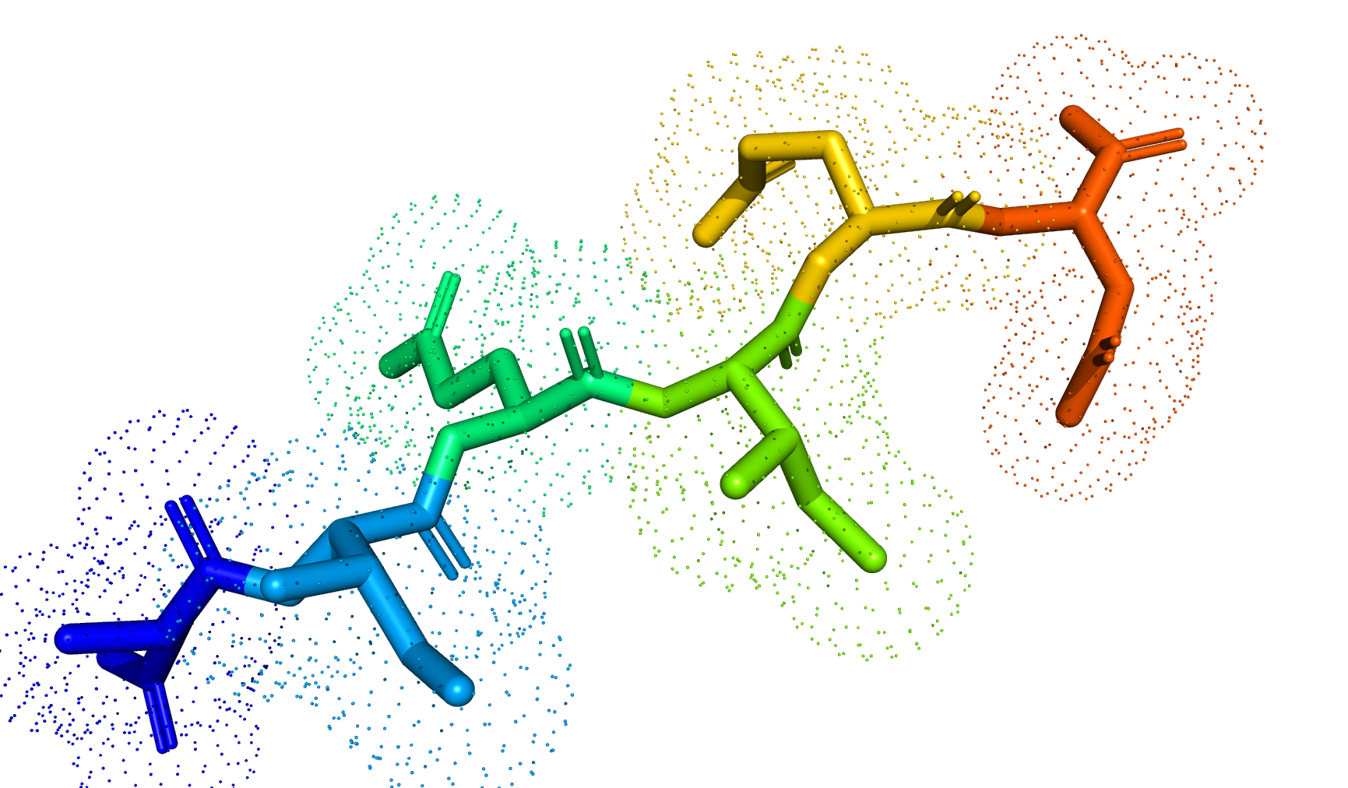

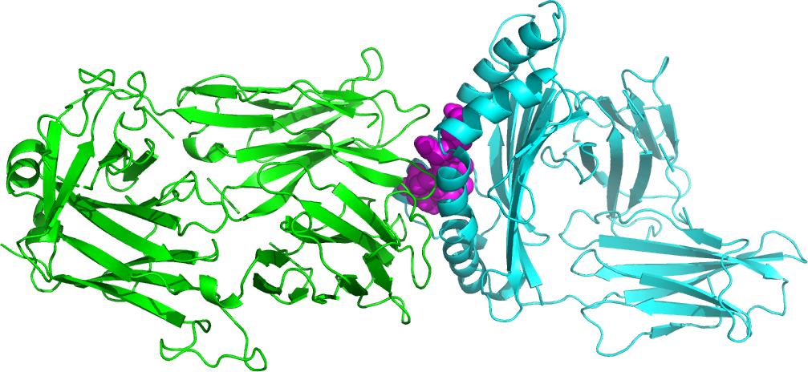
Deep Learning for Vaccine Efficacy P. falciparum Haplotyping for Understanding RTS,S Vaccine Efficacy in Ghana
Sequence-to-Structure
Proteasomal
Degradation
(to generate peptide)
Peptide docking between HLA and T-Cell Receptor
Dieng and Ford et al., (2021)
In Progress.

Slide 5
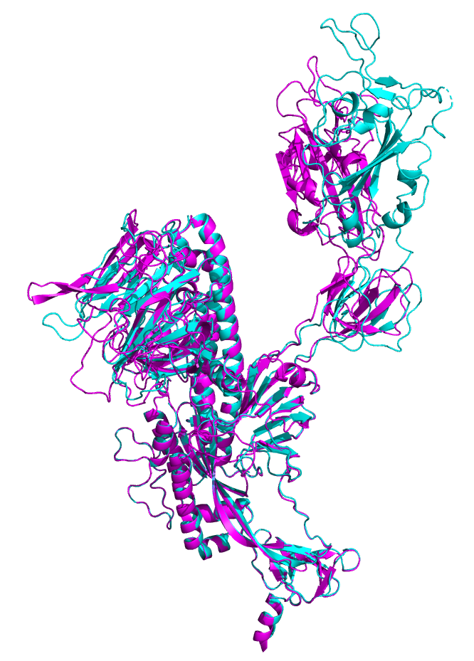
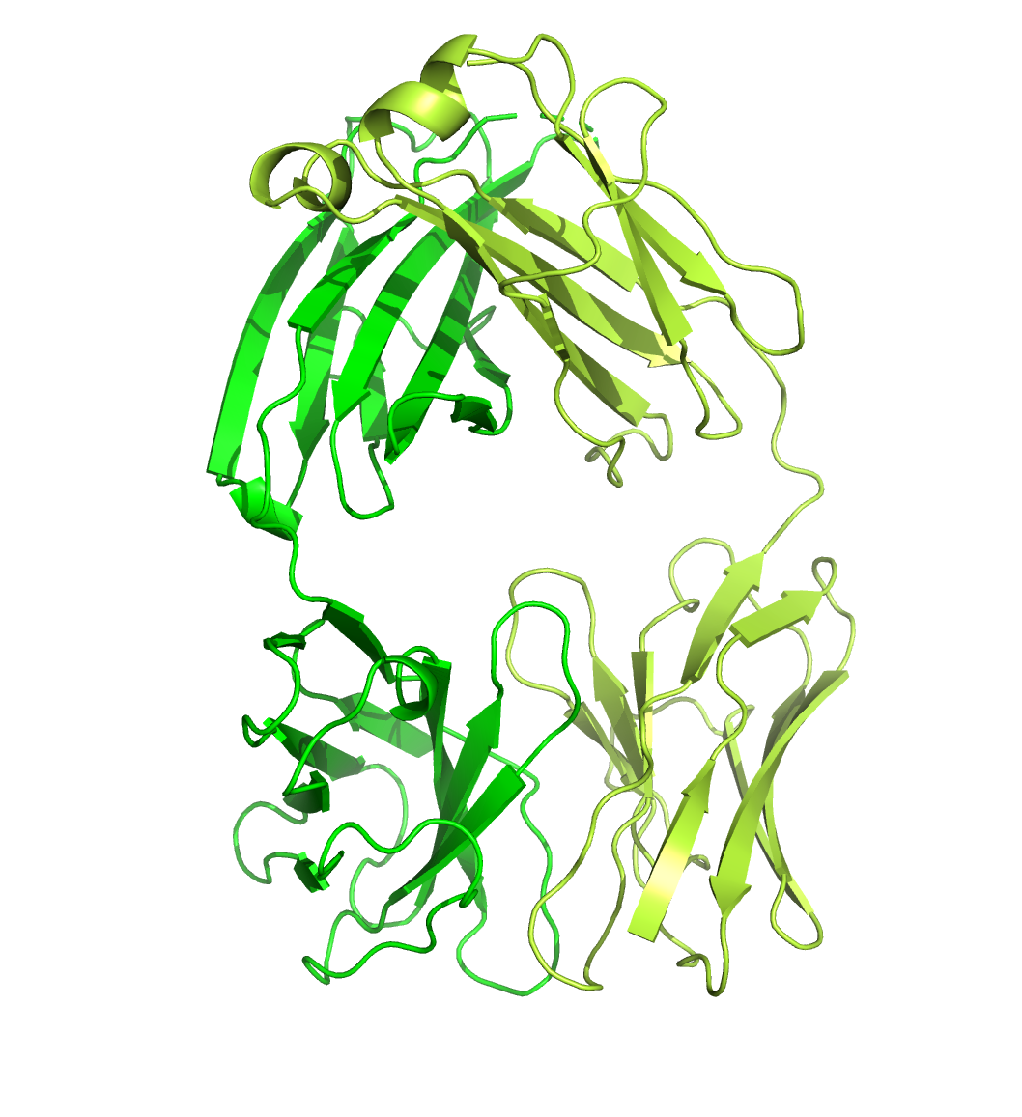
Protein Sequence Analysis for SARS-CoV-2 Spike Variants
Antibody Binding Site
Get Variant Sequence
(e.g., BV-1)
Get Reference Antibody Structure
(e.g., 7CAC Chains D&E)
Predict Structure using I-TASSER
Docker Antibody with Structure using HADDOCK
Magenta: Predicted BV-1 Variant Structure
Cyan: 7CAC Reference Structure
Green: 7CAC Antibody Structure
Compare Antibody Binding Between Reference and Prediction
(e.g., 7CAC vs. BV-1)

