Slide 1
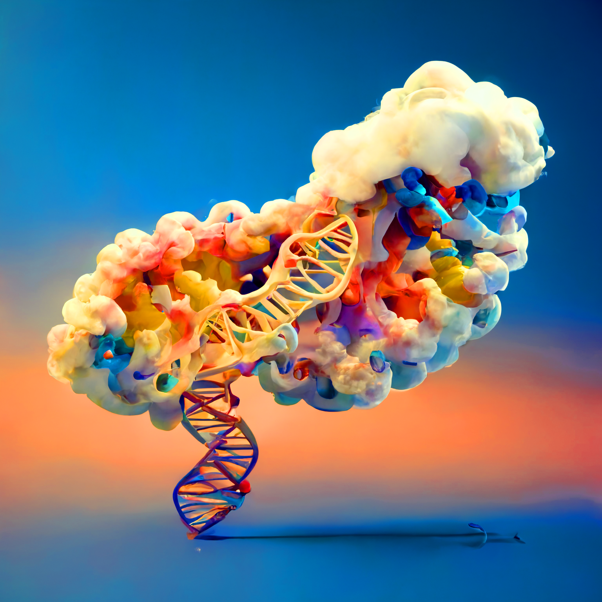
Scaling Biotech Workloads in the Cloud
Colby T. Ford, Ph.D.
<Tuple>

Slide 2
Caveats and Considerations
Everything in this talk is public, but opinions are my own.
This talk is very Microsoft-focused, but totally applicable to other clouds.
I’ll provide opinions that span scientific, technical, academic, and industry viewpoints.

Slide 3
Talk Topics
Considerations for/against
the Cloud
Data Storage and Organization
Scaling with Compute

