Slide 1
Building Agentic Solutions with Microsoft Foundry
Illustration Figures

Slide 2
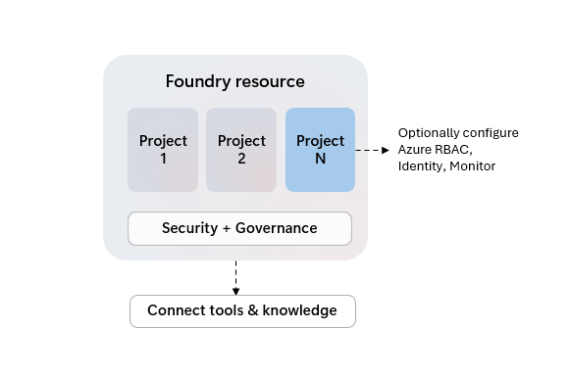
Foundry Resource
Project
1
Project
2
Project
n
Configure Identities, RBAC, Monitoring, etc.
…
Security + Governance
Connect to Tools and Knowledge bases
Notes:
Source: Create a Foundry resource - Foundry Tools | Microsoft Learn

Slide 3
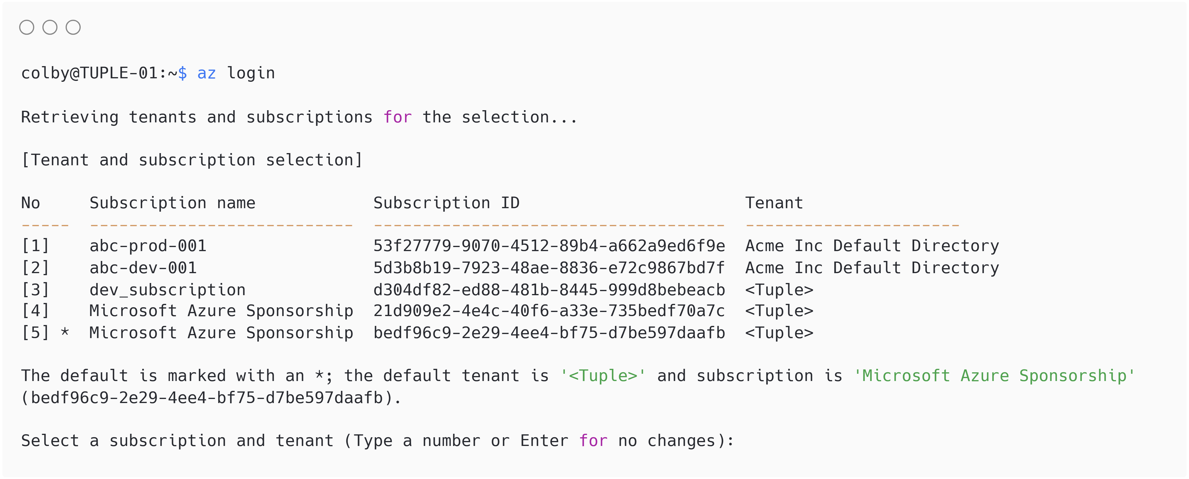
https://carbon.now.sh/
Theme: One Light
Notes:
Text:
colby@TUPLE-01:~$ az login
Retrieving tenants and subscriptions for the selection...
[Tenant and subscription selection]
No Subscription name Subscription ID Tenant
----- --------------------------- ------------------------------------ ----------------------
[1] abc-prod-001 d3c301c7-a8a5-417a-999b-71c166ab9ea1 Acme Inc Default Directory
[2] abc-dev-001 6283eb64-e04b-4c65-8360-e29ddf7ced32 Acme Inc Default Directory
[3] dev_subscription 21f436e1-bf10-4e17-9482-701611ba96e3 <Tuple>
[4] Microsoft Azure Sponsorship 716f8ad9-4f2d-48da-a905-eb77071da449 <Tuple>
[5] * Microsoft Azure Sponsorship bedf96c9-5241-45cc-b696-dcc91ebc089a <Tuple>
The default is marked with an *; the default tenant is '<Tuple>' and subscription is 'Microsoft Azure Sponsorship' (bedf96c9-5241-45cc-b696-dcc91ebc089a).
Select a subscription and tenant (Type a number or Enter for no changes):

Slide 4
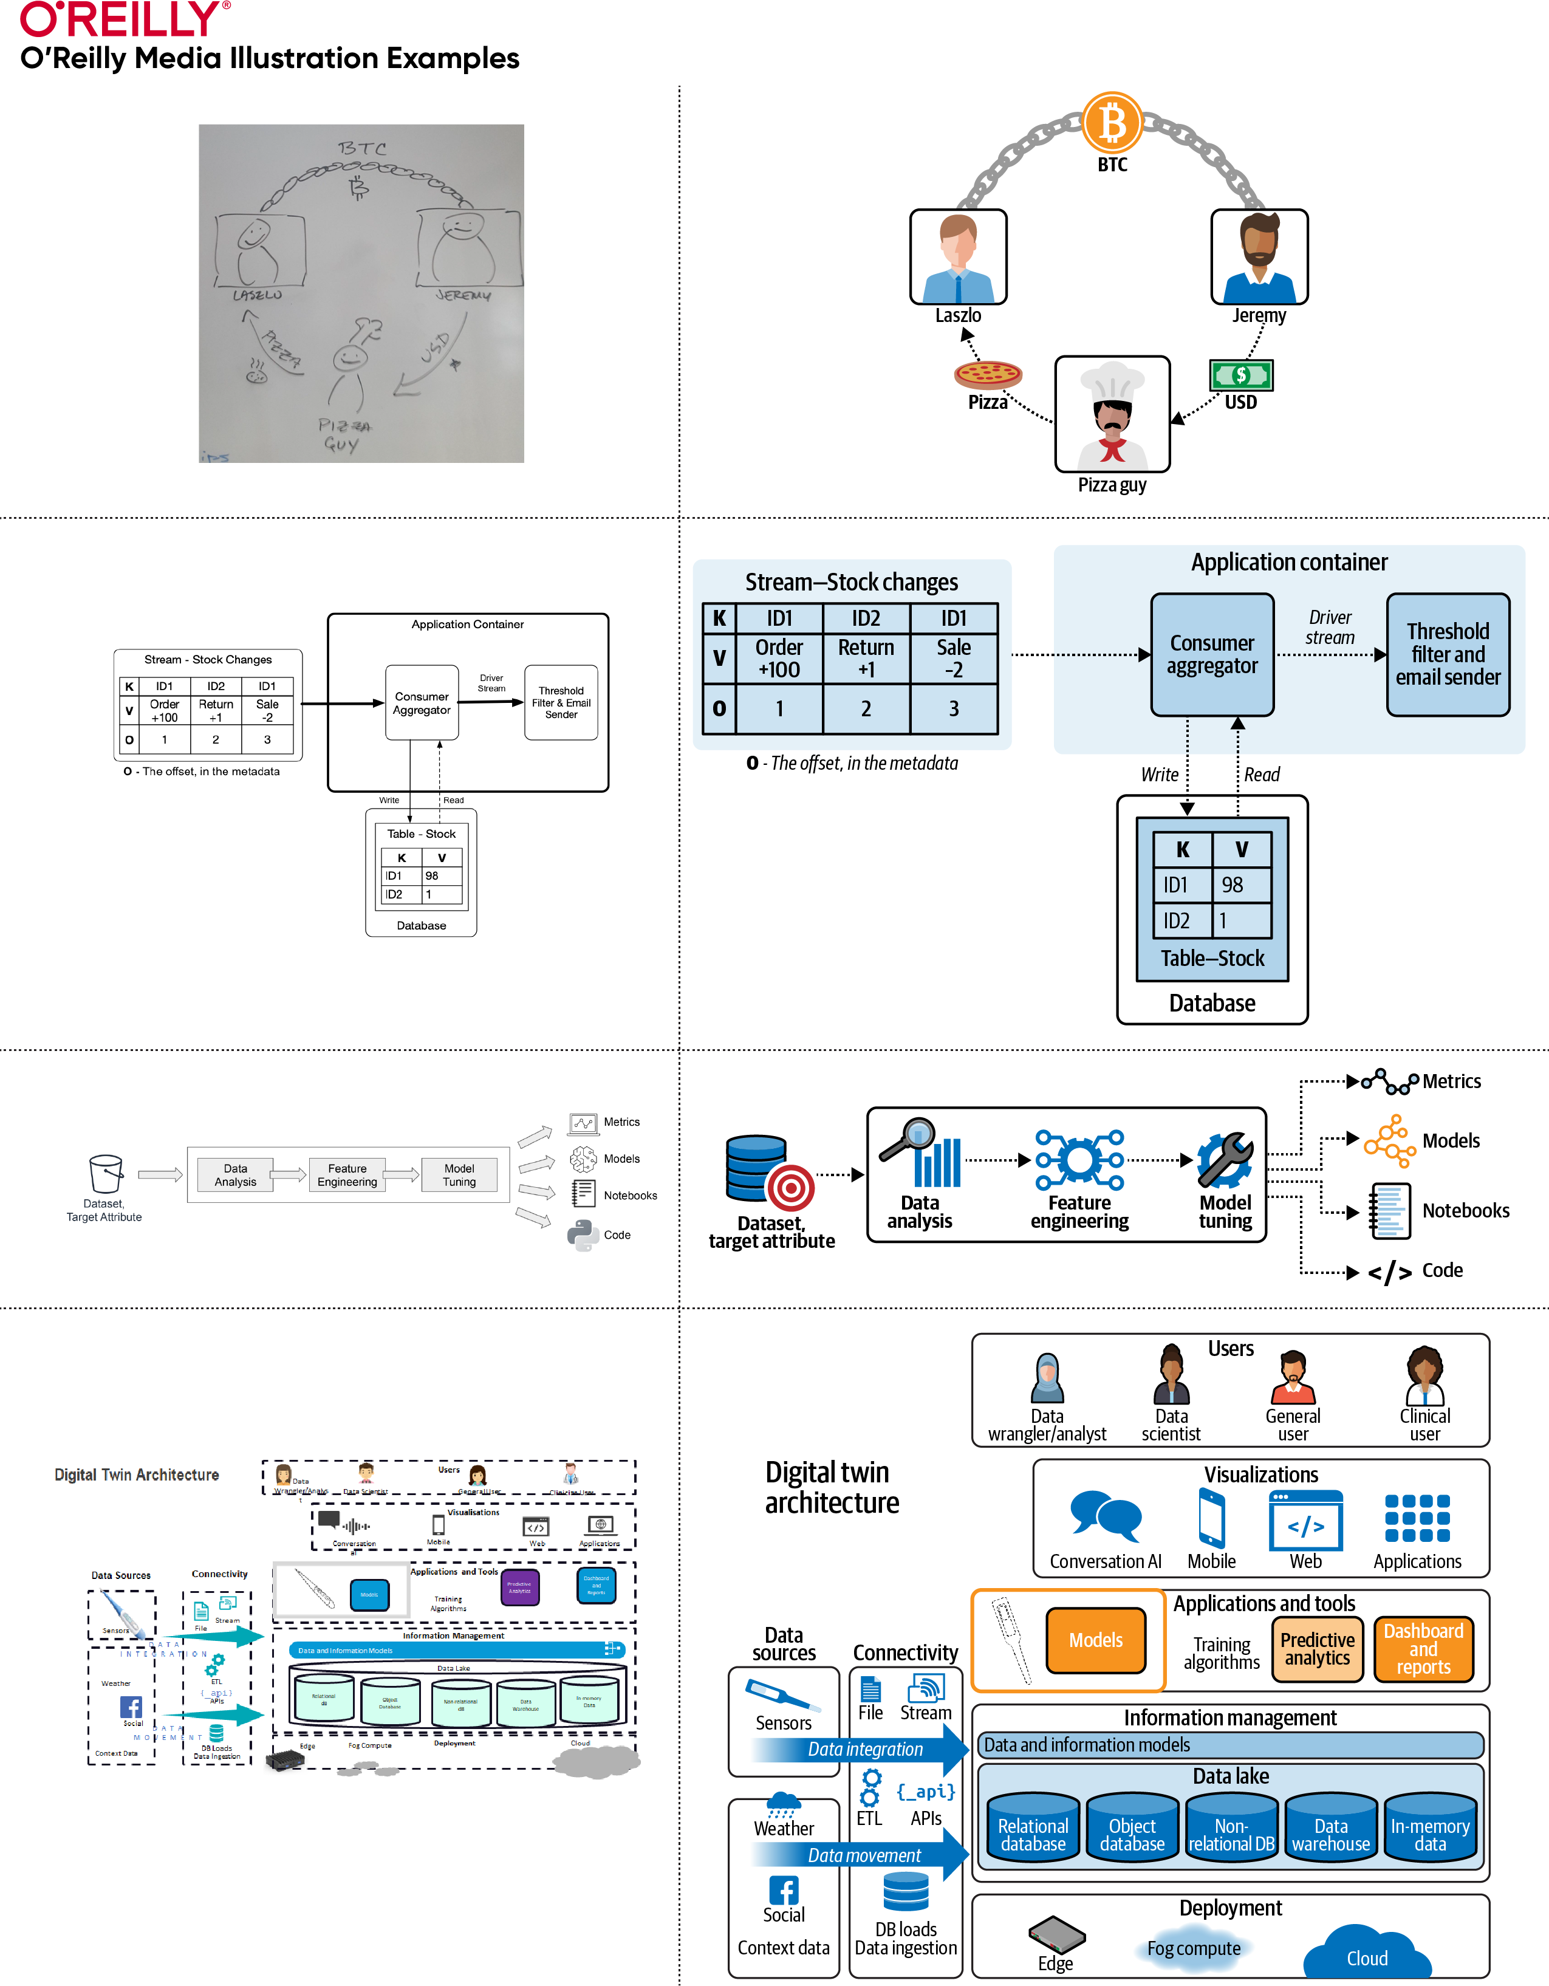
Style Guide: https://oreillymedia.github.io/production-resources/illustrations/
Fonts: Guardian Sans Cond Medium

