Slide 1


Zero-Shot Classification
of Protein Binders

Slide 2
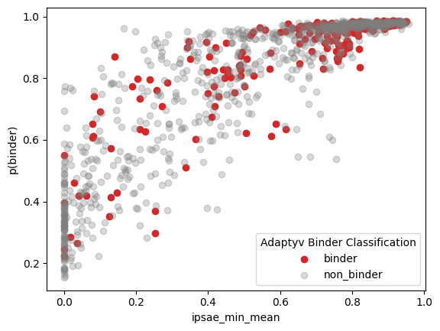
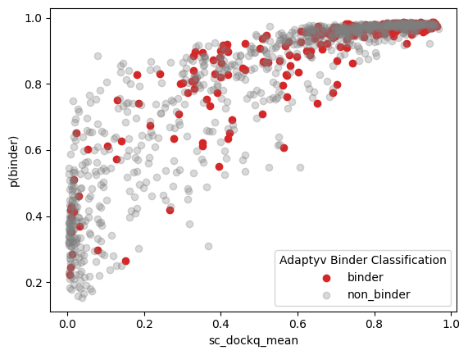
Adaptyv Binder - Qwen3.8-27B

Slide 3
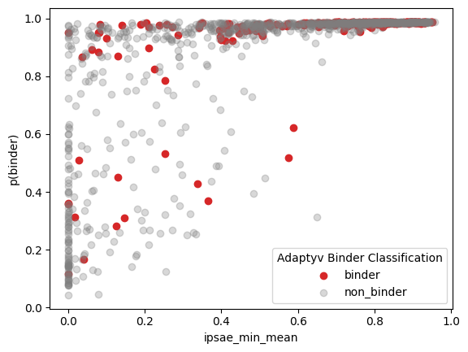
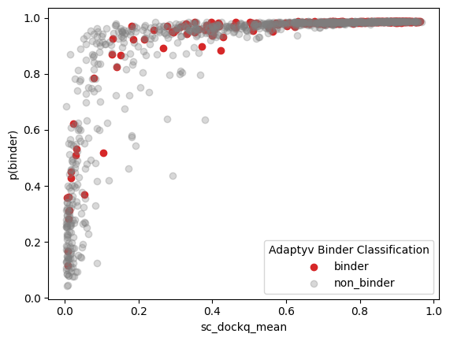
Adaptyv Binder - Qwen3.6-35B-A3B

Slide 4
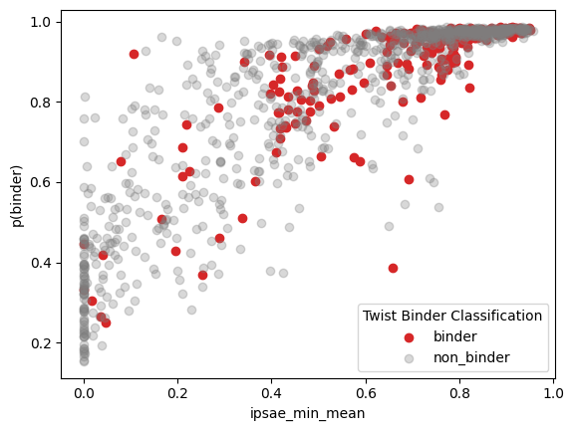
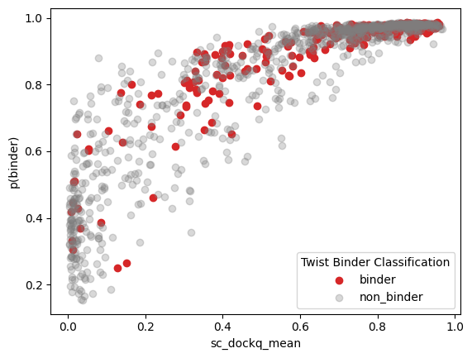
Twist Binder - Qwen3.8-27B

Slide 5
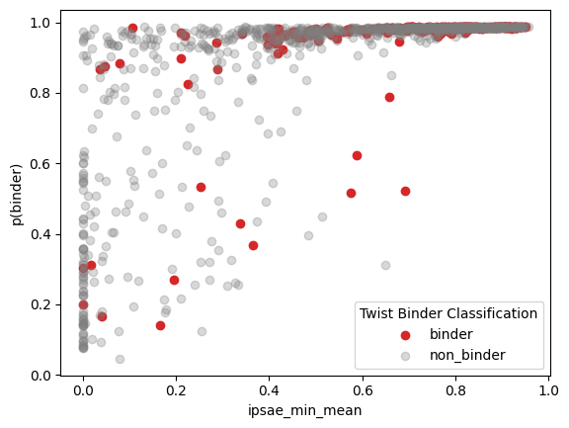

Twist Binder - Qwen3.6-35B-A3B

