Slide 1
Generating Inline Reports
A Working Example

Slide 2
Single text area
This vignette provides examples of how to add different types of slide content

Slide 3
Lists are pretty straight forward
Top level item
This is a sub bullet
This is another sub bullet

Slide 4
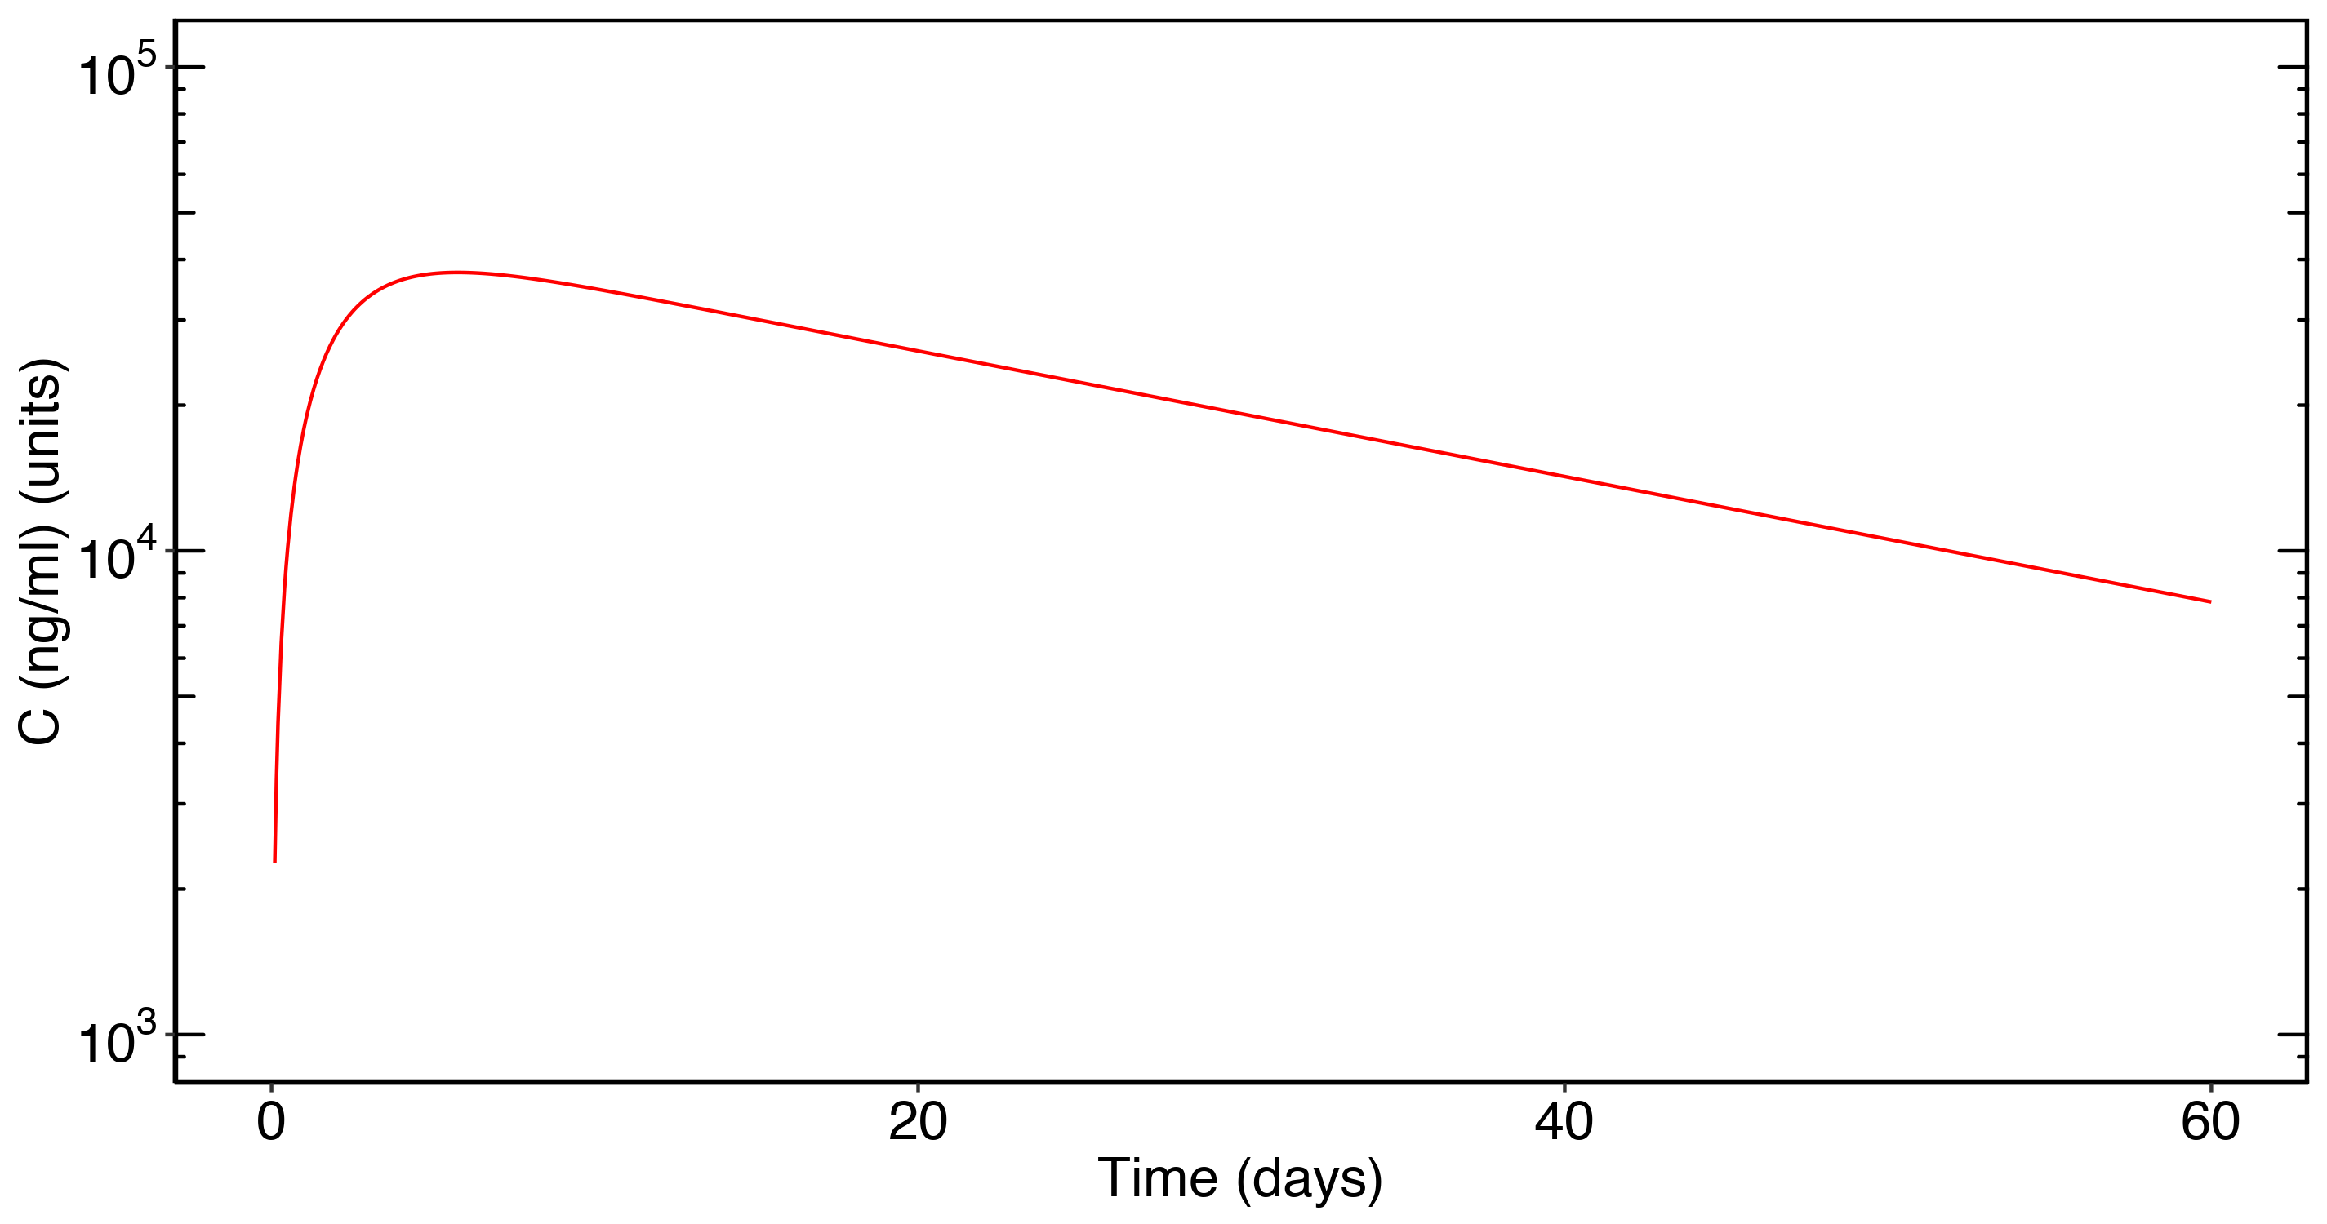
ggplot objects can be inserted directly

Slide 5

Images can be inserted from files
But the image should have the same aspect ratio as the placeholder

Slide 6
Simple Tables
F1 | ka | CL | Vc | Vp | Q | MW
0.744 | 0.282 | 0.2 | 3.61 | 2.75 | 0.747 | 140

Slide 7
Flextables
F1 | ka | CL | Vc | Vp | Q | MW
0.744 | 0.282 | 0.200 | 3.610 | 2.750 | 0.747 | 140.000

Slide 8
Two columns of lists
Top level item
This is a sub bullet
This is another sub bullet
F1 | ka | CL | Vc | Vp | Q | MW
0.744 | 0.282 | 0.200 | 3.610 | 2.750 | 0.747 | 140.000

Slide 9
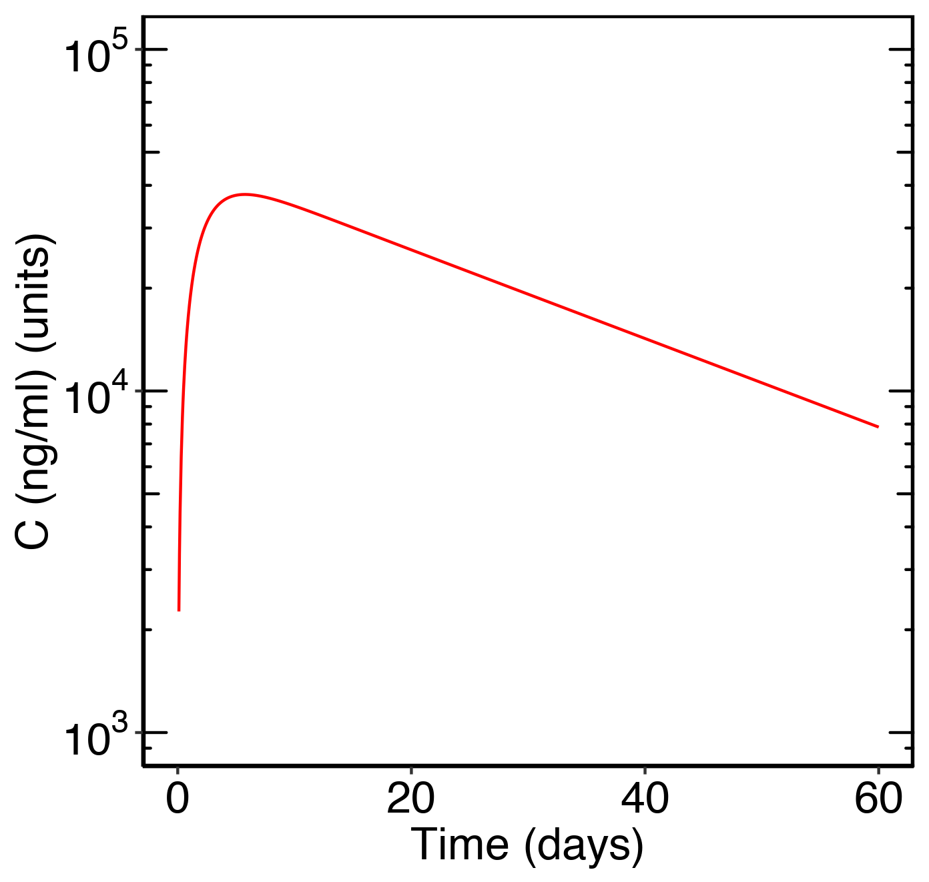
ggplot vs imagefile
Image file
ggplot object

