Slide 1
Generating Inline Reports
A Working Example

Slide 2
Single text area
This vignette provides examples of how to add different types of slide content

Slide 3
Lists are pretty straight forward
Top level item
This is a sub bullet
This is another sub bullet

Slide 4
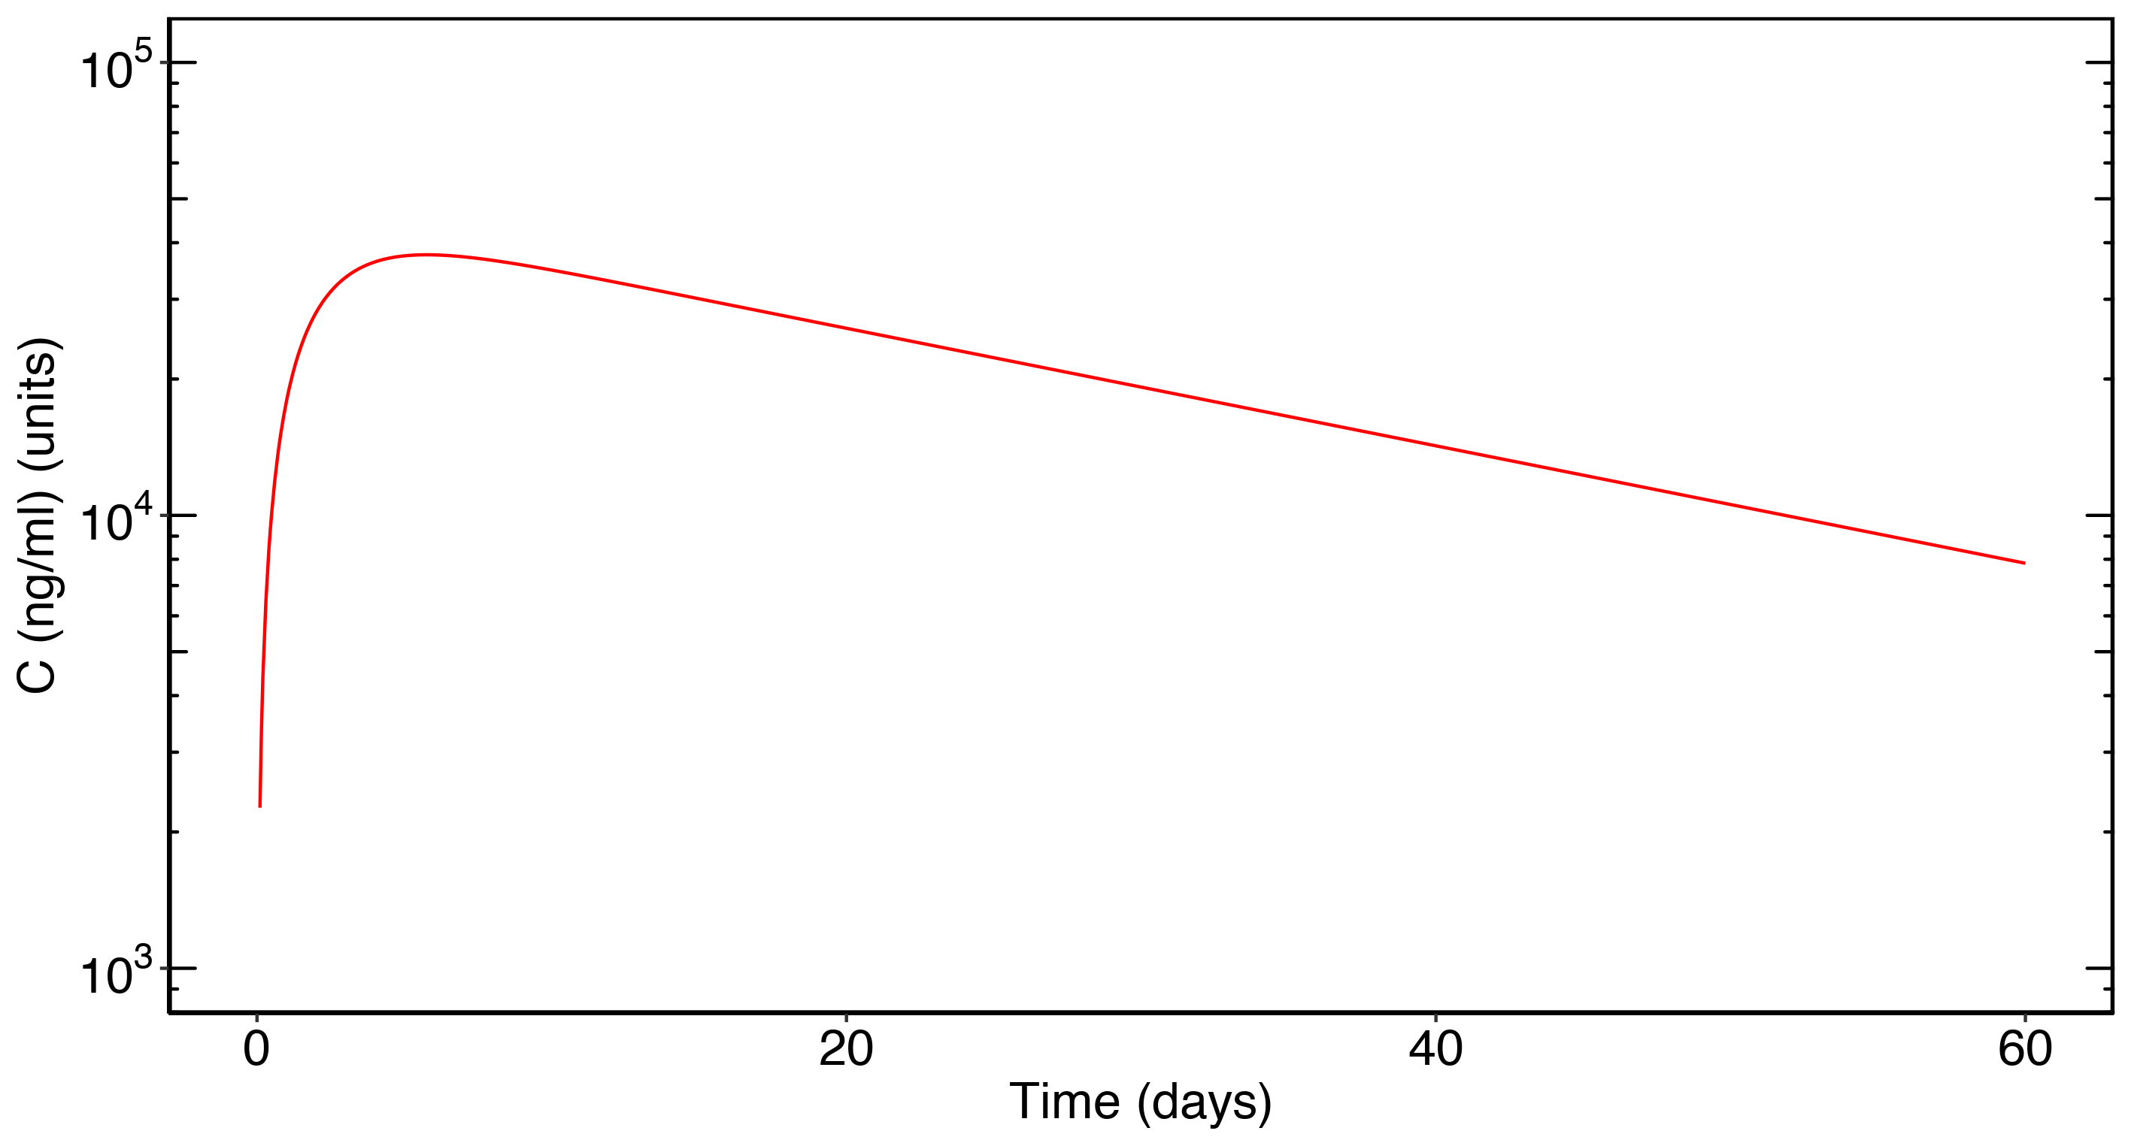
ggplot objects can be inserted directly

