Slide 1
CAL BERKELEY · INDEPENDENT STUDY · METHOD + LIVE RESULTS
Which traits travel into the Bundesliga?
Same pipeline on FBref (scale) and StatsBomb (deep dive) — in plain English.
Pipeline: Stability (does prior ↔ BL Y1 correlate?) → Redundancy (are two stable stats duplicates?) → Pizza (scout card from the keepers only).
Not Transfermarkt market value — we shortlist portable performance traits for scouting.
FBref Big 5: N=117 · gate r≥0.50 · shortlist 26 · StatsBomb Open Data: N=60 · gate r≥0.41 · shortlist 9

Slide 2
1 · DESIGN (COLLEGE-KID VERSION)
What we are actually doing
Question
Not market value
When a player moves into the 1. Bundesliga, which stats stay consistent — and which are mostly league context?
We do not optimize Transfermarkt price. We shortlist portable performance traits for scouting.
Pipeline: Stability (does prior ↔ BL Y1 correlate?) → Redundancy (are two stable stats duplicates?) → Pizza (scout card from the keepers only).
FBref = scale
StatsBomb = depth
Big 5 season stats · N=117 inbound pairs
103 metrics tested · gate r≥0.50 → 61 pass
Manual style-quota picks → shortlist 26
Minutes: prior ≥450 · BL Y1 ≥450
Open-data events · N=60 pairs
16 metrics · gate r≥0.41 → 11 pass
Keep more-stable side of pairs → shortlist 9
Interactive pizzas with Y1 percentile numbers

Slide 3
METHOD
Stability → redundancy → pizza
Same order as the NYRB metric framework. Destination = 1. Bundesliga. Axis 3 = portable traits, not market value.
① Stability
② Redundancy
③ Pizza
Correlate prior-league season vs Bundesliga Year-1 for each stat.
High r = the ranking travels.
Gate: FBref r≥0.50 · StatsBomb r≥0.41
Among passers, find pairs with |r|≥0.70 on BL Y1.
Those are near-duplicates.
Pick 1+ per cluster for style coverage (not only the single best).
Only shortlisted traits go on the scout card.
Filled wedge = Y1 percentile vs peers.
Number on the wedge = that percentile.
→
→
FBref: r≥0.50 → 61/103 pass → style-quota cluster picks → shortlist 26 (some intentional overlaps for success + failure).
StatsBomb: r≥0.41 → 11/16 pass → PAS>CRY · XG>SH · PPC>PAS → shortlist 9.

Slide 4
METHODOLOGY · WHAT THIS IS
Scouting metric evaluation — not a BL crystal ball
Family: applied sports analytics / metric selection (same logic as NYRB internship work).
Core stats tools: Pearson correlation, redundancy screening, percentile benchmarking, manual Step-2 judgment.
What we DID measure
What we did NOT build
Is that “data science”? Yes.
Trait portability: does prior-league ranking of a stat correlate with Bundesliga Y1 ranking? (stability r)
Trait uniqueness: among portable stats, which are near-duplicates? (|r|≥0.70)
Descriptive Y1 strength on the shortlist (stable-trait score = mean peer percentile).
Not a supervised ML model that predicts goals, minutes, or “success.”
No train/test split, no forecast of next-season outcomes.
Stability ≠ “this player will smash it” — it means “this trait’s ranking tends to travel.”
Cohort design + cleaning + joins
Correlation / feature screening
Redundancy (multicollinearity-style) pruning
Peer percentiles + interactive profiles
Human-in-the-loop selection (Step 2)
Honest claim for Conrad
This project answers: which measurable traits are trustworthy to weight when scouting Big-5 → Bundesliga moves?
It supports scouting judgment with evidence. It does not claim to predict Bundesliga performance end-to-end.
A natural Phase-2 (if more credits/time): regress Y1 minutes / contribution on prior shortlist traits with validation — that would be prediction.

Slide 5
2 · STABILITY (STATSBOMB)
Prior competition → Bundesliga Y1 · pass if r ≥ 0.41
Open Data · cohort N=60 · 11 of 16 pass (green) · 5 out
Abbrev | Metric | Category | r | Gate
DIS | Dispossessed (inverted) | Other | 0.787 | PASS
PPC | Progressive passes (~10m+ toward goal) | Passing | 0.720 | PASS
PRS | Pressures | Defending | 0.677 | PASS
PAS | Pass volume | Passing | 0.532 | PASS
TAC | Tackles | Defending | 0.532 | PASS
CLR | Clearances | Defending | 0.491 | PASS
XG | Non-pen xG | Attacking | 0.482 | PASS
SH | Shots | Attacking | 0.447 | PASS
DRB | Successful dribbles | Carrying | 0.439 | PASS
PATT | Passes into final third | Passing | 0.431 | PASS
CRY | Carries | Carrying | 0.413 | PASS
CFGP | Progressive carries | Carrying | 0.325 | out
FLW | Fouls won | Other | 0.316 | out
AER | Aerials won | Defending | 0.312 | out
XA | Expected assists | Attacking | 0.289 | out
INT | Interceptions | Defending | 0.167 | out
Next: redundancy among passers → shortlist of 9 → pizzas.

Slide 6
3 · STABILITY (FBREF)
61 metrics pass r ≥ 0.50 — showing top 20
Big 5 → Bundesliga · N=117 · prior≥450 · Y1≥450 · 103 tested · full list in results/fbref_stability_passed_r050.csv
Abbrev | Metric | Category | r | N
DEFPE | Def Pen Touches | Defending | 0.920 | 114
PRGC | PrgC Progression | Passing | 0.891 | 117
PRGDI | PrgDist Total | Passing | 0.865 | 117
ATTLO | Att Long | Other | 0.851 | 117
XG | xG Per | Attacking | 0.849 | 117
PRGR | PrgR Progression | Passing | 0.843 | 117
SHPER | Sh/90 Standard | Attacking | 0.836 | 117
XGPLU | xG+xAG Per | Passing | 0.833 | 117
NPXG | npxG Per | Attacking | 0.831 | 117
NPXGP | npxG+xAG Per | Passing | 0.821 | 117
CMPLO | Cmp Long | Passing | 0.812 | 117
TOTDI | TotDist Total | Passing | 0.797 | 117
DEF3R | Def 3rd Touches | Defending | 0.795 | 114
SOTPE | SoT/90 Standard | Attacking | 0.790 | 117
ATTME | Att Medium | Other | 0.790 | 117
CMPME | Cmp Medium | Passing | 0.782 | 117
ATT | Att Total | Other | 0.773 | 117
PRGRR | PrgR Receiving | Carrying | 0.769 | 114
PRGC | PrgC Carries | Carrying | 0.759 | 114
KP | KP | Passing | 0.756 | 117
Style coverage among passers: attacking · passing · carrying · defending · aerials

Slide 7
4 · REDUNDANCY PICKS
What we kept after resolving duplicates
StatsBomb shortlist (9)
FBref shortlist (26)
Among |r|≥0.70 pairs, keep the more stable metric:
PAS > CRY · XG > SH · PPC > PAS
Style quota: a few from attack / pass / carry / defend / aerial.
Allowed intentional overlaps for success + failure versions of a trait.
DIS · Dispossessed (inverted) · r=0.79
Attacking (3)
PPC · Progressive passes (~10m+ toward goa · r=0.72
XG (0.85) · GLS (0.71) · ATTSH (0.69)
PRS · Pressures · r=0.68
Passing (7)
PAS · Pass volume · r=0.53
PRGC (0.89) · PRGDI (0.87) · KP (0.76) · FINAL (0.70) · CMPPE (0.69) · CRSPA (0.66) · CRS (0.64)
TAC · Tackles · r=0.53
Carrying (4)
PRGRR (0.77) · ATT3R (0.73) · SUCC (0.71) · MIS (0.68)
CLR · Clearances · r=0.49
XG · Non-pen xG · r=0.48
Defending (11)
DEFPE (0.92) · CLR (0.72) · TKLD (0.71) · WON (0.71) · SH (0.69) · INT (0.65) · LOST (0.64) · WONPE (0.57) · DEF3R (0.54) · TKLPE (0.51) · RECOV (0.50)
DRB · Successful dribbles · r=0.44
PATT · Passes into final third · r=0.43
Other (1)
FLD (0.59)

Slide 8
FBREF · FINAL SHORTLIST (26)
Every kept trait with stability r — same list as the HTML brief
# | Abbrev | Metric | Category | r
1 | DEFPE | Def Pen Touches | Defending | 0.920
2 | PRGC | PrgC Progression | Passing | 0.891
3 | PRGDI | PrgDist Total | Passing | 0.866
4 | XG | xG Per | Attacking | 0.849
5 | PRGRR | PrgR Receiving | Carrying | 0.769
6 | KP | KP | Passing | 0.756
7 | ATT3R | Att 3rd Touches | Carrying | 0.733
8 | CLR | Clr | Defending | 0.723
9 | GLS | Gls Standard | Attacking | 0.714
10 | SUCC | Succ Take | Carrying | 0.712
11 | TKLD | Tkld Take | Defending | 0.709
12 | WON | Won Aerial | Defending | 0.709
13 | FINAL | Final Third | Passing | 0.698
14 | ATTSH | Att Short | Attacking | 0.695
15 | SH | Sh Blocks | Defending | 0.690
16 | CMPPE | Cmp percent Medium | Passing | 0.688
17 | MIS | Mis Carries | Carrying | 0.675
18 | CRSPA | CrsPA | Passing | 0.662
19 | INT | Int | Defending | 0.648
20 | LOST | Lost Aerial | Defending | 0.644
21 | CRS | Crs | Passing | 0.638
22 | FLD | Fld | Other | 0.592
23 | WONPE | Won percent Aerial | Defending | 0.567
24 | DEF3R | Def 3rd Tackles | Defending | 0.543
25 | TKLPE | Tkl percent Challenges | Defending | 0.511
26 | RECOV | Recov | Defending | 0.503
Source: decisions/step2_fbref.json · 10 acknowledged overlapping pairs kept on purpose

Slide 9
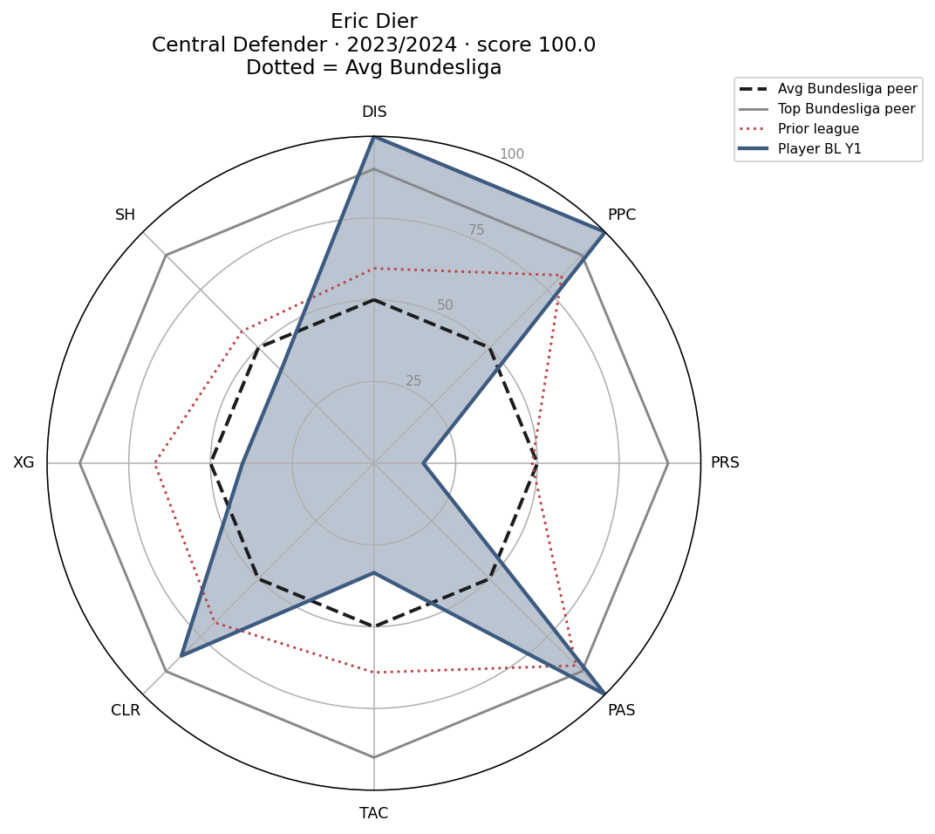
OUTPUT · SCOUT PIZZA
Example player profile
Built from shortlisted traits. Explorer HTML combines FBref + StatsBomb with category slices.
How to read
Blue fill = Bundesliga Y1 · red dotted = prior · dashed = avg peer (50) · grey = top peer (90).
Numbers are percentiles 0–100 vs position peers (not raw per-90).
Explorer combines both sources in one tool:
• StatsBomb — N=60 · 11 stability passers
• FBref — N=117 · 26 Step-2 traits
Radar slices = style categories; metric list grouped under each slice.

Slide 10
DEFINITION
What “stable-trait score” means
One number that answers: in Bundesliga Year-1, how strong is this player on the portable (shortlisted) traits — vs peers at their position?
1 · Pick the traits
2 · Turn each into a percentile
3 · Average them
Only use the shortlist from Step 2 (StatsBomb: 9 traits that passed stability and redundancy).
Unstable / dropped metrics do not enter the score.
For each shortlist trait, take the player’s Bundesliga Y1 per-90 value.
Rank it vs all Bundesliga peers in the same broad position.
0 = worst peer · 50 = average · 100 = best peer.
Stable-trait score = mean of those Y1 percentiles across the shortlist.
Example: if a CB is 70th / 60th / 80th on three traits → score ≈ 70.
Higher = better Year-1 profile on traits that travel.

Slide 11
5 · HOW TO USE THE EXPLORER
interactive_player_explorer.html
1
Open interactive_player_explorer.html in a browser.
2
Switch StatsBomb (N=60 · 11 traits) ↔ FBref (N=117 · 26 traits). Dropdowns: league → position → player.
3
Radar slices = style categories (attack/pass/carry/defend). Each slice averages that group’s percentiles.
4
Same explorer combines both sources — pick FBref or StatsBomb in the data-source dropdown.

Slide 12
RESULTS · SUCCESS INDICATORS
Which prior traits & leagues line up with BL Year-1 success?
Phase 2 (associative): after shortlisting portable traits, test what predicts BL success.
Outcomes: Y1 minutes (playing time) · Y1 minutes percentile · stable-trait score.
Trait test: Spearman ρ between prior-season trait percentile and each outcome.
League test: mean/median outcomes by feeder league. Directional — not a validated forecast model.
StatsBomb
FBref Big 5
Honest claim
N=60 open-data cohort
Primary priors often intl comps
Weaker league signal · use for traits
N=117 inbound pairs
Ligue 1 / PL / Serie A / La Liga
Stronger league + trait signal
Supports scouting weights
Does not predict every transfer
Repo: results/SUCCESS_INDICATORS.md
Interpretation: positive ρ = arriving with a higher prior percentile on that trait tends to coincide with more BL Y1 minutes / higher trait score.
Negative ρ on inverted metrics (e.g. dispossessed) can still be informative — read label + sign together.

Slide 13
SUCCESS DEFINITION · YEAR-1 MINUTES
How we operationalize “Bundesliga success” in Phase 2 with open data.
Primary success marker: Bundesliga minutes played in the player’s first BL season (Y1 minutes)
Interpretation: playing-time success — did the club trust and use the inbound player?
Also reported: Y1 minutes percentile (rank in cohort) and stable-trait score (profile fit)
Trait & league tests ask: which prior signals line up with more Y1 minutes?
Regression Δ Y1 min = estimated extra first-season minutes vs a reference league, holding controls
Why minutes?
Observable in FBref / StatsBomb cohorts
Directly measures opportunity & role
Not the same as goals, xG, or team points
Honest scope: associative scouting weights, not a forecast model

Slide 14
IF WE HAD THE DATA · TRANSFERMARKT VALUE
What we would use instead of (or alongside) Y1 minutes.
Top indicator in a full club model: change in market value (Δ Transfermarkt MV)
Captures performance + hype + contract context in one outcome scouts care about
NYRB Axis-3 used MV; this project uses open data only — Transfermarkt bans bots
So we proxy success with Y1 minutes until a licensed MV feed is available
Natural extension: prior traits → Δ MV with holdout regression / ML
Bottom line
Y1 minutes = best open-data proxy for first-year BL success
Δ Transfermarkt value = preferred outcome in a pro scouting stack
Same pipeline (stability → traits → outcome) — swap the Y variable

Slide 15
RESULTS · TRAITS → BL SUCCESS
Prior trait percentiles most indicative of Year-1 minutes (Spearman ρ)
StatsBomb (N=60) — top |ρ|
FBref Big 5 (N=117) — significant traits
Trait | ρ | p
DRB — Successful dribbles | -0.30 | 0.021
DIS — Dispossessed (inverted) | 0.29 | 0.026
PRS — Pressures | -0.29 | 0.026
PPC — Progressive passes (~10m+ to | 0.22 | 0.092
PATT — Passes into final third | -0.21 | 0.104
XG — Non-pen xG | -0.17 | 0.204
Trait | ρ | p
LOST — Lost Aerial* | 0.25 | 0.007
FINAL — Final Third* | 0.24 | 0.008
SH — Sh Blocks* | 0.23 | 0.011
DEFPE — Def Pen Touches* | 0.20 | 0.035
WONPE — Won percent Aerial | 0.17 | 0.062
PRGDI — PrgDist Total | 0.17 | 0.073
MIS — Mis Carries | 0.16 | 0.078
CLR — Clr | 0.13 | 0.162
StatsBomb (directional): higher prior progressive passes (PPC) & dispossessed (inv) ↔ more Y1 minutes; high prior pressures/dribbles ↔ fewer minutes in this sample.
FBref (stronger N): prior final-third passing, defensive box actions, blocks, aerials ↔ more Y1 minutes (ρ≈0.17–0.25, p<0.05 for top traits).
Takeaway for scouts: weight defensive involvement + progression in the penalty/third when judging Big-5 → BL transfers.

Slide 16
RESULTS · FEEDER LEAGUES → BL SUCCESS
Which source leagues produce the strongest Year-1 outcomes?
FBref Big 5 inbound (N=117) — minutes gate ≥450 both sides
League | N | Mean Y1 min | Median Y1 min | Trait score
Ligue 1 | 52 | 1574 | 1460 | 51.1
Premier League | 30 | 1508 | 1390 | 50.2
La Liga | 11 | 1479 | 1411 | 50.6
Serie A | 24 | 1426 | 1252 | 52.4
StatsBomb priors (N=60 · small league cells)
League | N | Mean Y1 min | Trait score
FIFA World Cup | 22 | 248 | 57.3
Premier League | 3 | 146 | 53.6
La Liga | 3 | 220 | 49.7
Ligue 1 | 16 | 132 | 49.5
UEFA Euro | 15 | 203 | 49.5
FBref: Ligue 1 arrivals average the most Y1 minutes (~1,574); Serie A the fewest (~1,426) but slightly highest mean trait score (~52). Differences are modest — all Big 5 feeders work.
StatsBomb: many priors are World Cup/Euro minutes — league ranking is directional only (PL/Ligue 1 cells very small).
Full tables: results/success_league_indicators_*.csv · script: scripts/run_success_indicators.py

Slide 17
NEXT PHASE · FEEDER REGRESSION (WHY)
Descriptive “best feeder” is not enough — OLS explains league gaps vs a baseline.
Outcome: BL Year-1 minutes (playing-time success proxy)
Reference league: Serie A (lowest mean Y1 minutes descriptively)
M1: y1_minutes ~ feeder league dummies + prior minutes + position
M3: add prior trait percentiles (Final Third, box touches, aerials…)
M4: 80/20 holdout check — exploratory, not a production forecast
What this is / is not
IS: next-phase explanatory regression — why Ligue 1 ranks high in means
IS: bridge to holdout ML (same features, train/test split)
NOT: validated BL performance prediction
N = 117 · league cells are small → wide confidence bands

Slide 18
RESULTS · REGRESSION — WHY LIGUE 1 LOOKS BEST
M1 R²=0.086 → M3 R²=0.215 when traits added · holdout r=0.35 (exploratory)
League vs Serie A | Δ Y1 min | p
La Liga | +48 | 0.856
Ligue 1 | +163 | 0.375
Premier League | +88 | 0.661
Prior trait pct | Δ Y1 min | p
Lost Aerial* | +9 | 0.002
Final Third | +5 | 0.158
Def Pen Touches | +5 | 0.189
PrgDist Total | -4 | 0.249
xG Per | +2 | 0.430
Descriptive: Ligue 1 highest mean Y1 minutes
Regression: +163 min vs Serie A, but p≈0.38 — not significant at N=117
Trait profile matters more than league label (R² doubles)
Lost Aerial prior pct: +9 min per step, p=0.002*
Takeaway: scout traits + minutes; league is a weak residual signal
* p<0.05. Full tables: results/FEEDER_REGRESSION.md

Slide 19
WHAT TO TAKE AWAY
Traits that travel · how to use them
FBref (scale)
Strong travelers: Def Pen touches, PrgC / PrgDist, xG, aerial wins, clearances, take-on success.
Shortlist spans attack · pass · carry · defend · aerial.
StatsBomb (depth)
Strong travelers: dispossessed (inv), progressive passes, pressures.
11 stability passers on N=60 — live in the combined explorer with FBref.
Scout use
When evaluating a Big 5 → Bundesliga target, weight shortlisted traits higher than flashy unstable ones.
Do not treat two metrics in a redundant pair as independent evidence — unless you intentionally kept both (e.g. aerial wins + losses).
Explorer: one HTML tool combining FBref + StatsBomb (toggle source). Gates: FBref r≥0.50 · StatsBomb r≥0.41.

Slide 20
6 · DELIVERABLES
What ships for Conrad
Deck
bundesliga_transfer_traits.pptx — this file (mirrors the HTML brief)
Explorer
interactive_player_explorer.html — combines FBref + StatsBomb; category pizza + percentiles
Brief
methodology_results_brief.html — same explanation + tables
Proposal
projectproposal / conrad docs
Decisions
decisions/step2_*.json + PDFs (local)
Data
results/ — stability CSVs, FBREF_RESULTS.md
Repo
github.com/colbymorris08/bundesliga-transfer-traits
FBref gate r≥0.50 · StatsBomb gate r≥0.41

