Slide 1
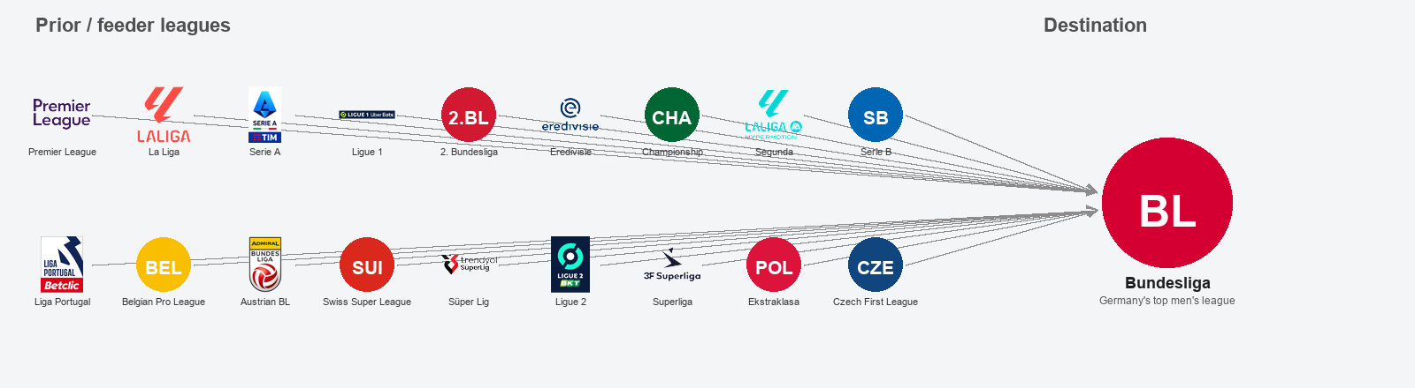
COLBY MORRIS · BERKELEY HAAS · INDEPENDENT STUDY
Which traits most accurately travel into the Bundesliga (Germany’s top men’s soccer league) from other professional soccer leagues?
Football Reference + StatsBomb data sources
*Based on framework used in data science internship with Red Bull New York transfer-market evaluation*

Slide 2
PROJECT STEPS · TIMELINE
Flow: research question → collect data (Football Reference + StatsBomb) → keep traits that stay consistent after the move → drop near-duplicate traits → interactive player charts → test which prior traits and leagues line up with more first-season Bundesliga minutes
1
Question
Which traits travel into the Bundesliga (Germany’s top men’s soccer league) — and which prior stats line up with more minutes in a player’s first Bundesliga season?
5
Drop near-duplicates
Remove traits that almost always move together (same information twice). Football Reference 43→32 · StatsBomb keep all 7.
6
Player charts
Category radar charts on the shortlisted traits (interactive_player_explorer.html).
2
Collect data from two sources
Football Reference: 19 leagues; first Bundesliga season in 2021–2025; prior season and first Bundesliga season each ≥300 minutes.
StatsBomb: 17 competitions; Bundesliga match files for 2015/16 and 2023/24; prior ≥45 minutes / first Bundesliga season ≥30 minutes.
7
Success tests
Spearman rank correlation: prior trait percentile vs first-season Bundesliga minutes; averages by prior league; exploratory ordinary least squares (OLS) regression.
Consistency check (“stability”)
For each per-90-minute rate, correlate the prior-league season with the first Bundesliga season. Keep traits that clear a minimum correlation (“travel”). Traits that miss the cutoff are treated as non-traveling (do not clear the consistency floor) and listed in the inspector, not on the final shortlist.
3
4
Choose cutoffs
Football Reference category cutoffs → 43 of 105 metrics met the consistency floor. StatsBomb Pearson r ≥ 0.40 → 7 of 16.
Compared with the New York Red Bulls project: here we define which traits stay consistent after a move and which prior rates line up with more first-season Bundesliga minutes — not Transfermarkt market value. Analysts can ask which outside-league rates best relate to playing time once a player arrives.

Slide 3
1 · DESIGN
Research Question
Question
Difference from New York Red Bulls Project: Not market value
When a player moves into the top German league, the Bundesliga, which stats stay consistent — and which are league context?
This applies only to players who entered the Bundesliga from a different league (transfers / promotions).
We do not optimize Transfermarkt price. We shortlist performance traits that stay consistent after the move into the Bundesliga.
Consistency check → drop near-duplicates → radar charts / explorer → success tests
Football Reference = larger sample, season-rate metrics
19 leagues · first Bundesliga season 2021–2025 · ≥300 minutes each side
N=329 player pairs
105 metrics tested → 43 met consistency floor → 32 left after dropping near-duplicates
Attacking / Passing / Other: Pearson r ≥ 0.60
Defending / Carrying: Pearson r ≥ 0.50 (slightly lower so enough defensive metrics remain)
StatsBomb = deeper event metrics, smaller sample
N=96 · prior ≥45 minutes / first Bundesliga season ≥30 minutes
Pearson r ≥ 0.40 → 7 of 16 · near-duplicate cutoff |r| ≥ 0.85 (all 7 kept)
Prior competitions: 17 · Bundesliga files: 2015/16 + 2023/24

Slide 4
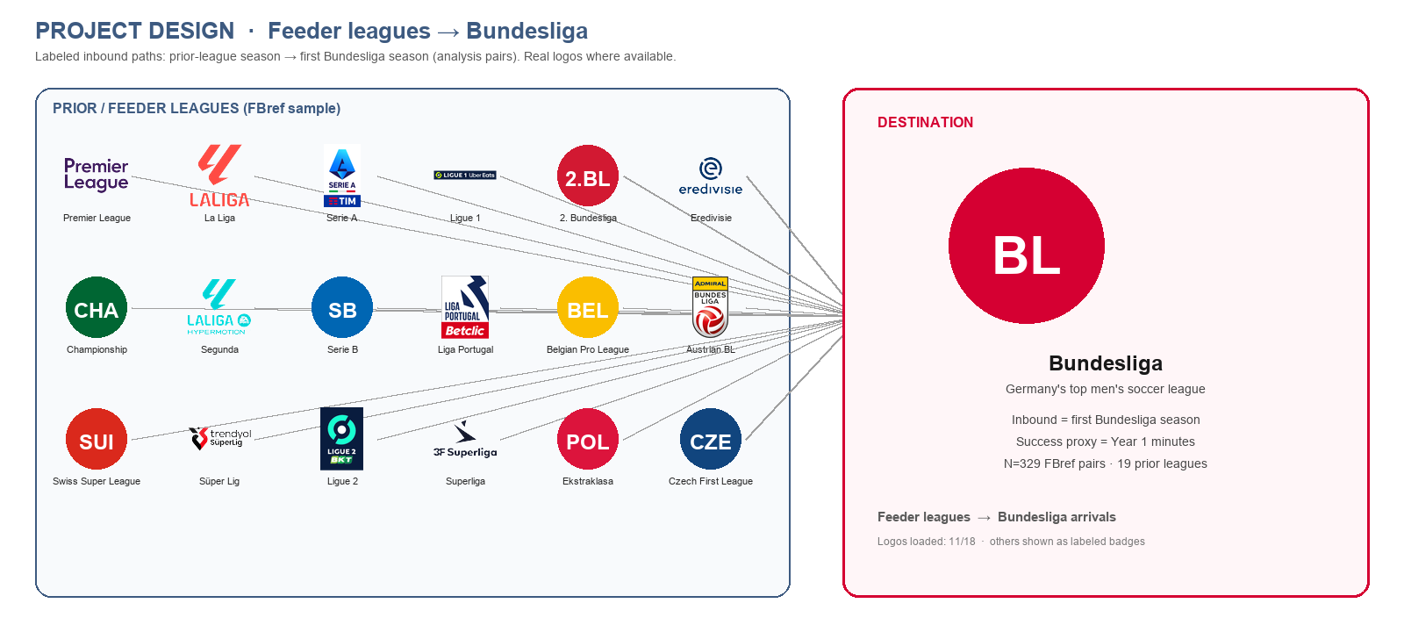
1 · DESIGN
GENERAL OVERVIEW

Slide 5
METHODOLOGY · WHAT THIS IS
Metric evaluation for transfers into the Bundesliga
Applied sports analytics / metric selection (same broad framework as a New York Red Bulls internship project).
Pearson r = consistency (“stability”): does a player’s ranking on a rate in the prior league tend to show up again in the first Bundesliga season?
Success = more minutes in the first Bundesliga season (playing time), not goals or market value. Spearman ρ asks whether higher prior trait ranks line up with more first-season minutes.
Near-duplicates = traits that move together; we keep one. Percentiles = rank versus Bundesliga players at a similar position (0–100).
Measurables
Disclaimer
Data science methods
Trait consistency — prior season ↔ first Bundesliga season (Pearson r)
Near-duplicates removed — Football Reference |r| ≥ 0.95 · StatsBomb |r| ≥ 0.85
First-season profile strength — stable-trait score (average percentile on kept traits)
Not a production forecast of goals, minutes, or “success.”
Consistency ≠ “this player will succeed” — it means the ranking tends to travel from one league to the Bundesliga.
OLS is exploratory (Big Five European leagues subset, N=117), not club-grade validation.
Cohort design + data joins
Correlation / feature screening
Near-duplicate pruning
Peer percentiles + interactive explorer
Analyst review of the shortlist after the automated filters

Slide 6
DATA · FOOTBALL REFERENCE (Primary Source)
Scale layer — prior leagues → Bundesliga
What we use
Season tables from leagues outside the Bundesliga, plus player-page fills when needed
Analysis window: first Bundesliga seasons ending 2021–2025
Minutes: prior season ≥300′ and first Bundesliga season ≥300′ → N=329 pairs · 19 leagues
League-relative scaling (mentioned once): we tried scoring each rate as “how high vs peers in the same prior league” (z-score / percentile). It did not improve prior→first-season consistency, so we keep absolute per-90-minute rates everywhere.
Time Window · 2021–2025 · ≥300′ both sides · N=329

Slide 7
DATA · STATSBOMB OPEN DATA (Deeper but secondary/smaller data source)
What we use
“Open” = free public StatsBomb match files (not a paid feed). Priors = any of those men’s competitions the player appeared in before the Bundesliga (club leagues and tournaments such as the World Cup, European Championship, and Champions League).
Bundesliga open match files available: 2015/16 and 2023/24 only
N=96 · prior ≥45′ · first Bundesliga season ≥30′
Pearson r ≥ 0.40 → 7 metrics · near-duplicate cutoff |r| ≥ 0.85 → keep all 7
Smaller open-data sample · only two Bundesliga seasons · event-level check
Versus Football Reference
Same pipeline; thinner year coverage by design.
Event-level check on trait families — not a second league-ranking study.
Priors mix club and international competitions, so prior-league tables here are directional only.

Slide 8
CONSISTENCY CHECK (FOOTBALL REFERENCE) · top metrics
Metric | Category | r | N
Defensive penalty-area touches | Defending | 0.906 | 95
Progressive carries | Passing | 0.805 | 100
Expected goals (xG) | Attacking | 0.797 | 100
Non-penalty expected goals | Attacking | 0.793 | 100
Defensive-third touches | Defending | 0.789 | 95
Progressive carry distance | Passing | 0.789 | 100
Shots per 90 minutes | Attacking | 0.789 | 292
Shots (standard counting) | Attacking | 0.788 | 292
Non-penalty xG + expected assists | Passing | 0.787 | 100
Expected goals + expected assists | Passing | 0.786 | 100
Long pass attempts | Other | 0.785 | 100
Shots on target | Attacking | 0.775 | 292
Shots on target per 90 | Attacking | 0.774 | 292
Long pass completions | Passing | 0.767 | 100
Medium pass completions | Passing | 0.730 | 100
Medium pass attempts | Other | 0.724 | 100
Total pass distance | Passing | 0.720 | 100
Progressive passes received | Passing | 0.703 | 100
Goals + assists | Other | 0.702 | 100
Free kicks | Other | 0.697 | 100
Prior league → first Bundesliga season (end-years 2021–2025)
Paired N=329 · 19 leagues · ≥300 minutes on both sides
Category cutoffs (not one global cut):
Attacking / Passing / Other · Pearson r ≥ 0.60
Defending / Carrying · Pearson r ≥ 0.50
43 of 105 metrics pass → next: drop near-duplicates
The defending cutoff is lower because fewer defensive rates cleared 0.60, and defending is harder to capture in event counts (positioning off the ball is mostly missing).
Full metric names in the table.
The other 62 metrics miss the floor — non-traveling; listed in the inspector.

Slide 9
→ Glossary
STABILITY (STATSBOMB)
Prior competition → Bundesliga Year 1 in Bundesliga · pass if r ≥ 0.40
Metric | Category | r | Clears floor?
Progressive passes | Passing | 0.74 | Yes
Times dispossessed (fewer better) | Other | 0.59 | Yes
Pressures (closing down opponents) | Defending | 0.51 | Yes
Pass volume | Passing | 0.49 | Yes
Clearances | Defending | 0.47 | Yes
Successful dribbles | Carrying | 0.46 | Yes
Passes into the final third | Passing | 0.42 | Yes
Shots | Attacking | 0.40 | No
Progressive carries | Carrying | 0.38 | No
Carries | Carrying | 0.38 | No
Tackles | Defending | 0.34 | No
Non-penalty expected goals | Attacking | 0.30 | No
Fouls won | Other | 0.27 | No
Interceptions | Defending | 0.20 | No
Expected assists | Attacking | 0.13 | No
Aerials won | Defending | 0.12 | No
Open data · cohort N=96 · 7 of 16 pass (r ≥ 0.40)
✓ Progressive passes (~10m+ toward goal) r=0.74
✓ Times dispossessed (inverted: fewer is better) r=0.59
✓ Pressures (closing down opponents) r=0.51
✓ Pass volume r=0.49
✓ Clearances r=0.47
✓ Successful dribbles r=0.46
✓ Passes into the final third r=0.42
· Shots r=0.40 (out)
· Progressive carries r=0.38 (out)
· Carries r=0.38 (out)
· Tackles r=0.34 · Non-penalty expected goals r=0.30 · Fouls won r=0.27
· Interceptions r=0.20 · Expected assists r=0.13 · Aerials won r=0.12
Next: drop near-duplicates at Pearson |r| ≥ 0.85 — only near-duplicates cut; pass volume kept with progressive passes (related but not identical).
Position changes: we use broad position groups for peer ranks. We do not model “center back became fullback” as the main story — role switches can add noise to consistency, but this project is about which rate traits travel, not which players changed position.

Slide 10
REDUNDANCY PICKS
Drop near-duplicate metrics
(metrics that move together — same information twice)
StatsBomb shortlist (7)
Consistency r ≥ 0.40 · near-duplicate |r| ≥ 0.85 (passes kept)
Progressive passes r=0.74
Times dispossessed (inverted) r=0.59
Pressures (closing down opponents) r=0.51
Pass volume r=0.49
Clearances r=0.47
Successful dribbles r=0.46
Passes into the final third r=0.42
Football Reference: 43 cleared consistency → 32 kept
105 tested · category cutoffs → 43 · Pearson |r| ≥ 0.95 → drop near-duplicates → 32
Near-duplicate = two metrics that almost always move together (same information twice).
When choosing which to keep: higher consistency → larger sample size → prefer rate/context metrics
Top consistency examples: Defensive penalty-area touches (0.91) · Progressive carries (0.81) · Expected goals (0.80)
Attacking (3)
Expected goals (0.80) · Goals (0.66) · Shots on target (0.56)
Passing (7)
Progressive carries (0.81) · Progressive carry distance (0.79) · Key passes (0.65) · Passes into final third (0.62) · Medium completion % (0.64) · Crosses into box (0.59) · Crosses (0.68)
Carrying (4)
Progressive receives (0.60) · Attacking-third touches (0.54) · Successful take-ons (0.65) · Miscontrols (0.37)
Defending (11)
Defensive box touches (0.91) · Clearances (0.67) · Tackled while dribbling (0.59) · Aerials won (0.42) · Shot blocks (0.79) · Interceptions (0.57) · Aerials lost (0.42) · Aerial win % (0.50) · Defensive-third touches (0.79) · Tackle % (0.31) · Recoveries (0.40)
StatsBomb: |r| ≥ 0.85 — no cuts; pass volume kept with progressive passes (related definitions, not identical).
Other (1)
Fouls drawn (0.53)

Slide 11
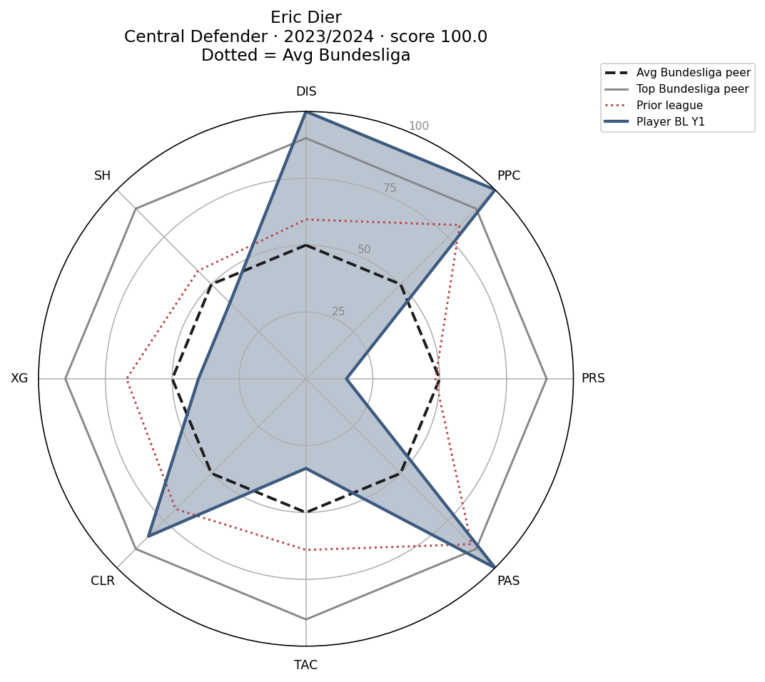
OUTPUT · CATEGORY RADAR CHART (Same chart style used in the New York Red Bulls internship project)
Example player profile
Built from shortlisted traits. Explorer HTML combines Football Reference + StatsBomb with category slices.
How to read
Blue = first Bundesliga season
Red dotted = prior season
Dashed = average peer (50th percentile)
Grey = top peer (~90th percentile)
Each slice averages shortlisted traits in that style category.

Slide 12
DEFINITION
What “stable-trait score” means
One number that answers: in Year 1 in Bundesliga, how strong is this player on the shortlisted (traveling) traits — vs peers at their position?
Phase 2 note: this is a secondary success outcome (alongside Year 1 minutes and minutes percentile) — a profile-fit score, not the primary playing-time marker.
1 · Pick the traits
2 · Turn each into a percentile
3 · Average them
1 · Pick the traits
Shortlist only (StatsBomb 7 · Football Reference 32). Dropped metrics stay out.
For each shortlist trait, take the player’s Bundesliga Year 1 in Bundesliga per-90 value.
Rank it vs all Bundesliga peers in the same broad position.
0 = worst peer · 50 = average · 100 = best peer.
Stable-trait score = mean of those Year 1 in Bundesliga percentiles across the shortlist.
Example: if a center back is 70th / 60th / 80th on three traits → score ≈ 70.
Higher = better Year 1 in Bundesliga profile on traits that travel.

Slide 13
HOW TO USE THE EXPLORER
interactive_player_explorer.html
1
Open interactive_player_explorer.html in a browser.
2
Switch StatsBomb (N=96 · 7 traits) ↔ Football Reference (N=329 · 32 traits).
Dropdowns: league → position → player.
3
Radar slices = style categories (attack/pass/carry/defend). Each slice averages that group’s percentiles.
4
Same explorer combines both sources — pick Football Reference or StatsBomb in the data-source dropdown.

Slide 14
RESULTS · SUCCESS INDICATORS
Which prior traits & leagues line up with Year 1 in Bundesliga success?
Phase 2: after trimming the metrics to the shortlist of traits that travel, test what lines up with Bundesliga success.
Success = Year 1 in Bundesliga minutes (more minutes = more playing time).
We also show two supporting numbers (not the main success definition):
• Year 1 minutes percentile — where this player’s first-season minutes rank among other arriving players in the study (0–100).
• Stable-trait score — how strong their Year 1 profile looks on the traits that travel we kept (average percentile vs position peers).
Spearman ρ: sort players from high to low on a prior trait, sort them from high to low on Year 1 minutes, and measure how often those two orderings agree. A positive link means players who ranked higher on that trait before the move also tended to play more in their first Bundesliga season.
Playing time still depends on the roster, injuries, and coaching choices — we use minutes as an observable open-data stand-in for “the club gave this player a real role,” not as proof that the player should have gotten those minutes.
Next steps on later slides: compare average Year 1 minutes by prior league (feeder-league averages (prior leagues before the Bundesliga)), then run exploratory ordinary least squares (OLS) regression with controls.
Interpretation: positive ρ = arriving with a higher prior percentile on that trait tends to coincide with more Year 1 in Bundesliga minutes / higher trait score.
Negative ρ on inverted metrics (e.g. dispossessed) can still be informative — read label + sign together since lower dispossessed score means better player performance
StatsBomb
Football Reference
N=329 · 19 leagues
Success = Year 1 in Bundesliga minutes
Weak Signaling
N=96 open-data cohort
Primary priors often intl comps
Weaker league signal · use for traits
Supports weights for evaluation
Does not predict every transfer
Full interactive tables: interactive_player_explorer.html · README.md

Slide 15
SUCCESS DEFINITION · YEAR-1 MINUTES
How we operationalize “Bundesliga success” in Phase 2 with open data.
Primary success marker: minutes played in the player’s first Bundesliga season (“Year 1 in Bundesliga minutes”).
Success means the club gave the arriving player playing time — not goals scored and not market value.
Also reported (secondary):
• Year 1 minutes percentile — where that player’s minutes rank among peers in the study
• Stable-trait score — how strong the Year 1 profile looks on the traits that travel
Trait and league tests ask: which prior signals line up with more Year 1 minutes?
Regression Δ Year 1 minutes = estimated extra first-season minutes versus a reference league (Serie A), holding other controls fixed.
Why minutes?
Observable in Football Reference / StatsBomb cohorts
Directly measures opportunity and role
Not the same as goals, expected goals, or team points
Scope: associations useful when weighing which prior rates matter — not a forecast model

Slide 16
RESULTS · TRAITS → BUNDESLIGA SUCCESS
StatsBomb (N=96)
prior percentile → Year 1 in Bundesliga minutes
Pressures (closing down opponents) ρ=-0.28 p=0.006
Successful dribbles ρ=-0.17 p=0.090
Progressive passes ρ=+0.16 p=0.112
Times dispossessed (inverted) ρ=+0.14 p=0.185
Passes into the final third ρ=-0.11 p=0.280
Clearances ρ=-0.07 p=0.473
Pass volume ρ=+0.00 p=0.980
Football Reference (N=329)
prior percentile → Year 1 in Bundesliga minutes
Passes into the final third ρ=+0.30 p=0.005 *
Shot blocks ρ=+0.27 p=0.011 *
Progressive carry distance ρ=+0.24 p=0.025 *
Times tackled while dribbling ρ=+0.23 p=0.030 *
Long pass attempts ρ=+0.22 p=0.036 *
Defensive-third touches ρ=+0.22 p=0.039 *
* p<0.05 · Final-third passes, shot blocks, progressive carry distance lead.
Trait | ρ | p
Pressures (closing down opponents) | -0.28 | 0.006
Successful dribbles | -0.17 | 0.090
Progressive passes | +0.16 | 0.112
Times dispossessed (inverted: fewer is better) | +0.14 | 0.185
Passes into the final third | -0.11 | 0.280
Clearances | -0.07 | 0.473
Trait | ρ | p
Passes into the final third* | +0.30 | 0.005
Shot blocks* | +0.27 | 0.011
Progressive carry distance* | +0.24 | 0.025
Times tackled while dribbling* | +0.23 | 0.030
Long pass attempts* | +0.22 | 0.036
Defensive-third touches* | +0.22 | 0.039
Miscontrols while carrying | 0.16 | 0.078
Clearances | 0.13 | 0.162

Slide 17
RESULTS · FEEDER (PRIOR) LEAGUES → BUNDESLIGA SUCCESS
Which source leagues produce the strongest Year 1 in Bundesliga outcomes?
League | N | Mean Year 1 in Bundesliga min | Median Year 1 in Bundesliga min | Trait score
DEN Superliga | 9 | 1864 | 1855 | 48.0
Premier League | 24 | 1424 | 1391 | 60.1
Eredivisie | 20 | 1401 | 1154 | 53.4
Ligue 1 | 40 | 1401 | 1251 | 53.5
Serie A | 21 | 1366 | 1040 | 56.7
2. Bundesliga | 84 | 1361 | 1111 | 49.6
Belgian Pro League | 16 | 1325 | 1342 | 53.1
Austrian Bundesliga | 10 | 1152 | 1284 | 49.6
Football Reference N=329 (only leagues with ≥8 players shown). StatsBomb N=96 — international priors are directional only.
How to read these averages: each row is players who already moved from that competition into the Bundesliga. Clubs chose whom to sign, so this is not a random sample of everyone in that league.
Relative prior-league averages are a useful description of arrivals. They are not a causal claim that “coming from league X causes more minutes” or that the league produces better transferable talent — that would need separating the league label from who gets signed and where they land. (The exploratory OLS later holds prior minutes / position / traits fixed and finds league gaps are modest.)
Tables also in the explorer Success tab · README.md
League | N | Mean Year 1 in Bundesliga min | Trait score
FIFA World Cup | 27 | 288 | 57.3
Champions League | 17 | 257 | 57.8
UEFA Euro | 17 | 193 | 45.9
Premier League | 3 | 146 | 53.7
La Liga | 13 | 133 | 55.2

Slide 18
PHASE 2 · FEEDER (PRIOR-LEAGUE) REGRESSION (EXPLORATORY)
Descriptive “best feeder league (prior league before the Bundesliga)” averages are not enough — ordinary least squares (OLS) regression asks whether league gaps remain after controls.
_x000B_Model 1 — league only (with basic controls)
Year 1 minutes = prior league (Premier League / La Liga / Ligue 1 vs Serie A baseline)
+ prior minutes + position
Question: after that, does league still matter?
Model 2 — league + traits
Year 1 minutes = Model 1 + prior trait percentiles
(e.g. passes into the final third, defensive penalty-area touches, …)
Question: once you know the prior profile, do league gaps shrink?
Model 3 — holdout check
Fit Model 2 on 80% of players; correlate predicted vs actual Year 1 minutes on the other 20%.
Question: is the fit just memorizing this sample?
Serie A = baseline (lowest average Year 1 minutes among Big Five feeder leagues (prior leagues before the Bundesliga) in this subset).
Big Five Football Reference subset N=117. Exploratory associations — not a validated forecast.

Slide 19
RESULTS · REGRESSION — WHY LIGUE 1 LOOKS BEST
Model 1 R²=0.086 → Model 2 R²=0.215 when traits added · Model 3 holdout correlation r=0.35 (exploratory)
Left table = Model 1 league gaps · Right table = Model 2 trait effects · Model 3 = holdout check only (no third chart)
Does the Ligue 1 result make sense?
The table shows Ligue 1 arrivals with about +163 Year 1 minutes versus Serie A. That gap looks large, but p≈0.38 with N=117 — under usual standards it is not distinguishable from chance. In plain terms: we do not have clear evidence that Ligue 1 labels alone buy more first-season playing time once prior minutes and position are held fixed.
What does look clearer: adding prior trait percentiles raises R² from about 0.09 to 0.22, so the player’s prior profile explains Year 1 minutes better than the league name. The holdout check (correlation ≈0.35) is only moderate — useful as exploration, not a strong forecast.
Takeaway: prioritize traits that travel and Year 1 minutes; treat prior-league labels as a weak leftover signal.
Serie A = baseline (lowest mean Year 1 minutes among Big Five feeder leagues (prior leagues before the Bundesliga)).
League vs Serie A | Δ Year 1 in Bundesliga min | p
La Liga | +48 | 0.856
Ligue 1 | +163 | 0.375
Premier League | +88 | 0.661
Prior trait pct | Δ Year 1 in Bundesliga min | p
Aerials lost (fewer is better)* | +9 | 0.002
Passes into the final third | +5 | 0.158
Defensive penalty-area touches | +5 | 0.189
Progressive carry distance | -4 | 0.249
Expected goals (xG) | +2 | 0.430
* p<0.05. Full tables: README.md (Exploratory feeder (prior-league) regression).

Slide 20
WHY P-VALUES STAY MODEST
• StatsBomb N=96 with mixed open-data priors (World Cup / European Championship / Champions League mix rather than clean domestic league seasons — larger count, less consistent prior context)
• Football Reference N=329 helps, but many advanced metrics only have ~90–100 complete pairs
• Multiple traits tested — treat Phase 2 as associations, not a forecast
What hardened the sample
• 19 leagues · first Bundesliga seasons 2021–2025 · prior / Year 1 ≥300′ → N=329
• Category consistency cutoffs + light near-duplicate filter (|r| ≥ 0.95) → 32 traits
• StatsBomb kept as an event deep dive (r ≥ 0.40 · 7 traits), not a league ranking

Slide 21
TAKEAWAYS
• Shortlists of traits that travel: Football Reference 105 tested → 43 met consistency floor → 32 after dropping near-duplicates · StatsBomb 16 tested → 7 met consistency floor (all 7 kept)
• Football Reference traits most linked to Year 1 Bundesliga minutes (p<0.05): passes into the final third, shot blocks, progressive carry distance, box defending
• The player (prior trait profile) matters more than the prior-league label: exploratory OLS (N=117) finds league gaps modest/non-significant once controls and traits are included, while adding traits raises fit more than league names alone
• Use metrics that stay consistent across leagues. Year 1 Bundesliga minutes = open-data success measure
• Future work: change in Transfermarkt market value (next slide) as a club-grade outcome

Slide 22
IF WE HAD THE DATA · TRANSFERMARKT VALUE
What we would use instead of (or alongside) Year 1 in Bundesliga minutes.
Top indicator in a full club model: change in market value (change in Transfermarkt market value)
Captures performance + hype + contract context in one outcome clubs care about
The New York Red Bulls internship project’s player-value work used market value rather than Year 1 Bundesliga minutes; this project uses open data only — Transfermarkt disallows scraping
So we use Year 1 Bundesliga minutes as the success measure until a licensed market-value feed is available
Natural extension: prior traits → change in market value with holdout regression / machine learning

Slide 23
GLOSSARY · METRIC NAMES (short codes in parentheses)
Football Reference (examples)
Defensive penalty-area touches /90 (short code: DEFPE)
Defensive-third touches /90 (short code: DEF3R)
Progressive carries /90 (short code: PRGC)
Progressive carry distance /90 (short code: PRGDI)
Progressive receives /90 (short code: PRGRR)
Expected goals /90 (short code: XG)
Goals /90 (short code: GLS)
Shots on target /90 (short code: SOTPE / ATTSH)
Passes into final third /90 (short code: FINAL)
Key passes /90 (short code: KP)
Shot blocks /90 (short code: SH)
Tackled (take-ons) /90 (short code: TKLD)
Clearances /90 (short code: CLR)
Interceptions /90 (short code: INT)
Long pass attempts /90 (short code: ATTLO)
Fouls drawn /90 (short code: FLD)
StatsBomb (N=96)
prior percentile → Year 1 in Bundesliga minutes
Pressures (closing down opponents) ρ=-0.28 p=0.006
Successful dribbles ρ=-0.17 p=0.090
Progressive passes ρ=+0.16 p=0.112
Times dispossessed (inverted) ρ=+0.14 p=0.185
Passes into the final third ρ=-0.11 p=0.280
Clearances ρ=-0.07 p=0.473
Pass volume ρ=+0.00 p=0.980

Slide 24
Deliverables (submit package)
1. bundesliga_transfer_traits.pptx — method + results deck
2. README.md — package overview + regression tables
3. interactive_player_explorer.html — success summary + player radar charts
4. stability_redundancy_inspector.html — consistency floors & near-duplicate cuts
5. projectproposal.docx — proposal memo
Pipeline (not separate files): cohort with minute floors → consistency check → drop near-duplicates → explorer + success tests
Consistency floors: Football Reference Attacking/Passing/Other Pearson r ≥ 0.60 · Defending/Carrying Pearson r ≥ 0.50 · StatsBomb Pearson r ≥ 0.40 · final shortlists 32 / 7

