Slide 1
Process Book
Bar-Hoppers
By Colby Wight, Marina Johnson

Slide 2

Initial Proposal
This visualization will take in comparison school performance data and average household income data. The performance of a school will be constructed using test scores across various subjects. The visualization we want to explore is if household income has an affect on a schools performance. We will measure this by location and if the general trend of both seem to match up. The point we want to make is that if we change how much funding a school gets, we can better equip our schools to be set up for success.

Slide 3
Current Proposal: The What
Over the course of this project we have modified our proposal to better fit the purpose of our project; which is to find what factors seem to have a relationship and affect on a how well a student does in school. We have taken multiple factors such as school day length, school funding, student body diversity, etc. and measured its overall pattern with student performance across all the states in the US.
Our main purpose of this visualization is to be able to determine what factors makes a student successful. Thus being able to set up a student for success based off of the data shown.

Slide 4
Motivation: The Why
Why choose this topic?
We chose this topic based off a group members interest in education improvement through computer science resources. However, it would be helpful to see what actually affects a student's performance to determine what needs to be improved. Although the factors measure aren’t necessarily computer science related, it could help show other affecting factors as well as outliers.
Project goals
Find patterns within data to determine correlation to performance.
What did we want to show?
An interpretable way to show overall correlation along with outliers and patterns of individual states.

Slide 5
Articles
Some articles related to topic research, trying to determine what affects a student’s performance:
Factors Affecting Students’ Performance
https://www.researchgate.net/publication/24112529_Factors_Affecting_Students'_Performance
Primer: Education Issues – Variables Affecting Student Achievement
http://weac.org/articles/primer-variable/
Trick of Cheat? 10 Things Affecting Students’ Academic Performance
https://www.collegeraptor.com/find-colleges/articles/tips-tools-advice/trick-cheat-10-things-affecting-students-academic-performance/
Student Achievement Factors
https://files.eric.ed.gov/fulltext/ED568687.pdf

Slide 6
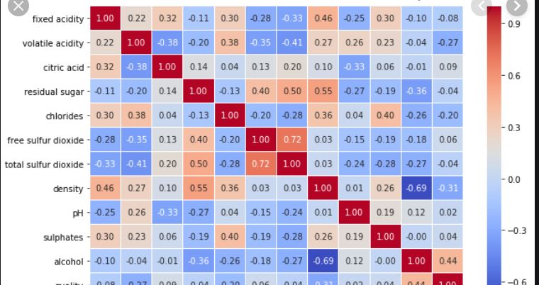
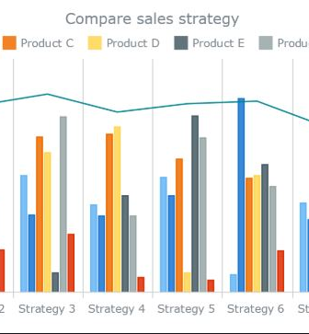
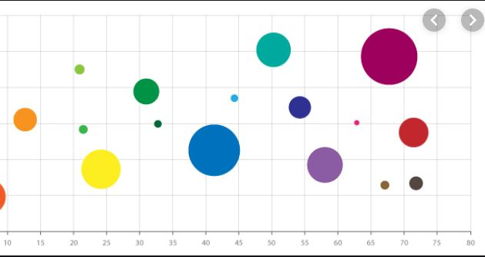
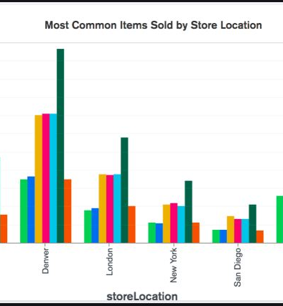
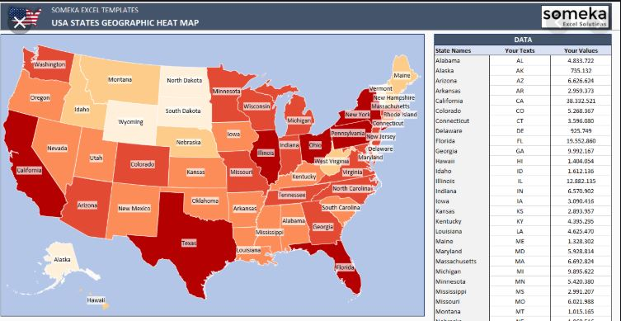
Mood Board: Visualization inspirations

Slide 7
Questions: The Purpose
We are trying to solve the miscommunication between figuring out what factors affect student performance and how we can change this to improve student performance.
Our purpose evolved from studying individual subjects for how schools in a given state perform and how much that state makes in average household income to seeing which factors that are a part of the school system seem to have an affect on schools in the U.S. and find the most correlated factors.

Slide 8
Data: Layout
Map Data:
JSON
Paths identified by an ID
Attribute Data:
CSV
Each row is identified by a state
Each column is identified by a factor we think could have correlation to performance

Slide 9
Data
Source
nces.ed.gov
Features
Student Financial Assistance
Hours in School Day
School Attendance
Diversity
Library Visit per Capita
Homeless Students per Enrollment
Teach to Student Ration
Teachers with PHD
Education Expenditure
Gifted/Talented Programs

Slide 10
Data
We chose this data because we felt it had a good variety of attributes related to things such as finances, demographics, school administrative practices, and others
These attributes were also chosen because they had recent, complete or nearly complete information for each state in the US
The data was small enough that all of the separately downloaded csv’s could be combined manually in excel in a short amount of time

Slide 11
Exploratory Data Analysis
The website that contained the student test scores had some nice built in data exploration tools that we used to get an idea of student test scores across the states. The NAEP Data Explorer tool actually let us make bar charts and line charts to help us get an idea of what the scores look like over time and across states. We were also able to see maps of the us with scores. While these provided some insight both for our visualization design and attribute selection, these graphs only showed the one attribute of student performance in a specific subject at a time. It helped us realize that building a simple heat map of scores and other attributes would not be very useful since we want to see correlation not just one attribute comparing across states. We want to show multiple attributes across states to prove correlation, or possibly no correlation (outliers or factors having no influence on performance). Our biggest enemy is clutter and comparing these three factors attribute scores, across state comparability, to infer correlation or non-correlation. We want a clean, concise, informing visual to show this data. We thought a matrix could do that but found issues with it which are discussed further below.

Slide 12
Exploratory Data Analysis
We also made some crude scatterplots in excel to get an idea of the correlation of the attributes and school performance

Slide 13
Design
Explain each Phase
PhaseI
PhaseII
PhaseIII
PhaseIV

Slide 14
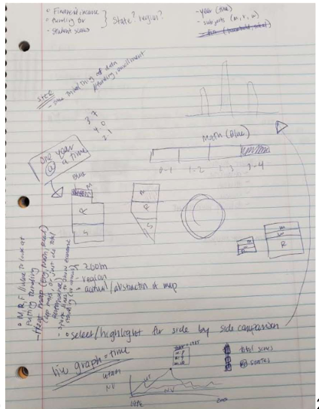
Phase I

Slide 15
Design: Phase I
In Phase I our idea was to try and encode performance of individual subjects. We drew out how we could do a stacked bar chart, or an area chart within a us map and then show performance and funding over time. However, we found it difficult to encode the funding with the individual subject performances in a way that the user could easily see correlation on the same visualization. It was also brought up that our target audience for this data wasn’t very clear. Why would we need to show individual subject data along with funding? Showing funding for a state didn’t completely explain why a state did better in math rather than English. There was a miscommunication in what we were trying to convey. So we moved onto Phase II.

Slide 16
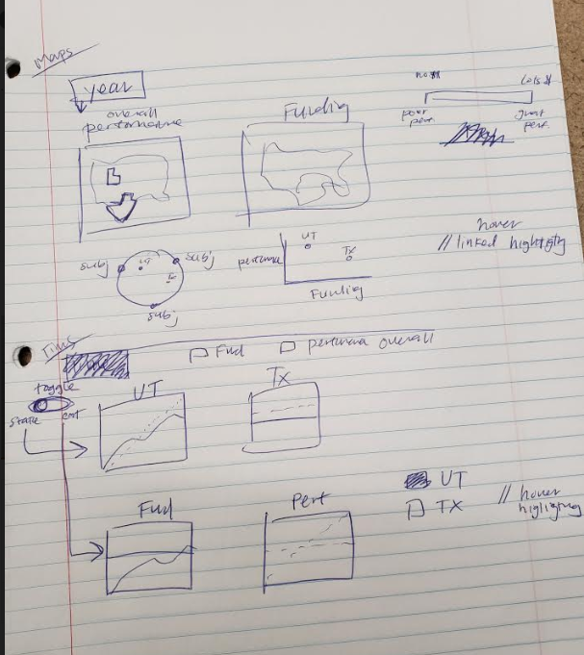
Phase II

Slide 17
Design: Phase II
In this design we wanted to have a year selection and show two heat maps, one for performance and one for funding. Then we thought about using a web map if a state was clicked on to show subject performance, just more detail if the user wanted to see it. Then from class we talked about scatter plots being able to show good correlation between two attributes, ours being performance and funding. We would also have a selection of state from the map where it would highlight and how a line graph of the performance and funding over time. The issue with this approach is that we were showing a lot of visualizations, but without a lot of data. So mainly it just became a lot of not super efficient ways to show two attributes, over 50 states, through some 30+ years of data. There was a disconnect again with what we were trying to portray to our audience. Although time would show patterns possibly, it wasn’t an influencing factor on performance. There is also the issue of clutter.

Slide 18
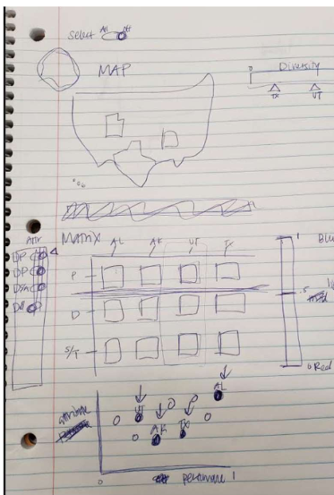
Phase III: The Matrix

Slide 19
Phase III: The Matrix
For our third design we scrapped using time and individual subjects. We were able to find datasets that encoded more enriched data with multiple attributes representing factors that could be applicable to student performance. Now we had the issue of how to best communicate correlation with multi-dimensional data. We were not sure what the map would be for other than showing a common visualization to help our users understand what states they are looking at. We also thought about displaying performance to show comparability between states just on performance alone. In this way a user could see if a state was doing well what other attributes were they doing well in as well. Then they could easily compare with a state not doing so well. We knew that scatter plots were good for showing correlation, however, it was only for a single attribute in comparison to our comparison attribute which is performance. Thus we needed a way to see multiple states with multiple attributes so we thought a matrix would be a good way to show this. See the next slide for an implementation of the matrix.

Slide 20
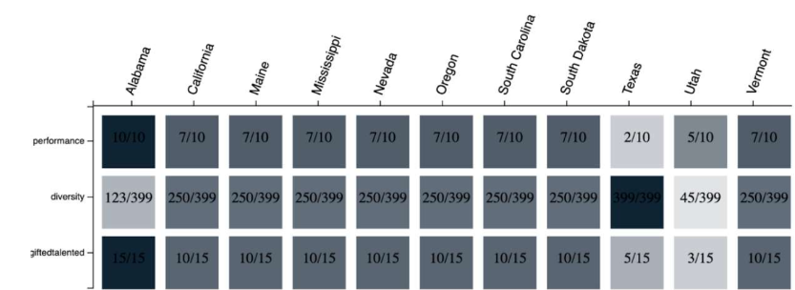
Looks like a heatmap Matrix
Phase III: The Matrix

Slide 21
Phase III: The Matrix
This implementation seemed good in theory, however, when we ended up implementing it it was difficult to tell the correlation of the attributes to a state's performance. The issues were that it wasn’t perfectly clear that you were trying to compare all the attributes box colors to the performance box color of a particular state. This is probably issues with spatial representation and a learning curve. Since most people read left to right it seemed more intuitive to make comparisons that way rather than vertically. Also the matrix was more represented as a heat map which is usually looking for patterns in spatial area. Ours had no relation to where the square was located in relation to its neighbors, so the spatial position and color had no meaning but was being interpreted that way. Which moves us onto design four.

Slide 22
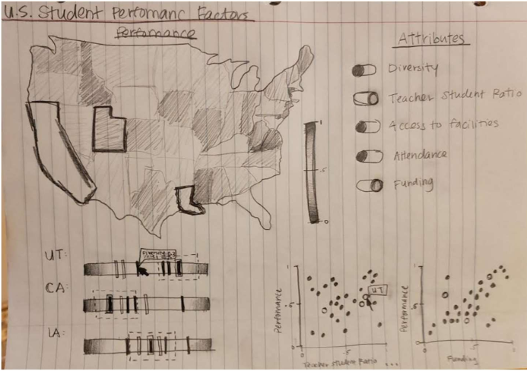
Phase IV

Slide 23
Phase IV
We have our map, which as stated before compares performances of a state so a user can see which states are doing well and not doing well so they can make decisions of which states to select for comparison. Then we have a series of horizontal bars with vertical bars plotted onto them. There is a bar for each state and the points on them are representations of all their attributes on a scale of 0 to 1. We normalized everything to a 0 to 1 scale. The point of this bar was to see that if it was close to the bigger performance bar, it had more correlation in that state, thus using position to encode correlation. The performance vertical bar also has dotted lines on each side to represent deviation of what counts as good correlation and bad. If an attribute bar lands within this section between performance bar and dotted line, we will consider it to probably be correlated in this one instance of a state as they have similar scores. Then to double check if the pattern is agreeable across states, we will have an attribute selection which brings up a scatter plot per attribute and compares it against performance plotting all the states. This way we can see if there is a relation. If the scatter plot is all over the place, then the one correlation from the bar graph was probably just a coincidence or a special case for that state and not a regular pattern. It could also be an outlier that is the only factor showing if a state does well, so maybe if other states did well in that attribute their performance could go up too. Then we will also have a highlighting tool to highlight both bars on the bar graph so that a user can see specific attributes and where they generally are positioned in relation to performance and highlighting states on the scatterplot. This way a user can compare specific states and where they lie on an attribute to performance scale and compare state by state that way.

Slide 24
Current Design
We stuck with our current design because we realized a fatal flaw in the scatterplot: if we are trying to get the user to understand correlation, just show them correlation. Don’t make them figure it out on their own if not needed, and if that’s what we want to show.
With the scatterplots, it’s almost like we were making them find correlation while showing them states and stats. What we wanted was to just show which are most correlated and which attributes don’t seem to matter
Can compare multiple attributes across multiple states
With simple scales and explanation, correlation can be easier to see

Slide 25
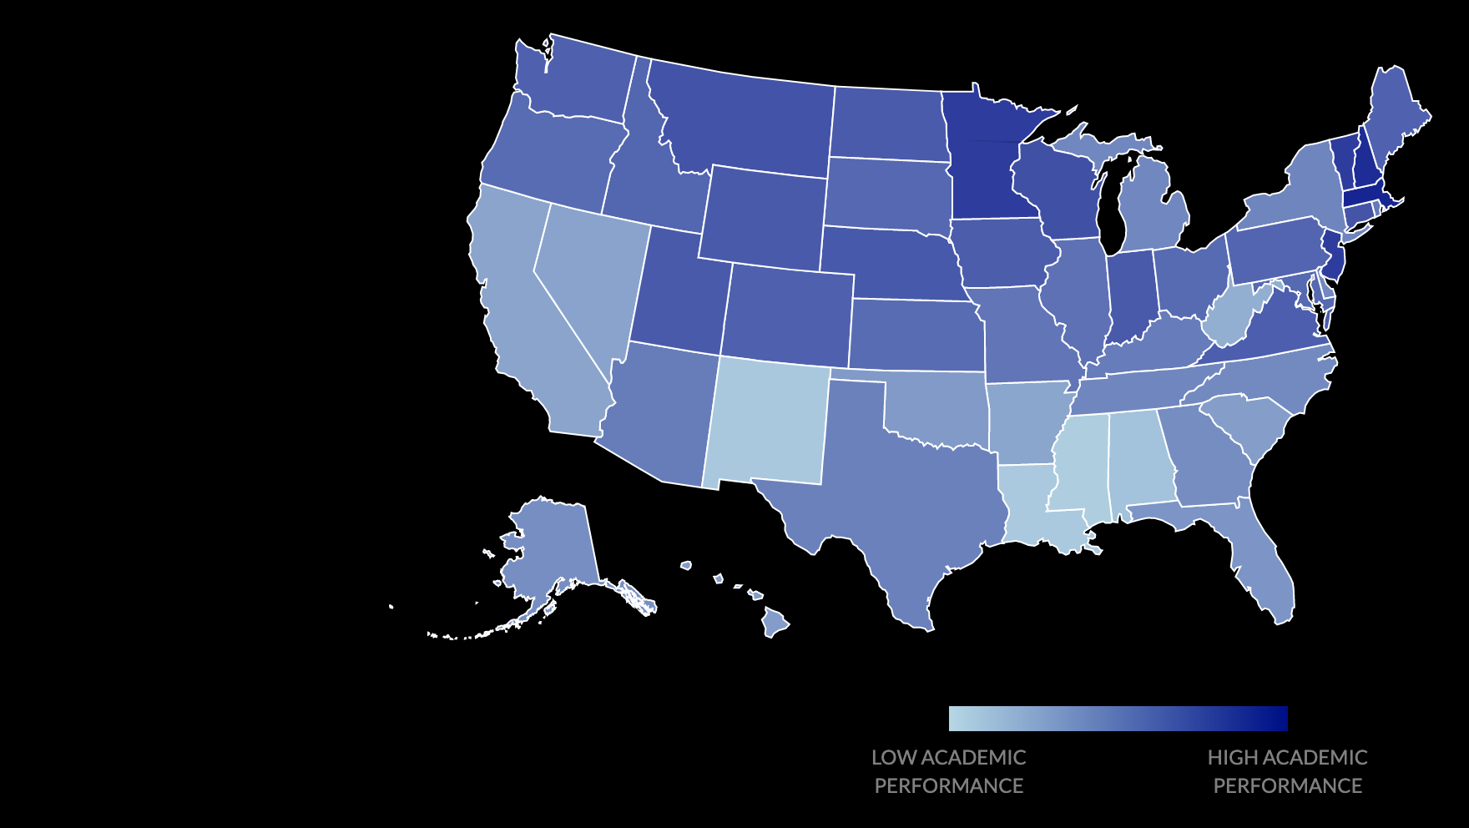
Map

Slide 26
Map
The map is used both to show the academic performance of each state and as a state selector for the bar chart
We encode the performance with the color channel
Using a map makes it easy for the user to select the state they want to explore if they are familiar with the us (our audience should be)

Slide 27
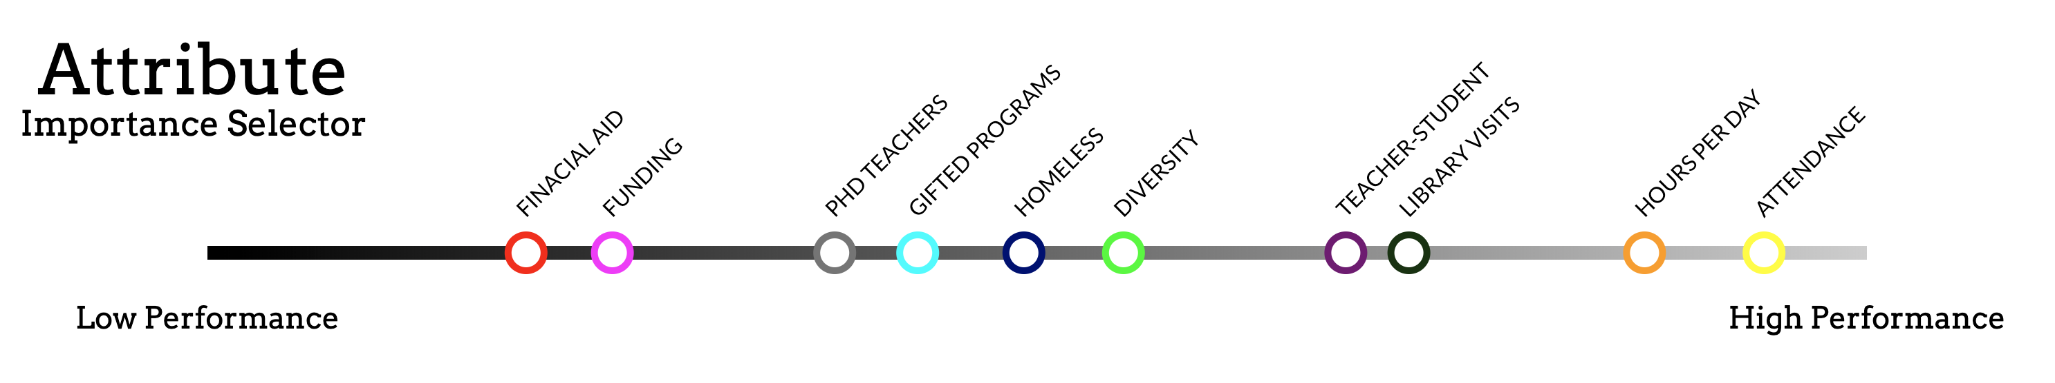
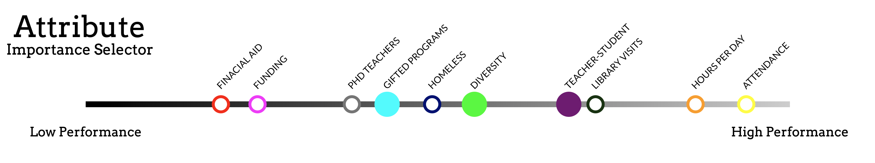
Correlation Bar Menu

Slide 28
Correlation Bar Menu
The correlation bar also serves two purposes: The first is to show the overall ranking for each attribute for its correlation to performance. The second is to allow the user to select the attributes they wish to explore further
The ranking is calculated by normalizing each attribute and taking its proximity to normalized performance score

Slide 29

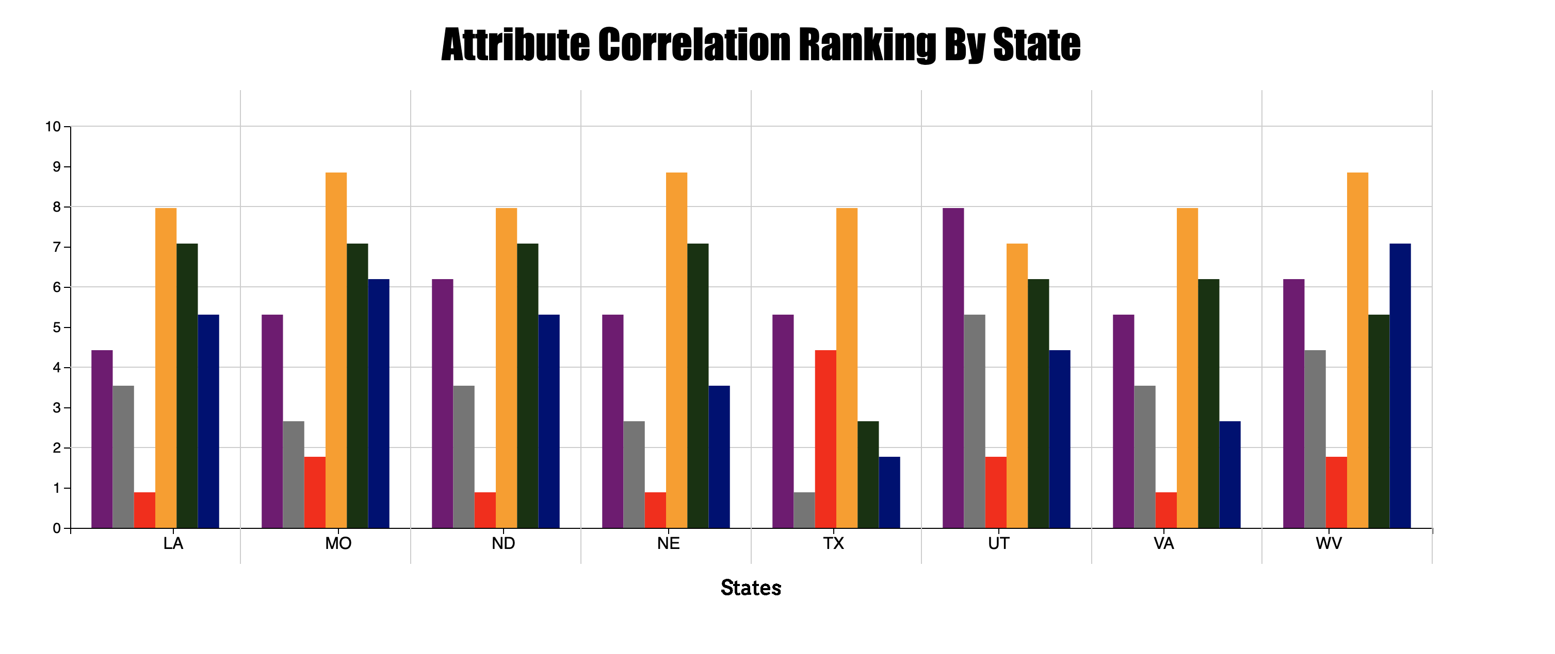
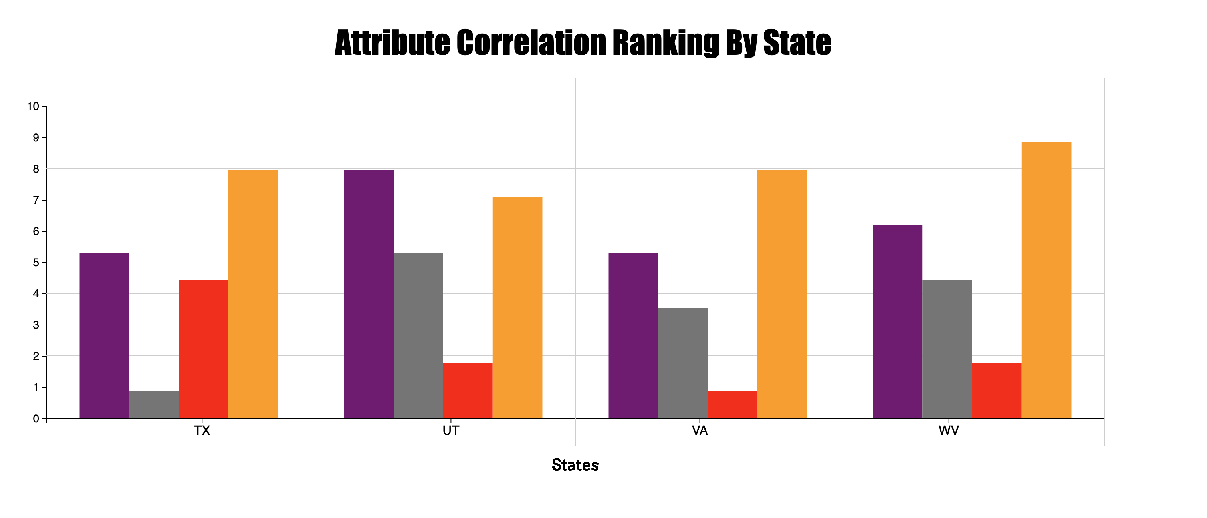
Bar Chart

Slide 30
Bar Chart
The purpose of the bar chart is to separate the rankings by state.
It is basically just a way to see more detail, outliers, and general patterns.
For example, a user can click on a an attribute ranking highly affects performance and see that for most states it indeed does (yellow bar in previous image) However, we can see that for some states it ranked lower, in some cases very low and we can see outliers as well.
This bar chart can be used to compare a few attributes across lots of states, lots of attributes across a few states, or many attributes to many states. This isn’t usually recommended as there is still issues with visual clutter and being able to determine more detailed information. This is the point of this chart; the attribute bar plot is more for seeing overall patterns and is to help the bar chart in seeing lots of data by compressing it.

Slide 31
Evaluation
How did you answer your questions?
I think we answered our question in a visualization as far as what seems to be correlated. However, I am unsure if we can say for sure that changing these factors would improve school performance, as with time and data constraints it is hard to know for sure as this wasn’t a controlled experiment.
How well does your visualization work, and how could you further improve it?
Something we could improve is having a bar chart that grows left to right and have the legend of performance correlation as the x-axis so that it is more directly comparable as our current design has the bars growing vertically and our overall ranking attribute bar runs horizontal. I think there is a slight disconnect between these two which could’ve added easier interpretation.
Still a lot of clutter if a lot of states and attributes are selected. Maybe a better way to tell things apart in that special case, but still see detail. I am not sure how we would do that as it was one of our major challenges, but with more time I would’ve liked to have done more iterations on design.

Slide 32
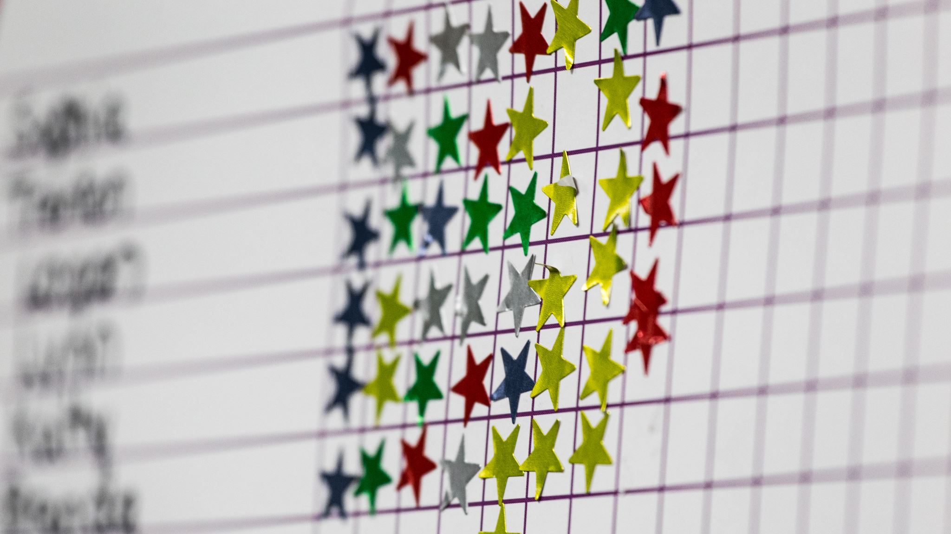
What We Learned
What did you learn about the data by using your visualizations?
We learned what we thought would be the opposite of the outcome we would see from our data.
First, that financial standing seemed to have little to do with how well a student performed. Rather it was things more within the schools control such as attendance, teacher/student ratio, and how many teachers have PHD’s.
We do realize that correlation does not necessarily mean causation. There are still a lot of other factors that could play a part in how well a student does.

Slide 33
Conclusion
Although we didn’t get the results we expected, it was interesting to try to show correlation rather than just data of multi-dimension data.
Hopefully, this starts a need to look further into what may actually be affecting our student's performance. Possibly under more controlled conditions to see clear correlation.

