Slide 1

  Fixora AI – An Intelligent Home Repair and Service Discovery & Coordination Engine
SOA Project Review-2
Date& Time
Team Members : Anakala Sarayu 2420030249 Manduri Varshitha 2420030269 Divya 2420030287
Under the Guidance of
Dr.Neelima Gogineni
SOA Professor,
Department of Computer Science and Engineering,
KLH CSE Bowrampet Campus

Slide 2
Project Design
1. User Interface Layer
Customer interface
Service provider dashboard
Service request and booking interface
Service status tracking
2. Service & Intelligence Layer
API Gateway
Authentication and authorization
AI-based service recommendation
Service discovery and provider management
Booking and scheduling services
3. Data & Event Layer
PostgreSQL database
REST APIs
Apache Kafka
Event-driven service communication
Design Goal:
To provide a flexible architecture where services can be independently developed, scaled, maintained, and updated, while enabling intelligent and reliable home service coordination.
Notes:
Fixora follows a layered architecture.
The first layer is the User Interface Layer, where customers can describe their problem, view recommended providers, book services, and track their service status.
The second is the Service and Intelligence Layer. This contains authentication, service request processing, AI-based problem analysis, provider matching, booking and scheduling.
The third is the Data and Event Layer, where PostgreSQL is used for storing application data and REST APIs are used for communication. Apache Kafka is planned for event-driven communication.
The main design goal is to make the system modular and scalable.

Slide 3
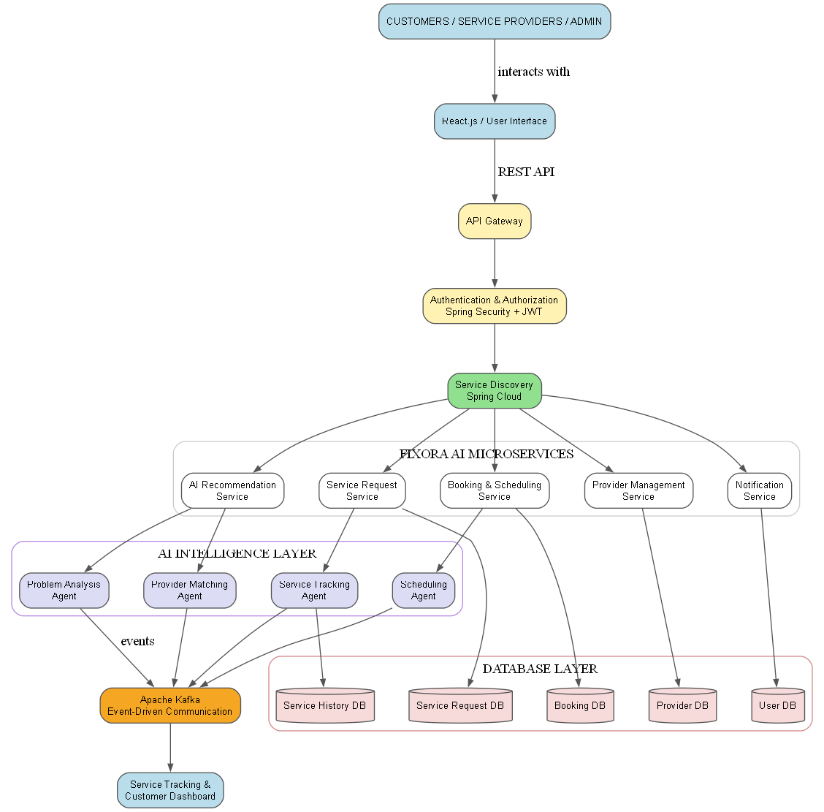
System Architecture
Notes:
The architecture starts with the customer interacting with the React frontend.
The request is sent to the Spring Boot backend through REST APIs.
The AI service analyzes the customer's natural-language problem and identifies the required service category.
Based on this category and location, Fixora finds suitable service providers.
The customer can then select a provider, schedule the service, and track the request.
Authentication is handled using Spring Security and JWT.

Slide 4
Component Design
Component | Responsibility
Frontend | User interaction and service dashboard
API Gateway | Central entry point for client requests
Authentication Service | User authentication and role-based authorization
Service Request Service | Creates and tracks repair requests
Provider Management Service | Manages service providers, skills, and availability
AI Recommendation Service | Analyzes problems and recommends suitable services/providers
Booking & Scheduling Service | Manages appointments and time slots
Notification Service | Sends booking and service status updates
AI Agents | Perform problem analysis, provider matching, and service tracking
Apache Kafka | Handles asynchronous event communication
PostgreSQL | Stores users, providers, requests, bookings, and service history
Docker | Containerizes services for deployment and portability
Notes:
Our system has different components, each with a specific role.
React handles the user interface, while Spring Boot manages requests and backend services.
AI analyzes customer problems and recommends suitable services and providers.
PostgreSQL stores users, providers, requests and bookings.
JWT and Spring Security provide secure role-based access, and Kafka supports event-based communication.

Slide 5
Methodology
Requirement Analysis
Identify customer, service-provider, and administrative requirements.
System Design
Design the microservices architecture, database structure, APIs, and communication flow.
Service Development
Develop independent services for service requests, providers, booking, scheduling, and notifications using Spring Boot.
AI Integration
Integrate Spring AI and LLM/Ollama APIs for problem analysis and service/provider recommendations.
Event Integration
Use Apache Kafka for asynchronous communication between services and processing service-related events.
Security Implementation
Implement Spring Security and JWT-based authentication with role-based access.
Testing & Integration
Test individual services and then integrate them to verify complete request-to-service workflows.
Deployment
Containerize the application using Docker for consistent and scalable deployment.
Notes:
Our methodology consists of five main stages.
Requirement Analysis – Identify customer and provider requirements.
System Design – Design the architecture, database and APIs.
Service Development – Develop the frontend, backend, provider, booking and request services.
AI & Event Integration – Integrate AI-based problem analysis and event-driven communication.
Testing & Deployment – Test the complete workflow and prepare the system for deployment.

Slide 6
Workflow
Customer
↓
Login / Registration
↓
Describe Home Repair Problem
↓
AI Problem Analysis
↓
Service Category Identification
↓
Provider Recommendation
↓
Select Provider & Book Service
↓
Schedule Appointment
↓
Kafka Event Processing
↓
Service Execution & Status Updates
↓
Notification to Customer
↓
Service Completion & History
Notes:
The customer then describes the home repair problem in natural language.
Fixora's AI analyzes the problem and identifies the service category.
The system then recommends suitable providers.
If multiple providers are available, the customer can select the preferred provider.
The service can then be scheduled.
The provider receives the request and updates its status.
The customer can track the status until the service is completed.
Finally, the completed request is stored in the service history.

Slide 7
Technology Stack
Frontend
React.js, HTML, CSS, JavaScript
Backend
Java, Spring Boot, REST APIs
Microservices Architecture
Spring Cloud, API Gateway, Eureka Service Discovery
AI & Recommendation
Spring AI, LLM APIs
Messaging
Apache Kafka
Database
PostgreSQL
Security
Spring Security, JWT, Role-Based Access Control
Deployment
Docker
Notes:
We use React for the frontend and Spring Boot for the backend. Spring Cloud, API Gateway and Eureka manage the microservices. Spring AI and LLM APIs provide recommendations, Kafka handles messaging, PostgreSQL stores data, and Docker is used for deployment.

Slide 8
Technical Validation & Testing
Testing Area | Validation
Frontend Testing | Verify user interface, forms, navigation, and service tracking
API Testing | Test REST API requests, responses, and error handling
AI Testing | Validate problem analysis and service/provider recommendations
Microservice Testing | Verify communication and functionality of individual services
Kafka Testing | Validate event publishing, consumption, and message flow
Security Testing | Test JWT authentication and role-based access
Database Testing | Verify data storage, retrieval, and consistency in PostgreSQL
Integration Testing | Test complete workflow from service request to completion
Deployment Testing | Verify Docker containers and application execution
Notes:
“Our project follows a step-by-step methodology. First, we identify customer and service provider requirements and design the microservices architecture.
Next, we develop independent services using Spring Boot for bookings, provider management and notifications. We integrate Spring AI for problem analysis and recommendations, and Kafka for communication between services.
Finally, we implement JWT-based security, test each service and the complete workflow, and use Docker for deployment.”

Slide 9
Thank You

