Slide 1


HR MANAGEMENT SYSTEM DATABASE
SEMESTER PROJECT
MEMBERS: ROLL NO:
RUMAISA ALI (24K-5518)
HAADIYA FARHAN (24K-5560)
SARAH RANTA (24K-5639)
LECTURER:
MS. MAGDALENE GLORIA MIRANDA
INSTRUCTOR:
SIR IRFAN ALI
29 APRIL, 2026

Slide 2


HR MANAGEMENT SYSTEM
DESIGNED TO ALLOW EASY SEARCHING, UPDATING, RETRIEVING AND REPORTING OF EMPLOYEE INFORMATION.
PROVIDES ANALYTICAL INSIGHTS SUCH AS SALARY DISTRIBUTION, ATTENDANCE-BASED EVALUATION, AND DEPARTMENT-WISE FINANCIAL IMPACT.
AN AID TO HELP HR MANAGERS AND RESPECTIVE AUTHORITIES TO ORGANIZE INFORMATION ABOUT EMPLOYEES PERSONAL DETAILS, INTERVIEWS AND PAYROLL INFORMATION TO SUPPORT WORKFORCE MANAGEMENT.

Slide 3

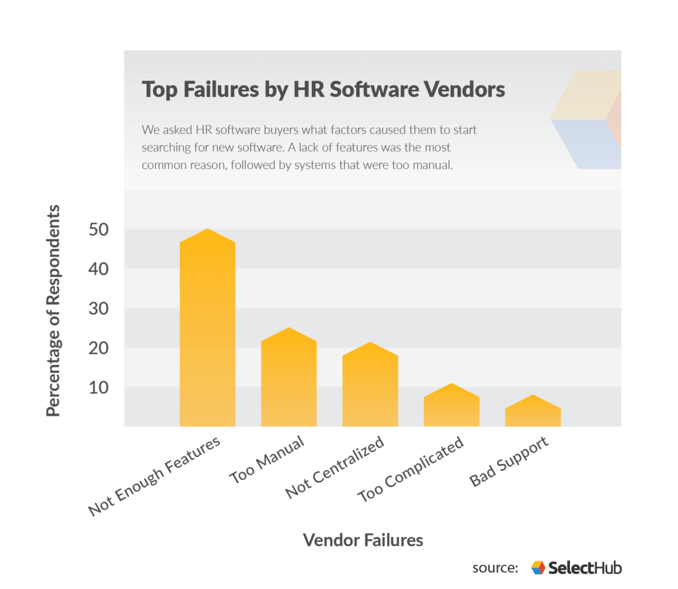
PROBLEM
STATEMENT
USAGE OF FLAT FILES SUCH AS SPREADSHEETS: UNRELIABLE AND OUTDATED
LACK OF DATA SECURITY: NO LIMITED ACCESS, EASILY MODIFIABLE
DATA DUPLICATION: DATA REPETITION
CALCULATION ERROS IN PAYROLL MANAGEMENT: NO STRICT CONSTRAINTS
LACK OF AUTOMATION CAUSES HUMAN ERRORS
Notes:
manual invoice generation

Slide 4
PROJECT OBJECTIVES
TO IMPLEMENT SQL VIEWS FOR SECURE AND SIMPLIFIED DATA ACCESS | TO REDUCE MANUAL RECORD-KEEPING ERRORS
TO GENERATE USEFUL HR REPORTS: MONTHLY PAYROLL RECORDS., PAYMENT HISTORY OF EMPLOYEES, HIRING PROCESS | TO MANAGE EMPLOYEE, DEPARTMENT, AND SALARY RECORDS EFFICIENTLY.

Slide 5


IN SCOPE
KEY FEATURES:
Employee record management
Payroll and salary tracking
Attendance monitoring
Recruitment and interview tracking
Role-Based Access Control (RBAC)
Advanced SQL reporting
Dynamic Filtering
Advanced Reporting:
Top Paid Employees
Salary and payroll reports
Hiring summary report
Interview schedule report
Attendance reports
Applicant tracking
Department with highest salaries
Employees with most absences
OUT SCOPE:
Mobile applications AI-based hiring decisions Biometric attendance systems Integration with external banking system

Slide 6


EXISTING SYSTEM
Excel systems: Info leakage Manual Processes: Reduces productivity Manual Invoice Generation
Our Solution + Additional Features
Role-Based Access Control (RBAC): HR Manager → full access Finance → payroll only Admin → limited access
Advanced Reporting: Automated calculations (salary reports) Attendance Integration

Slide 7

3-TIER ARCHITECTURE
IMPROVES SCALABILITY, MAINTAINABILITY, AND SECURITY.
1)PRESENTATION LAYER (FRONTEND) - IMPLEMENTED USING PYTHON TKINTER GUI
PROVIDES USER INTERFACE FOR HR OPERATIONS
ALLOWS USERS TO INPUT DATA AND VIEW REPORTS
2) APPLICATION LAYER (LOGIC LAYER)
HANDLES BUSINESS LOGIC AND QUERY EXECUTION
PROCESSES USER INPUT AND INTERACTS WITH THE DATABASE
3) DATA LAYER
A CENTRALIZED DBMS STORES AND MANAGES ALL
HR RELATED DATA
ENSURES DATA INTEGRITY THROUGH KEYS AND CONSTRAINTS
SYSTEM
ARCHITECTURE

Slide 8

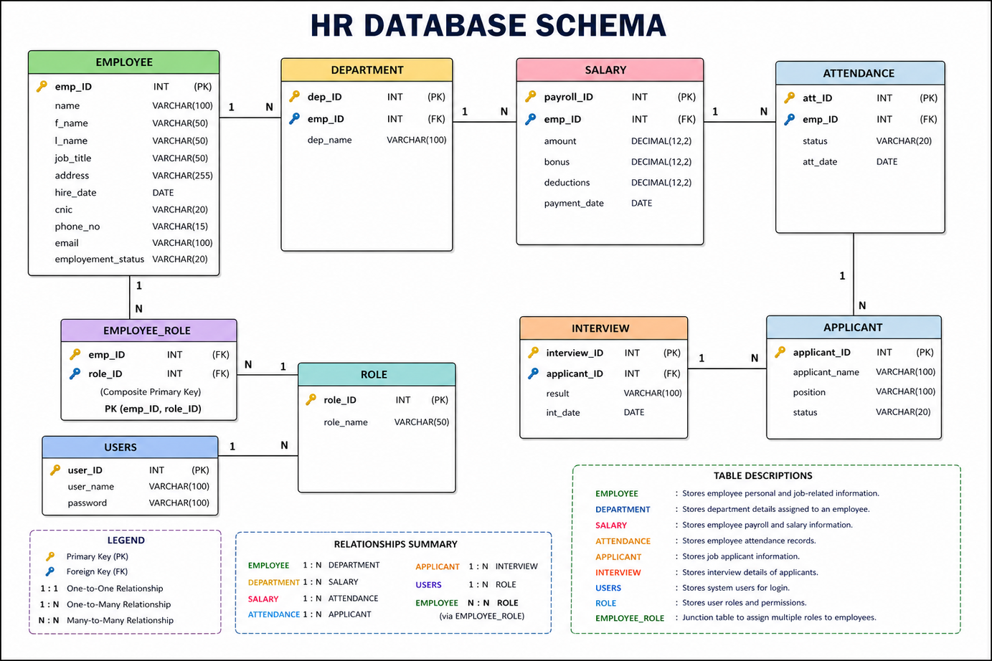

SCHEMA IMPLEMENTAION
The database consists of eight main tables designed to manage employee records, departments, salaries, attendance, recruitment, users, and system roles.
Primary keys ensured unique identification and foreign keys maintained relationships between tables. Check constraints enforced data validity such as valid roles, positive salaries, allowed statuses, and no future dates.

Slide 9
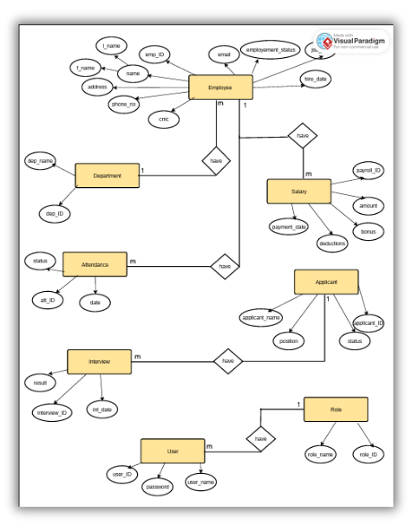

ENTITY RELATIONSHIP DIAGRAM
Relationships Implemented :
Department → Employee: 1 : n (every department has many employees)
Employee → Salary: 1 : N (one employee can have multiple
salary records)
Employee → Attendance: 1 : N (one employee can have
multiple attendance records)
Applicant → Interview: 1 : N (one applicant can have
multiple interview records)
User → Role: 1 : 1 (each user is assigned one role)

Slide 10
DEMONSTRATION
Project Tools: PostgreSQL, PYTHON Tkinkter

Slide 11
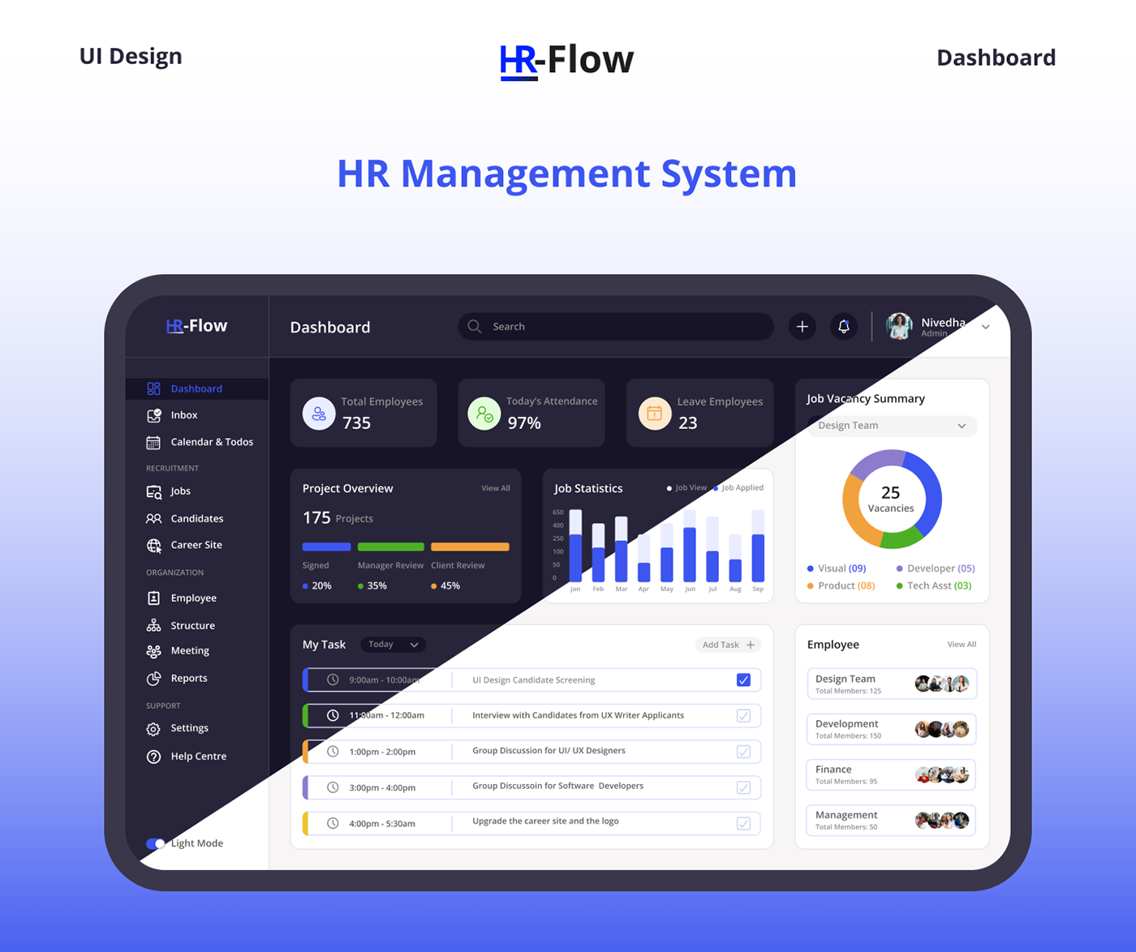

IMPACT+ ENHANCEMENT
Impact:
Better decision-making through analytical reports (salary, attendance, hiring trends)
Faster data retrieval and report generation using SQL queries
Enhanced data security through Role-Based Access Control (RBAC)
Interactive user interface using Tkinter, making the system user-friendly
Improved data accuracy and consistency
Future Enhancements:
Web-based interface
Integration with payroll/banking systems
Performance evaluation system

Slide 12
THANK YOU!

