Slide 1
Static Analysis for PHP
Semester Project
Fall 2009
Etienne Kneuss
EPFL

Slide 2
PHP
Weak & Dynamic Typing
Compiler optimized for speed, not safety
Large internal API (> 2500 functions)
All kinds of dynamic features
  → “If it can be done, it usually can be done dynamically”

Slide 3
The problem
Lot of room for run-time errors
  Nearly all possible errors happen at run-time
Most of those errors will be non-fatal
Until recently, PHP was shipped to ignore lots of errors by default
→ Lots of broken or badly written scripts

Slide 4
Previous Work
PHP-Sat
  Mostly (only?) structure based
PHPMD (PHP Mess Detector)
  Program metrics
  Some semantic checks
Pixy
  Taint-analysis, inter-procedural, for PHP4

Slide 5
This solution
Structural checks
Semantic checks
Data/Type flow analysis
Based on the grammar of PHP5.3

Slide 6
Why do types matter?
PHP does type juggling
  switch
  What about ctype_digit ?
  → Relying on it is a problem waiting to happen: #50696, #49057, #34772, #25763, #24905, ...
Non-scalar types

Slide 7
Analysis phases
Lexing (Jflex)
Parsing (modified CUP)
ST → AST
AST Transformations
Structural checks
API
Semantic analysis
AST → CFG
Flow analysis

Slide 8
AST Transformations
Allows to freely transform the AST
Used for:
  Include resolver
  Annotations

Slide 9
Include Resolver
Link ASTs
Support some expressions:
  dirname(), constants, string literals, concatenation
  include dirname(__DIR__).'/path/to/file.php';
One problem: include is an expression!

Slide 10
Annotations
Comments preceding declarations
Compatible with phpDocumentor
/**
* My super concat function
* @param string $foo
* @param string $bar
* @return string
*/
function concat ($foo, $bar) {
return $foo.$bar;
}

Slide 11
Structural Checks
Looks for common mistakes
  Conditional class/functions declarations
  Call-time pass by reference
  Variable variables ($$a)
function foo($a) {
return ++$a;
}
$b = 2;
foo(&$b);
echo $b;

Slide 12
API
Support for API importation
  e.g. defined(name: String): Boolean
<function name="defined">
<return><type name="bool"></type></return>
<args>
<arg opt="0"><type name="string"></type></arg>
</args>
</function>

Slide 13
Semantic analysis
Attaches symbols to identifiers
  Double declarations
  Inheritance cycles
Define variable scopes

Slide 14
Data types flow analysis
Model the flow of types for each values in a series of statements
The result is a model of the possible types for each values at each program point
→ We can typecheck the result

Slide 15
Examples

Slide 16
Multiple verbosities
<?php
$a = 2;
if ($a = 3) {
$b = 2;
}

Slide 17
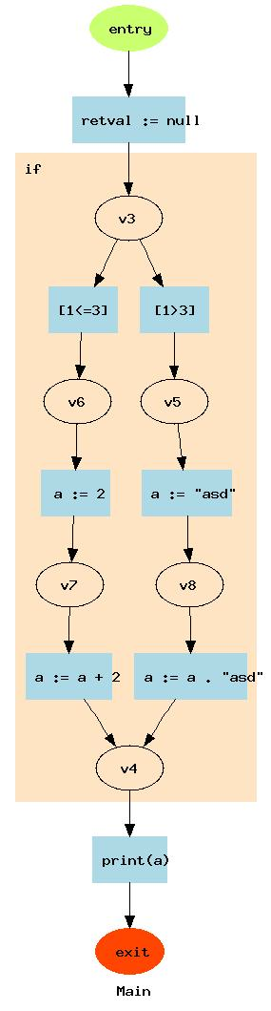
Branches
<?php
if (1 > 3) {
$a = "asd";
$a = $a."asd";
} else {
$a = 2;
$a = $a+2;
}
echo $a;

Slide 18
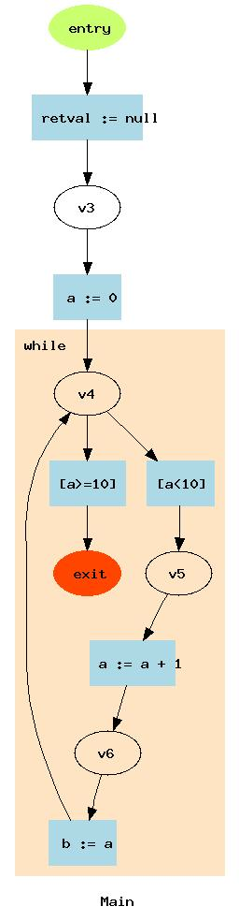
Loops
<?php
$a = 0;
while($a < 10) {
$a = $a + 1;
$b = $a;
}

Slide 19
Conditional types filtering
“remembering” checks
Every values have a boolean value:
Lots of functions possibly return false on error
We don't want false to pollute our results, if properly checked!
TRUE | FALSE
Arrays, integers, floats, strings, resources, objects, true | Arrays, integers, floats, strings, false, null

Slide 20
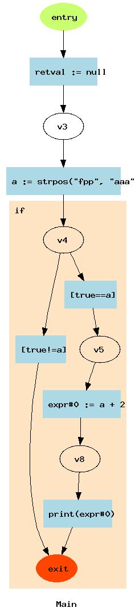
Conditional type filtering
<?php
$a = strpos("fpp", "aaa");
if ($a) {
echo $a+2;
}

Slide 21
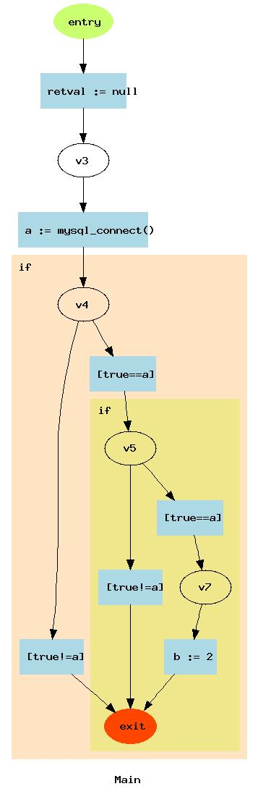
Redundant tests
<?php
$a = mysql_connect();
if ($a) {
if ($a) {
$b = 2;
}
}

Slide 22
Tests on real code
Used to find 4 mistakes in 2 scripts written by a colleague!
Too many false positives in complex, modular, OOP code.
  134 false notices found in a 370 lines class containing 9 methods
  → Increasing the signal-to-noise ratio is the next challenge!

Slide 23
Future Work
Stabilize the support for every PHP5.3 features
Provide a decent model for references
Improve annotations for complex arrays
Add support for in-code annotations?
...

