Slide 1
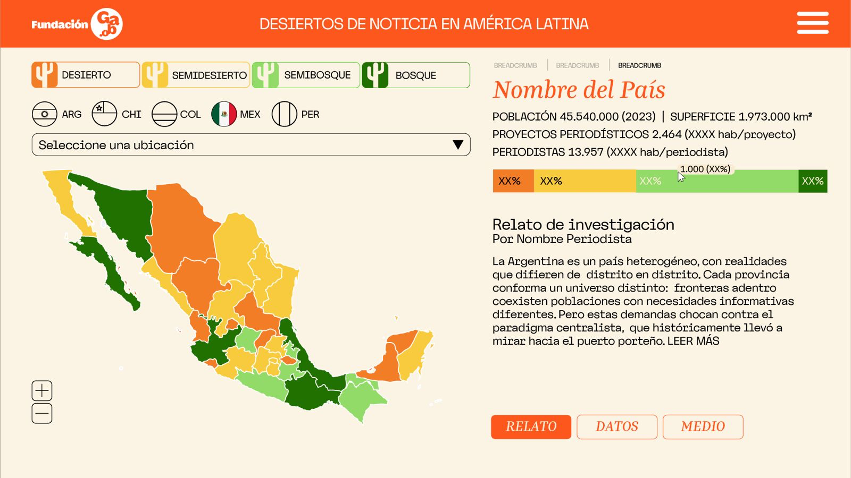
#F77A27
#F8CB3E
#82C45C
#207001

