Slide 1
Router C IP
Router B IP
Router B IP
Router A IP
Router A IP
Router A IP
Client IP
Client IP
Client IP
Client IP
Client
Router A
Router B
Router C
Server
Router A IP
Router B IP
Router C IP
Client IP
Client IP
Router A IP
Router B IP
Client IP
Router A IP
Client IP

Slide 2
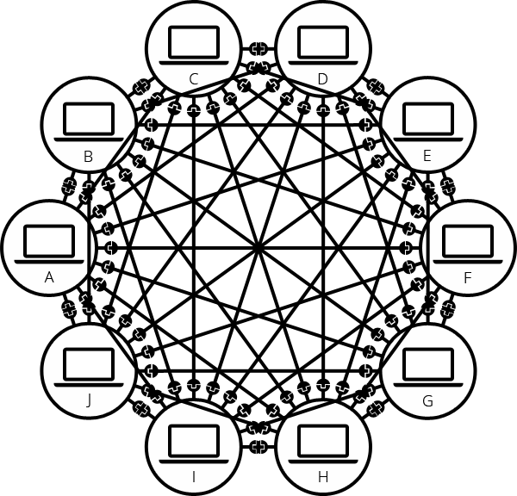
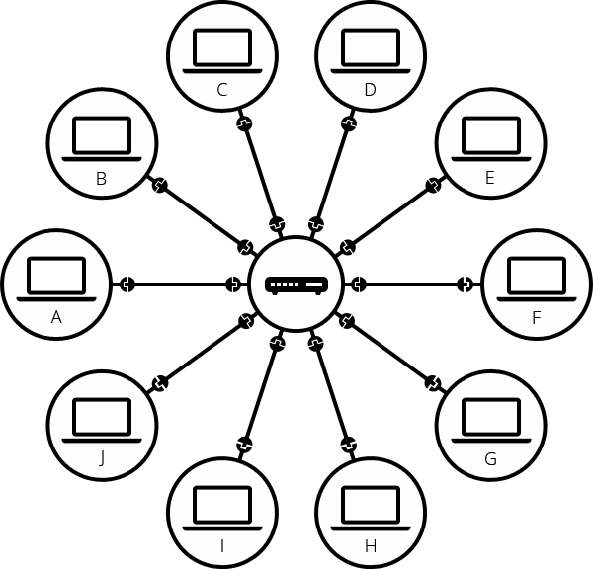
With router, less edges required as devices all connect to router.
Without router, more edges required for more nodes.

Slide 3
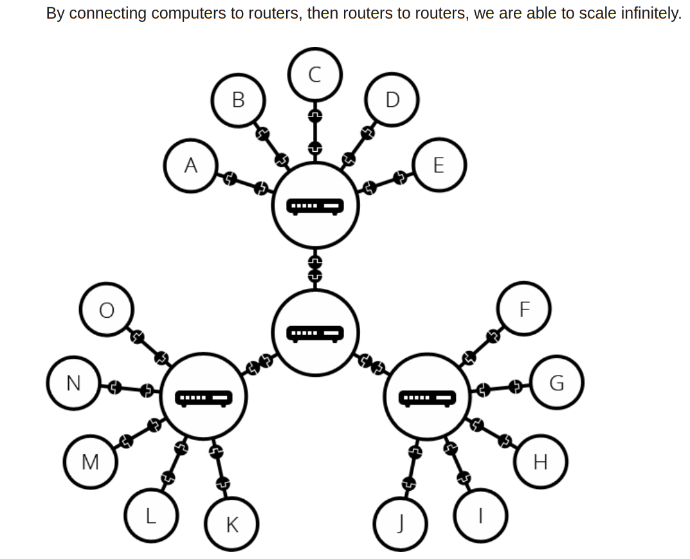

Slide 4
domainname.com + root
Describe the process
of a DNS request
Browser
Matching IP address returned
to OS and then browser.
Matching IP
address
returned
to browser
OS
Resolving Name Server
Root Name Server returns
IP address of corresponding
TLD to Resolving Name Server.
Root Name Server
Yes
No
Resolving Name Server
obtains matching IP
address from
Authoritative
Name Server
OS checks for
matching IP
address in DNS cache
Top Level Domain Name Server / TLD
TLD Server checks domain registrar for
IP of corresponding Authoritative
Name Server.
And return its IP address to Resolving
Name Server.
Authoritative Name Server

