Slide 1
Track Classification/Identification
By: Maya Wallach

Slide 2
Project
Track identification using the Faster R-CNN from Detectron2
In an effort to train a better model I am working to improve training data

Slide 3
DCGAN
GAN (Generative Adversarial Network): A 2 in 1 model where there one generates the data while another learns to tell real images from fake ones
DCGAN (Deep Convolutional Generative Adversarial Network): Is a GAN that uses deep convolutions which makes it better with images

Slide 4
Updates
Fixed problem with image resolution, now at 128x128!
For higher resolutions, I am planning on using a super-resolution network (SRGAN) for compiling time purposes
  A Super Resolution Generative Adversarial Network (SRGAN) is a model which is used to upscale images (i.e. from 32x32 to 128x128)
  Already started working on it, not yet implemented

Slide 5
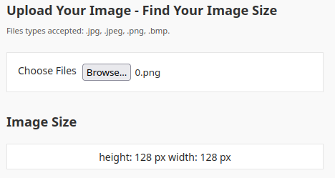
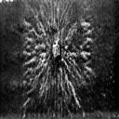
Updates Part 2
Proof they’re 128x128px:

Slide 6
Updates Part 3
Made other minor updates:
  Updated the README
  Both Discriminator and Generator models get saved to saved_models folder
  Switched activation function in the Generator back to ReLU after seeing other implementations

Slide 7

Updates Part 4
I watched the Red Wings opening game against the Tampa Bay Lightning
  Red Wings won

