Slide 1
Battleship
By Aiden Van Dyke & Jacob Burritt

Slide 2
Table of Contents
Introduction
Project Objectives
Requirements and Parameters
Problems
Design and Operation
Applications
Conclusion

Slide 3
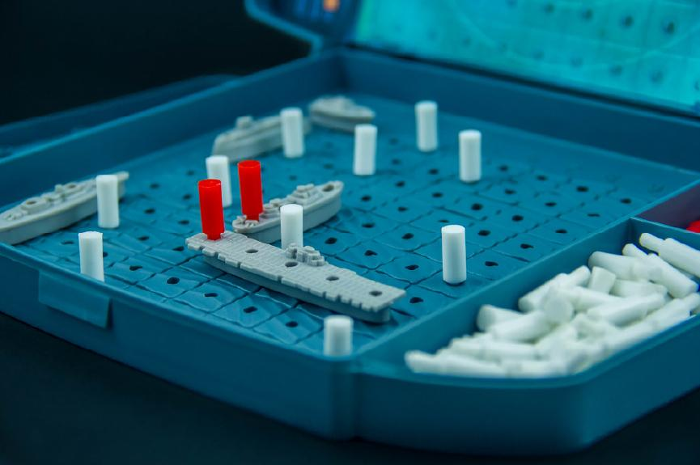
Introduction
Classic board games often make great computer science projects, as they tend to be manageable for students, have logical rules, and can even be fun
Because of this, we choose to implement the classic game of Battleship for the Arduino project

Slide 4
Basic Battleship Rules
Players each place a few ships (typically five) of various sizes on a 10 by 10 grid
They then take turns trying to guess the location of the other’s ships by calling out grid coordinates
If the shot would pass through an opponent’s ship, the opponent says hit. Otherwise, they say miss.
If after a hit, all of the points that a ship covers is a hit, the opponent tells the player that they sunk that ship, as well as telling them what kind of ship it is (thus how long it is)
Whoever sinks all of their opponents ships first wins.

Slide 5
Project Objectives
Play a game of Battleship against a competent computer opponent
Do so via a LED Matrix
Use as few pins and wires as possible

Slide 6
Requirements and Parameters
Confirm and Cancel actions
Move a cursor to select squares
A way of seeing which mode the user is in
Visualization of the grid
Algorithms that can place enemy ships and fire at player ships in a logical way

Slide 7
Problems
How to get user input?
How to send messages to the user?
How to display the game grid?
How to create a computer opponent?
How to make all this work with only 2 Kilobytes of dynamic RAM?

Slide 8
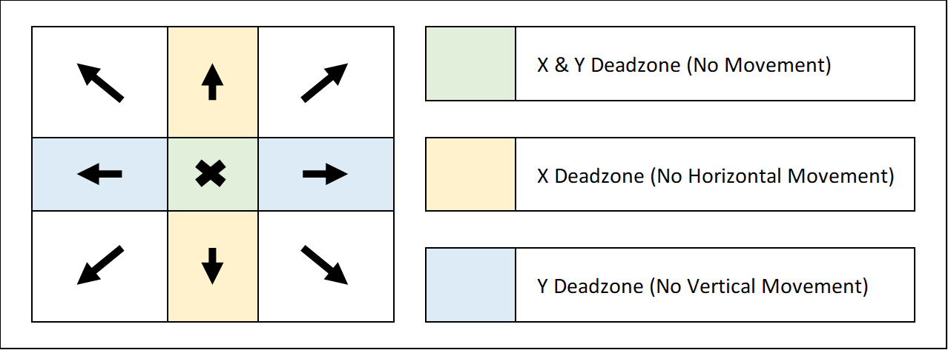
How to get input?
Use a joystick to control a virtual cursor
Use a deadzone (as shown in image) to reduce sensitivity of the cursor
Wrap around the edges by adding and then taking the modulus of the grid size
Use buttons for confirm and cancel actions.
Use internal Arduino pull up resistor (Remember to check for LOW, not HIGH)

Slide 9
How can we send messages to the user?
This can be accomplished easily through the use of a LCD module
LCDs on Arduino usually require at least 6 data pins to operate, but though the use of a $1.50 I2C adapter, we can reduce that down to only 2 + GND & VCC.
Ended up not being necessary for this project, but the reduction in wires was nice.

Slide 10
How to display the game grid?
Traditional displays get expensive quick for sizes above 1 inch, so for something big, we needed to roll our own solution
WS2812b LEDs are cheap and have plenty of libraries available, so these were cut into 10 strips of 10 LEDs and soldered into a grid pattern to create a RGB Matrix,
The player and enemy grid are combined into this single display and shown when relevant in order to save cost, complexity, and size.

Slide 11
RGB Matrix - Power Requirements
Each RGB LED draws a max of 60 milliamps, so 100 LEDs could draw 6 amps
That’s way too much for an Arduino, so a separate power supply was attached, composed of 3xAA batteries, with a shared ground connection back to the Arduino (important when devices have different power supplies)
A 220 ohm resistor at the first LED Data-In line and a polarized capacitor was added near the battery in order to protect the LED strip from current fluctuations

Slide 12
How to create a computer opponent?
Basic Algorithm: Search for a ship, then once a hit is found, switch to destroy mode until the ship is sunk
One way to do this is through random guessing in search mode
Once we’ve found a ship with a hit, we can add each square that touches that hit to a list
We can then hit all squares in that list before returning to search mode
This has expectly poor results, usually requiring around 90 turns to sink all the opponents ships

Slide 13
Using parity
A slightly better algorithm involves thinking of the game grid like a checkerboard
Since every ship is at least 2 units long, we can speed up the guessing by only targeting every other square in search mode, like only moving on white or black squares on a checkerboard
This is better than just random search, but it’s still not a very efficient algorithm

Slide 14
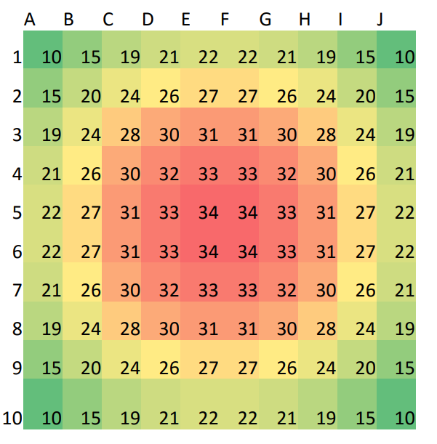
The Probability Algorithm - Search Mode
For each ship that hasn’t been sunk, we check where it can be placed. Everywhere that the ship can be placed has those squares value incremented by 1 from a starting value of 0
There are more ways to place ships in the center, so they score higher
Once the highest probability value has been determined, the AI randomly picks from the squares that have that maximum value, with the probability values adjusting as misses and sunk ships reduce the possible positions that unknown ships could be in
The probability grid at the start of the game.
Image from Boyd & Boyd, 2016

Slide 15
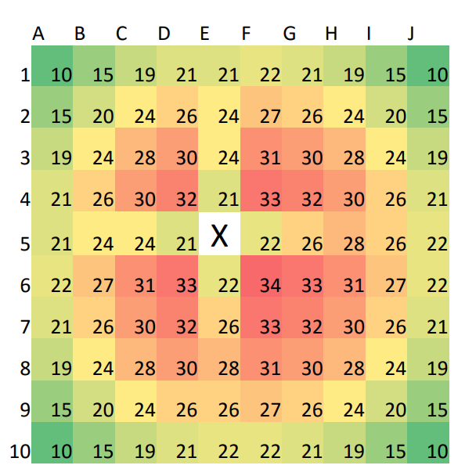
The Probability Algorithm - After the first shot
In the example to the right, E5 has been shot at and missed. Since E5 is right near the center of the board (where at the start a ship would be most likely to be) and it’s now known to not contain a ship, that center point of the board is no longer a “hot spot”, though it is still “hotter” than the edges of the board.
Image from Boyd & Boyd, 2016

Slide 16
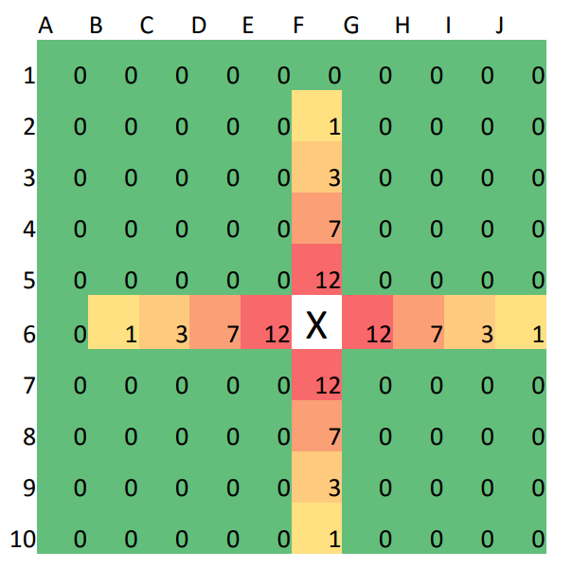
The Probability Algorithm - Destroy Mode
When the AI encounters a hit, it switches to destroy mode, where instead of considering the all squares on the entire board that haven’t been shot at yet, it considers only those that can be reached by a ship that intersects the original hit square -- in other words, it will search up, down, left, and right from the original hit square.
The AI stays in destroy mode until all hit squares are part of a sunken ship, at which point it will return to hunt mode.
The probability grid upon the first hit. All ships are still in play.
Image from Boyd & Boyd, 2016.

Slide 17
How to deal with the Arduino UNO’s limited RAM
Use minimal libraries and switch to libraries that use less RAM when possible (FastLED vs Adafruit_NeoPixel)
Store strings as C style char arrays instead of as String objects
This helps keep the heap from filling with unusable holes and memory issues
Even more dynamic memory can be preserved by storing string constants in program memory, which has 32 KBs vs the 2 KBs for dynamic RAM (PROGMEM)
This requires special handling, mostly with LCD helper methods
Need to copy program memory strings over to dynamic memory as we use them (strlcpy_P(), etc)

Slide 18
Design and Operation
Use a joystick and buttons for user input
An LCD can be used to display messages for the user
A custom built RGB LED Matrix can display the grid
Use a probability density grid for determining where the enemy should fire at
Use smaller libraries, C style strings, and program memory storage to save RAM

Slide 19
Basic Game Loop
First, the enemy ships are placed in random positions and orientations
Next, the player positions their ships, according to the rules of the game
After pressing a button to confirm, the basic gameplay loop starts, with both the player and the computer getting a chance to fire at each other’s ships
When all the player or enemy ships have been sunk, the game ends and a game over message is displayed to user.

Slide 20
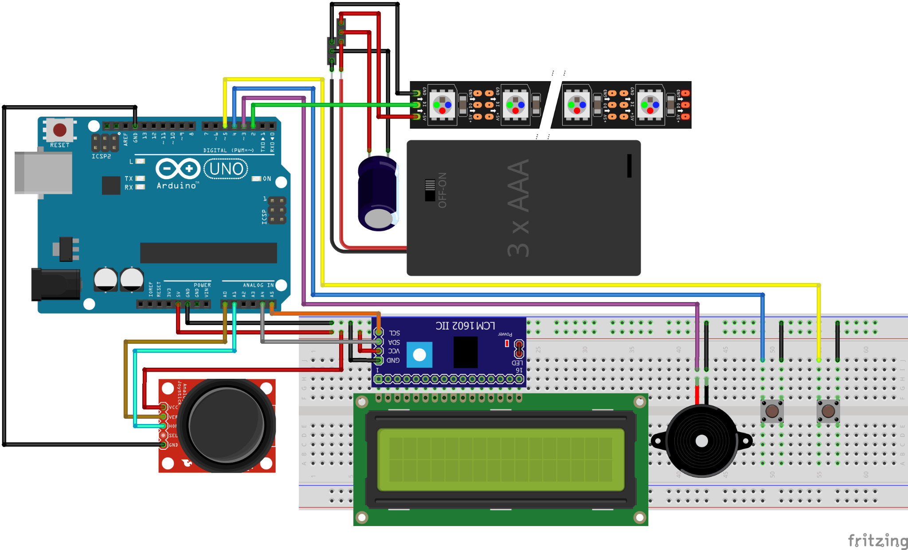
Battleship - Schematic

Slide 21
Applications
Arcade games (Displays, input)
LED lighting, digital signage, & visualizers, and their power requirements
Techniques for saving microcontroller memory (Useful for embedded devices)

Slide 22
Conclusions - Lessons Learned
Syncing two independent devices is more difficult than you might think (this caused us to switch to one player vs. a computer with one board instead of two human players with one board each)
RGB Matrices are great for basic grids that need to be more than a few centimeters large, but power consumption must be kept in mind
Simple everyday board games like battleship show how probability can help increase chances of winning
On microcontrollers, memory is a very important thing to consider (It’s easy to run out)

Slide 23
References
Boyd, J. [Jacob], & Boyd, J. [Johnathan]. (2016). Battleship Playing Program Utilizing Probability Density Functions https://www.csuohio.edu/sites/default/files/82B-2016.pdf
Berry, N. (2011, December 3). Battleship. http://www.datagenetics.com/blog/december32011

