Slide 1
Employee email privacy
Policies and Practices

Slide 2
What does the law say?

Slide 3
The electronic communications privacy act of 1986
THE ECPA HAS 3 TITLES
The Wiretap Act
Prohibits any intentional interception, use, disclosure, or acquisition of any wire, oral, or electronic communication of any other person.
The Stored Communications Act
Protects the privacy of the files stored by service providers and of records held about the subscriber by service providers.
Pen Registers and Trap & Traces
Requires government persons to obtain a court order authorizing the instillation and use of a pen register and/or a trap and trace.
EXCEPTIONS
Title 1 provides exceptions for operators, service providers, and government officers.
SIGNIFICANT AMENDMENTS
CALEA (1994)
The USA PATRIOT ACT (2001)
The FISA Amendment Act (2008)
Notes:
The Electronic Communications Privacy Act & the Stored Wire Electronic Communications Act together make the ECPA.
The ECPA updated the Federal Wiretap Act of 1968, which addressed interception of conversations using "hard" telephone lines, but did not apply to interception of computer and other digital and electronic communications.
The ECPA protects wire, oral, and electronic communications while those communications are being made, are in transit, and when they are stored on computers. The Act applies to email, telephone conversations, and data stored electronically.
requires government entities to obtain a court order authorizing the installation and use of a pen register (a device that captures the dialed numbers and related information to which outgoing calls or communications are made by the subject) and/or a trap and trace (a device that captures the numbers and related information from which incoming calls and communications coming to the subject have originated). No actual communications are intercepted by a pen register or trap and trace. The authorization order can be issued on the basis of certification by the applicant that the information likely to be obtained is relevant to an ongoing criminal investigation being conducted by the applicant’s agency.
EXCEPTIONS: Title I provides exceptions for operators and service providers for uses in the normal course of his employment while engaged in any activity which is a necessary incident to the rendition of his service and for persons authorized by law to intercept wire, oral, or electronic communications or to conduct electronic surveillance. It provides procedures for Federal, State, and other government officers to obtain judicial authorization for intercepting such communications, and regulates the use and disclosure of information obtained through authorized wiretapping. A judge may issue a warrant authorizing interception of communications for up to 30 days upon a showing of probable cause that the interception will reveal evidence that an individual is committing, has committed, or is about to commit a "particular offense“.
SIGNIFICANT AMENDMENTS
CALEA: The Communications Assistance to Law Enforcement Act of 1994 enhanced the ability of law enforcement agencies to conduct electronic surveillance by requiring that telecommunications carriers and manufacturers of telecommunications equipment modify and design their equipment and services to ensure that they have built-in surveillance capabilities, allowing federal agencies to wiretap any telephone traffic. It has since been extended to cover communication methods such as broadband internet.
The USA PATRIOT Act, clarifies and updates the ECPA to keep pace with the evolution of new communications technologies and methods, including easing restrictions on law enforcement access to stored communications in some cases.
The FISA Amendment Act of 2008 amended the Foreign Intelligence Surveillance Act of 1978 to ‘establish a procedure for authorizing certain acquisitions of foreign intelligence, and for other purposes.’

Slide 4
what does this mean for employee email privacy?
Not a lot.
Notes:
The Electronic Communications Act of 1986 does very little to protect employee email privacy because (technically) employees’ corporate email accounts are the property of the company.

Slide 5
So how is employee email privacy handled?
The Two-Step Test
1. Reasonable Expectations of Privacy
Did the employee have any (valid) reason to expect their account records were private?
User experience with/understanding of technology
Management policies
Employee-Employer conversations
2. Sufficient Reason for Search/Seizure
What reason did the employer have for viewing an employee’s email records?
Harassment Claims
Internal Investigations
Information Sensitivity
Notes:
Test created for Katz v. United States in 1967, where the evidence brought against Katz was obtained by the FBI by using a wiretap on the public phone booth Katz was using without first obtaining a warrant. The first step required Katz to prove he had an actual expectation of privacy and the second was determining whether the defendant (FBI) had sufficient reason perform the search. Katz proved he had a reasonable expectation of privacy because the telephone booth was public and there were no postings informing users that it was under surveillance. For the second step, it was determined that placing a wiretap on a public phone booth without a warrant is a violation of the 4th amendment because it is an unreasonable search of private property.

Slide 6
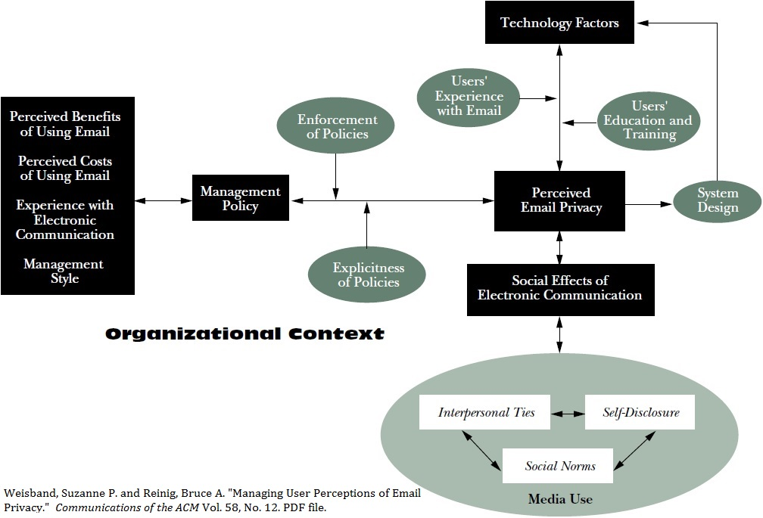
Step 1: perceived email privacy

Slide 7
Step 2: Sufficient Reason for Search/Seizure
Internal Corporate Investigations
Flagged by Filter
Records Management
Falmouth Fire Fighters’ Union vs. Town of Falmouth

Slide 8
What is practiced?

Slide 9
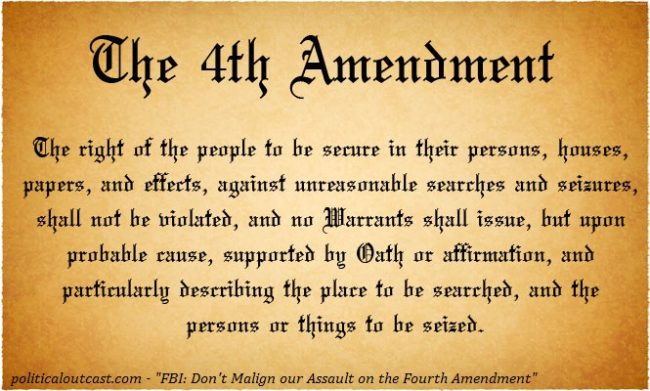
Government employees

Slide 10
Bibliography
United States Department of Justice. (1986, October 21). Electronic Communications Privacy Act of 1986.

