Slide 1


Gamma Filter Video Processing Circuit on Intel’s DE1 SoC FPGA
Cole Maxwell
https://github.com/cole-maxwell/Gamma_Filter_DE1_SoC_FPGA

Slide 2
Outline
1 · What is a Gamma Filter?
2 · Project Overview
3 · Demonstration
4 · Technical Discussion & Applications
5 · Questions

Slide 3
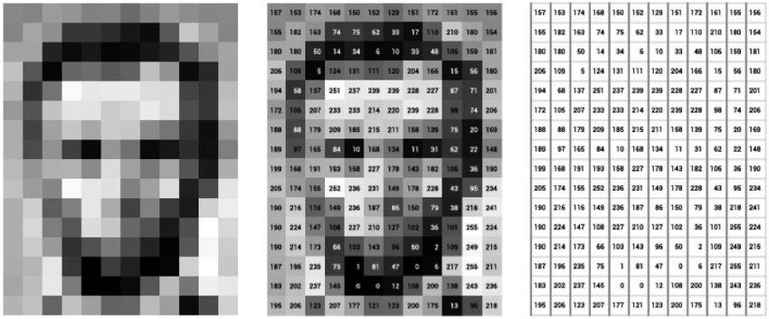
1 · What is a Gamma Filter?
First, what is a computer image?
2D array of pixels with 8-bit intensity values ranging from 0 to 255.
Reference: (III)

Slide 4
1 · What is a Gamma Filter?
Intensity Histogram
Displays the number of times each intensity value appears in the image.
Reference: (I)

Slide 5
1 · What is a Gamma Filter?
Image Filtering
Transforming the intensity values of each pixel in an image is a common technique that can make the image easier for a human to see or better for an algorithm to process.
There are many types of image filters for different applications, many of them based on convolution.
xs
Linear Histogram Scaling
Size Filter
Gaussian Filter
Reference: (I)

Slide 6

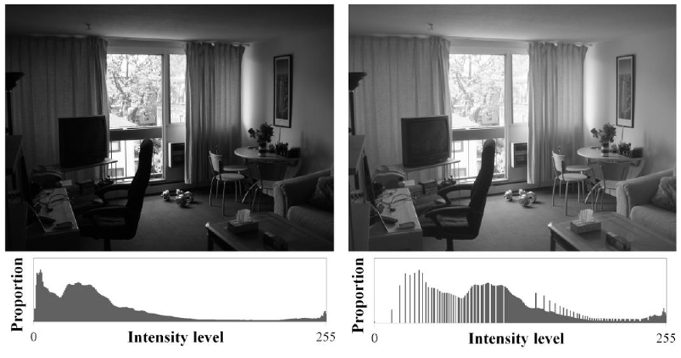
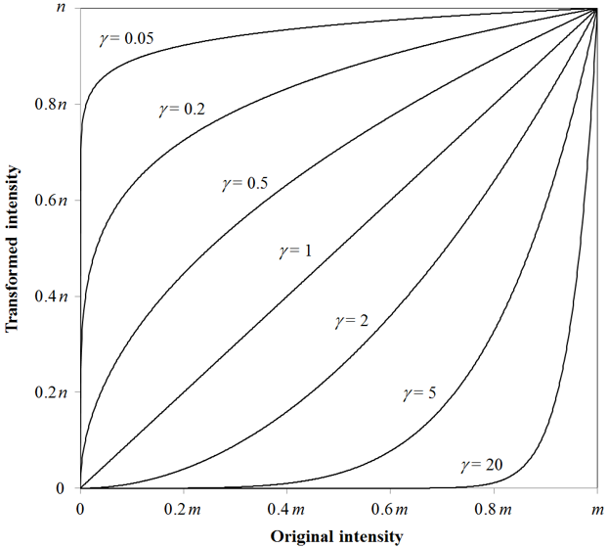
1 · What is a Gamma Filter?
Gamma Filter
Image histograms that skew high or skew low can lack contrast.
A gamma filter remaps intensity values to increase visibility.
Reference: (II)

Slide 7
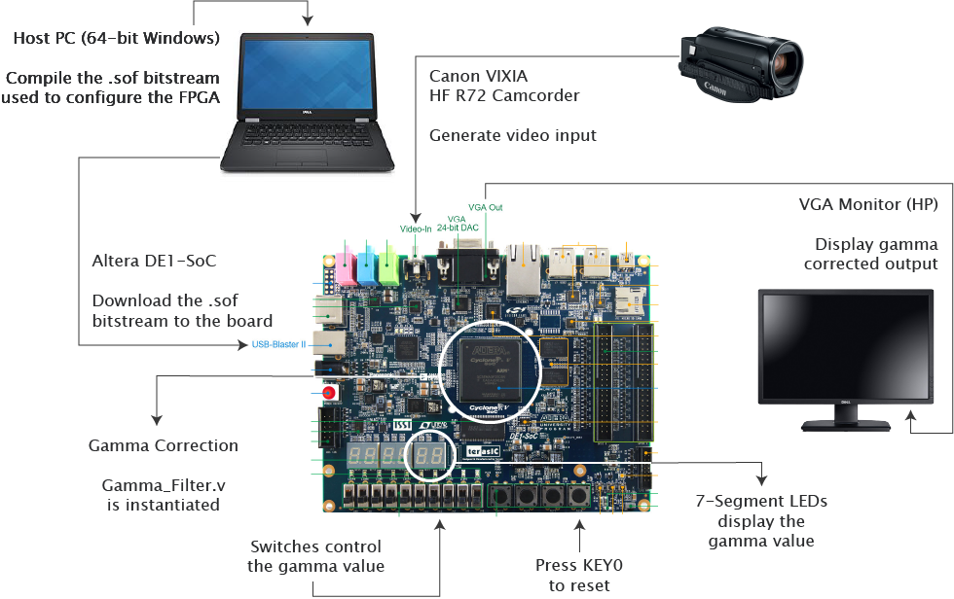
2 · Project Overview
Hardware Setup
Reference: (IV, VI)

Slide 8



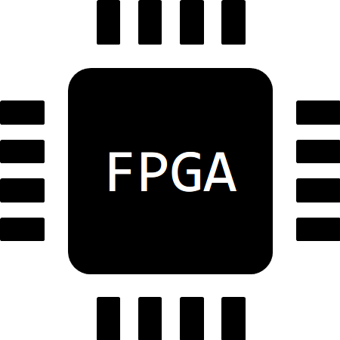


2 · Project Overview
Software Setup
C, Verilog &
SystemVerilog
Quartus Prime
Lite 18.1
Programmer
(Quartus Prime 18.1)
ModelSim
Generate_Gamma_Values.c
Gamma_Correct_TB.v
DE1_Gamma_Filer.v
Gamma_Correct.v
SEG7_LED.v
…
Project File:
DE1_Gamma_Filter.qpf
Analysis &
Synthesis
Compilation & Debugging
RTL Simulation with
Gamma_Correct_TB.v &
Gamma_Correct.v
Waveform Viewer
Hardware Detection
& Setup
Download the DE1_Gamma_Filter.sof
bitstream to the board

Slide 9
Demonstration
Notes:
generate_gamma_values.c
Show how to generate test files & case statements
Gamma_Correct_TB.v
Show how to load values into the testbench
Analysis and synthesis
Run RTL simulation
Compile testbench, simulate, verify values
DE1_Gamma_Filter.v
Full compilation, generate .sof
**** Do something during these minutes…show project structure in VS Code
Programmer, auto-detect
Download .sof

Slide 10
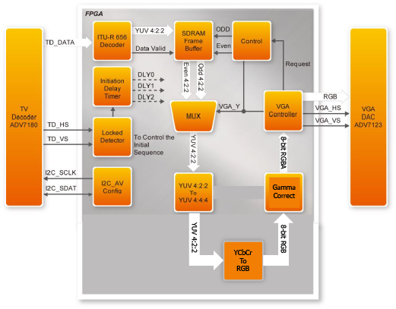
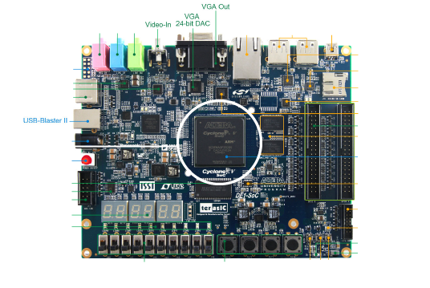
4 · Technical Discussion & Applications
FPGA Block Diagram
Reference: (V)

Slide 11
4 · Technical Discussion & Applications
Future Work
Improve gamma transformation algorithm in Gamma_Correct.v
sdcsdc
Option 1: Implement ALTFP_EXP megafunction from Quartus IP Catalog
Option 2: Custom circuit
Additional features for KEY1, KEY2, KEY3
sdcsdc
Feature 1: Save Video Data
Feature 2: Play, Pause, Rewind, Fast-forward

Slide 12
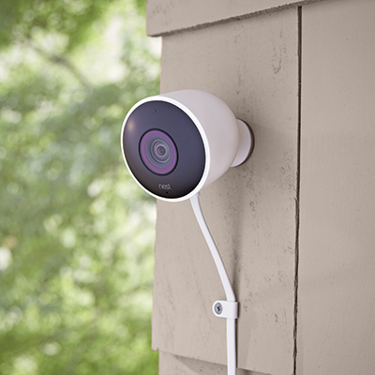
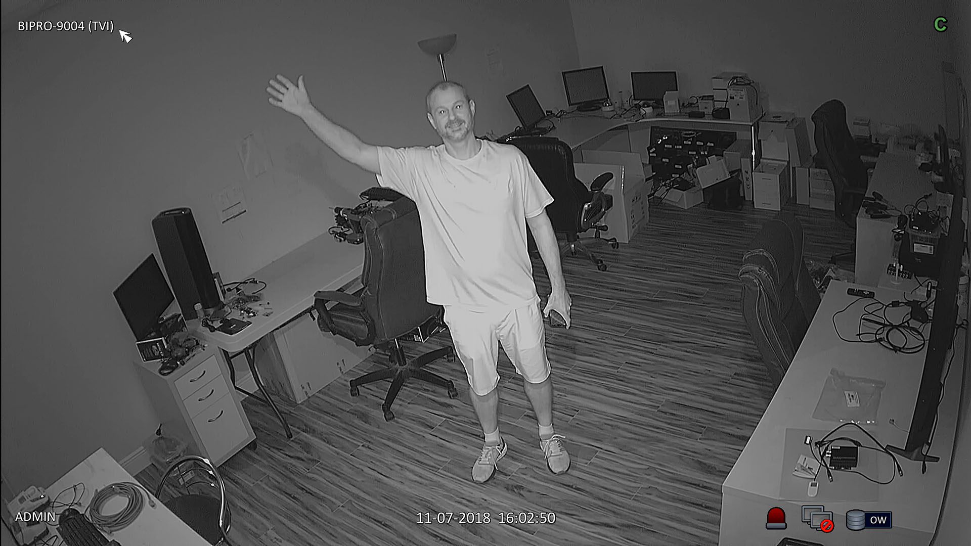
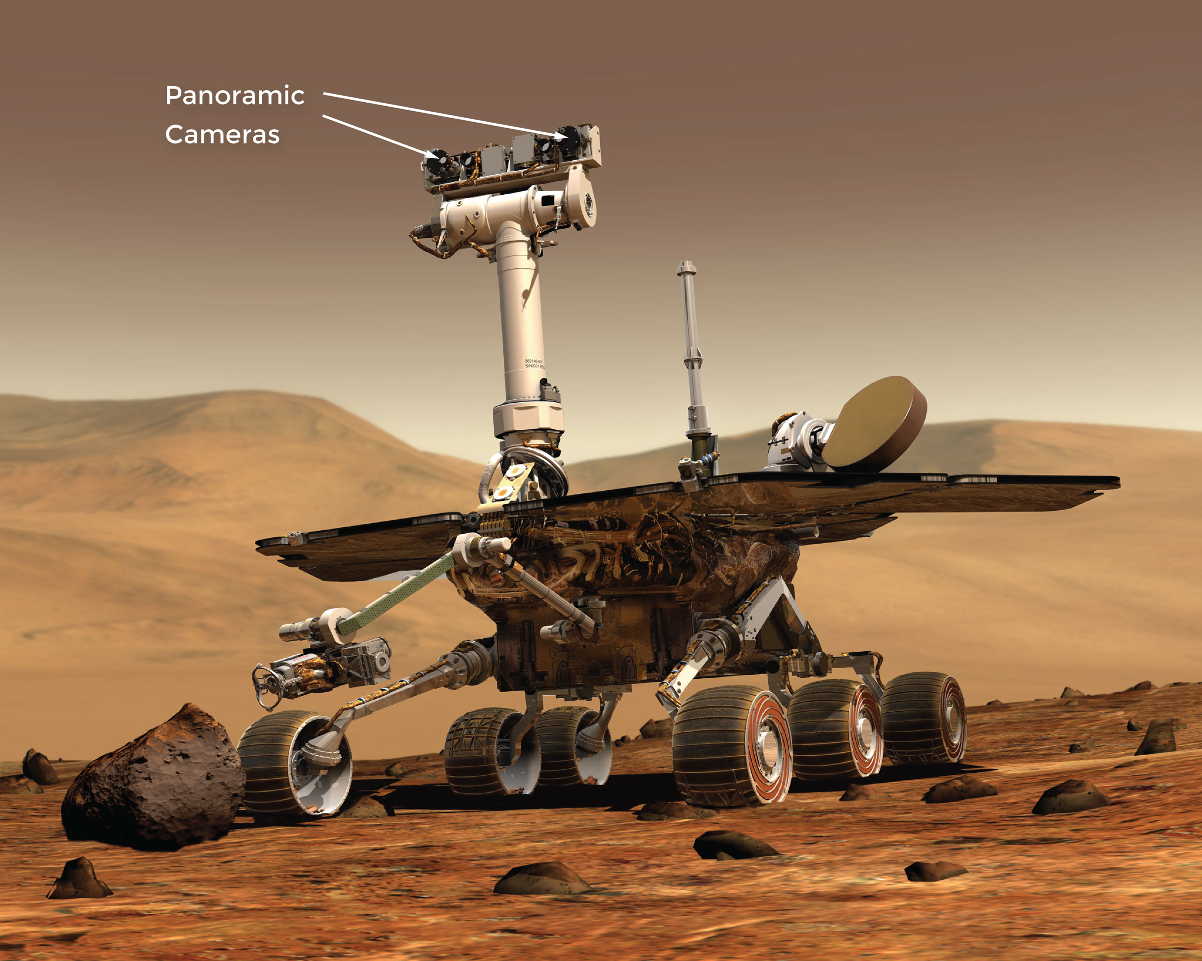
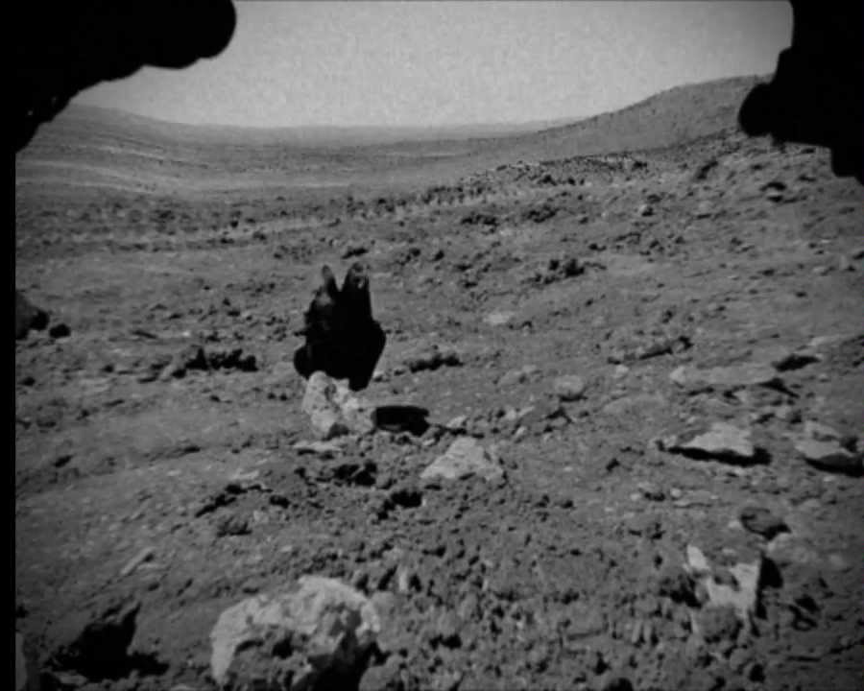
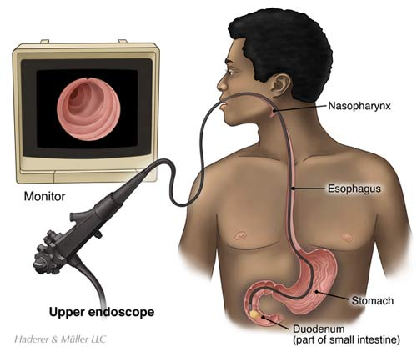
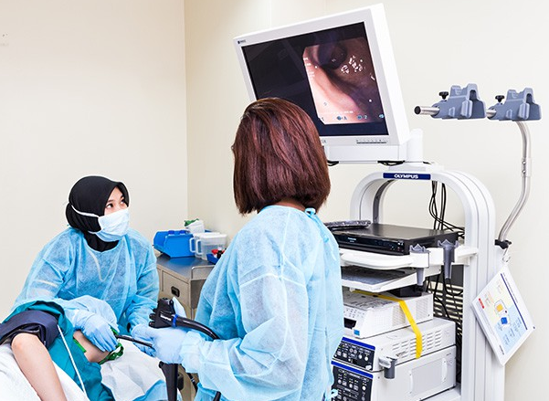
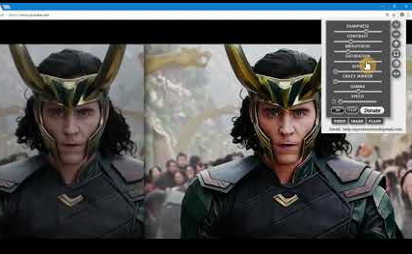
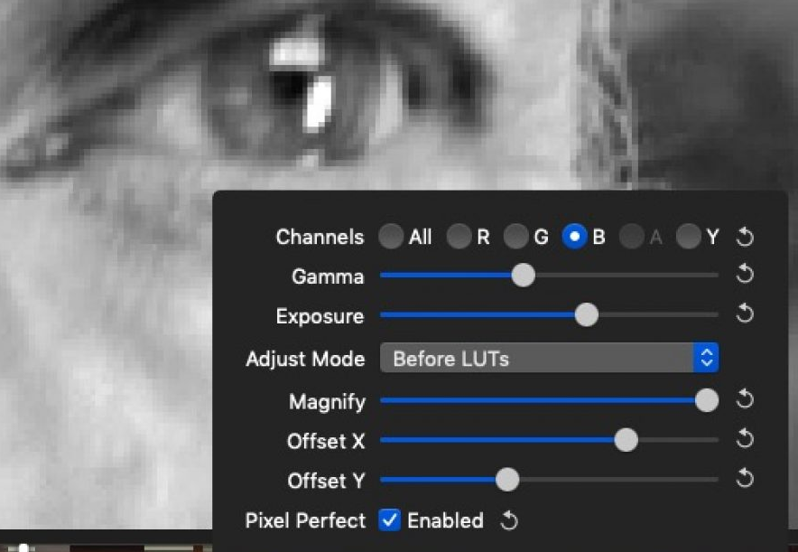
4 · Technical Discussion & Applications
Applications
Surveillance & Security
Aerospace
Medical Imaging: Endoscope
Filmography

Slide 13
References
Pomplun, Marc. Computer Science 675: Computer Vision. Fall 2019, University of Massachusetts Boston. Class Lecture 4: Thresholding, Component Labelling, Size Filter.
Pomplun, Marc. Computer Science 675: Computer Vision. Fall 2019, University of Massachusetts Boston. Class lecture 5: Compactness, Intensity, and Gamma.
ResearchGate: https://www.researchgate.net/figure/Pixel-Data-Diagram-of-Abraham-Lincoln-166_fig4_337402608
Terasic Technologies Inc. 2003-2013, DE1-SoC Getting Started Guide, April 11, 2019
Terasic Technologies Inc. 2003-2013, DE1-SoC User Manual, April 11, 2019
Canon, HF R72/R70, HD Camcorder Instruction Manual, PUB. DIE-0468-000

Slide 14
Questions

