Slide 1
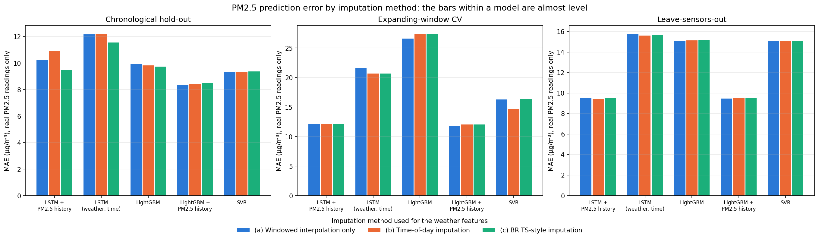
Did the BiLSTM imputer improve training?
Five models were retrained on weather filled by each imputation method, under three validation setups.
Within each model the three bars are almost level: the imputation method barely changes the prediction error.

Slide 2
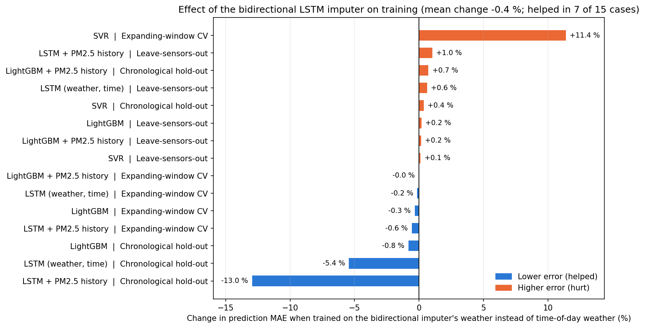
BiLSTM imputer against time-of-day imputation
Mean change in MAE: −0.4 %
Helped in 7 of 15 cases
Helped the LSTMs on the hold-out: 10.89 → 9.48 and 12.22 → 11.56 µg/m³
Hurt the SVR in the expanding-window CV: 14.68 → 16.35 µg/m³
Everything else changed by about 1 % or less
As an imputer it is better: 21 % lower error on hidden values

Slide 3
Decision: final models use time-of-day imputation
The BiLSTM (BRITS-style) imputer is kept in the notebook as a tested method; the final models are not retrained on its values.
No reliable benefit: −0.4 % MAE on average, better in 7 of 15 cases.
It only fills temperature and humidity, which are minor inputs for the models (SHAP).
The LSTMs improved, but stay behind LightGBM + PM2.5 history (8.43 µg/m³): the best model does not change.
It must be retrained for every split and would add a neural network to serving; time-of-day needs no training.
PM2.5 is never imputed for training or scoring.
Revisit if weather becomes a stronger predictor or if 6 to 12 hour gaps become common.

