Slide 1
LipScribe: Teaching a Computer to Read Lips and Listen at the Same Time
Progress so far (Weeks 1–4) · Computer Vision and Deep Learning · Group 4
Charis Opol · Ainomugisha Faith · Lisa Lusinga Namugenyi · Ansasire Nehum Naamaye · Wakisa Isabelle · Cole Rodney Migisha
12 November 2026
Notes:
LipScribe turns speech into live captions. Its twist: it watches the speaker's lips as well as listening, so captions stay accurate even when the room is noisy.

Slide 2
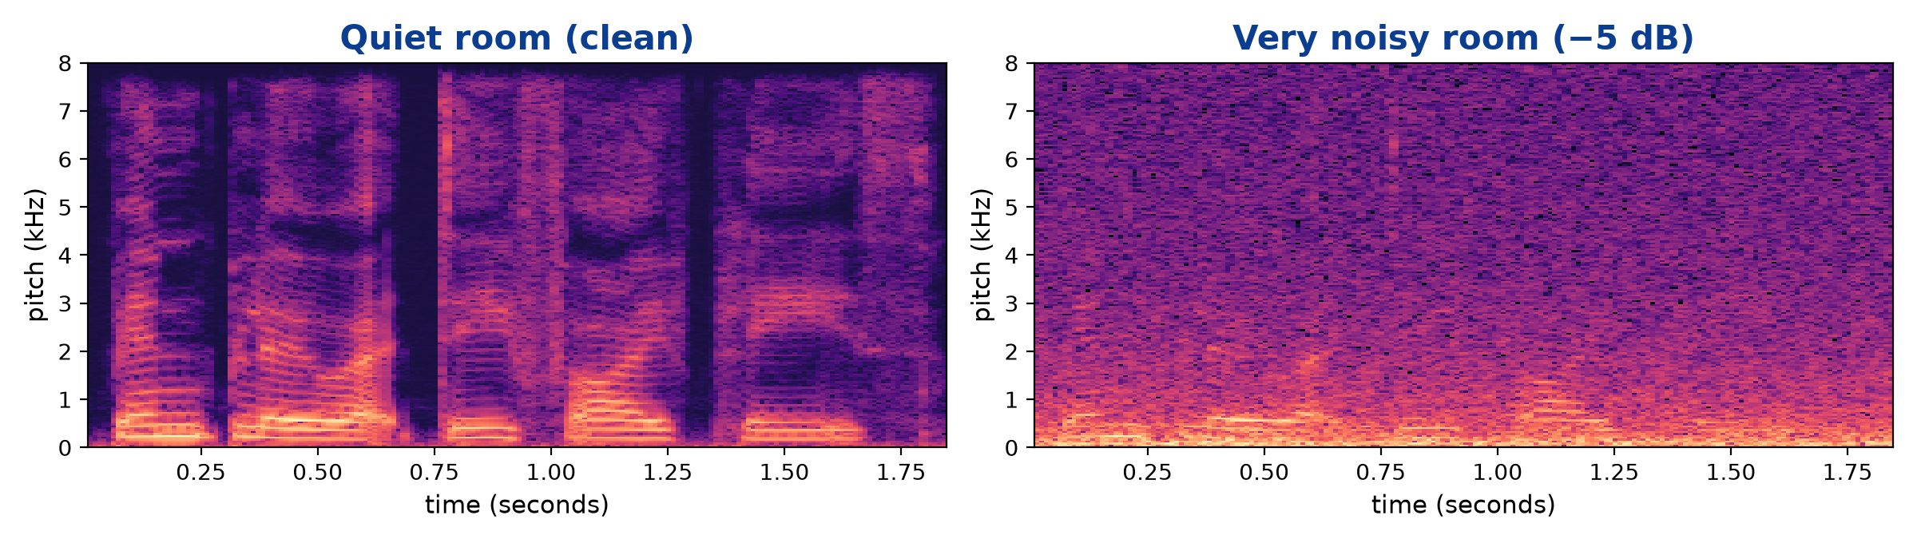
The problem: captions break when a room gets loud
1
Sound gets buried
Noise drowns out the voice, so a listen-only system starts guessing.
2
Lips don’t change
A ‘sound picture’ of the same sentence. The bright stripes are the voice; on the right, noise almost hides them.
Noise can’t touch what the camera sees. The mouth moves the same way.
Who this helps: people who are deaf or hard of hearing, and anyone captioning a lecture, market, taxi park or video call where the audio is poor.
3
Our idea: use both
Listen and lip-read together, and lean on the lips when it gets loud.
Notes:
Left picture is a 'sound picture' of one sentence in a quiet room: bright stripes are the voice. Right is the same sentence with heavy background noise: the voice is almost invisible. A computer that only listens struggles here. But the speaker's lips look exactly the same in both rooms.

Slide 3
Where we are, in four numbers
1.0%
0.7%
−43%
1.9%
words wrong in a quiet room
with our grammar checker on
fewer errors in the noisiest room
with the camera switched off
about 1 word in 100
fewer than 1 word in 100
5.3% vs 9.5% for listen-only
still as good as listen-only
In short: all planned models are built and tested. Our final design, Model P, makes the fewest mistakes overall, cuts errors in noise, and keeps working if the camera or microphone fails.
Notes:
WER = word error rate: out of every 100 words, how many the system gets wrong. Lower is better. All numbers are on 4 test speakers the system never saw during training (3,998 sentences).

Slide 4
Four words you’ll hear in this talk
M
Model
%
Word error rate (WER)
A program that learns a skill from examples instead of following hand-written rules. We show it thousands of videos with their correct sentences, and it slowly learns the pattern.
Out of every 100 words spoken, how many the model gets wrong. 2% means 2 mistakes per 100 words. Lower is better.
dB
Noise level (dB)
?
Unseen speakers
How loud the background is compared to the voice. “Quiet” has no noise; at −5 dB the noise is about 3× stronger than the speaker.
We test only on people the model never saw while learning, so the score shows how it would do on a brand-new person.
Notes:
Keep these four ideas in mind and the rest of the slides will make sense.

Slide 5
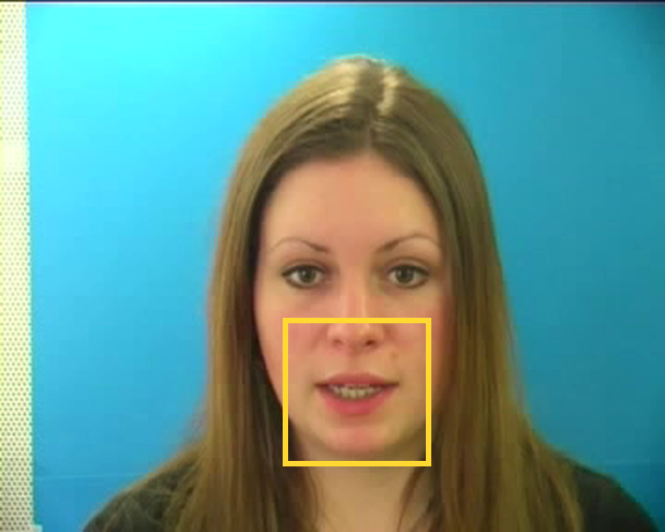
Our data: 33 people, 32,890 short video clips
Every clip is a 3-second, six-word sentence, for example:
“bin blue at d five please”
26
3
4
people to learn from
people to tune on
new people to test on
Quality checks first. An automatic audit of all 34,000 files found one speaker with no video and 110 broken clips. We removed them and kept 96.7% of the data.
A real GRID clip. The yellow box is the part we keep.
Notes:
GRID is a public research dataset: each person reads 1,000 short sentences to a camera. Every sentence has the same six-word pattern. Before using it we checked every file: one speaker (s21) had no video at all and 110 clips were broken, so we removed them.

Slide 6
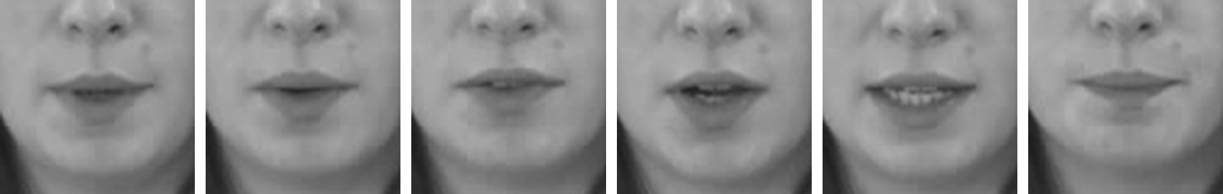
What the computer actually looks at
Six moments from the sentence “bin blue at d five please”: the lip shape changes with each sound.
1
Find the face
2
Cut out the mouth
3
Keep the timing
4
Line up the sound
A face-finding tool marks 40 points around the lips in every frame.
Crop a steady square around the lips, grey, 96×96 pixels.
Never drop a frame: a missed frame is filled in from its neighbours.
Shift the audio so each sound lands on the right lip movement.
Notes:
We find the face in every frame, draw a box around the lips, cut it out, turn it grey and shrink it to 96 by 96 pixels. 25 frames a second, 75 frames per clip. If the face finder misses a frame we fill the gap from its neighbours instead of deleting it, so sound and video stay in sync.

Slide 7
How LipScribe turns a video into a sentence
Lip video
Eye part
Reader + grammar check
75 mouth pictures
learns lip shapes
Combiner
spells out letters, then snaps to the nearest valid sentence
merges what the eyes and ears found, moment by moment
Sound
Ear part
“bin blue at d five please”
voice recording
learns sounds
The key design question is the combiner: how should the system mix the two senses? We tried a simple version first (baselines), then built a smarter one (Model P).
Notes:
Two 'senses' work side by side. The ear part turns sound into numbers; the eye part turns lip movements into numbers, one set every 40 milliseconds. The combiner merges them, the reader spells out letters, and a grammar checker makes sure the result is a valid GRID sentence.

Slide 8
Progress against our plan
M1
M2
M3–M4
M5
M6–M7
M8–M9
Set up computers and check the data
Prepare all 32,890 clips
Build the three simple models
Build the smart combiner (Model P)
Fine-tune and test thoroughly
Live caption app and demo
Done · 29 Oct
Done · 3 Nov
Done · 4 Nov
Done · 5 Nov
In progress · due 22 Nov
Started · due 29 Nov
Team of six, one shared machine: every model was trained on our Alienware workstation (RTX 4080 SUPER graphics card), and every result was re-checked there on 12 November.
Notes:
Five of nine milestones are complete, ahead of schedule: the smart combiner (M5) was due 15 November and is done. Tuning and evaluation is underway; the live demo app is next.

Slide 9
Step 1: three simple models to beat
B1
Ears only
B2
Eyes only
B3
Eyes + ears, glued
Listens to the sound.
Reads the lips, no sound at all.
Sticks both together in one step.
2.0% wrong in a quiet room
23% wrong, in every room
1.2% wrong in a quiet room
9.5% wrong in the noisiest room
5.2% wrong in the noisiest room
Great when it’s quiet, but errors grow almost 5× in noise.
Noise has zero effect, but some sounds look the same on the lips (b, p, m).
Better than B1 everywhere, but it falls apart if the camera or mic stops.
Notes:
Before building anything clever, we built three simple 'baselines' so we'd know what good looks like. B1 listens only. B2 lip-reads only. B3 does both by simply gluing the two together.

Slide 10
Using both senses beats listening alone in every room
Quiet room
Model P: 1.0 wrong per 100 words, the best of all our models (ears only: 2.0).
Noisiest room
43% fewer errors than ears only (5.3 vs 9.5). Glued B3 is level here (5.2).
Notes:
Each line shows how many words go wrong as the room gets noisier (left to right). The ears-only model (red) climbs steeply. Both models that also use the lips stay much lower. Lip-reading alone (not drawn) stays flat at 23% because noise doesn't affect it.

Slide 11
Why we upgraded the ‘eyes’ to ResNet-18
Old eyes: simple 3D-CNN
Only 3 layers deep.
Tied to exact pixel positions, so a new face shape or lighting threw it off: 13% to 34% wrong depending on the person.
New eyes: ResNet-18
17 layers with ‘shortcuts’ that make deep learning stable.
A proven design, but it learned everything from our own GRID videos.
Result: half the mistakes in a quiet room (2.1% → 1.0%), and the combiner trusts the lips nearly twice as much in noise.
Notes:
Version 1 of the eye part was shallow and memorised where things sat in the picture, so it did well on some people (13% wrong) and badly on others (34% wrong). Version 2 uses ResNet-18, a deeper, well-proven image design. It evens out lighting per clip, looks at 5 frames of motion at once, and summarises the whole mouth so a slightly shifted crop doesn't confuse it. Fair test: same ears, same combiner, same 30 minutes of training; only the eyes changed.

Slide 12
Borrowed design, our own learning
1
Copied the blueprint
2
Reused our own experience
3
Took GRID skills to films
Like building from a proven house plan, but laying every brick ourselves. ResNet-18 comes from published lip-reading research; it learned everything from our GRID videos, starting from random.
Like hiring someone who already knows half the job. Model P starts with the trained eyes (B2) and ears (B1), then learns how to combine them.
Later in this talk: for the film clips, the model starts from what it learned on GRID instead of from zero.
Technical: adopted architecture, trained from scratch
Technical: transfer learning between our models
Technical: transfer learning to a new dataset
In one sentence: we adopted the ResNet-18 lip-reading architecture and trained it from scratch on GRID; we then used transfer learning to reuse those GRID-trained parts in Model P and in the film-clip experiments.
Notes:
People often ask whether we used a ready-made, pre-trained model. We did not. ResNet-18 is a published design, a blueprint, and we built it in our own code. Every one of its millions of settings started random and was learned from GRID's mouth videos. That is 'adopting the architecture' and 'training from scratch'. Transfer learning is different: it means reusing settings a model has already learned. We do that in two places. Model P starts with the eyes of B2 and the ears of B1 already trained, then only has to learn how to combine them. And in the film test, the model starts from what it learned on GRID instead of from zero, because a few minutes of film are far too little to learn from scratch.

Slide 13
Step 2: Model P, a smarter way to combine the senses
1
2
3
The senses check each other
A trust dial for every moment
A stand-in when a sense is missing
Ears can glance at nearby lip movements to fill in a word lost in noise; eyes can use the sound to tell look-alike lip shapes apart (b, p, m).
25 times a second, the model sets a dial between ‘trust the ears’ and ‘trust the lips’. Loud room: turn towards the lips.
If the camera loses the face or the mic cuts out, a learned ‘nothing here’ signal fills the gap so the model knows to rely on the other sense.
Technical name: cross-modal attention
Technical name: gated fusion
Technical name: missing-modality embedding
Notes:
Three ideas make Model P different from simply gluing sound and lips together. Cross-checking lets each sense look at the other. The dial decides, for every 40 ms moment, how much to trust each. The stand-in is a learned placeholder used when a sense is missing, so nothing breaks.

Slide 14
If the camera or mic fails, Model P keeps going
Camera off
Model P: 1.9% wrong, as good as the ears-only model (2.0%). Glued B3: 25%.
Microphone off
Model P: 32% wrong, as good as lips-only. Glued B3: 75%, nearly useless.
Notes:
We switched off one sense at test time. The glued model (B3) collapses: 25% wrong with no camera and 75% with no microphone, worse than using one sense on its own. Model P drops back gracefully: 1.9% with no camera, about the same as the ears-only model (2.0%); 32% with no microphone, about the same as lips-only.

Slide 15
As the room gets louder, Model P trusts the lips more
20% → 31%
share of trust given to the lips, quiet room → noisiest room
Why it matters
The model learned by itself to lean on the lips when the sound gets bad: exactly the behaviour we designed it for.
Notes:
This is the trust dial from slide 12, averaged over 3,998 test sentences. Nobody told the model to do this; it learned it. In a quiet room it gives the lips about 20% of the say. In the noisiest room that rises to 31%.

Slide 16
From letter guesses to words: greedy vs grammar
Greedy: best letter each moment
Merge repeats, drop the gaps. Fast, but one weak letter spells a wrong word.
Grammar: only real GRID sentences
Every sentence is command · colour · preposition · letter · digit · adverb, from 51 words. The decoder picks the allowed sentence that best fits the guesses.
Real fixes (0 dB):
place white by x five snow → now
lay red by k ninhe please → nine
555 test sentences fixed, none made worse. Films have no fixed pattern, so there we use the open-ended version: a word list + which words usually follow which.
Notes:
25 times a second the model guesses a letter, or a 'gap'. Something has to turn those guesses into words. Greedy decoding simply takes the most likely letter each moment, merges repeats and drops the gaps; it is fast but one weak letter spells a wrong word. Every GRID sentence follows one pattern of six slots from 51 words, so the grammar decoder only lets the model choose between sentences that fit that pattern, and picks the one that best matches its letter guesses. On Model P4's test set it fixed 555 sentences and made none worse, cutting errors by 30% in a quiet room (1.02% to 0.71%) and 26% in the noisiest room (5.34% to 3.95%). Films have no fixed pattern, so for the film clips we use the open-ended version: only real words from a word list, scored by how likely each word is to follow the previous one.

Slide 17
Problems we hit, and how we fixed them
1
Sound ran ahead of the lips
2
Missing and broken files
3
The model ‘cheated’
The audio files had their silence cut off, so speech started up to 1.5 s early. We re-aligned every clip using its timing file.
One speaker had no video and 110 clips wouldn’t open. An automatic audit found and removed them.
In a practice run all 8 sentences began “bin blue at f”, so it guessed the same answer for all. Mixed examples forced it to really read lips.
4
Eyes didn’t work on new people
5
Gluing made quiet rooms worse
6
Crashes when a sense was missing
The old eye part ranged from 13% to 34% wrong depending on the person. Fixed by switching to ResNet-18.
Training both senses from zero let the weak lip side add noise. Fixed by starting from the trained B1 and B2.
Blanking a whole sense made the maths divide by zero. The learned ‘stand-in’ signal fixed it.
Notes:
We logged 13 setbacks in total; these six matter most. The biggest lesson: test every piece joined together, early, because each part passed its own tests but five bugs only showed up when they were connected.

Slide 18
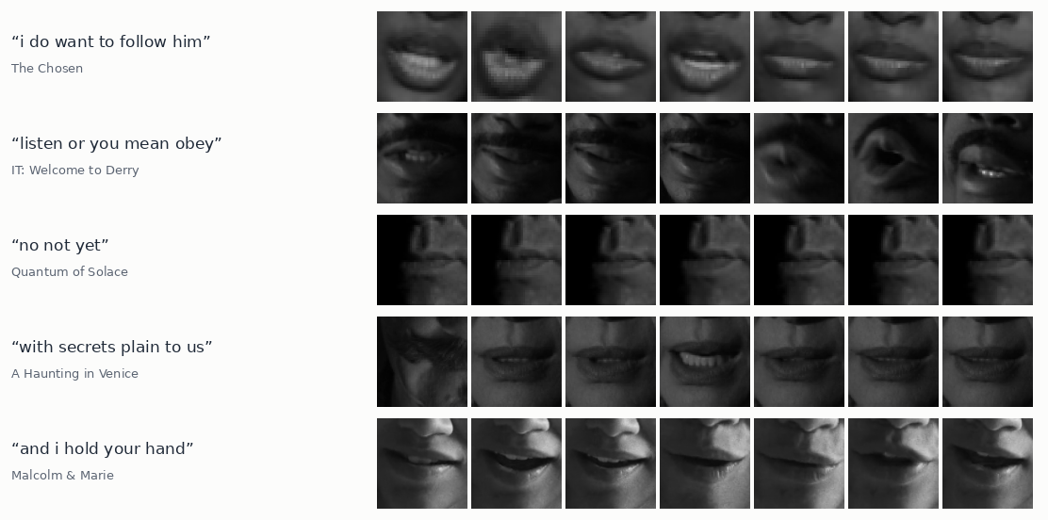
Teaching Model P film dialogue
The film data
305 clips from 13 titles: 9.7 min, 651 words. 3 films kept aside for the test.
Three things we tried
1
Fine-tune Model P, GRID mixed in
2
Retrain it the P4 way, films only: 26 settings tested, best one × 3 runs × 150 rounds
Real mouth crops our script found in films, 7 moments per line, with the subtitle that labels them.
3
Word grammar: only real words, from 9,053 in the training films’ subtitles
Notes:
GRID only has 51 words. To see whether Model P can learn real speech, a script searched 13 of our own films and series for moments where one person faces the camera and speaks, with no camera cut, and cut out the mouth and the sound, labelled with the subtitle. That gave 305 clips: 9.7 minutes, 651 different words. Three films are kept aside for testing and never used in training. We tried three things: (1) fine-tune Model P with some GRID mixed in; (2) retrain Model P the same way we built it (from the B1 ears and B2 eyes), on films only, testing 26 different training settings and then training the best one three times for 150 rounds; (3) a word grammar for films: the model may only write real words from a 9,053-word list built from the training films' subtitles, scored by which words usually follow which.

Slide 19
Results on three films it never saw
Better
Letters: 81.5% → 74.5% wrong. Grammar: first time under 100% words wrong.
Still not working
About 1 word in 30 right, short ones: you, and, what. It also forgot GRID (0.8% → 115%).
Why
9.7 minutes of film. Research systems use hundreds of hours; ~7× more is being collected.
Notes:
Scores on 43 clips from the three test films, quiet sound. Words wrong can pass 100% when the model adds extra words. Retraining on films lowered letters wrong from 81.5% to 74.5% (the same in all three runs, so it is real). With the word grammar, words wrong dropped below 100% for the first time (97.5%) and it got about 7 of the 223 non-GRID words right on average, against about 3 without; letters wrong rose to 80.5% because it now writes whole words. Still, only about 1 word in 30 is right, and short ones: you, and, what, don't. Trained on films only, it also forgot GRID: 0.8% to 115% words wrong. The reason is the amount of data, 9.7 minutes; research systems use hundreds of hours. The full set, about seven times more, is being collected now.

Slide 20
Watching it train: practice vs. unseen films
Alienware · training log (real)
round practice unseen letters
error error wrong
1 5.19 3.35 100.0%
10 3.05 3.10 100.0%
30 2.66 3.19 86.4%
46 2.18 3.58 75.3% ★
100 1.10 5.24 78.3%
150 1.05 5.53 78.5%
150 rounds · ~4 s each · RTX 4080 SUPER
Best round: 46 (75.3% of letters wrong on unseen films). After that it memorises.
Notes:
One of the three 150-round training runs. The blue line is the model's error on its own practice clips; it keeps falling. The red line is its error on clips from films it does not train on; it stops improving early and then rises. That gap means it is memorising its 193 practice clips rather than learning to lip-read in general. We keep the version from the best round (round 46, 75.3% of letters wrong on the unseen films), not the last one. The panel on the right is the real training log from the Alienware.

Slide 21
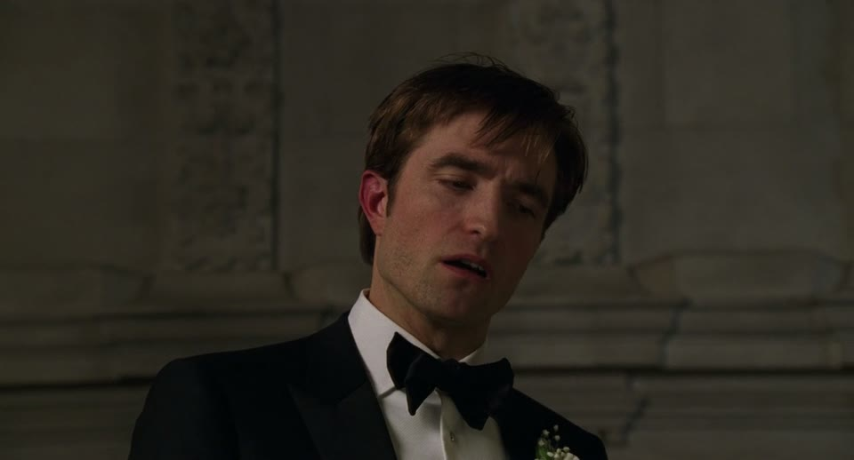
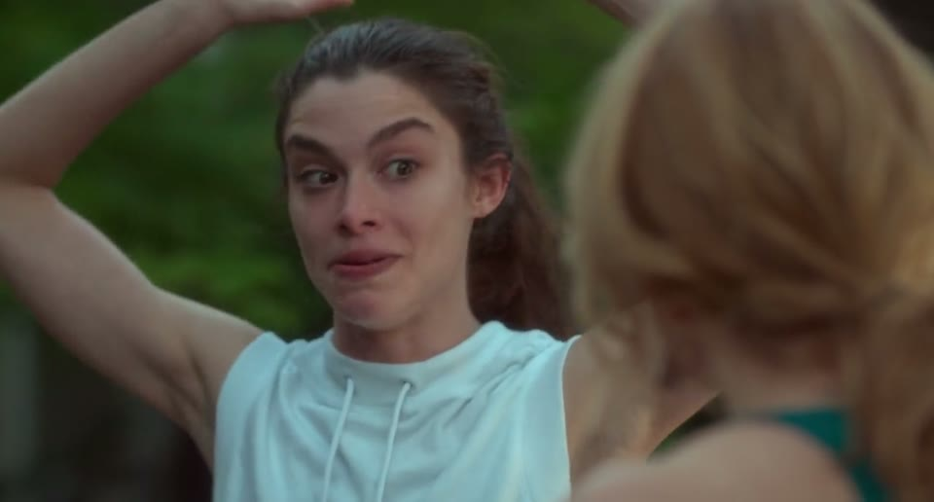
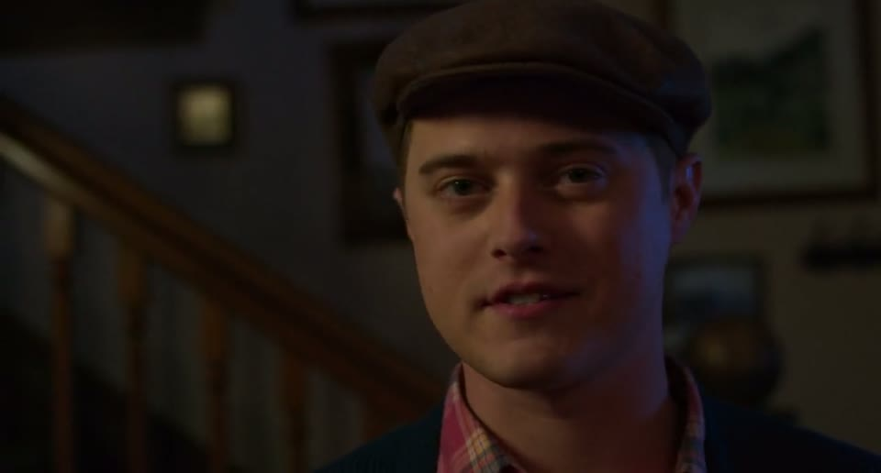
What our model wrote, scene by scene
Best result
Best result
Typical result
Subtitle (The Drama)
“you know like uh”
Model P as is
“bn ne now”
Retrained on films
“you nt a ne”
Retrained + word grammar
“you dont and”
Subtitle (Little Women)
“i used to be”
Model P as is
“lian whe win b eight sgon”
Retrained on films
“wha ma ne”
Retrained + word grammar
“i am”
Subtitle (Little Women)
“oh i thought you were a novelist not a screenwriter”
Model P as is
“lay reten bi v iro soon”
Retrained on films
“iond tao u maes srs sne te”
Retrained + word grammar
“and to me sense”
Notes:
Three scenes from films the model never saw in training. Real subtitle in bold; below it, what each version of our model wrote. Scenes marked 'best' are the 2 clips where the retrained + word grammar model did best out of 35 test clips; 'typical' is from the middle of the pack. So these are its best moments, not an average. Even then it gets only scraps right: a few sounds and short words. An empty caption means the model wrote nothing.

Slide 22
What’s next
✓
Just finished
M6
By 22 November
M8
By 29 November
Better sound features: ears-only errors on the tuning speakers dropped from 7.7% to 6.9%. To be merged.
First version of the caption app is in the code base.
Retrain Model P with the new sound features.
Fine-tune settings and finish the full test report.
Live captions from a webcam and microphone, powered by Model P.
Final testing and the demo.
Double-checked on the Alienware (12 Nov): all 9 trained models are saved, the ‘best model’ file is byte-for-byte the P4 model, and the test scores in this deck match the saved results.
Notes:
Since the Week 3 report: (1) Lisa and Charis finished the audio-feature experiment W3-08 on the Alienware; adding MFCC features to log-Mel (119 channels) improved ears-only validation error from 7.7% to 6.9%, so we switch to it. This sits on the charis branch and is not merged into main yet. (2) The first version of the live caption app (Gradio, W3-10) was merged into main in PR #55 on 10 November.

Slide 23
Notes:
Thank you. Happy to take questions.

