Slide 1

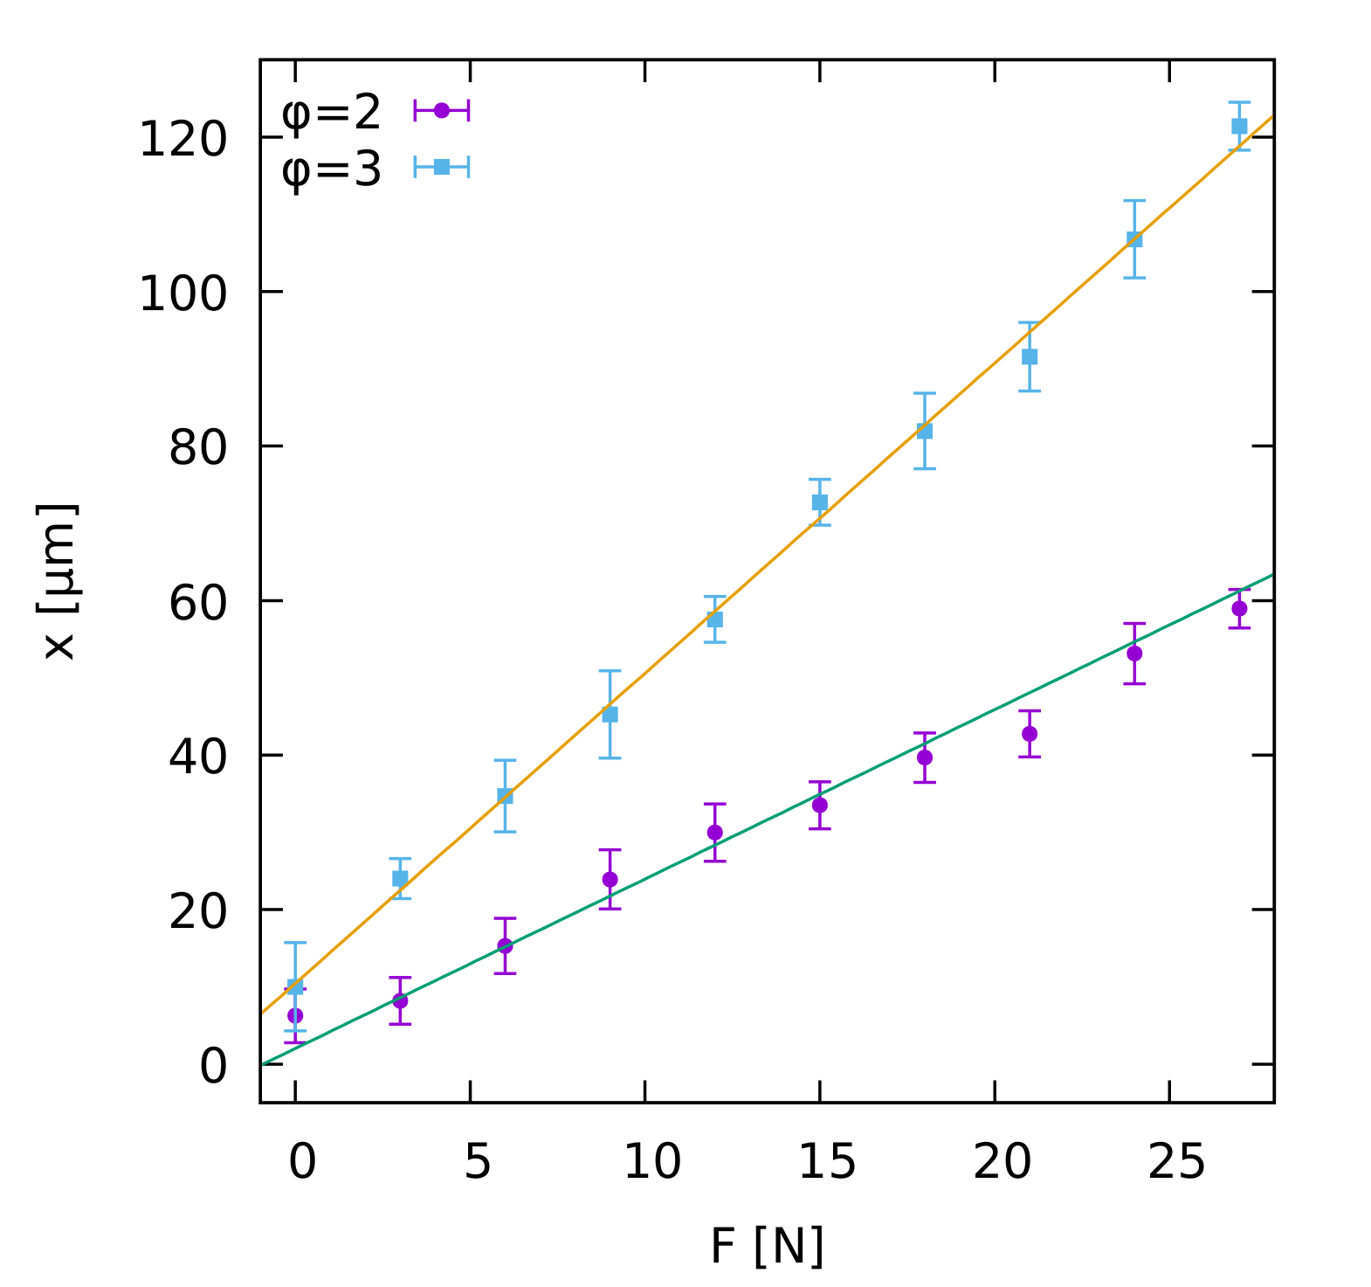
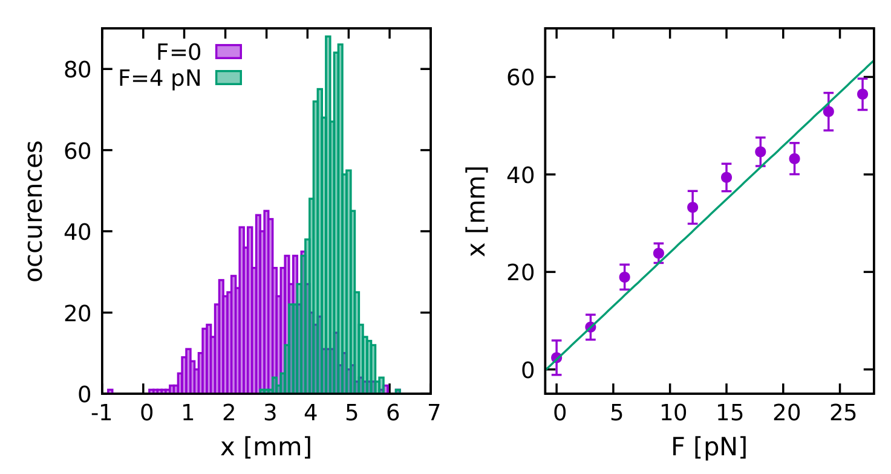


Poster title: An investigation into…
Your name
Supervisor: Prof XXX YYY
Introduction
Posters are a common way to present research at scientific conferences. Often at a ‘poster session’, researchers will stand next to their poster and talk an audience through their results. For the Senior Honours Projects, the posters will be displayed on screens in the school. They should therefore present the work in a way such that someone can understand your project from the poster alone (with no additional explanation). You should pitch the poster at your fellow SH students, i.e., at a similar lever as the report.
The poster should ‘tell the story’ of your project in a visual way, so there should be a mixture of text, diagrams, plots, images, equations etc. This template definitely has too much text!
Though the poster might have similar sections to the report, it is obviously much shorter, so you will need to be selective about what you include.
Result A: My first result
The key results from your project and a discussion of what they mean. In this layout the results are placed centre stage. Use figures and/or graphs to show key findings.
Make sure all labels etc. are visible. You will likely need to re-draw plots specifically for the poster. The poster should be eye catching, but easy to read; try to avoid ‘busy’ backgrounds and colour schemes which distract from the content.
$$\frac{∂u}{∂t}=D\frac{∂^{2}u}{∂x^{2}}−V\frac{∂u}{∂x}$$
Equations can be useful if they help the reader understand the results, but in most cases, they will not be needed.
Result B: My second result
This poster layout is functional, but plain. A more eye-catching design will help your poster stand out.
This is a BAD example, where a good plot has been lifted directly from the report.
The plot shape does not fit the space, the numbers are too small, low resolution etc.
Try to use all the space, but don’t squash in too many elements.
Figure 1: Distribution of comment codes.
Fig 2: Points show mean of 10 measurements; error bars show the standard error. The line is a linear fit.
Fig. 1: Figures should have brief captions. Left: Histograms show example distributions of lengths. Right: Length as a function of force. Points show mean with error, line is a fit.
Conclusions
Discussion, conclusions and suggestions for future work. Use references where appropriate¹.
The main points your poster should get across are the project motivation and aim (what you set out to do, and why its interesting/important), a key result (take home message), and the broader implications of that finding. You will need to be selective on what (not) to include.
Methods
A summary of the methods you used. You do not need to give all the fine details, just enough for the reader to understand. Figures/diagrams etc. can be useful.
Bullet points can help get messages across in fewer words
Methods may not be of interest to everyone, so in this layout this section is tucked away at the bottom left, although the poster still follows a logical flow.
It should be clear to the reader in which order the should look at the panels/sections.
Rate of change of $u$
References
¹ Pollitt, A. (2012). The method of Adaptive Comparative Judgement. Assessment in Education: Principles, Policy & Practice, 19(3), 281–300
diffusion
drift
Acknowledgements
Thanks to…

