Slide 1


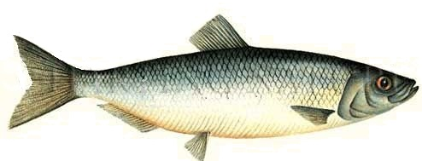
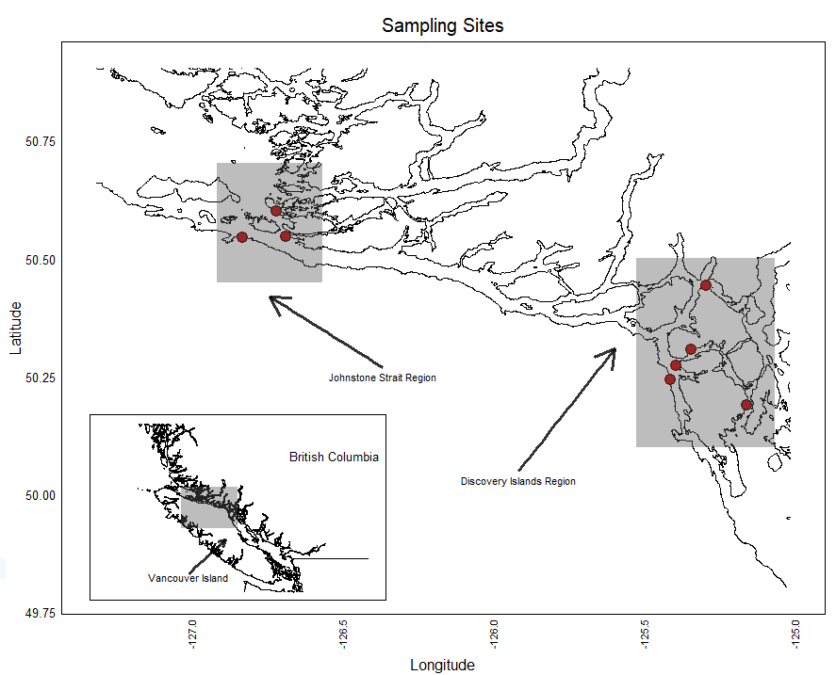
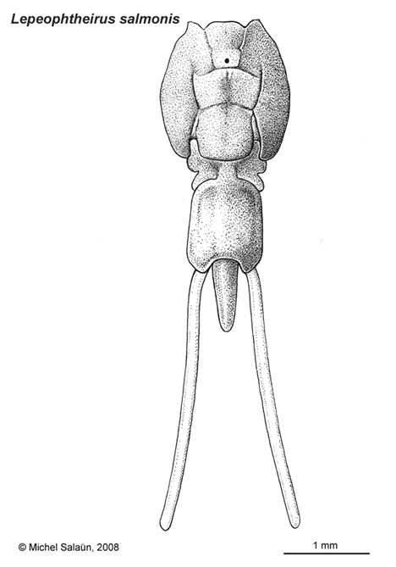
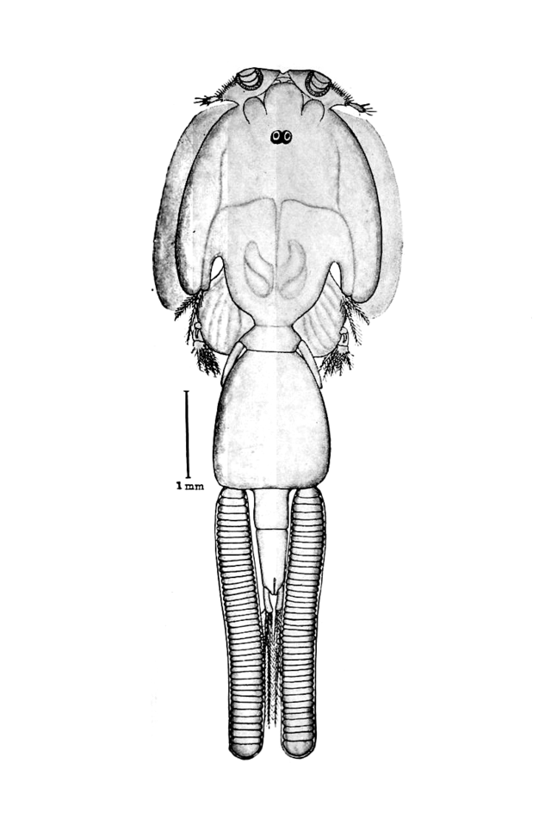
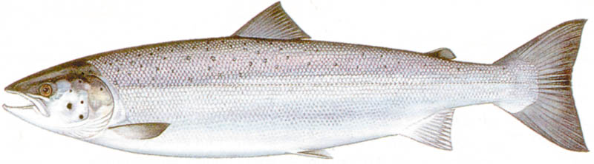
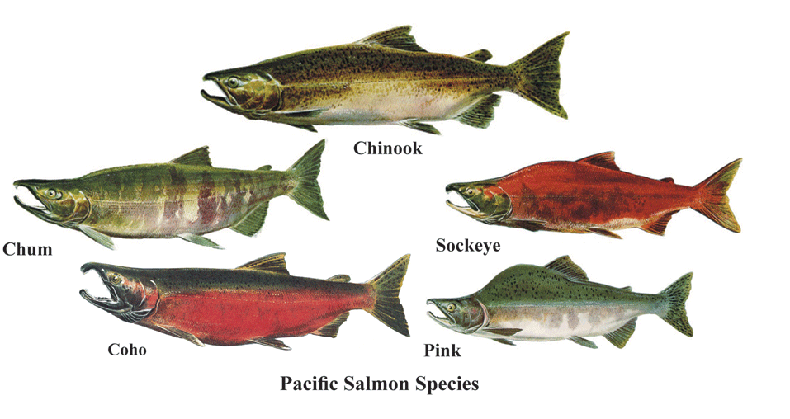
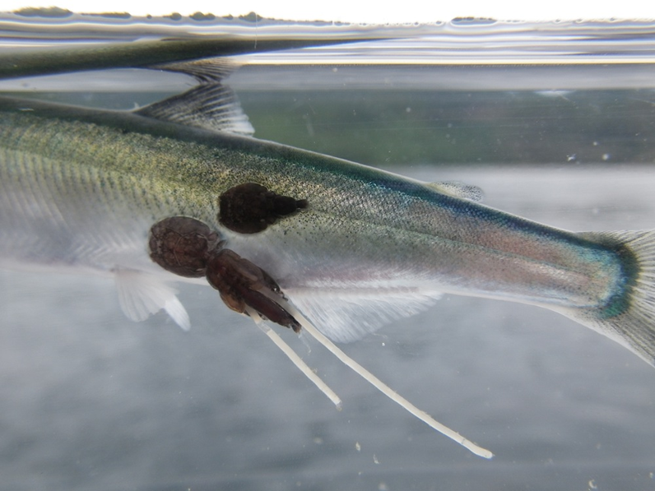
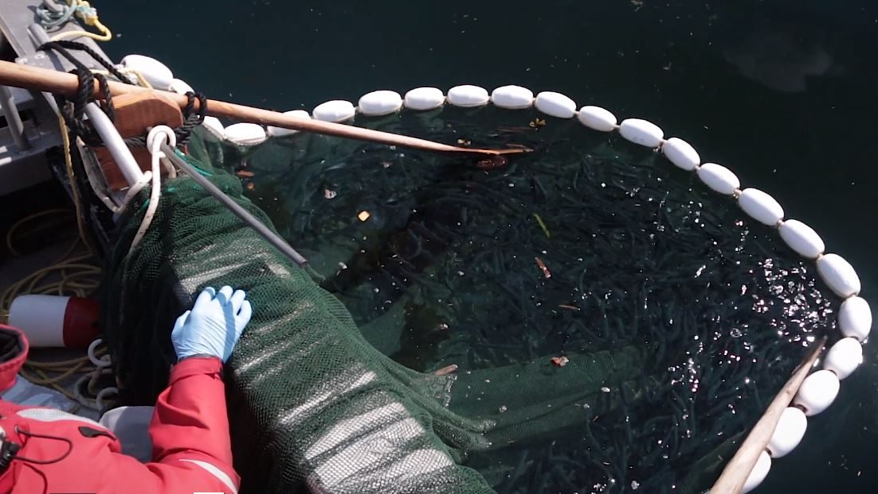
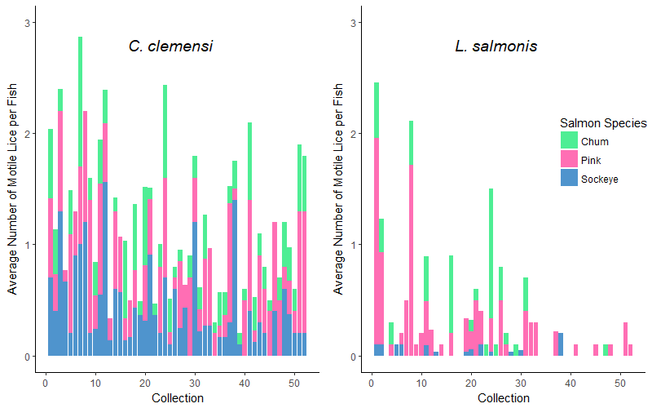
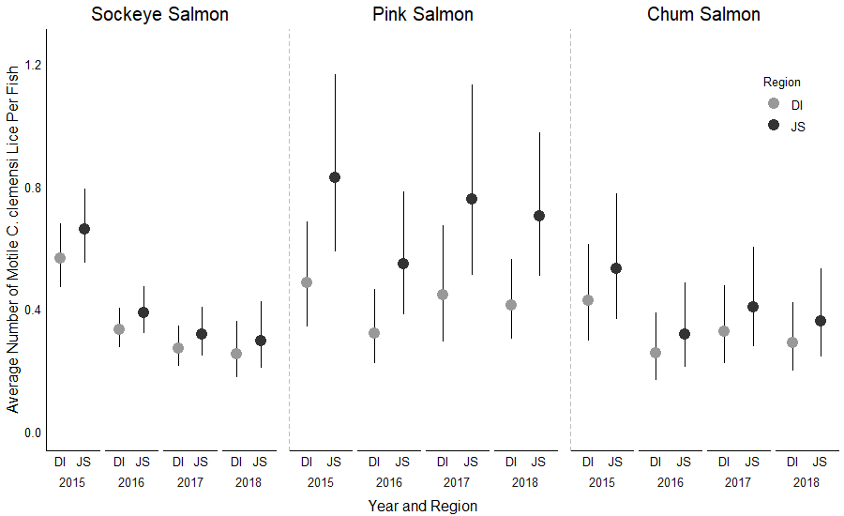
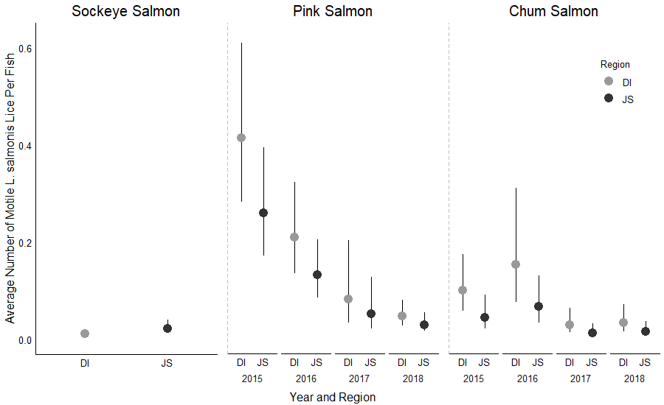
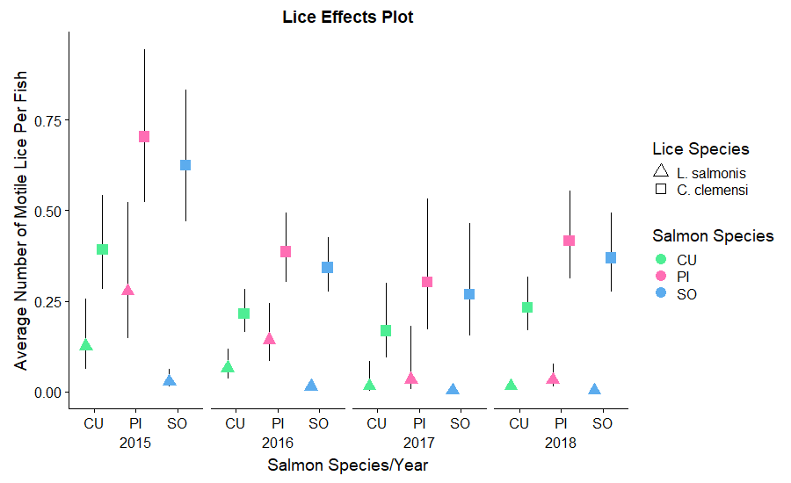
Differential Infection of Juvenile Pacific Salmon by Parasitic Sea Lice
Cole B. Brookson¹, Brian P. V. Hunt², Sean C. Godwin³, Martin Krkošek^{1,4}
Background
Methods
Wild Pacific Herring
Field Sampling
Individuals were sampled from May to July (2015 – 2018), in the Discovery Islands and Johnstone Strait
Fish were measured and worked up for sea lice
L. salmonis
C. clemensi
Johnstone Strait Region
British Columbia
Discovery Islands Region
Farmed Atlantic Salmon
Wild Pacific Salmon
Vancouver Island
Fraser River
Sockeye
Pink
Figure 3: Study region depicting the two major sampling regions
Analysis
GLMMs parsed out species-level and region-level differences in parasite loads
Models were compared/selected based on AIC
Hierarchical bootstrapping confirmed model predictions
Chum
Figure 1: Study system depicting the various infection pathways of ectoparasitic sea lice onto sympatric fish species
Study Goals:
Investigate differential parasite loads of C. clemensi and L. salmonis on pink, chum, and sockeye salmon
Determine what factors contribute to the differences in infection across different regions
Figure 2: Adult lice on juvenile salmon
Figure 4: Juvenile salmon sampling, Johnstone Strait, 2016
Species-Level Results
Region-Level Results
Figure 5: Average number of lice per fish in each collection, divided by louse species, and fish species. The two lice species are present at different abundances across all collections, with C. clemensi present ubiquitously and L. salmonis thinly dispersed across collections. Motile lice are adult lice that are easily identifiable by species.
Figure 7: Estimated number of lice per fish for C. clemensi & L. salmonis in each region, according to the respective best fitting model. Parasite prevalence differed between sites in nearly every species comparison. AIC scores indicated the full model fit best for all data except Sockeye/L. salmonis. Discovery Islands (DI) showed higher estimated per-fish louse abundance for C. clemensi than for Johnstone Strait (JS), with the opposite in L. salmonis except Sockeye.
Figure 6: Estimated number of lice per fish for C. clemensi & L. salmonis calculated by back-transformation, divided by sampling year, as well as by salmon species, and grouped by site region. Pink salmon (PI) show highest estimated lice loads for all years and both lice species, with sockeye (SO) also showing high loads of C. clemensi and chum (CU) showing the lowest infection from both lice. 2015 shows higher parasite loads for almost all species combinations.
Conclusions
Sea lice show different infection pressures on different salmon
Table 1: AIC table for full model set. The full model fit our data best for both species of lice.
.
Inverse region-level differences between lice species indicates that Herring might play a larger role than previously thought in determining infection pressures
C. clemensi Model | Negative Log Likelihood | AIC value | Delta-AIC value
Null | -1509.7 | 3025.5 | 27.9
Year | -1502.8 | 3017.7 | 20.1
Species | -1497.3 | 3004.7 | 7.1
Species, Year | -1490.7 | 2997.6 | 0.0
L. salmonis Model | Negative Log Likelihood | AIC value | Delta-AIC value
Null | -461.3 | 928.7 | 75.8
Year | -452.4 | 916.7 | 63.9
Species | -427.8 | 865.7 | 12.8
Species, Year | -418.4 | 852.8 | 0.0
Basic infection patterns were consistent across years indicating internal dynamics are driving infection patterns
Acknowledgements
Affiliations:
Thanks to the Hakai Juvenile Salmon Marine Survival Program, special thanks to Martin Krkosek and Sean Godwin for their assistance and support throughout this project. Thanks as well to the other members of the Krkosek lab for their invaluable feedback.
1: Department of Ecology & Evolutionary Biology, University of Toronto, Toronto, Ontario, Canada
2: Department of Earth, Ocean, and Atmospheric Sciences, University of British Columbia, Vancouver, BC, Canada
3: E2O Research Group, Department of Biological Sciences, Simon Faser University, Burnaby, BC, Canada
4: Salmon Coast Field Station, Simoom Sound, British Columbia, Canada
Citations -- 1. Hunt et al. 2018, Juvenile Salmon Program; 2. Johnson & Albright, 1991. J. Mar. Biol. Assoc. UK; 3. Costello, 2006. Trends Parisitol; 4. Krkosek et al. 2007. Science

Slide 2
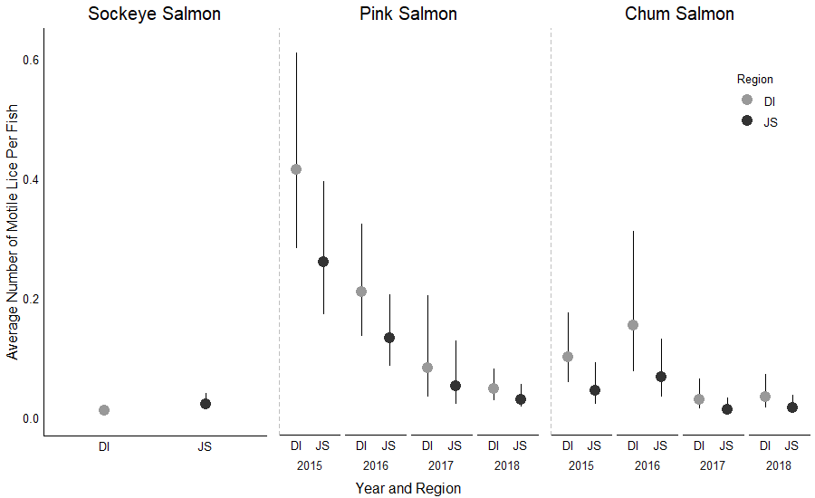
Differential Infection of Juvenile Pacific Salmon by Parasitic Sea Lice
Cole B. Brookson¹, Brian P. V. Hunt², Sean C. Godwin³, Martin Krkošek^{1,4}
Background
Methods
The Hakai Juvenile Salmon Marine Survival Program was set up in 2015 to answer questions about the juvenile survival of sockeye (Oncorhynchus nerka), pink (O. gorbuscha), and chum salmon (O. keta)¹
Field Sampling
Individuals were sampled during the juvenile migration from May to July (2015 – 2018), in the Discovery Islands and Johnstone Strait
Purse seine nets were deployed to sample juvenile pink, chum and sockeye salmon
Parasitism by two species of sea lice, Caligus clemensi a generalist parasite, and Lepeophtheirus salmonis, a salmon specialist²
Infection pressure on juvenile salmon has increased significantly post-aquaculture development ⁴
Johnstone Strait Region
British Columbia
Discovery Islands Region
While this has been tied to population level declines, there are still many unknowns about the dynamics of this multi-host, multi-parasite system¹
All fish were weighed, measured, and worked up for parasite loads
Vancouver Island
Figure 1: Adult louse on juvenile salmon
Figure 2: Study region depicting the two major sampling regions
Study Goals:
Investigate differential parasite loads of C. clemensi and L. salmonis on pink, chum, and sockeye salmon
Determine what factors contribute to the differences in infection across different regions
Analysis
We fit two series of GLMMs to our data to parse out species-level differences in parasite loads, from region-level differences in parasite loads
AIC was used to perform model comparison and selection
We used hierarchical bootstrapping to pair model-driven estimates with data-based estimates to confirm our model predictions
Species-Level Results
Region-Level Results
The two lice species were present at different abundances across all collections and all species (Fig. 3)
C. clemensi was present ubiquitously throughout the sampling regions, but L. salmonis was not as widespread
Parasite prevalence differed between sites in nearly every species-combination comparison
AIC scores indicated the full model fit our data best for all models except the sockeye and L. salmonis model
For C. clemensi, every single combination showed higher estimated per-fish louse abundance in Johnstone Strait (JS), than the Discovery Islands (DI)
For L. salmonis, estimated abundance was higher in the Discovery Islands than in Johnstone Strait in every combination except sockeye, which did not incorporate year
Figure 3: the average number of lice per fish in each collection, divided by louse species, and fish species
Table 1: AIC table for full model set.
.
Conclusions
C. clemensi Model | Negative Log Likelihood | AIC value | Delta-AIC value
Null | -1509.7 | 3025.5 | 27.9
Year | -1502.8 | 3017.7 | 20.1
Species | -1497.3 | 3004.7 | 7.1
Species, Year | -1490.7 | 2997.6 | 0.0
AIC scores indicated that the full model best fit our data for both species of lice (Table 1)
Back-transformation of the model outputs revealed higher C. clemensi loads than L. salmonis (Fig. 4)
L. salmonis Model | Negative Log Likelihood | AIC value | Delta-AIC value
Null | -461.3 | 928.7 | 75.8
Year | -452.4 | 916.7 | 63.9
Species | -427.8 | 865.7 | 12.8
Species, Year | -418.4 | 852.8 | 0.0
Figure 5: Estimated number of lice per fish for C. clemensi & L. salmonis in each region, according to the respective best fitting model
Bootstrapped estimated median and 95% CIs confirmed our model estimations for all but one comparison
Almost all bootstrapped medians for L. salmonis are equal to zero
Pink salmon had, on average, highest estimated parasite loads for both lice species
2015 showed higher parasite loads for almost all species combinations than any other year
Conclusions
Sea lice show higher infection pressures on different salmon species, indicating that there are explicit drivers causing differential infection pressures
Figure 4: Estimated number of lice per fish for C. clemensi & L. salmonis, divided by sampling year, as well as by salmon species, and grouped by site region.
Basic infection patterns were consistent across years with C. clemensi preferring sockeye and chum salmon, and L. salmonis preferring pink and chum salmon
Acknowledgements
Generally inverse region-level differences between L. salmonis and C. clemensi indicates that perhaps aquaculture is playing a role in determining where along the migration route these juvenile salmon are most exposed to infection pressures
Thanks to the Hakai Juvenile Salmon Marine Survival Program, special thanks to Dr. Martin Krkosek and Dr. Sean Godwin for their assistance and support throughout this project. Thanks as well to the other members of the Krkosek lab for their invaluable feedback.
1: Department of Ecology & Evolutionary Biology, University of Toronto, Toronto, Ontario, Canada
2: Department of Earth, Ocean, and Atmospheric Sciences, University of British Columbia, Vancouver, BC, Canada
3: E2O Research Group, Department of Biological Sciences, Simon Faser University, Burnaby, BC, Canada
4: Salmon Coast Field Station, Simoom Sound, British Columbia, Canada
Citations -- 1. Hunt et al. 2018, Juvenile Salmon Program; 2. Johnson & Albright, 1991. J. Mar. Biol. Assoc. UK; 3. Costello, 2006. Trends Parisitol; 4. Krkosek et al. 2007. Science

