Slide 1
Basic Matrix Algebra
Cole Brookson & Alex Davis
20 October 2021

Slide 2
Definitions
Matrix – a rectangular array of symbols
Entry/Element – one of the symbols contained in a matrix, identified by subscripts denoting column and row
Dimensions – the number of rows and columns
Column Vector – an (m x 1) matrix
Scalar – an ordinary number (1x1) matrix

Slide 3

Why Matrix Algebra?
“In 1969, having been told that matrix algebra would someday be useful in ecology, I enrolled in a course in the subject. It was a standard undergraduate matrix algebra course...but I found it frustrating because I couldn’t see how it was going to be useful. Only after suffering through the course did I stumble on P.H. Leslie’s papers on matrix population models. I began investigating them; this book is the result.”
-Hal Caswell, 2000.

Slide 4
Introduction to Class-Structured Models
Cole Brookson & Alex Davis
20 October 2021

Slide 5
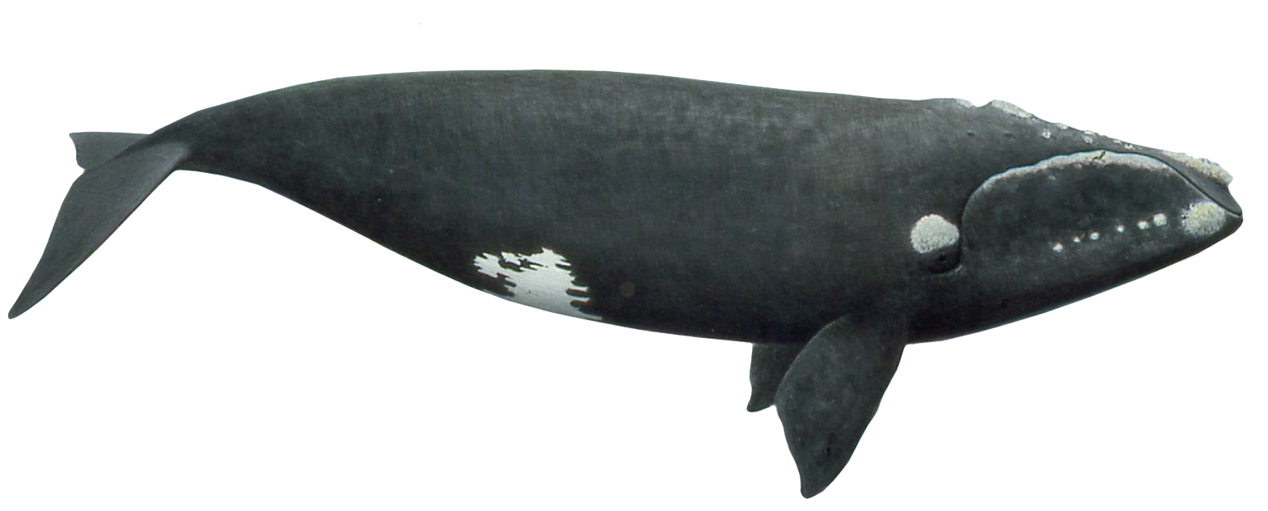
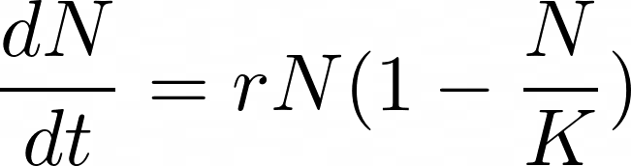
What is a class-structured model?
Notes:
So recall how yesterday we sort of vaguely posed this question about northern right whales “can they recover?” Well we could start to try and answer that question by saying okay well let’s create this nice model for this population, wherein we have these simple terms. But in this example, we’re treating all individuals equally. Which may be an okay assumption if we know NOTHING or have NO assumptions about a population, but here that’s actually not true!

Slide 6
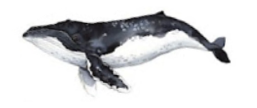

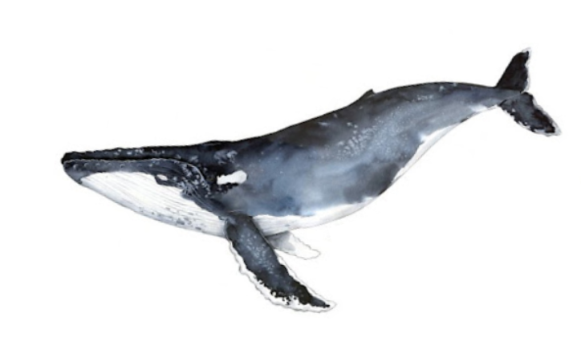
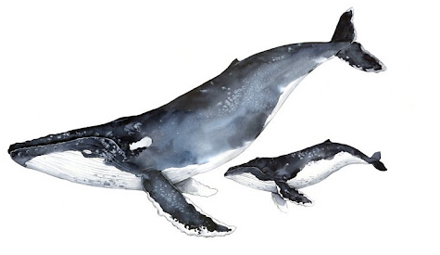
What is a class-structured model?
Notes:
Well what we actually now know about right whales, is their survival is not consistent across life stages. In fact, their death rate (which influences r!!!) is really variable! So we could now break it up into calfs, immature females, mature females, and mature females WITH newborn calves? Well maybe it’s better to model these stages differently?

Slide 7
Life Cycle Diagram
Calves
Immature
Mature
Reproductive
Notes:
So you might notice we only mentioned females in the last slide! Well typically in these models and in lots of other models, we only really care about females! They control rate of offspring and therefore we confine our model to those ones.

