Slide 1
Project Carbon Cycle
Rahmat Saeedi
Michael Browne
Cole Fichter

Slide 2
Objective
Simulate carbon moving through the forest ecosystem

Slide 3
Glossary
Litter
Humus
Stable humus charcoal

Slide 4
Glossary
Humification
Carbonization

Slide 5
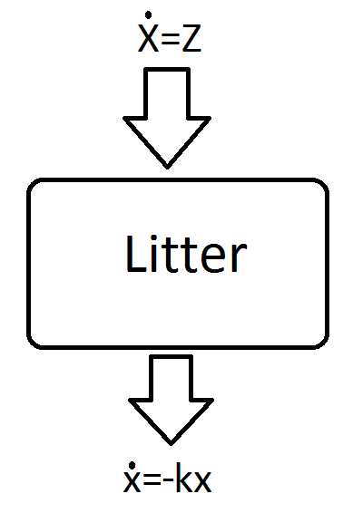
Simple Litter Model
Calculate the amount of carbon trapped in litter at any given time

Slide 6
Simple Litter Model
Begin with zero litter (after a ground fire)
Litter falls at constant rate
Carbon exits litter by respiration and humification as litter is composted

Slide 7
Simple Litter Model
Model: one differential equation
  x'(t) = z – k*x(t)
  Assume z = 240, k = 0.4

Slide 8
Simple Litter Model
Model: one differential equation
  x'(t) = 240 – 0.4*x(t), and x(0) = 0
Specific Solution
  x(t) = 600 - 600*exp(-0.4t)

Slide 9
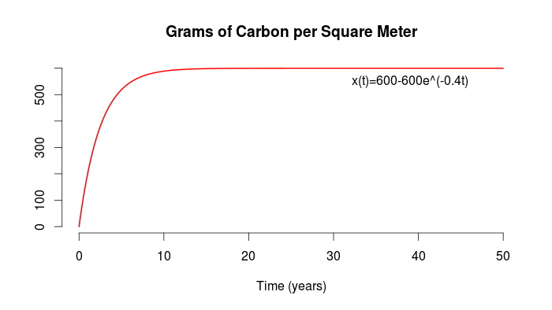
  x(t) = 600 - 600*exp(-0.4t)

Slide 10
Steady States
Equilibrium occurs when x'(t) = 0, and
  x'(t) = 240 -0.4*x(t)
  <=>
  x'(t) = -0.4(x(t) - 600)

Slide 11
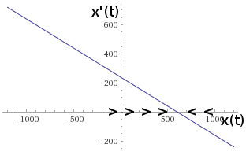
Graphical Stability Analysis

Slide 12
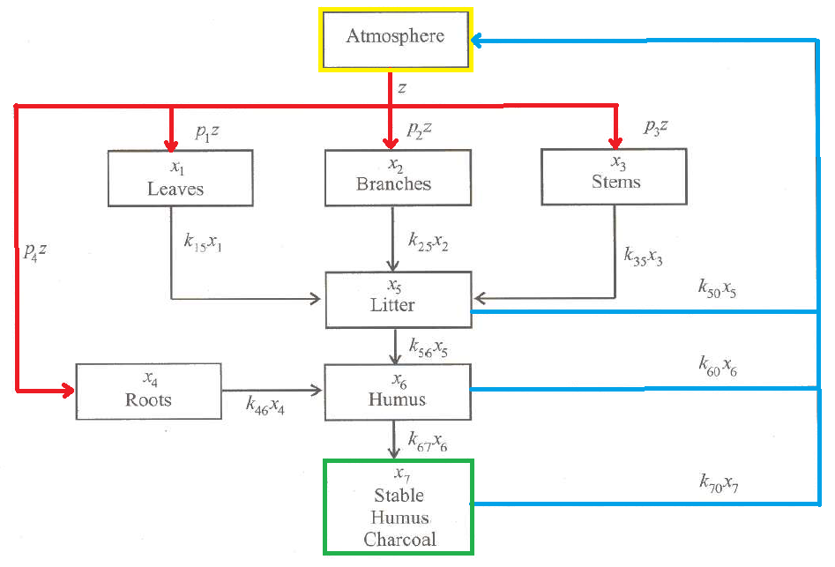
The Carbon Cycle

Slide 13
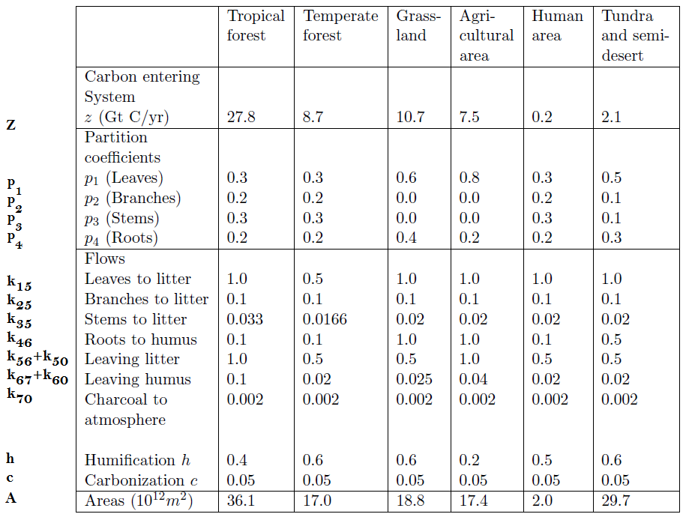
Given Data

Slide 14
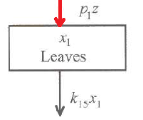
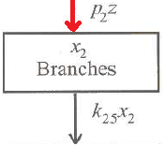
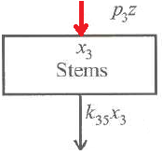
D.E. Set Up
X'1(t) = p1z - k15X1
Leaves Atm. To Litter
X'2(t) = p2z - k25X2
Branches Atm. To Litter
X'3(t) = p3z - k35X3
Stems Atm. To Litter
X'4(t) = p4z - k46X4
Roots Atm. To Litter

Slide 15
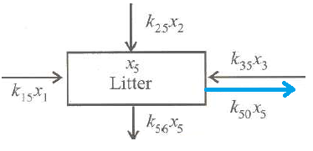
D.E. Set Up
X'5(t) = k15X1 + k25X2 + k35X3 - k56X5 - k50X5
Litter Leaves Branches Stems Humus Atm.
X'6(t) = k46X4 + k56X5 - k67X6 - k60X6
Humus Roots Litter Charcoal Atm.
X'7(t) = k67X6 - k70X7
Charcoal Humus Atm.

Slide 16
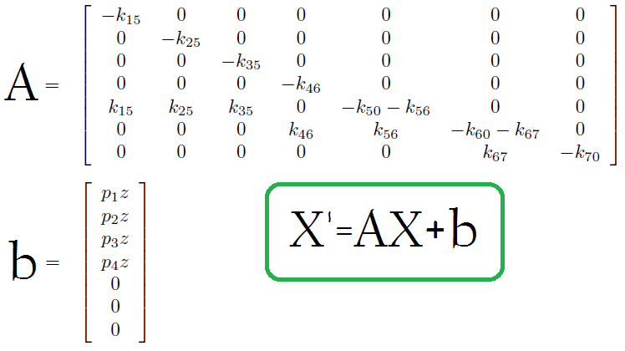
Matrix Representation of DE

Slide 17
X'=AX+b
Diagonal of A
  Multiset of Eiganvalues
Fixed Points
  0 = X' = AX + b
  AX=-b

Slide 18
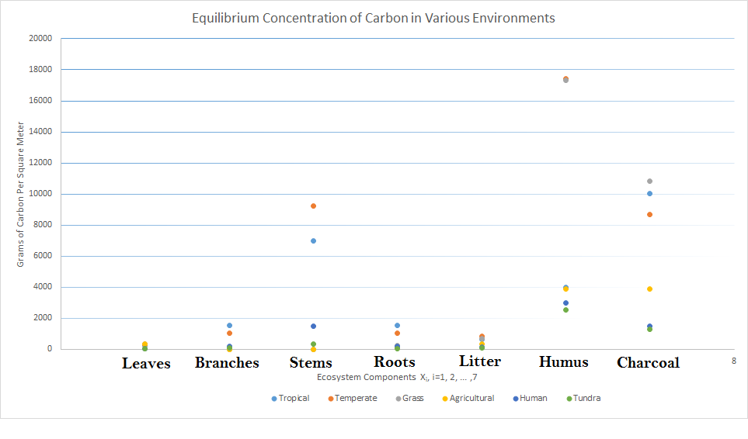
Fixed Point of The Ecosystems

Slide 19
Solution
Analytical
  Maple
  Matrix Exponential
    X' = AX+b
    X = c1e^{At} - b/A
Numerical
  Matlab
  Euler Method
    X(n+1) = X(n) + δt X'(n)

Slide 20
Ecosystems
1. Tropical Forests
2. Grasslands
3. Agricultural Lands

Slide 21
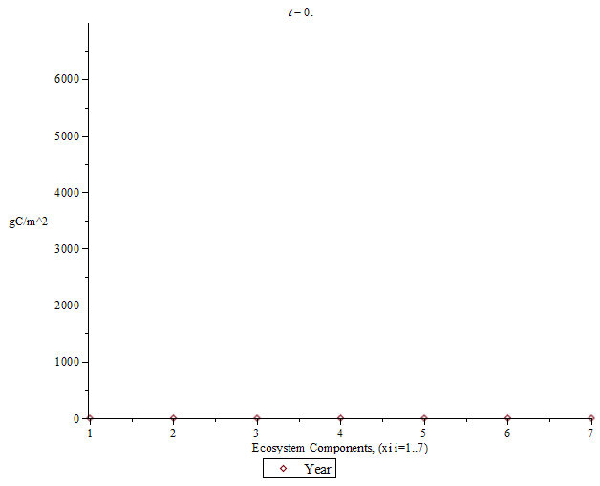
Tropical Forest: First 225 Years

Slide 22
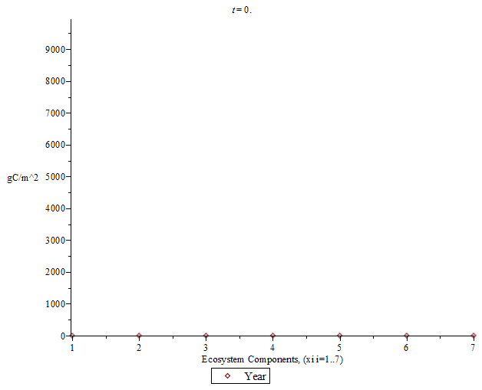
Tropical Forest: First 2500 Years

Slide 23

Grassland: First 5 Years

Slide 24
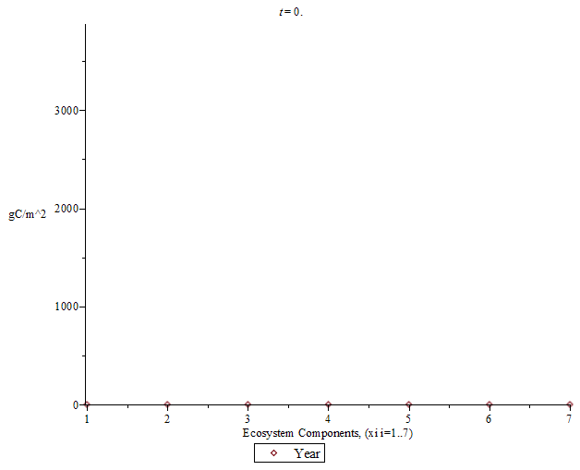
Grasslands: First 3000 Years

Slide 25
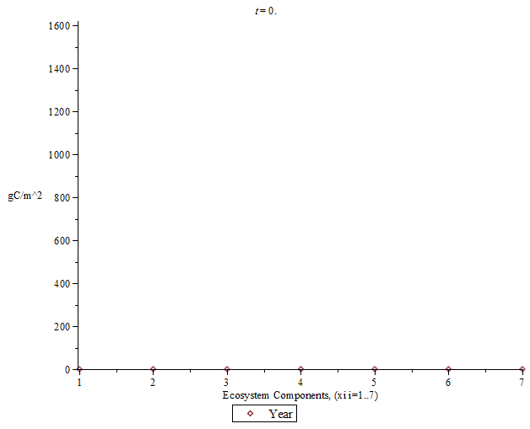
Agricultural Land: First 15 Years

Slide 26
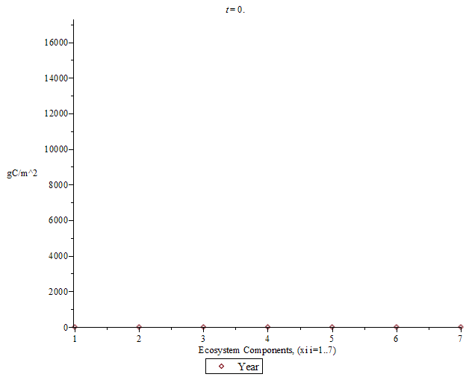
Agricultural Land: First 3000 Years

Slide 27
Agricultural Land: First 3000 Years

Slide 28
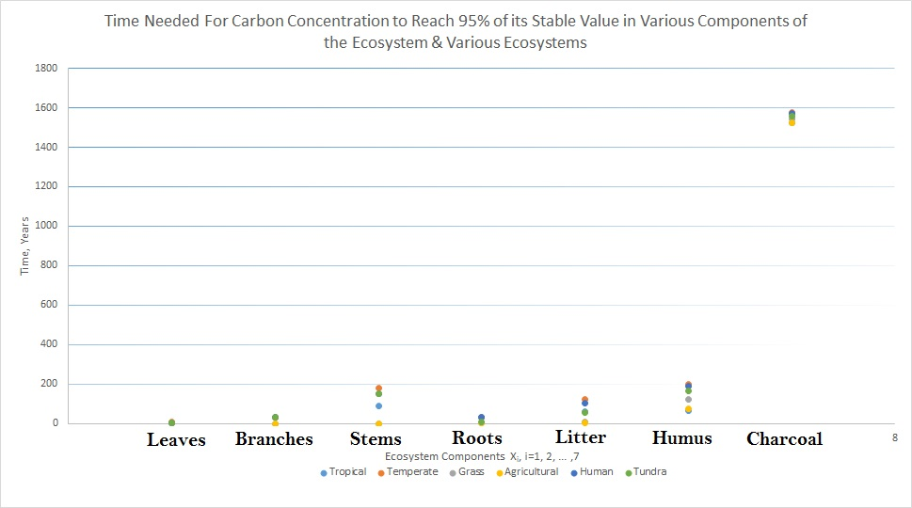

Slide 29
Analytical Stability Analysis
•After Converting the system into its Matrix form, the stability was found from the matrix’s Eigenvalues

Slide 30
•Since all of the Eigenvalues were negative, it can be show that ANY fixed point is stable

Slide 31
•Since these Eigenvalues are linear, it can be shown that they are also not sensitive to change
•This means that the only way for instability in the system to occur, is for the flows in one subsection to reverse

Slide 32
Criticisms of the Model
•Like any mathematical model, there are errors made when creating a model for a system
•The main contributor for these errors in general is a lack of model variables

Slide 33
•For this model, the equations had not taken into account that the number of trees change with respect to how much atmospheric carbon dioxide there is

Slide 34
•Furthermore, this system is considered in isolation
•There are different types of trees in a given ecosystem and thus the values for the parameters for each part of the tree are actually functions of how many of each tree there are

