Slide 1


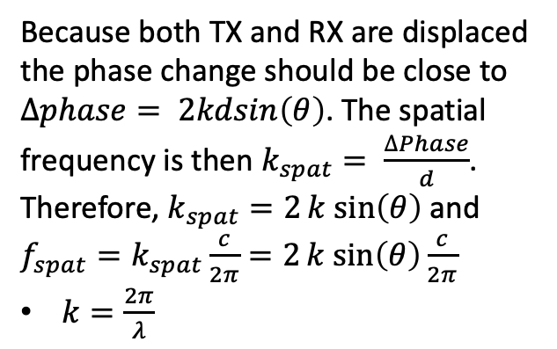


Theory
Approximate scatter as being in far field
Wavefront
$$θ$$
$$dsin\left(θ\right)$$
Because both TX and RX are displaced the phase change should be close to $∆phase= 2kdsin\left(θ\right)$. The spatial frequency is then $k_{spat}= \frac{∆Phase}{d}$. Therefore, $k_{spat}=2k sin\left(θ\right)$ and $f_{spat}=k_{spat}\frac{c}{2π}=2k sin\left(θ\right)\frac{c}{2π}$
$k=\frac{2π}{λ}$
$$θ$$
TX1
RX1
TX2
RX2
$$d$$

Slide 2
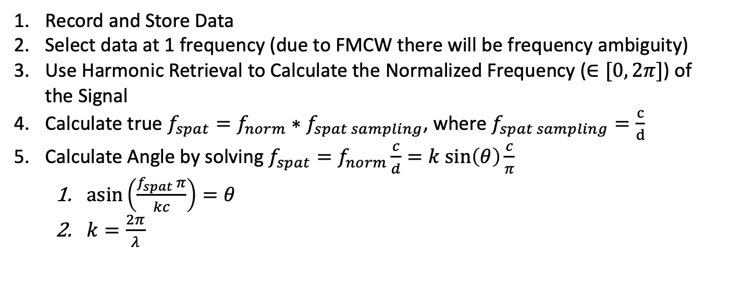
Algorithm
Record and Store Data
Select data at 1 frequency (due to FMCW there will be frequency ambiguity)
Use Harmonic Retrieval to Calculate the Normalized Frequency ($∈[0, 2π]$) of the Signal
Calculate true $f_{spat}=f_{norm}∗f_{spat sampling}$, where $f_{spat sampling}=\frac{c}{d}$
Calculate Angle by solving $f_{spat}=f_{norm}\frac{c}{d}=k sin\left(θ\right)\frac{c}{π}$
$\operatorname{asin}\left(\frac{f_{spat} π}{kc}\right)=θ$
$k=\frac{2π}{λ}$

Slide 3
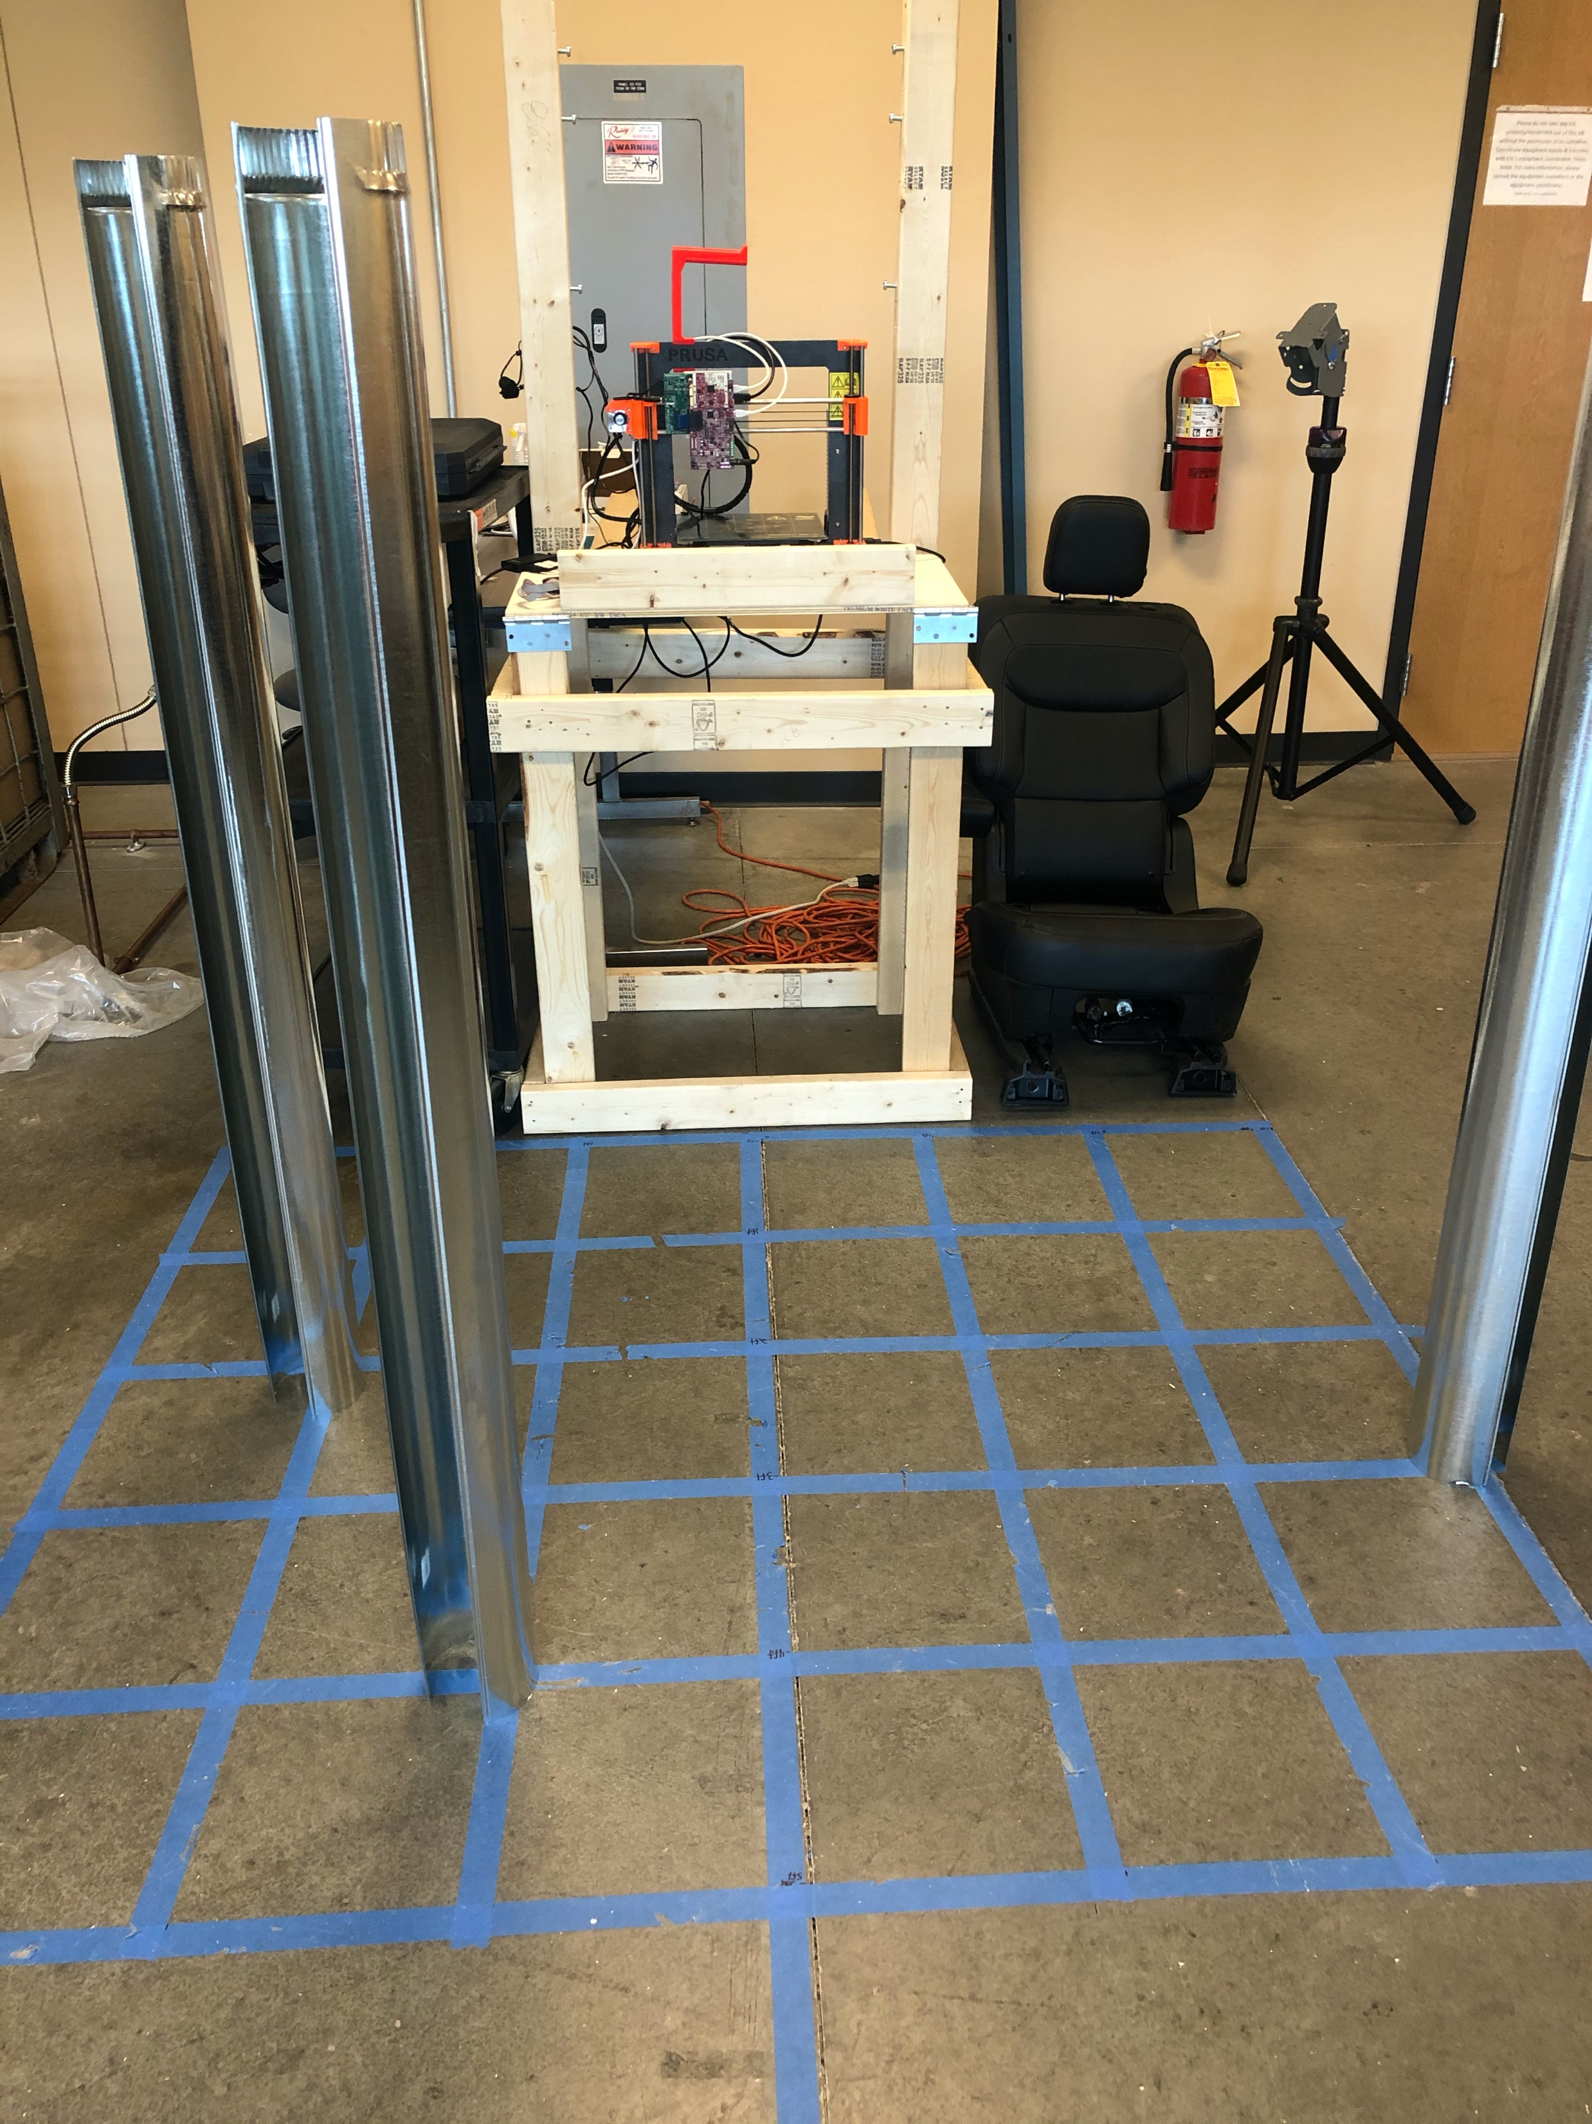


3 Cylinder Tests (Measure 47)
1
3
2
$$\hat{z}$$
3
4
5
$$\hat{x}$$
Transceiver
Cylinder # | Location (x,z) m | Range
1 | 0.30 ,1.22 | 1.25m
2 | 0.61, 0.61 | 0.86m
3 | -0.91, 0.91 | 1.29m

Slide 4

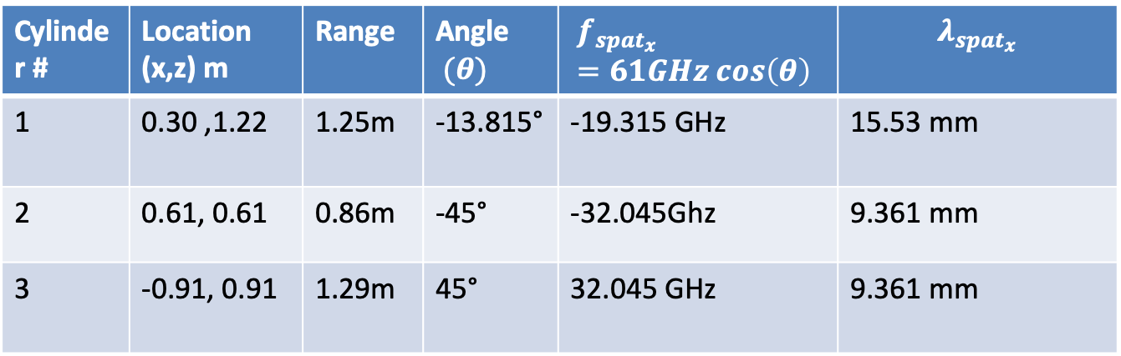



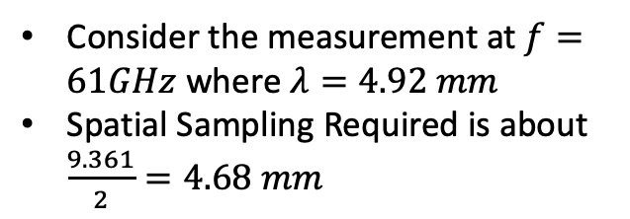
Max $\hat{x}$Frequency 3 Cylinder Test (Measure 47)c
Cylinder # | Location (x,z) m | Range | Angle$(θ)$ | $$f_{spat_{x}}=61GHz cos\left(θ\right)$$ | $$λ_{spat_{x}}$$
1 | 0.30 ,1.22 | 1.25m | -13.815° | -19.315 GHz | 15.53 mm
2 | 0.61, 0.61 | 0.86m | -45° | -32.045Ghz | 9.361 mm
3 | -0.91, 0.91 | 1.29m | 45° | 32.045 GHz | 9.361 mm
Consider the measurement at $f=61GHz$ where $λ=4.92 mm$
Spatial Sampling Required is about $\frac{9.361}{2}=4.68 mm$
Wavefront
$$θ$$
$$\hat{z}$$
$$θ$$
$$\hat{x}$$
TX1
RX1

Slide 5
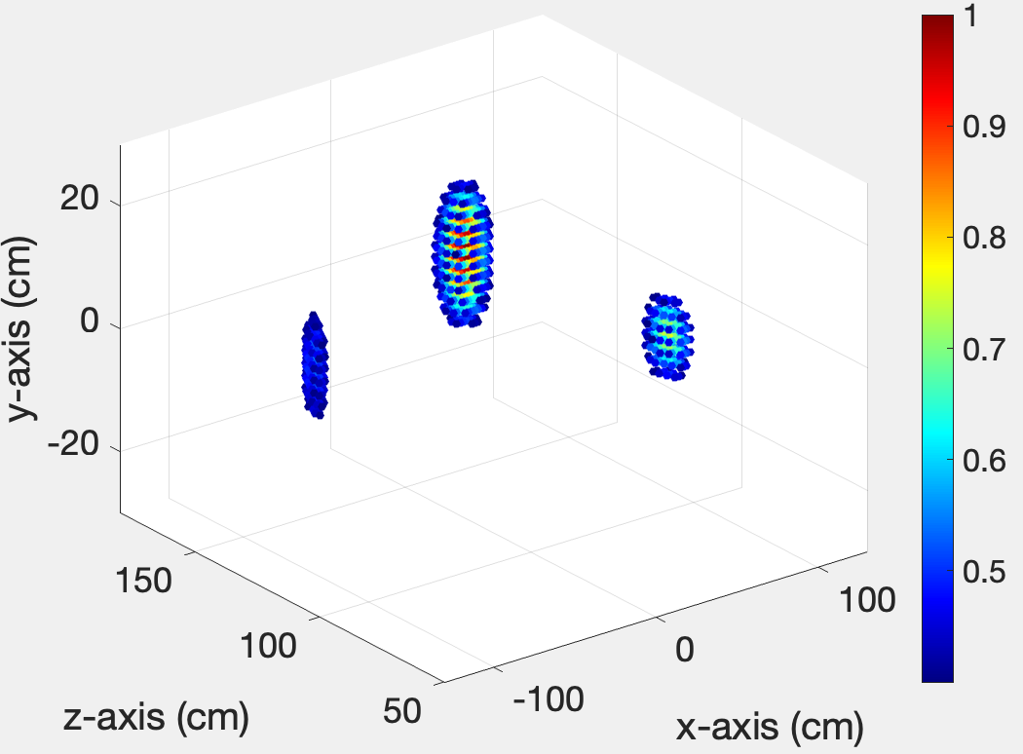
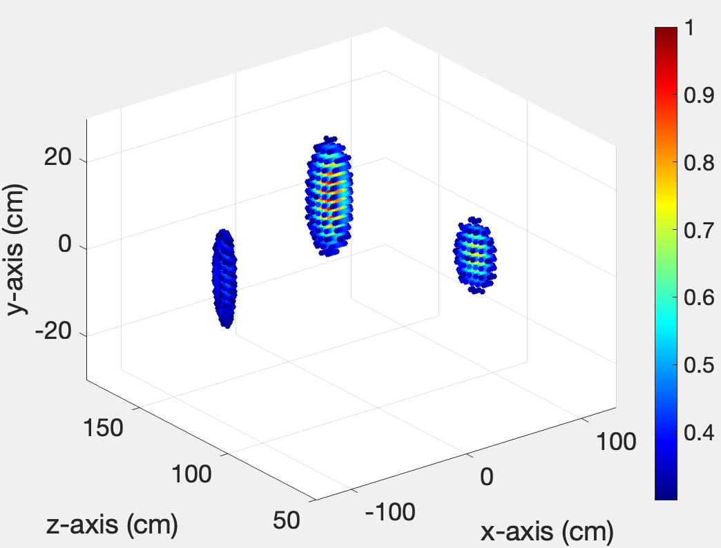
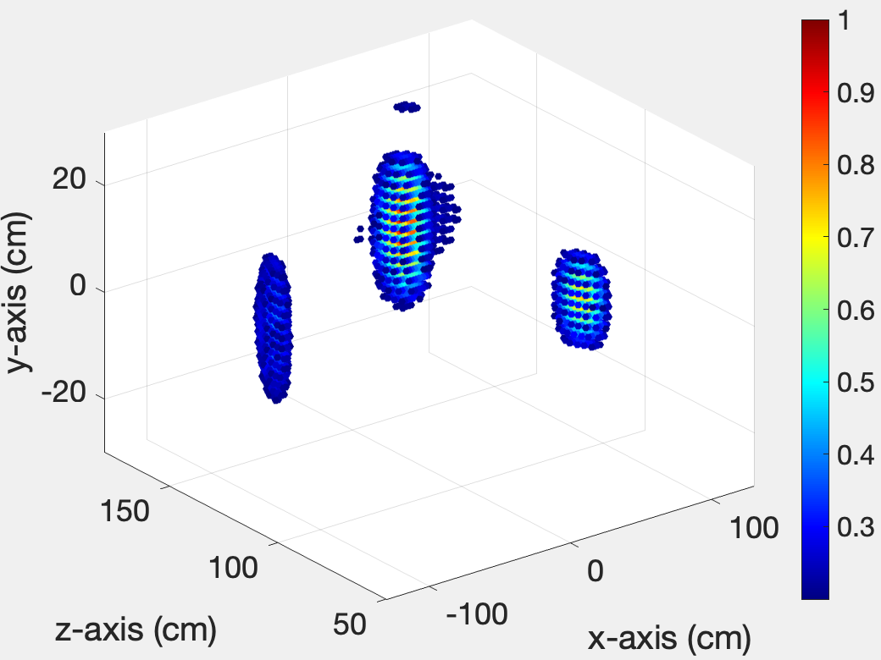
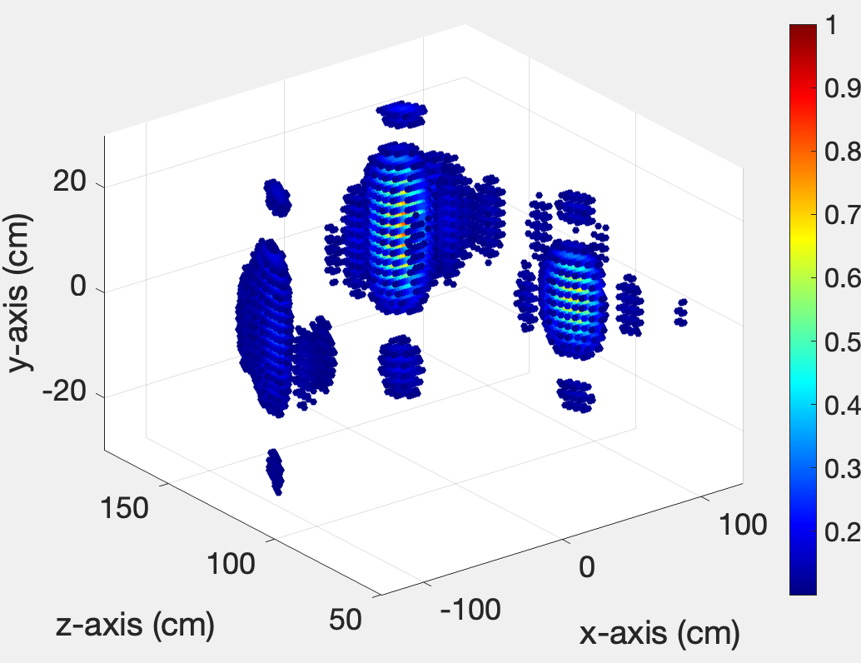
NFF Generated Image
Thresh = 0.4
Thresh = 0.3
Thresh = 0.2
Thresh = 0.1

Slide 6
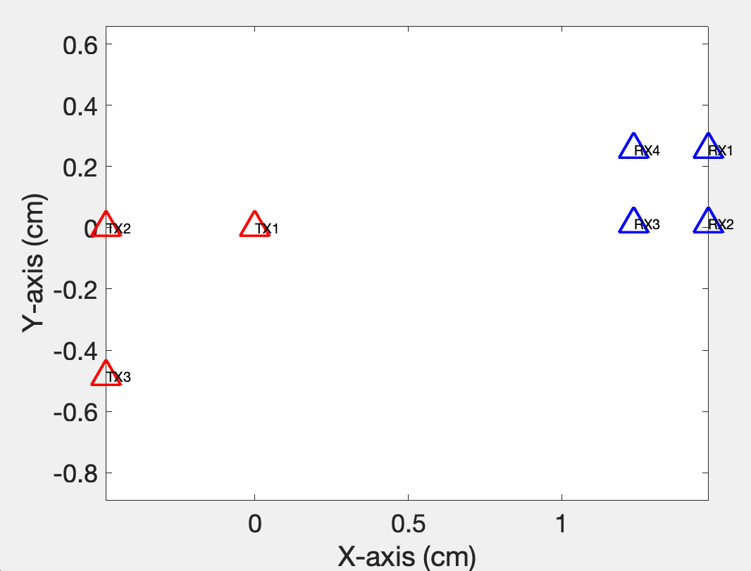
Antenna Configuration

Slide 7
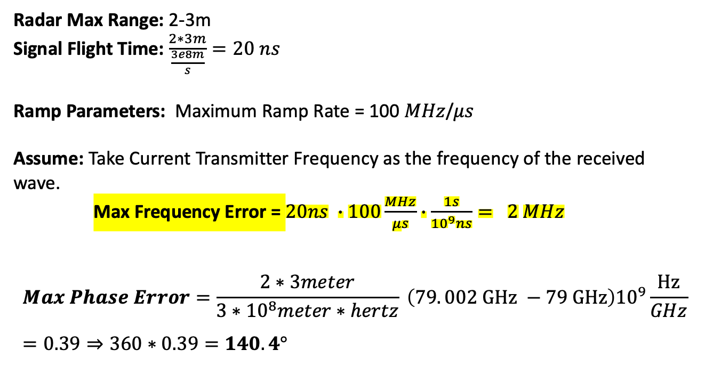
FMCW Frequency In Accuracy From 2_4_2021
Radar Max Range: 2-3m
Signal Flight Time: $\frac{2∗3m}{\frac{3e8m}{s}}=20 ns$
Ramp Parameters: Maximum Ramp Rate = 100 $MHz$/$μs$
Assume: Take Current Transmitter Frequency as the frequency of the received wave.
Max Frequency Error = $20ns ∙100\frac{MHz}{μs}∙\frac{1s}{{10}^{9}ns}= 2 MHz$
$$Max Phase Error=\frac{2∗3meter}{3∗{10}^{8}meter∗hertz} \left(79. 002 GHz −79 GHz\right){10}^{9}\frac{Hz}{GHz}=0.39⇒360∗0.39=140.4°$$

Slide 8
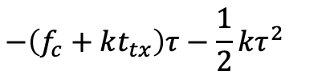
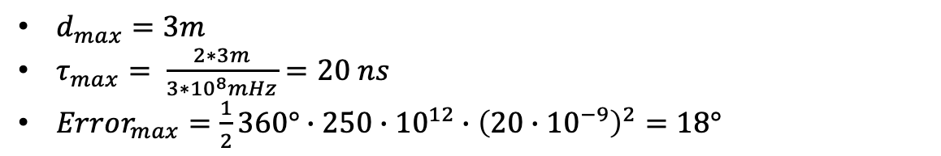
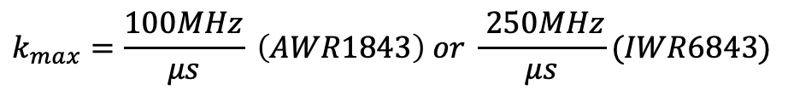
Size of The Error Term From Feb 6 2021
Error Term
$$−\left(f_{c}+kt_{tx}\right)τ−\frac{1}{2}kτ^{2}$$
Phase Change During Propagation
$$k_{max}=\frac{100MHz}{μs} \left(AWR1843\right) or \frac{ 250MHz}{μs}(IWR6843)$$
$d_{max}=3m$
$τ_{max}= \frac{2∗3m}{3∗{10}^{8}mHz}=20 ns$
$Error_{max}=\frac{1}{2}360°∙250∙{10}^{12}∙{\left(20∙{10}^{−9}\right)}^{2}=18°$
The error in degrees can be large

Slide 9



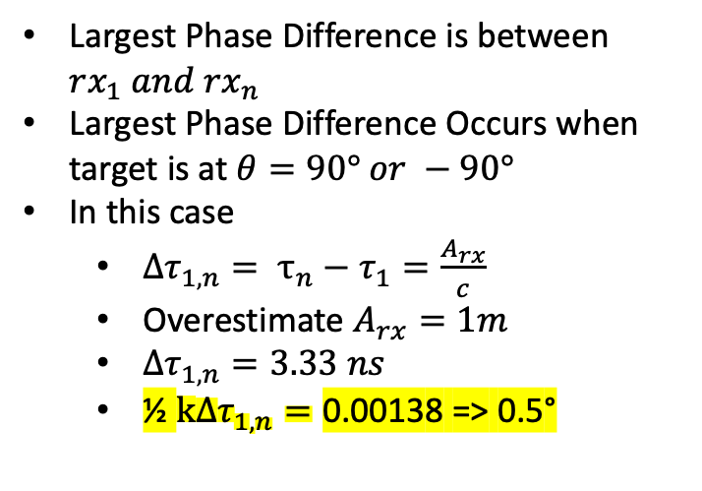



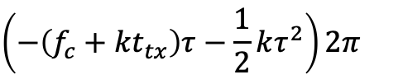

Does The Error Term Impact Results From Feb 6 2021
$$Error_{max}=18°$$
The error is frequency independent
$$\left(−\left(f_{c}+kt_{tx}\right)τ−\frac{1}{2}kτ^{2}\right)2π$$
This term should vary between each RX
Largest Phase Difference is between $rx_{1} and rx_{n}$
Largest Phase Difference Occurs when target is at $θ=90° or −90°$
In this case
$∆τ_{1,n}= τ_{n}−τ_{1}=\frac{A_{rx}}{c}$
Overestimate $A_{rx}=1m$
$∆τ_{1,n}=3.33 ns$
½ $k∆τ_{1,n}=\text{0.0013}\text{8 => 0.5°}$
Target
$$θ$$
$$rx_{2}$$
$$rx_{n}$$
$$rx_{1}$$
. . .
RX-Aperture
$$rx_{3}$$
$$A_{rx}$$
Even under worst case assumptions error term has only a small variation across the aperture

