Slide 1
Air Quality Management System
Cole Hoener & Lukas Schirren

Slide 2
Project Requirements
A system which tests air quality with sensors that is able to
Follow the sensors state
Get aggregate information about the sensors
Identify sensors with similar behaviors

Slide 3
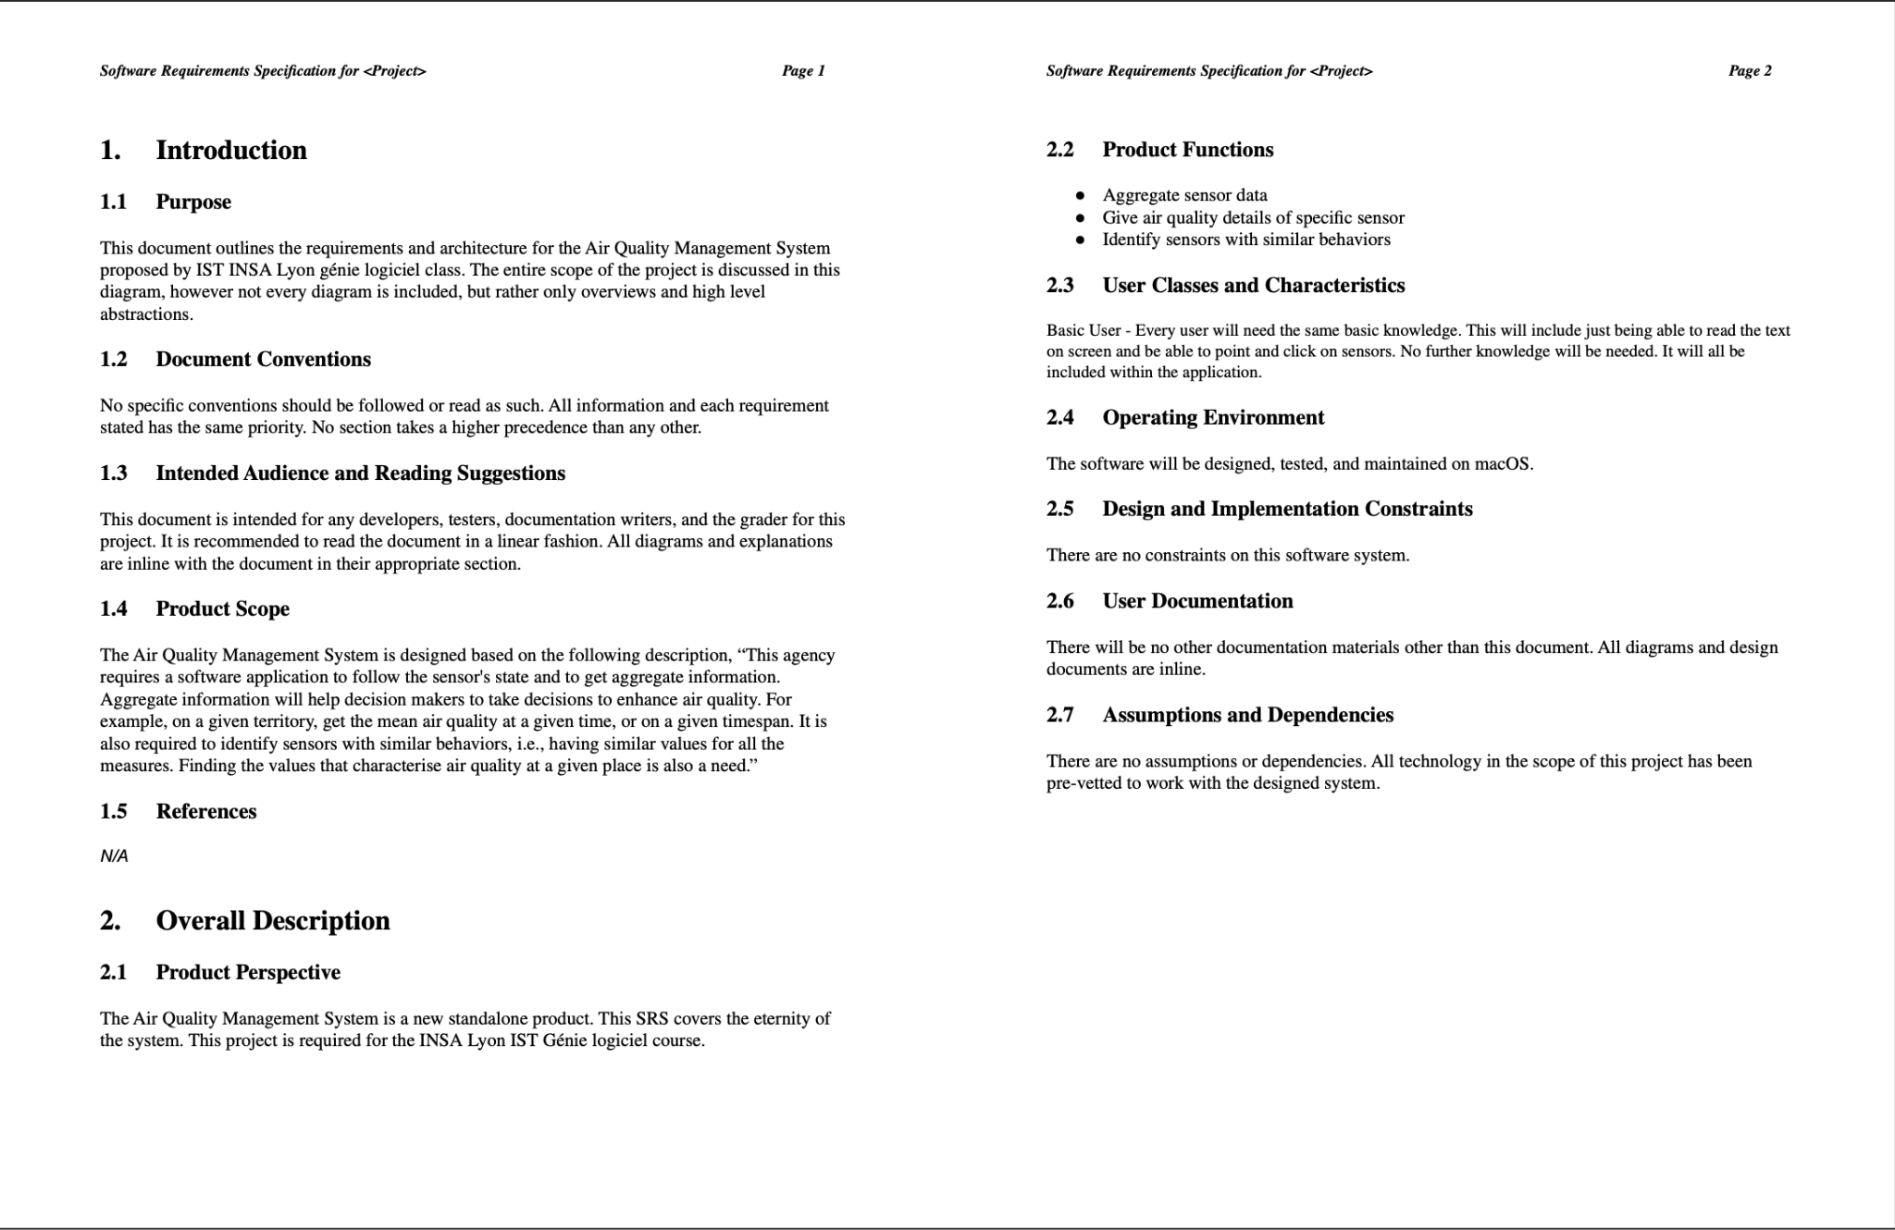
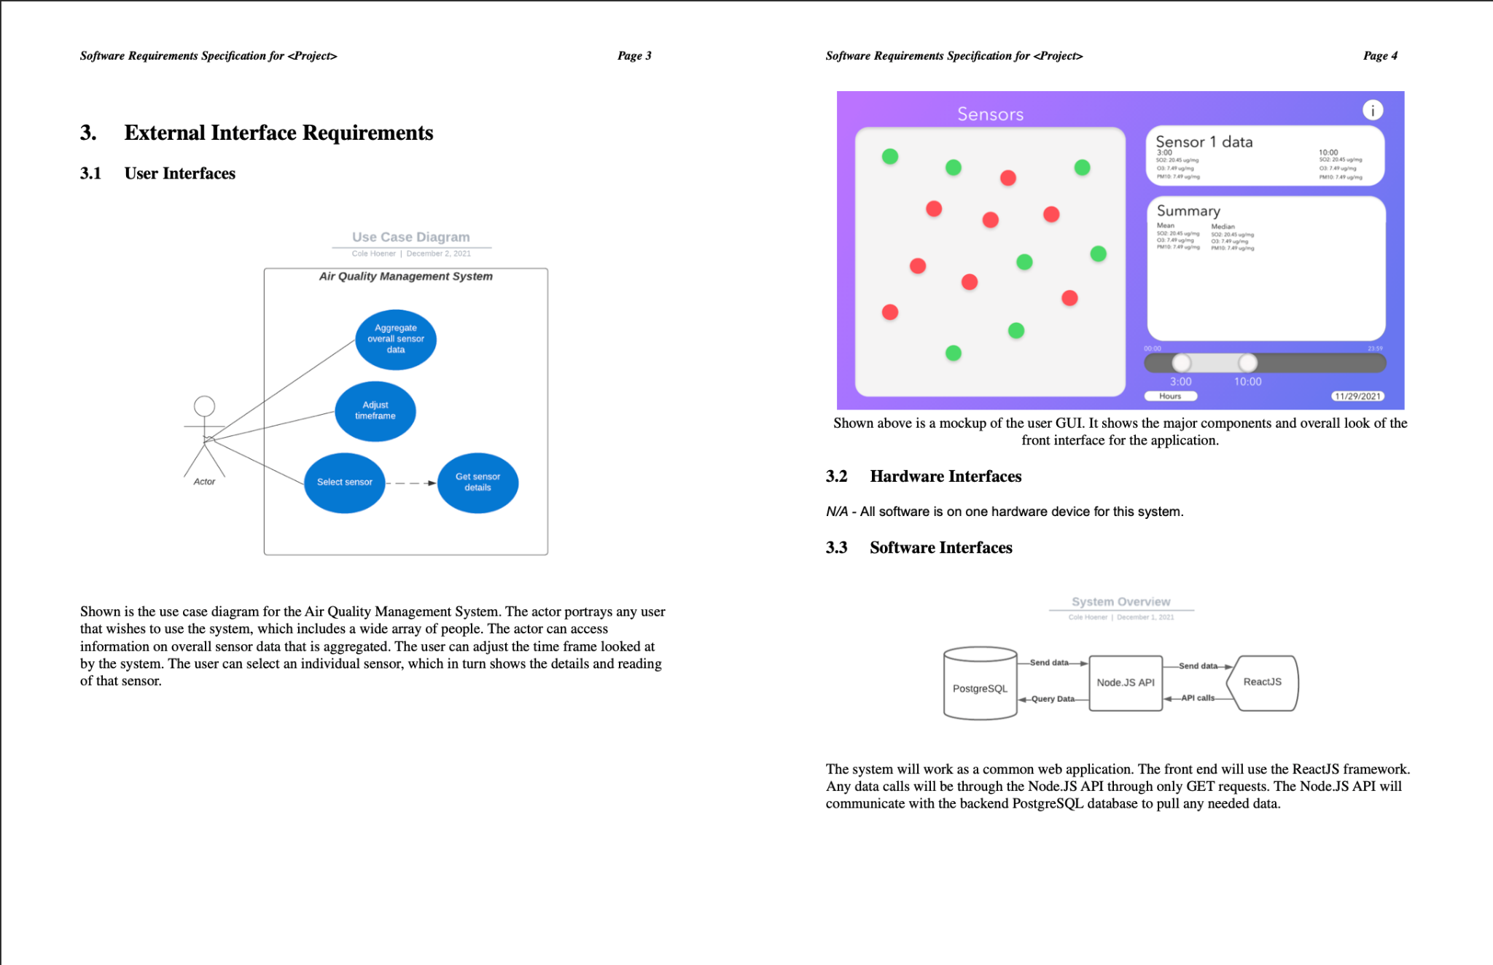
SRS (Software Requirements Specification)

Slide 4
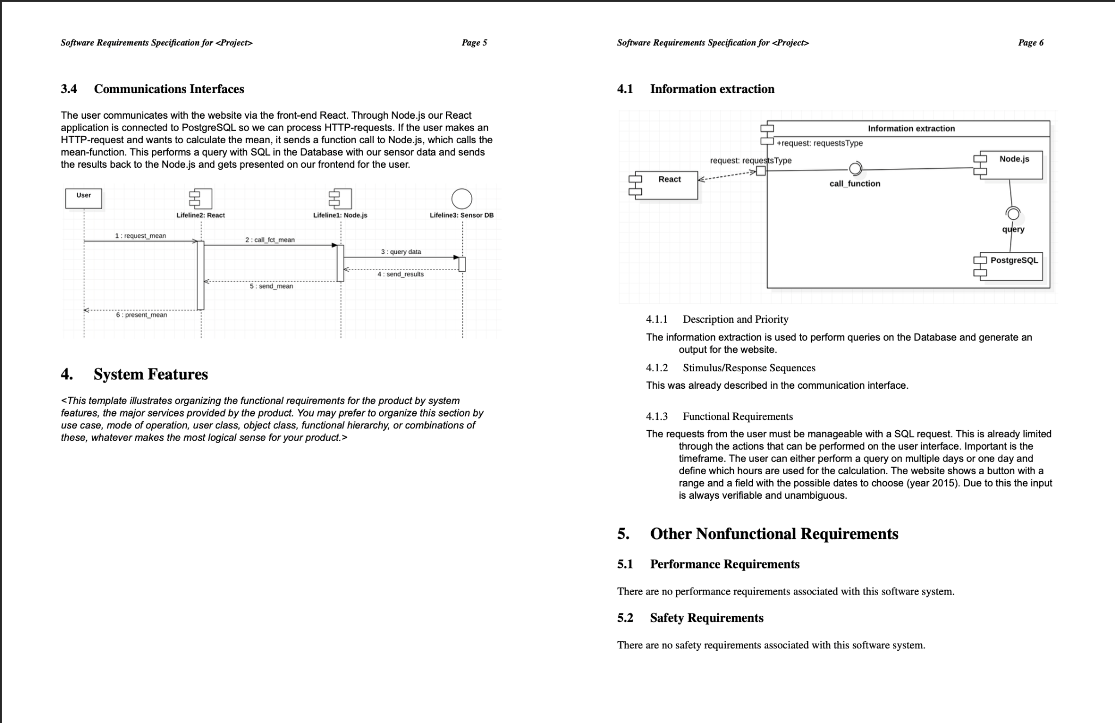
SRS (Software Requirements Specification) cont.

Slide 5
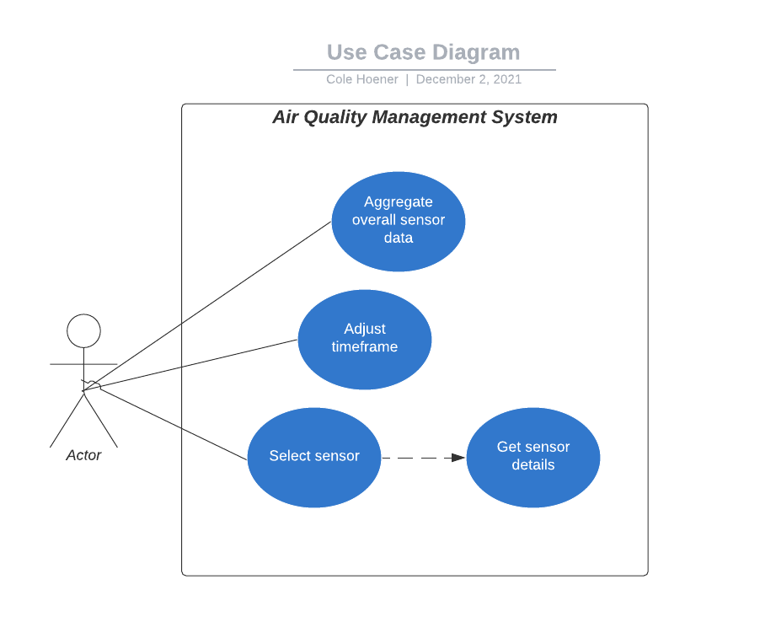

Slide 6
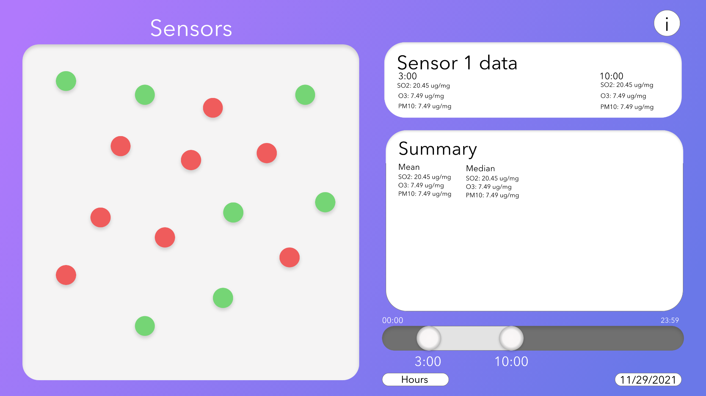

Slide 7
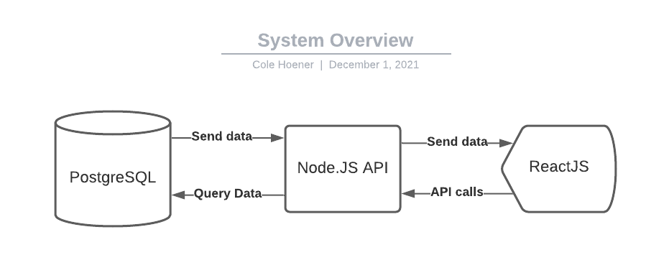

Slide 8
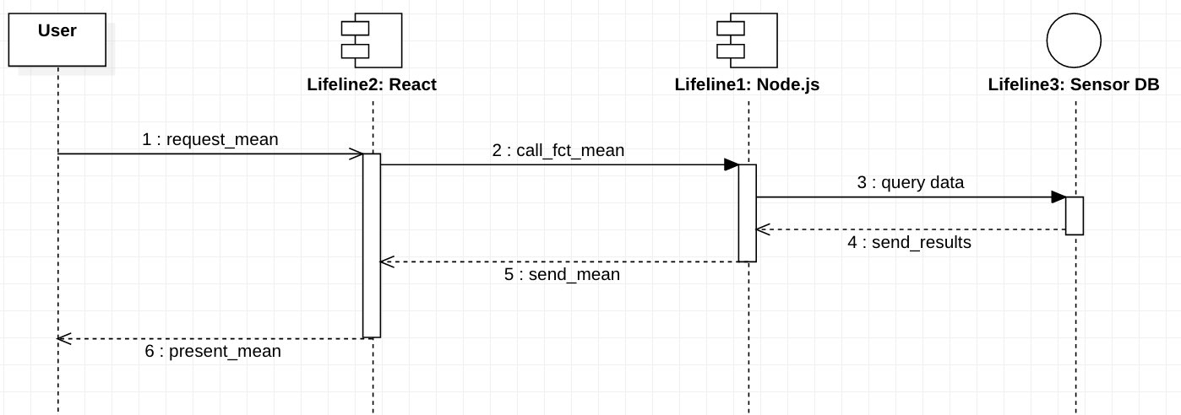

Slide 9
Demo

