Slide 1
Docker 101

Slide 2
Docker is not magic it is an abstraction.

Slide 3
What is Docker?
Linux Control Groups (cgroups)
Linux namespaces
Union file system
Docker CLI
Docker API
Notes:
Allows container to have isolated fs, network, and process space.

Slide 4
Linux Namespaces
Linux namespaces allow for isolation of system resources.
PID namespace
Networking namespace
Mount namespace

Slide 5
Linux Namespaces
PID Namespaces
PID namespaces isolate the process ID number space, meaning that processes in different PID namespaces can have the same PID ~manpages
Practical Example
$ sudo unshare --fork --pid --mount-proc bash
root@dev:# ps aux

Slide 6
Linux Namespaces
Practical Example
Network Namespaces
A network namespace is logically another copy of the network stack, with its own routes, firewall rules, and network devices. ~manpages
Make a network namespace:
sudo ip netns add test1
ip netns list
Execute command in network namespace:
sudo ip netns exec test1 ip a
Delete the network namespace:
sudo ip netns delete test1
Notes:
Nsenter – enter namespace of another program

Slide 7
Linux Namespaces
Practical Example
Start bash in a namespace:
sudo unshare –m /bin/bash
Create a new tempory directory:
secret_dir=`mktemp –d –tmpdir=/tmp`
Mount the directory:
mount –n –o size=1m –t tmpfs tmpfs $secret_dir
grep /tmp /proc/mounts <- note the directory listed in the output
Add something to the directory:
cd /tmp/tmp.XXXXXXXXX
touch iamsecret
touch iamalsosecret
ls –lFa
In another terminal….
sudo su
cd /tmp/tmp.XXXXXXXXX
ls -lFa
Mount Namespaces
A mount namespace is the set of filesystem mounts that are visible to a process. ~ manpages
Notes:
Nsenter – enter namespace of another program

Slide 8
Linux Cgroups
Linux Control Groups
Control cgroups, usually referred to as cgroups, are a Linux kernel
feature which allow processes to be organized into hierarchical
groups whose usage of various types of resources can then be limited
and monitored. ~ manpages
Practical Example
Cgroups are managed in the filesystem:
mkdir /sys/fs/cgroup/memory/mygroup
ls -la /sys/fs/cgroup/memory/mygroup
Set memory limit of 10MB for this group:
echo 10000000 > /sys/fs/cgroup/memory/mygroup/memory.limit_in_bytes
echo 0 > /sys/fs/cgroup/memory/mygroup/memory.swappiness
Make something memory hungry:
cat <<EOT >> crash.py
f = open("/dev/urandom", "r")
data = ""
i=0
while True:
data += f.read(1000000) # 1mb
i += 1
print "%dmb" % (i*10,)
EOT
python crash.py
Add current PID to the cgroup we just made:
echo $$ > /sys/fs/cgroup/memory/mygroup/tasks
python crash.py
blkio | Limits on IO
cpu | Cpu Scheduling
cpuset | Assigns cpu on multicore systems
devices | Controls access to devices
memory | Memory limits
Notes:
Nsenter – enter namespace of another program

Slide 9
That is complicated!
I wish there was a tool to make all of this easy.
Notes:
Nsenter – enter namespace of another program

Slide 10
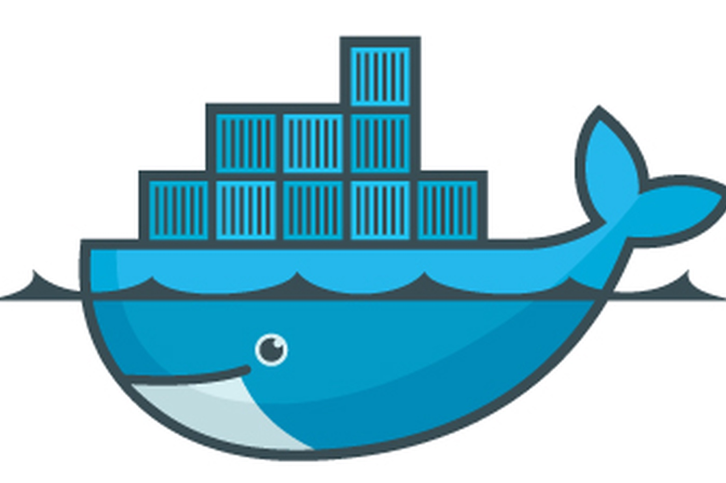
That is complicated!
I wish there was a tool to make all of this easy.
Notes:
Nsenter – enter namespace of another program

Slide 11
Union Filesystem
Practical Example
Union File System
Union file systems, or UnionFS, are file systems that operate by creating layers, making them very lightweight and fast. Docker Engine uses UnionFS to provide the building blocks for containers. ~docs.docker.com
Pull images:
docker pull alpine:latest
docker pull colek42/cassandra-lucene
Export to tar:
docker image save colek42/cassandra-lucene > cassandra.tar
docker image save alpine:latest > alpine.tar
Notes:
Nsenter – enter namespace of another program

Slide 12
Dockerfile
Practical Example
Dockerfile
Docker can build images automatically by reading the instructions from a Dockerfile. A Dockerfile is a text document that contains all the commands a user could call on the command line to assemble an image. Using docker build users can create an automated build that executes several command-line instructions in succession.
~docs.docker.com
Pull repo:
go get github.com/colek42/helloworld
cd $GOPATH/src/github.com/colek42/helloworld
Build binary:
CGO_ENABLED=0 GOOS=linux go build -o main .
Dockerfile:
cat <<EOT >> Dockerfile
FROM scratch
COPY main /
CMD ["/main"]
EOT
Build image:
docker build --no-cache -t colek42/helloworld:latest .
Run Container:
docker run -p 8383:8383 colek42/helloworld:latest
Notes:
Nsenter – enter namespace of another program

Slide 13
docker-compose
Kubernetes

