Slide 1
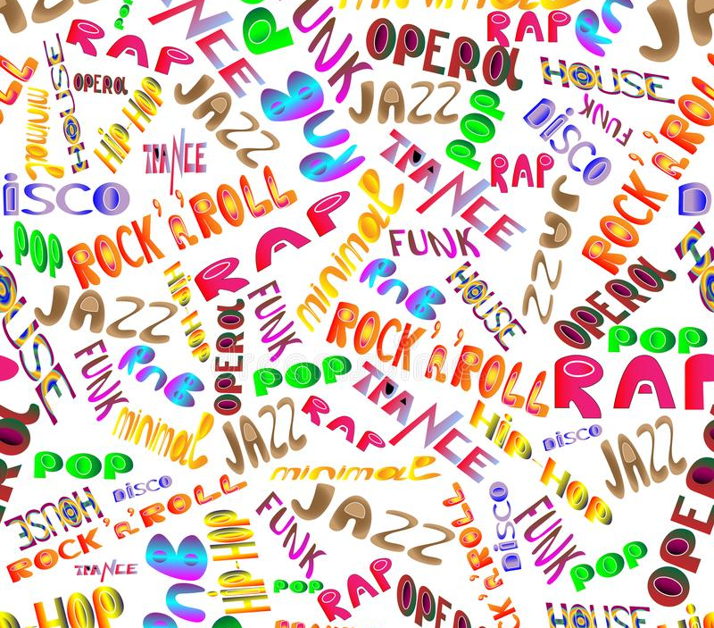
Music Genre Classification
by Cole Landolt

Slide 2
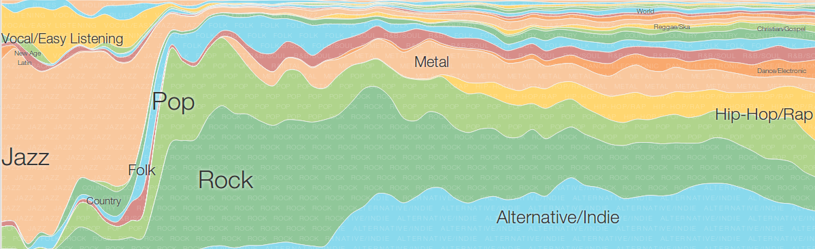
Why should we want to identify a song’s genre?
Landscape of music evolves over time
An accurate model of this landscape provides actionable information
Source: https://ai.googleblog.com/2014/01/explore-history-of-pop-and-punk-jazz.html
Notes:
This project aims to train various classification models on the audio features of songs to predict which of the twelve major genres they belong to. An accurate model of the evolving landscape of music over time would not only widen the understanding of the genres themselves but primarily provide insight about artists and the listeners of their music that can be used to optimize each of their goals.

Slide 3
Artist Clustering
Artist
Artist
Genre
Notes:
For example, classifying a song’s genre can help a model that clusters artists based on their similarity, by informing the model as to whether their similarity has to do with their genre as supposed to other factors, such as acoustic features of the music or shared fanbases.

Slide 4
Fanbase Segmentation
Diehard Fans
Passive Fans
Casual Fans
Notes:
Also, understanding which genres fans listen to and the frequency in which they do so, amongst other information, can help categorize fans into certain types that can be targeted differently in marketing endeavors.

Slide 5

Recommender Systems
Notes:
Being able to identify a body of similar music to a given song or artist is especially helpful in recommending new music. Recommender Systems are tasked at recommending items to users that maximize their utility, or in other words, songs that have a high probability of satisfaction. However, user-item utility is almost always unknown and must be inferred, especially in the context of discovery where the goal is to present novel items to the user. Consequently, an item’s utility for a user is usually estimated from past samples of correct utility data. This information can be acquired explicitly, such as in the form of a rating, or implicitly, by monitoring users’ behavior. Since explicit ratings are often not available, especially in the context of music, being able to identify similar content to what the user already prefers helps generate a pool of possible recommendations that an algorithm can choose between based on expected utility.

Slide 6
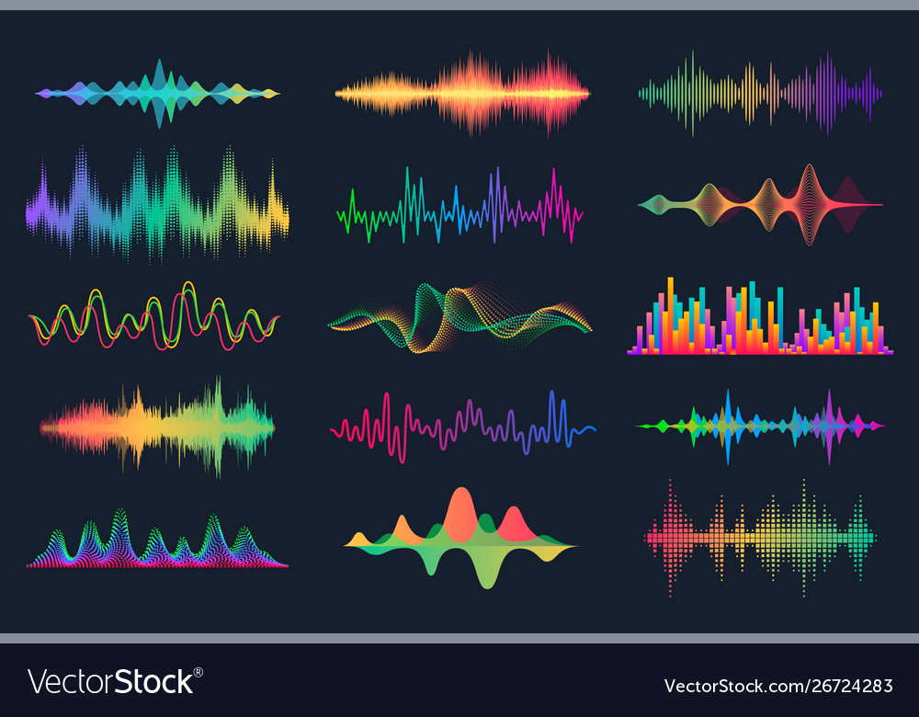
How is genre classification accomplished?
Analyzing
Audio Features
Notes:
So how can we classify a song’s genre? By analyzing the audio features of various genres.

Slide 7

Notes:
Audio features, as well as other track-wise information, were collected from Spotify’s publicly available API database. Since Spotify doesn’t store genre information, I turned to The Sounds of Spotify, an independent music genre project that utilized unsupervised learning techniques to identify new and unique genres of music (more of which can be read about here), to collect accurate genre labels to test various predictive models and a subset of songs that represented each genre, whose audio features were used to train those models.

Slide 8
Audio Features
Danceability: How suitable a track is for dancing based on a combination of musical elements
Energy: A perceptual measure of intensity and activity
Loudness: The overall loudness of a track in decibels (dB)
Speechiness: Represents the presence of spoken words in a track
Acousticness: Confidence measure as to whether a song is acoustic
Instrumentalness: Confidence measure as to whether a song contains no lyrics
Valence: Represents the musical positiveness conveyed by a track
Tempo: The overall estimated tempo of a track in beats per minute (BPM)
Notes:
Here are the 8 audio features that were used to train the models.
Between any of the above features, energy and Loudness exhibit the strongest relationship, with a correlation of 0.82. It makes intuitive sense that subjectively more energetic songs would tend to be louder on average. Another moderate correlation exists between danceability and valence, with a correlation of 0.58. Although their relationship expresses far more variability than that of as that of energy and loudness, there is clearly a positive association between a song's suitability for dancing and its overall positivity.

Slide 9


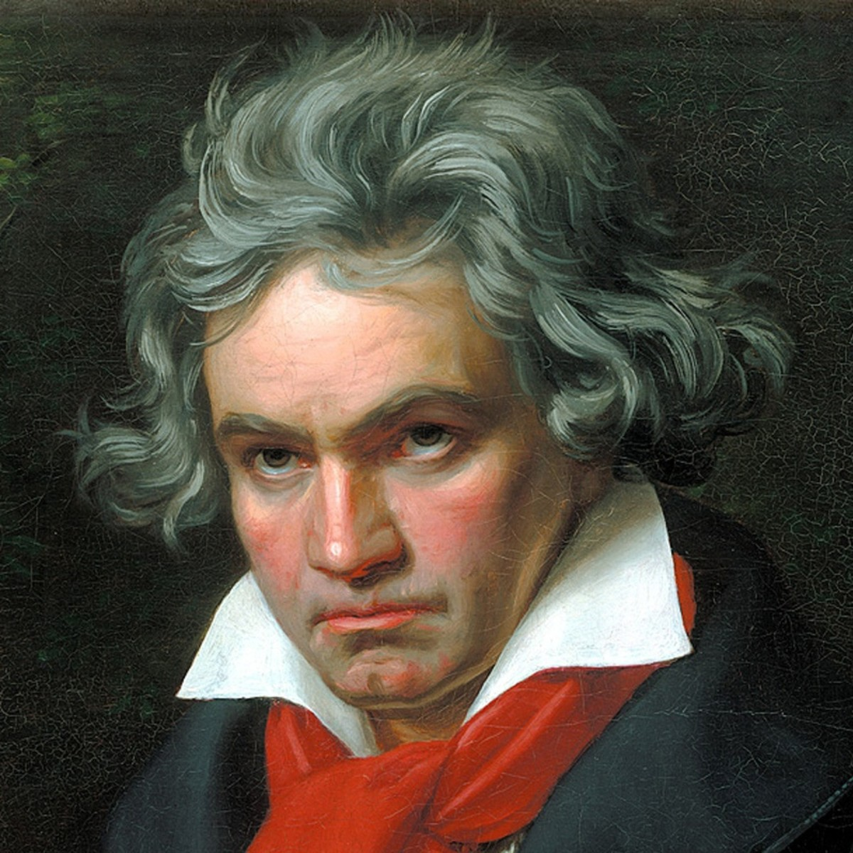
Audio Features (examples)
Danceability | Energy | Loudness (dB) | Speechiness | Acousticness | Instrumental | Valence | Tempo (BPM)
0.556 | 0.319 | -8.251 | 0.056 | 0.893 | 0.00 | 0.294 | 135
0.876 | 0.662 | -6.482 | 0.852 | 0.061 | 0.00 | 0.844 | 75
0.300 | 0.0379 | -32.498 | 0.096 | 0.994 | 0.916 | 0.155 | 122

Slide 10
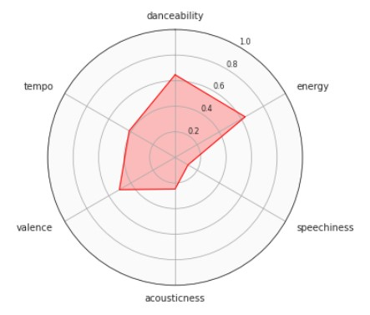
Pop
Notes:
Pop songs are characterized as moderately danceable and energetic on average.

Slide 11
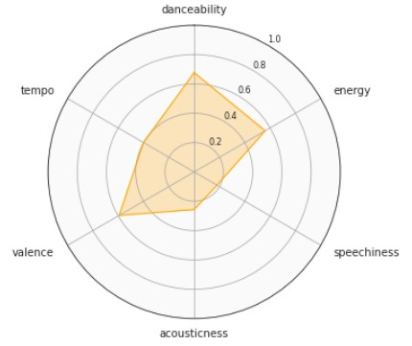
R&B
Notes:
R&B songs are also moderately danceable and energetic on average.

Slide 12
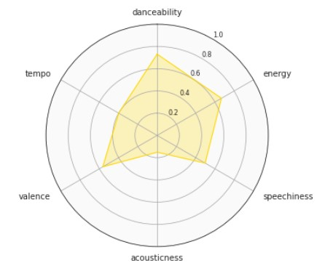
Hip Hop
Notes:
Hip Hop songs are characterized as highly danceable, energetic, and most importantly, very speechy on average.

Slide 13
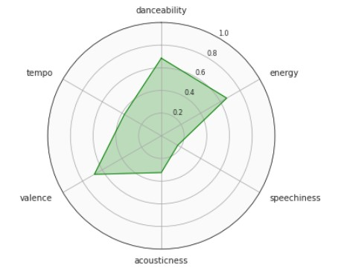
Latin
Notes:
Latin songs are not only characterized as highly danceable, energetic, but they are also very positive on average comparatively to most other genres.

Slide 14
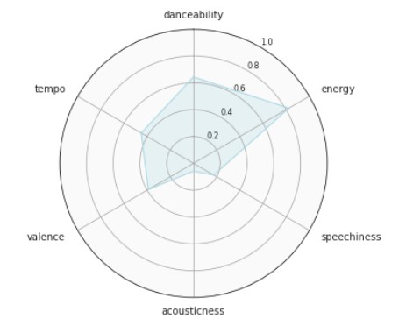
EDM
Notes:
EDM songs are very energetic on average.

Slide 15
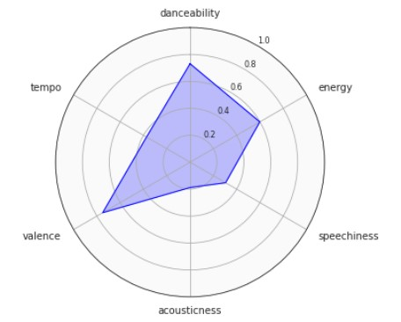
Reggae
Notes:
Reggae songs have the highest valence on average and are have higher speechiness than most other genres.

Slide 16
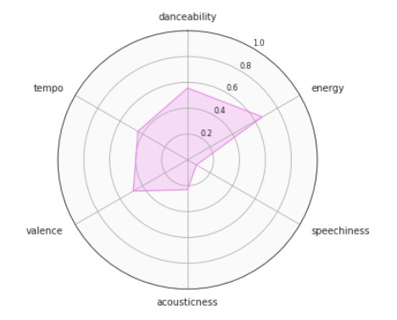
Indie
Notes:
Indie songs are very energetic on average.

Slide 17
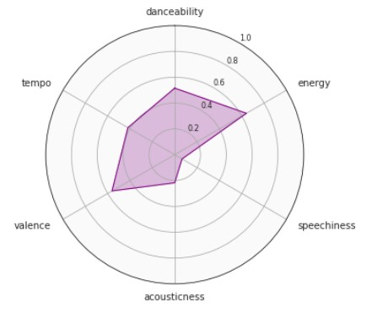
Rock
Notes:
Rock songs are moderately danceable, energetic, and valent on average. Their feature representation resembles those of both the Pop and Indie genres.

Slide 18
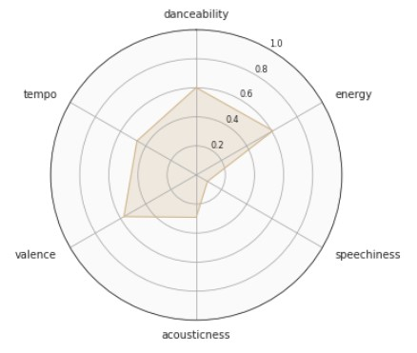
Country
Notes:
Country songs are moderately danceable, energetic, and valent on average. Their average feature representation resembles those of the Pop and Rock genres.

Slide 19
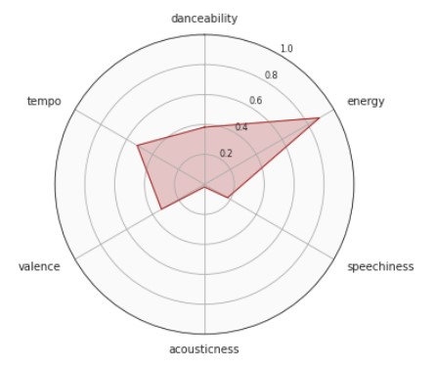
Metal
Notes:
Metal songs are the most energetic on average comparatively to other genres and are not acoustic whatsoever.

Slide 20
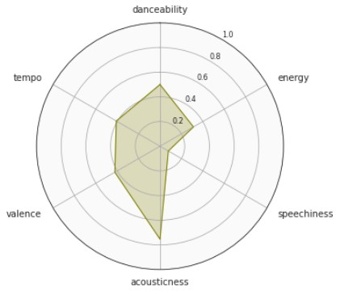
Jazz
Notes:
Jazz songs are very acoustic, and typically, they're not energetic.

Slide 21
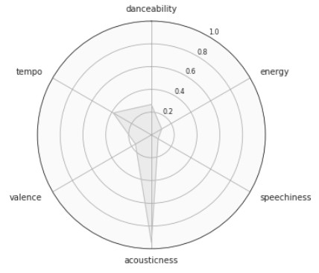
Classical
Notes:
Classical songs are, in fact, the most acoustic and the least energetic of all genres.

Slide 22
Modeling
Comparing 4 models:
Decision Tree Classifier
Random Forest Classifier
Gradient Boosting Classifier
Extreme Gradient Boosting Classifier
*For the three ensemble methods, Randomized Searches with Cross Validation were conducted to determine the optimal hyperparameters*
Notes:
To predict the genre of new songs, I sought to train various classification models on the audio features of the songs from each genre and compare their performance on unseen data.

Slide 23
Decision Tree Classifier
66% accuracy
Notes:
The Decision Tree Classifier was 66% percent accurate on average. The genres that the model learned best were Classical, Jazz, and Metal, whereas Pop was the most difficult genre to classify. Although the proceeding ensemble methods will surely outperform this model, it serves as a base to compare the improvement of more complex models.

Slide 24
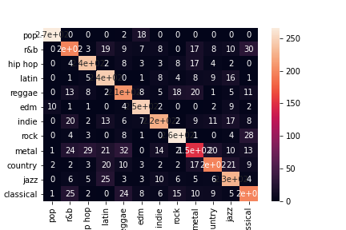
Random Forest Classifier
75% accuracy
498 estimators
Notes:
The Random Forest Classifier, with 498 estimators, as suggested by a randomized search of hyperparameters with cross validation, performed far better, averaging 75% accuracy. This model still picked up Classical, Jazz, and Metal the best, but its performance on the remaining genres significantly improved across the board, as well.

Slide 25
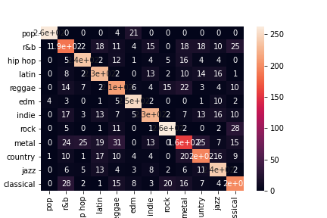
Gradient Boosting Classifier
74% accuracy
455 estimators
0.1 learning rate
max tree depth of 4
Notes:
On the other hand, the Gradient Boosting Classifier, with 455 estimators, a 0.1 learning rate, and a maximum tree depth of 4, as suggested by a randomized search of hyperparameters with cross validation, was only 74% accurate on average.

Slide 26
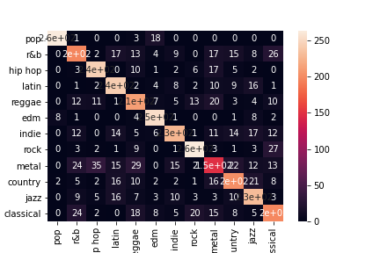
Extreme Gradient Boosting Classifier
75% accuracy
401 estimators
0.25 lambda rate
0.1 gamma rate
01 learning rate
max tree depth of 7
Notes:
Lastly, the Extreme Gradient Boosting (XGB) Classifier, with 401 estimators, a 0.25 lambda rate, a 0.1 gamma rate, a 0.1 learning rate, and a maximum tree depth of 7, as suggested by a randomized search of hyperparameters with cross validation, was 75% accurate on average, and was the best performer comparatively to the other models.

Slide 27
Conclusion

Slide 28
Next Steps
Analyze the sentiment from song’s lyrical content to add as a feature to these models
Create a Recommender that utilizes genre information

