Slide 1
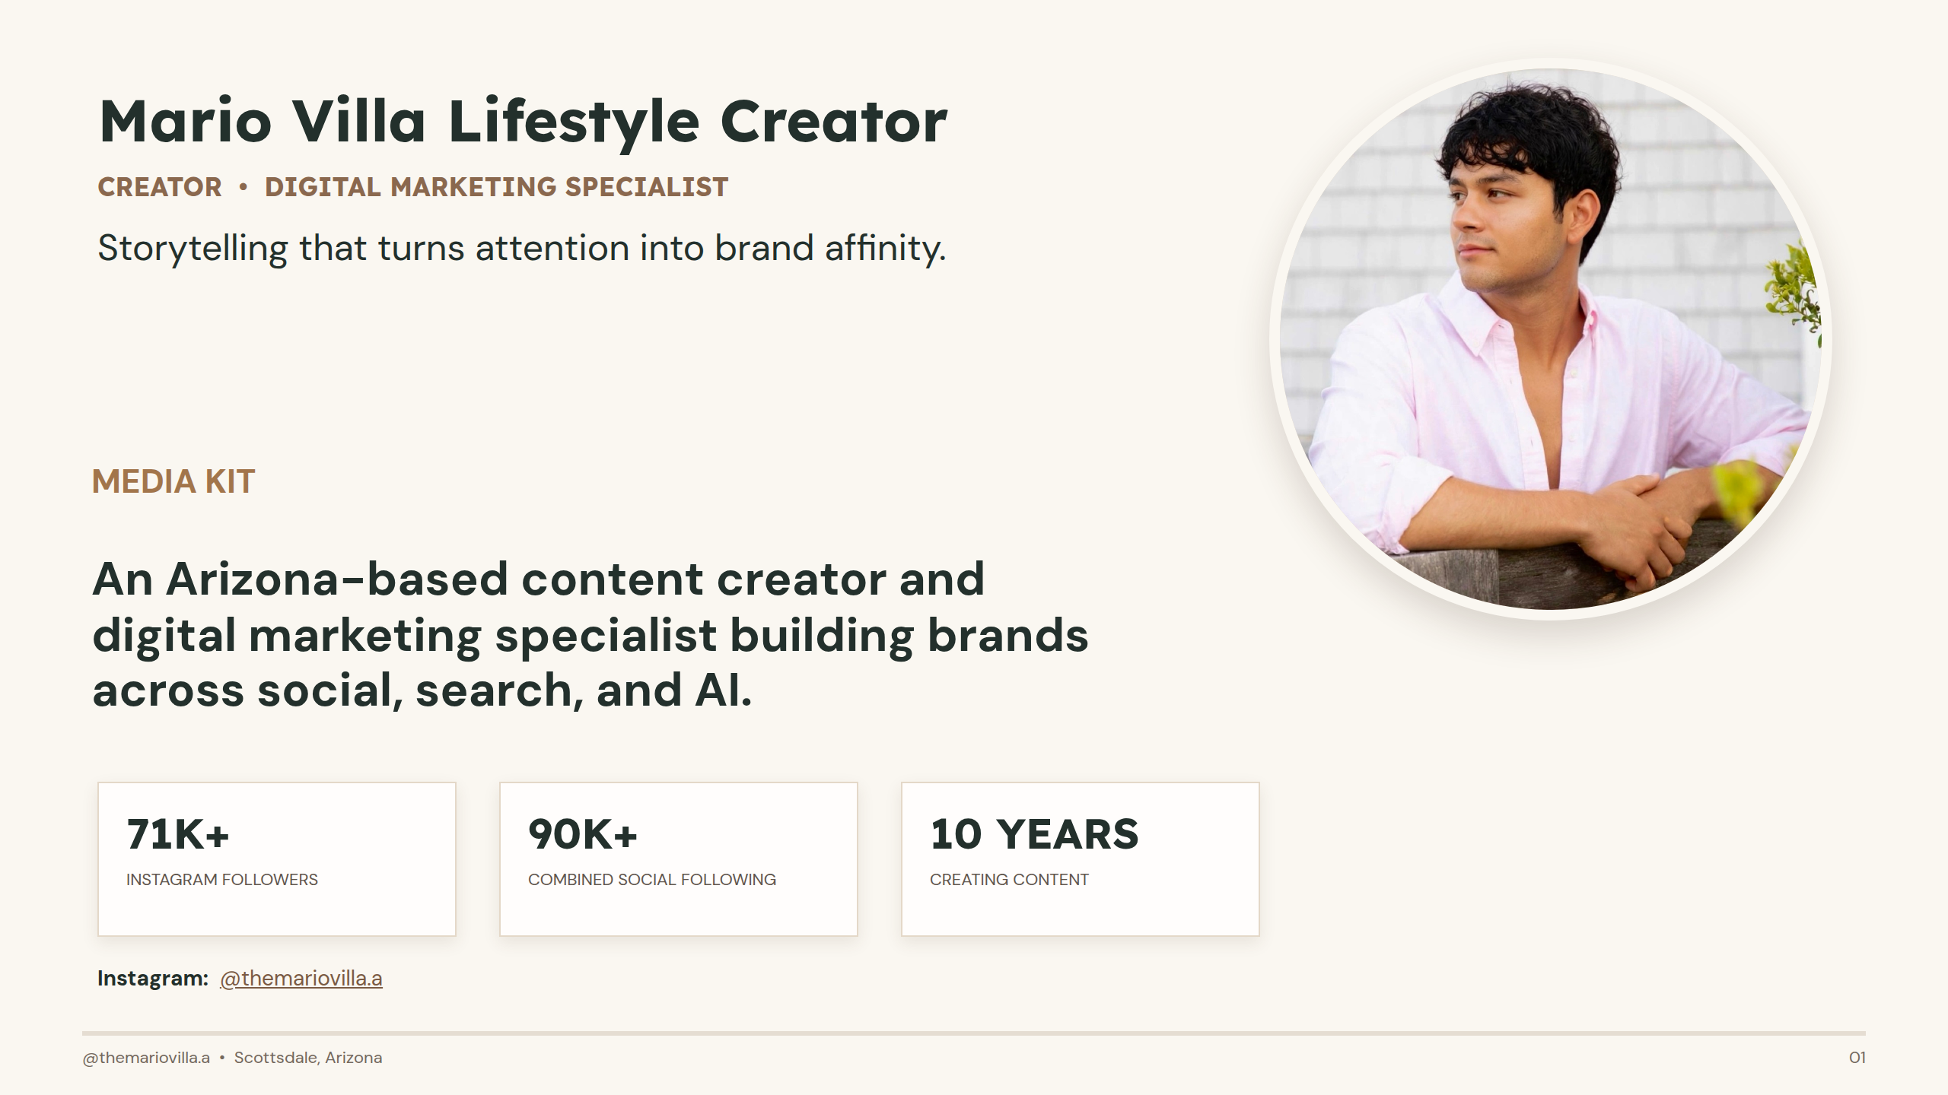
Notes:
Mario Villa Lifestyle Creator

Slide 2
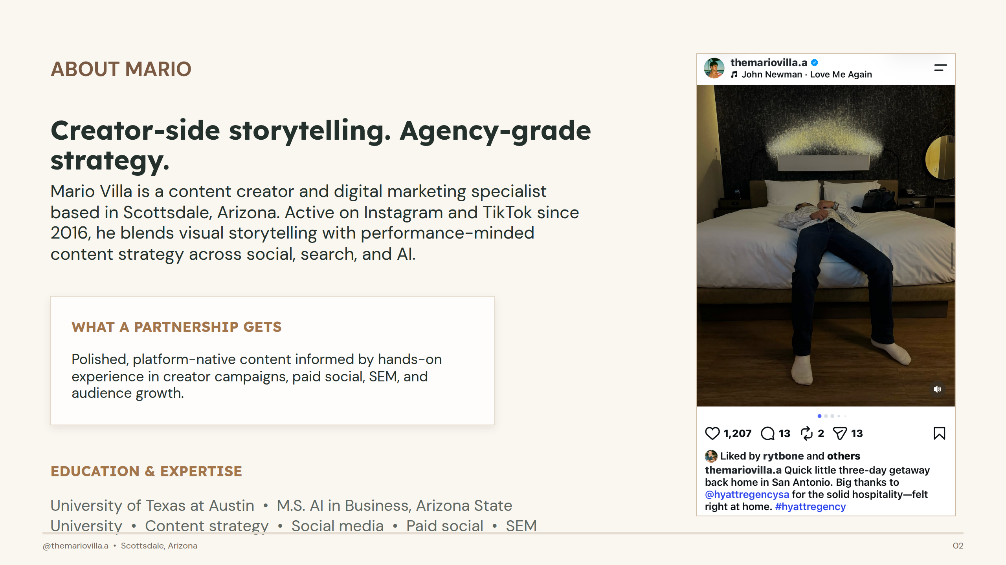
Notes:
Creator-side storytelling. Agency-grade strategy.

Slide 3
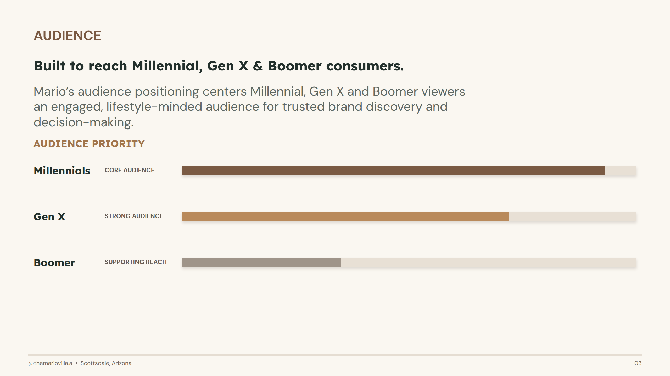
Notes:
Built to reach Millennial, Gen X & Boomer consumers.

Slide 4
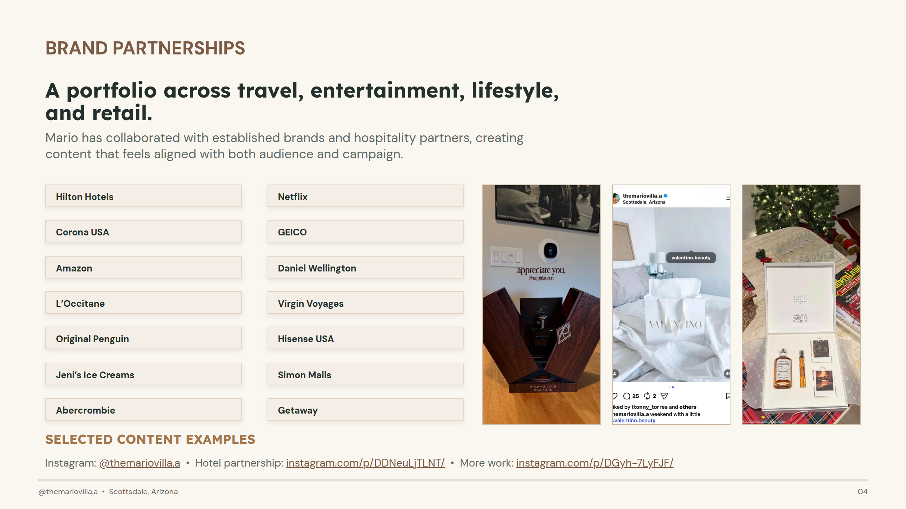
Notes:
A portfolio across travel, entertainment, lifestyle, and retail.

Slide 5
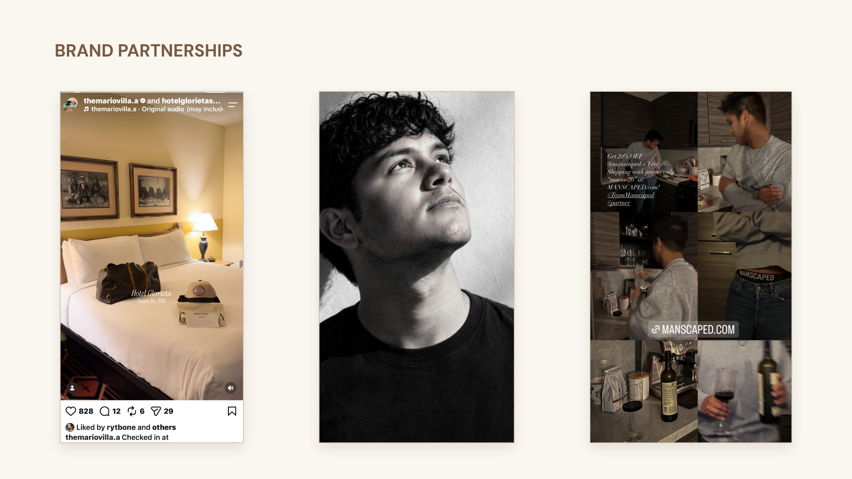

Slide 6
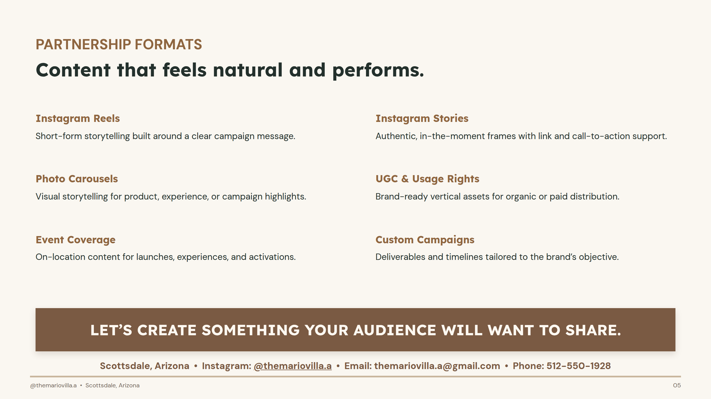
Notes:
Content that feels natural and performs.

