Slide 1
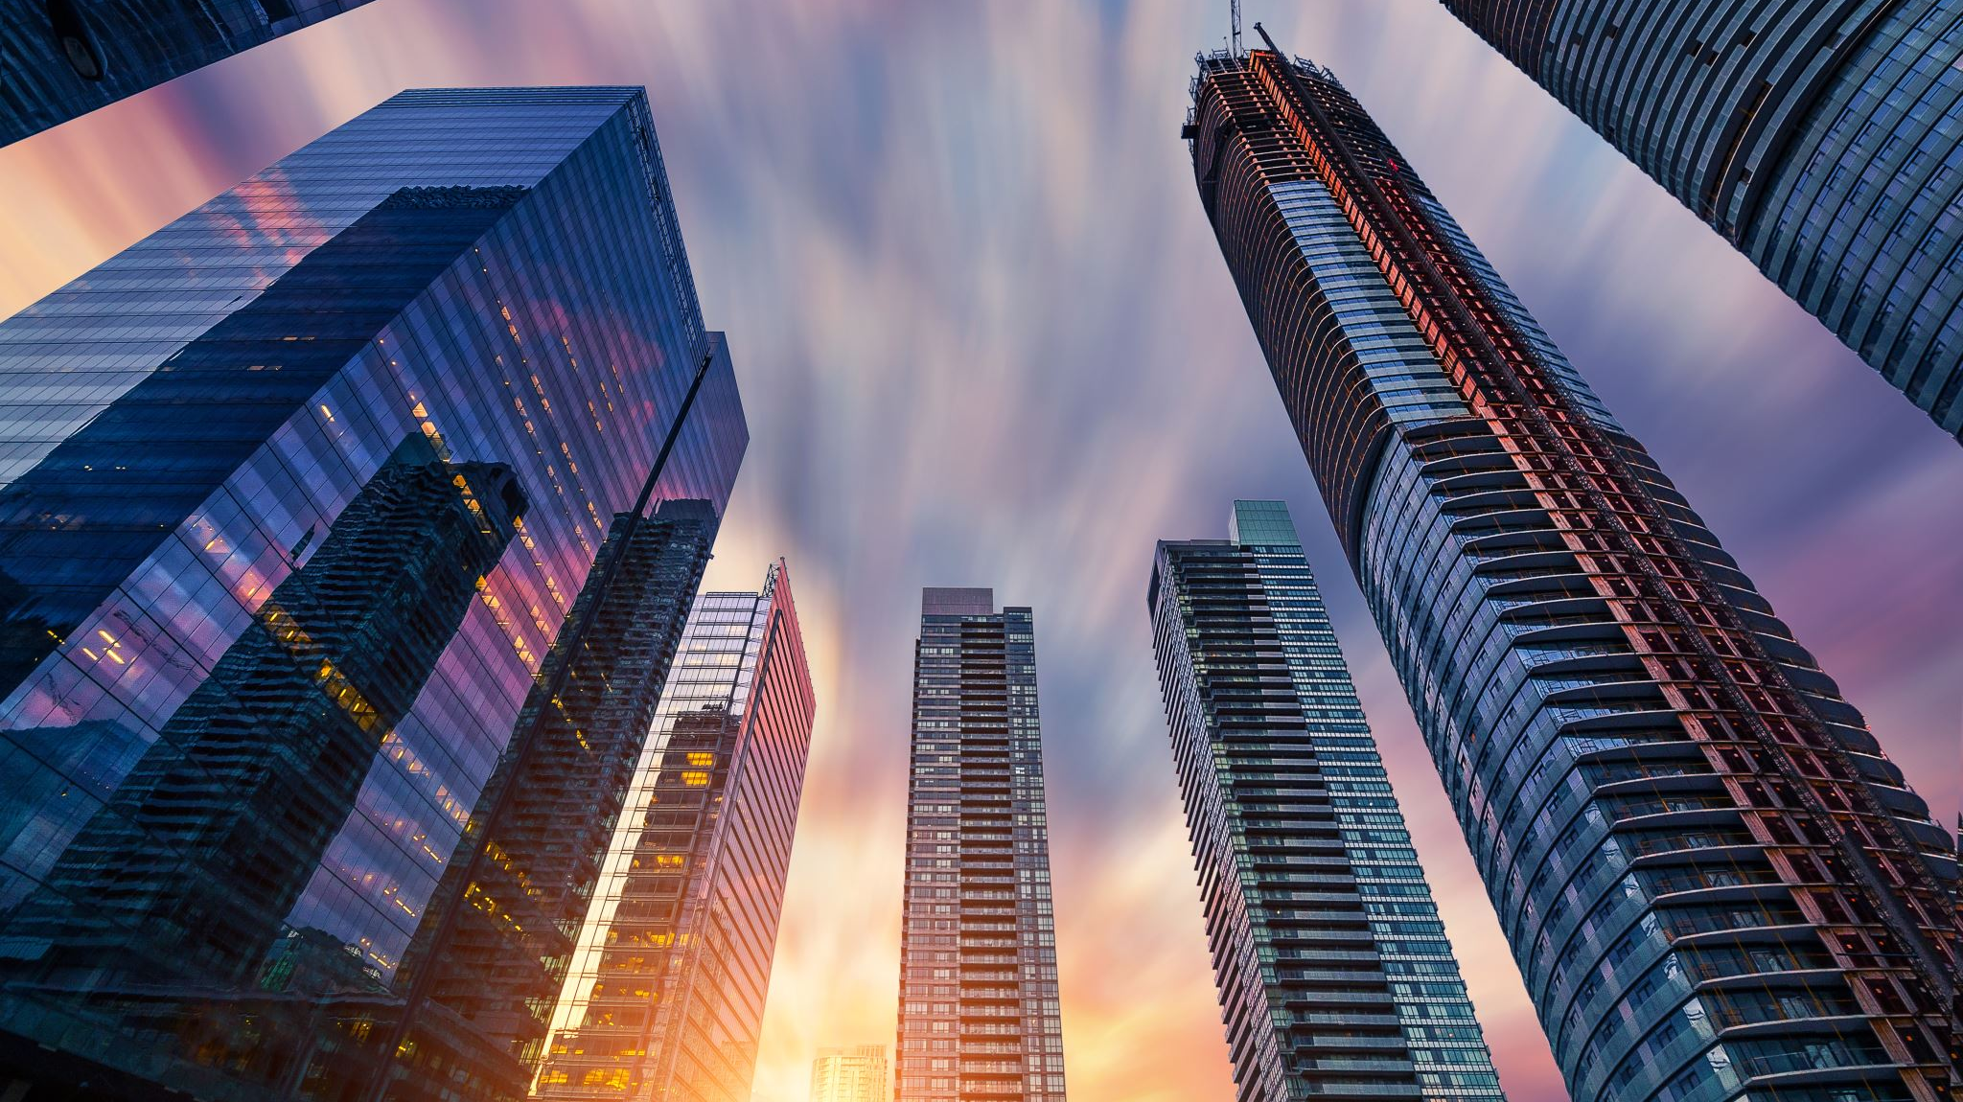
Smart Cities
Presented by Stryder R. Coleman

Slide 2


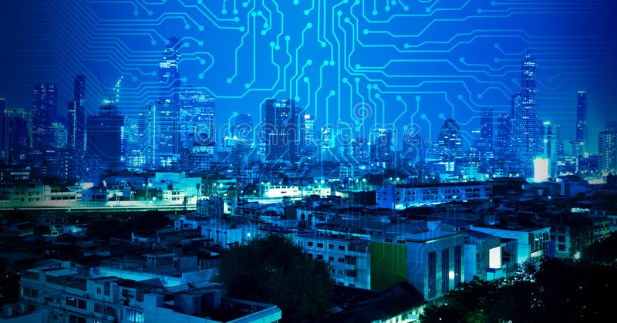


What is a Smart City?

Slide 3
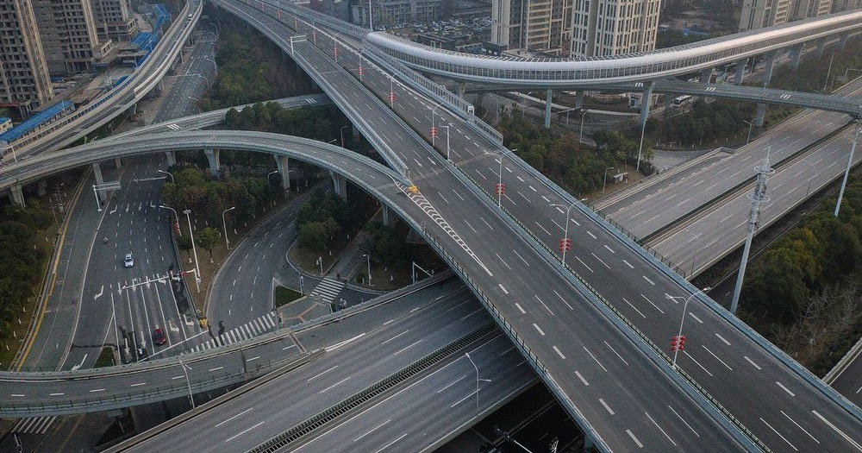
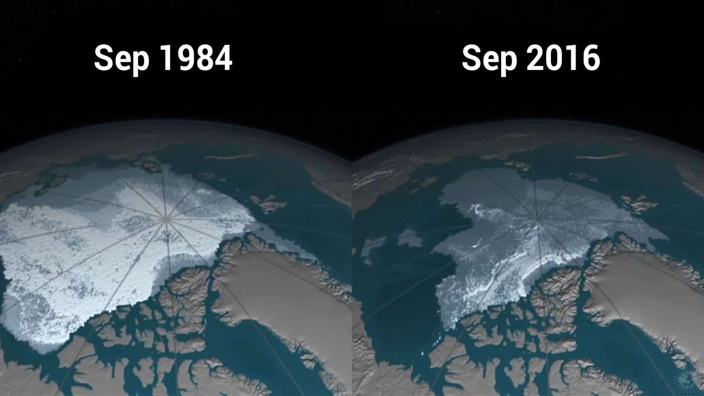
Why now?
Coronavirus
Climate Change

Slide 4


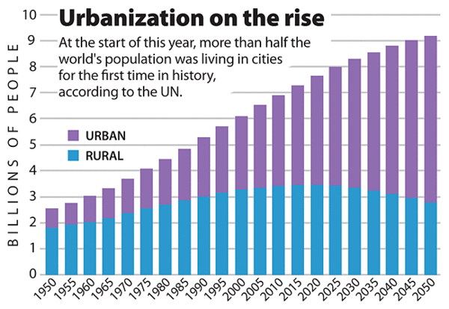
Urbanization
75% of the world’s population will live in cities
Increasing demand for services

Slide 5
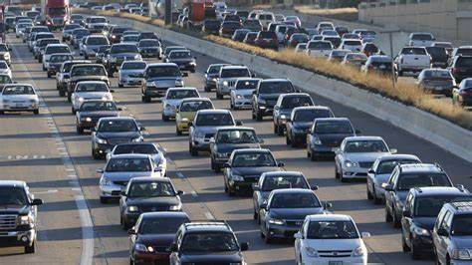
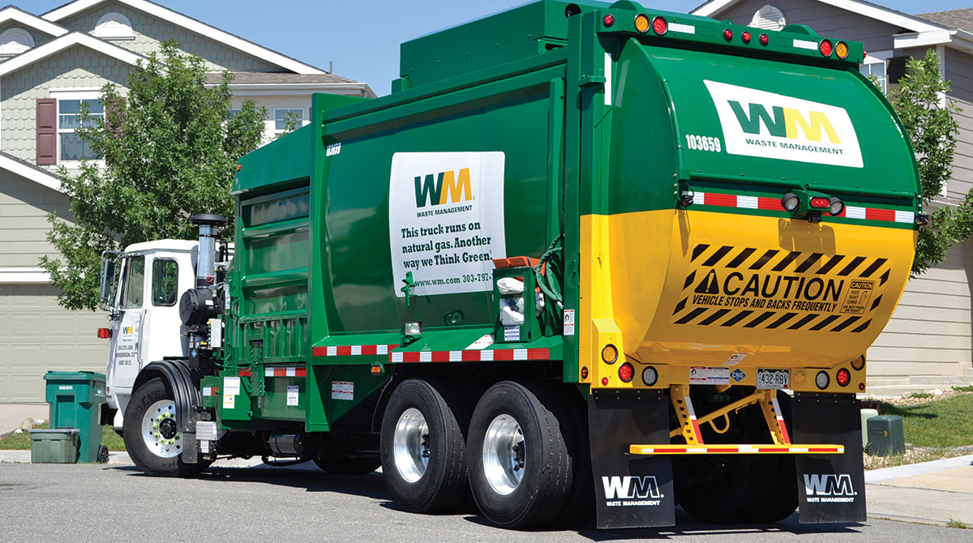
Applications of Smart Technologies
Traffic
Utility Management

Slide 6
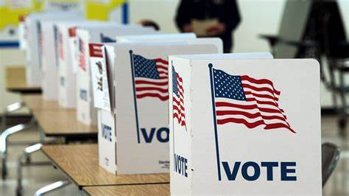
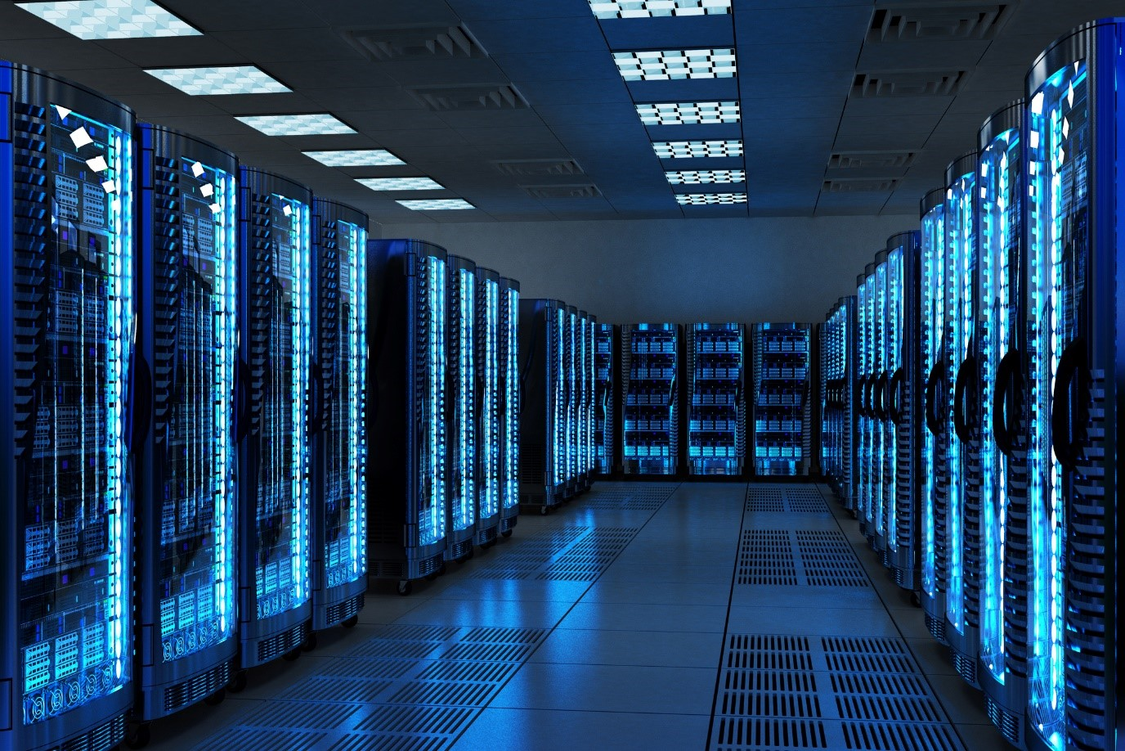
Applications of Smart Technologies
Public Awareness
Data Collection

Slide 7
Pros vs. Cons
Pros
Cons
Job Creation and Apprenticeship Programs
Reduced Carbon Emissions
Better Traffic
Lower expenses
Personal Privacy
Vulnerabilities to Hacking
Automation

Slide 8
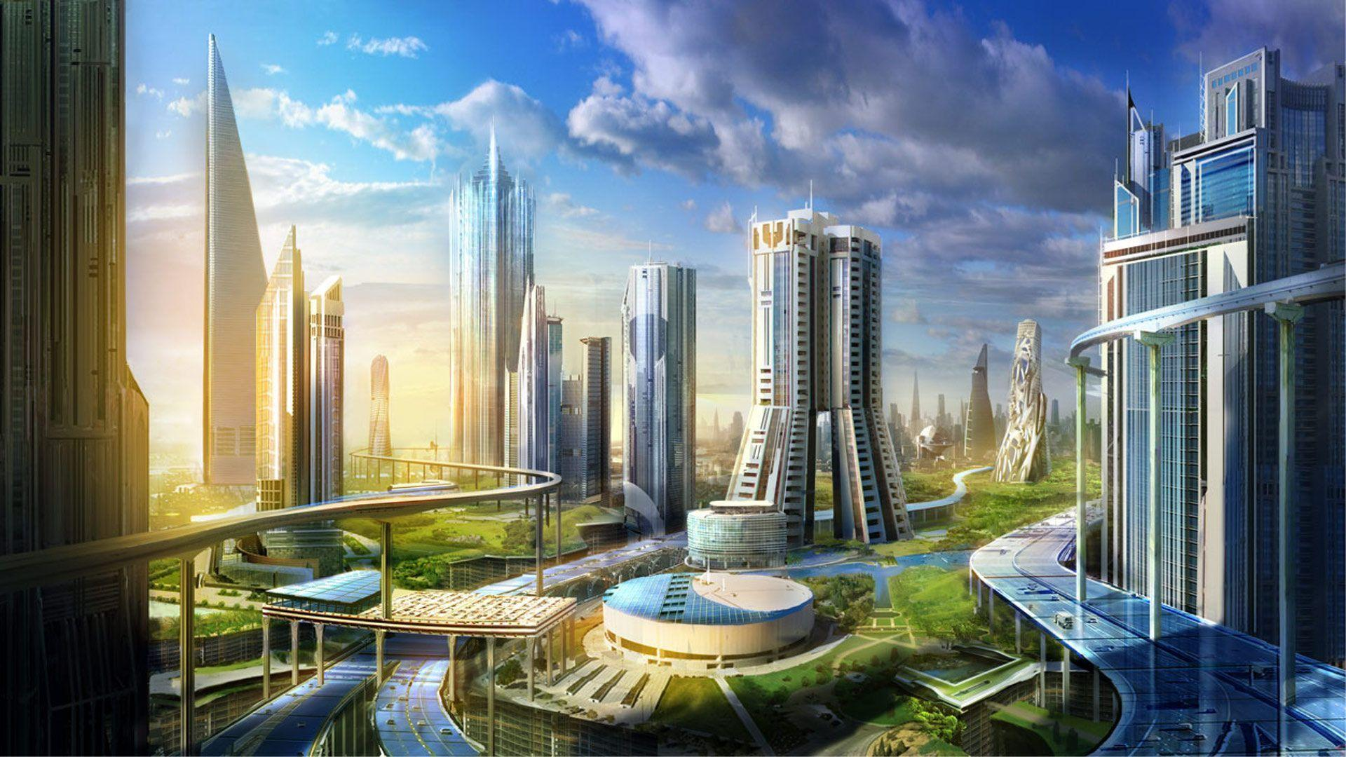
Conclusion

