Slide 1

Movie Ticket Manager
By: Luke Hurtig, Ethan Coleman, and Jake Smith

Slide 2
Overview
Our project handles ticket transactions and movie showing times across many different theaters
Allows for many different forms of filtering to find movies
Target Users: Our program’s target audience is movie go-ers and small theater owners as we have both client and admin panels with separate functionality.

Slide 3
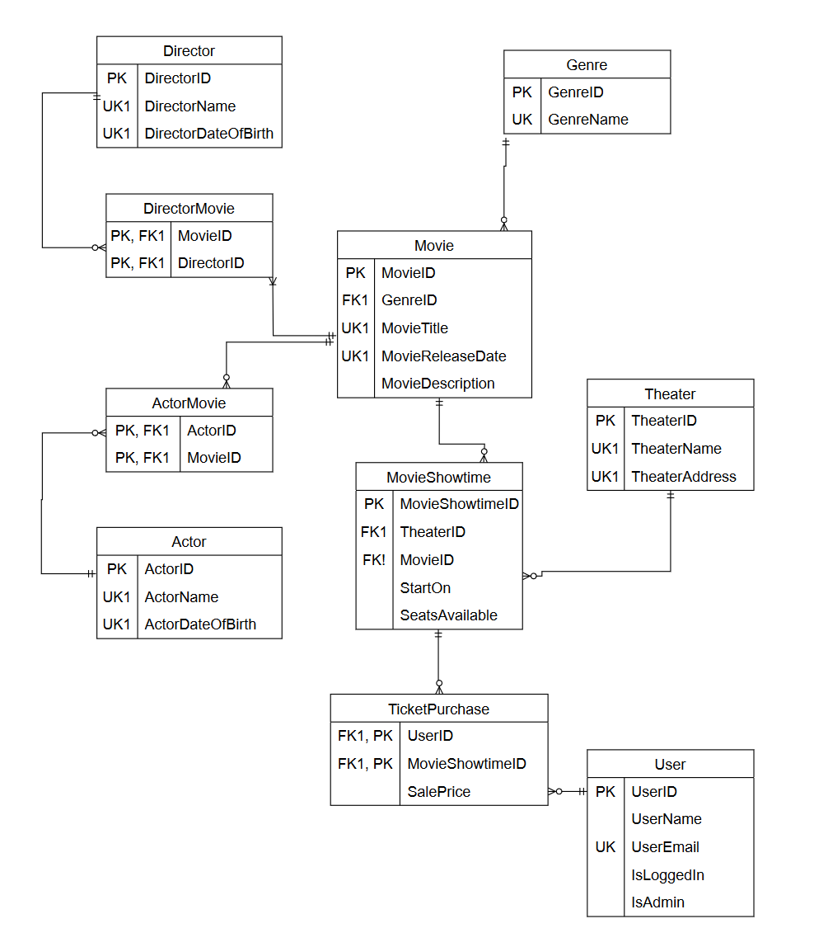
Technical Details

Slide 4
High Level Architecture
User Interface / Front end: Written in C# using .NET 6.0 and WPF
SQL Server Management Studio

Slide 5
Challenges
Time Management: We should’ve started earlier!
Getting the application fully connected with the database
Getting and importing data to the database

