Slide 1

Movie Ticket Manager
By: Luke Hurtig, Ethan Coleman, and Jake Smith

Slide 2
Overview
Our project handles ticket transactions and movie showing times across many different theaters
Provides services for both movie-goers and small movie theater owners with client and admin services.
Gives clients many different forms of filtering to find movies
Provides various statistics for owners about overall theater, movie, genre, and hourly performance

Slide 3

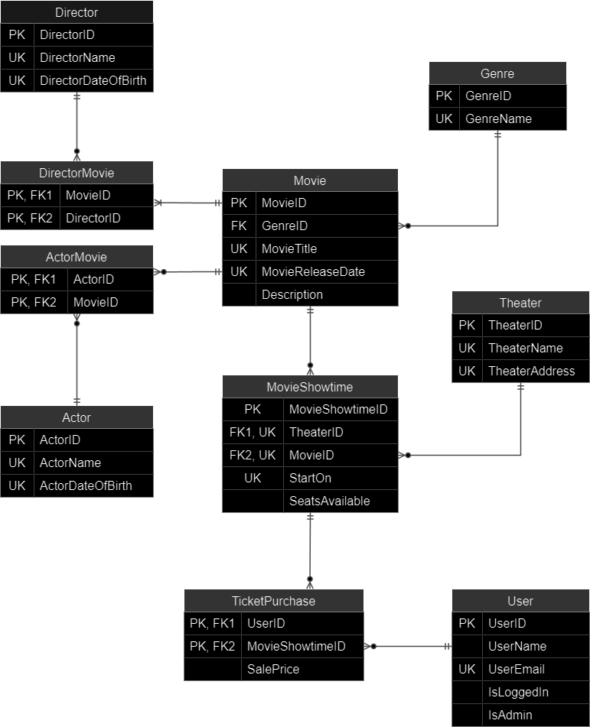
Technical Details

Slide 4
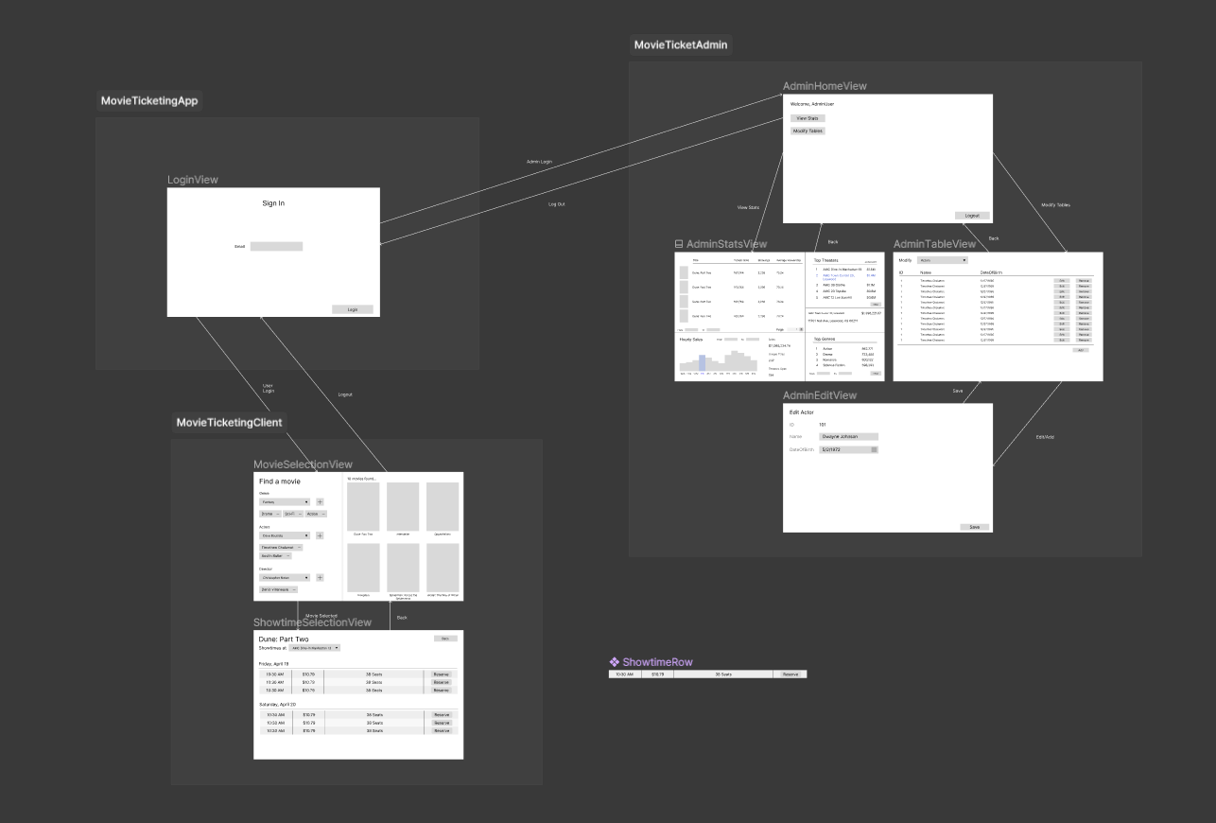
App Structure

Slide 5
High Level Architecture
User Interface / Front End: Written in C# using .NET 8.0 and WPF
SQL Server Management Studio using a LocalDB for Data
UI Implemented using MVVM Architecture
Shell Script to Compile Various .sql Files for DB

Slide 6
Challenges
Time Management: We should’ve started earlier!
Getting the application fully connected with the database
Getting and importing data to the database

